Slide 1

Logical Rules and Tactics
Inference rules and tactics

Slide 2

Contents
Tactics
True/False
Conjunctions

Slide 3
Tactics

Slide 4
Creating Tactics
Previously, we’ve seen how you can chain inference rules together as equations
Sometimes, however, it is more intuitive to separate individual steps in order to make reasoning better
Consider the simple inference rule: lemma zeqz : 0 = 0 := eq.refl 0
We could rewrite this as: lemma zeqz' : 0 = 0 := begin apply eq.refl 0, end

Slide 5
Tactics Explanation
Each step in a tactic adds to the state
Steps later in the tactic can rely on facts deduced from steps earlier in the tactic
Do not abuse tactics by writing tactics with dozens of lines!

Slide 6
Exploration
Open up 01_Equality/07_tactics.lean and then open up the Lean Messages panel
[Ctrl]+[Shift]+[Enter] for Windows
[Cmd]+[Shift]+[Enter] for OS X
Move your cursor to the the lemma for zeqz'
Note the tactic state

Slide 7
Exercise
Define zeqz'' as also being of type 0 = 0, but after the :=, just write begin on the next line and then end on the following line. You need to type the begin and end lines before continuing.
Hover over the red squiggle under end, and note what it tells you.
Insert a blank line between the begin and end lines and look at the tactic state.
Insert the required tactic to complete it.
What other tactics work?

Slide 8
True/False

Slide 9
Different types of true?
Previously we’ve seen the boolean value tt
Lean also supports a value of true
Are these the same thing, does tt = true?
#check tt -> tt : bool
#check true -> true : Prop
What’s the difference?

Slide 10

Creating the true proposition
To prove the true proposition, we can use the true.intro inference rule: $\frac{\{\}}{pf:true}(true.intro)$
What does this mean?

Slide 11
Exercises
Prove the lemma t' : true using a tactic script.
lemma t' : true := begin apply true.intro end
Read and explain the error message to a colleague in your class: theorem bad : true := tt

Slide 12
Proof by Contradiction
https://xkcd.com/704/

Slide 13
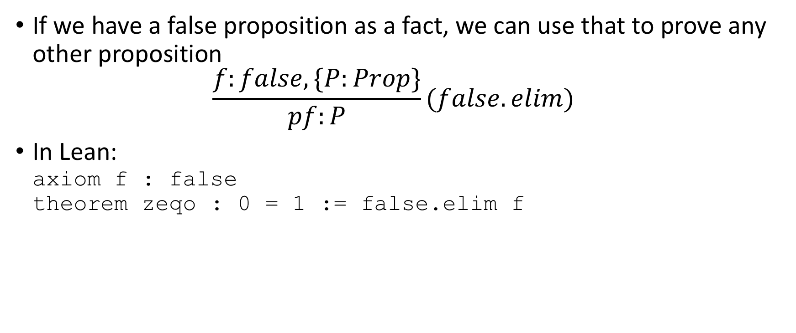
False Elimination
If we have a false proposition as a fact, we can use that to prove any other proposition $\frac{f:false,\{P:Prop\}}{pf:P}(false.elim)$
In Lean: axiom f : false theorem zeqo : 0 = 1 := false.elim f

Slide 14
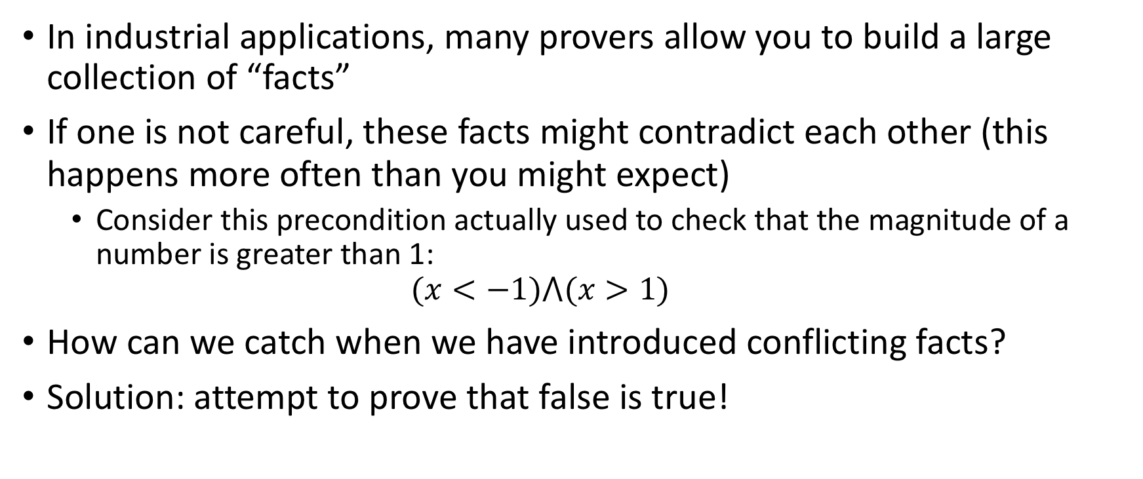
Storytime…
In industrial applications, many provers allow you to build a large collection of “facts”
If one is not careful, these facts might contradict each other (this happens more often than you might expect)
Consider this precondition actually used to check that the magnitude of a number is greater than 1: $(x<−1)⋀(x>1)$
How can we catch when we have introduced conflicting facts?
Solution: attempt to prove that false is true!

Slide 15
Exercises
Prove that true = false
theorem teqf : true = false := false.elim f
What happens if you try to prove 1 = tt?

Slide 16
Conjunctions

Slide 17
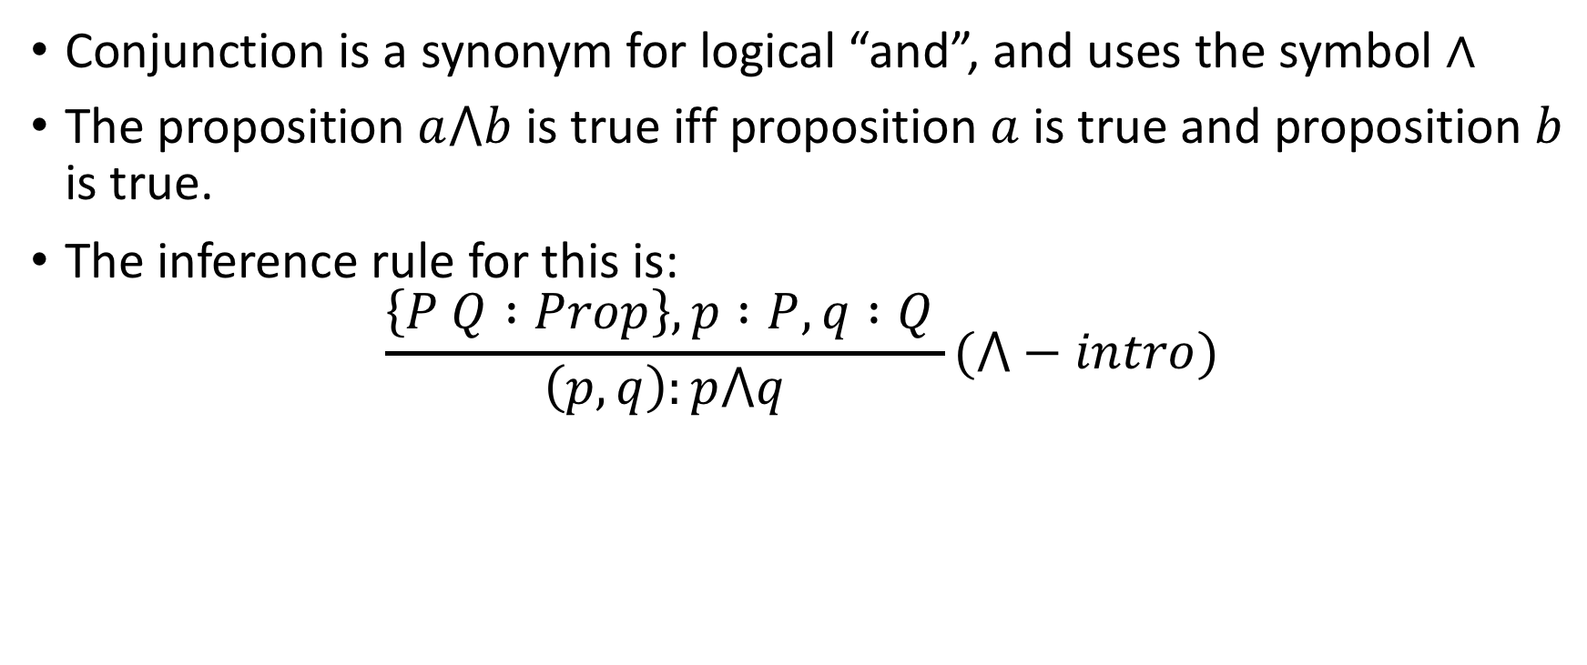
What is a conjunction
Conjunction is a synonym for logical “and”, and uses the symbol ∧
The proposition $a⋀b$ is true iff proposition $a$ is true and proposition $b$ is true.
The inference rule for this is: $\frac{\left\{P Q :Prop\right\}, p :P, q :Q }{\left(p, q\right):p⋀q}(⋀−intro)$

Slide 18
and.intro in Lean
def P : Prop := 0 = 0
def Q : Prop := 1 = 1
theorem pfP : P := eq.refl 0
theorem pfQ : Q := eq.refl 1
def P_and_Q : Prop := P ∧ Q
theorem pf_PQ: P ∧ Q := and.intro pfP pfQ
Now let’s decode this…

Slide 19
Proof Trees
0 = 0 ∧ 1 = 1
and.intro
0 = 0
1 = 1
eq.refl 0
eq.refl 1
We can read this from bottom-to-top or from top-to-bottom

Slide 20
Proof Trees, part 2
0 = 0 ∧ 1 = 1
and.intro
0 = 0
1 = 1
eq.refl 0
eq.refl 1
0 : nat
1 : nat

Slide 21
Exercise
What smaller propositions might you want to prove to prove that 5 = 1 + 4 ∧ "Strike" = "S" ++ "trike"? Prove those smaller propositions giving them whatever names you choose. Then write the theorem in Lean that proves the final result using and.intro.

Slide 22
Conjunction tactic, top-down
0 = 0 ∧ 1 = 1
theorem pf_PQ': P ∧ Q :=
begin
apply and.intro,
exact (eq.refl 0),
exact (eq.refl 1),
end
and.intro
0 = 0
1 = 1
eq.refl 0
eq.refl 1
View each line of the tactic in the Lean Messages Window
⊢ P ∧ Q
2 goals ⊢ P ⊢ Q
⊢ Q
no goals

Slide 23
Conjunction tactic, bottom up
0 = 0 ∧ 1 = 1
theorem pf_PQ'': P ∧ Q :=
begin
have X := (eq.refl 0),
have Y := (eq.refl 1),
apply and.intro X Y
end
and.intro
0 = 0
1 = 1
eq.refl 0
eq.refl 1
View each line of the tactic in the Lean Messages Window
⊢ P ∧ Q
X : 0 = 0 ⊢ P ∧ Q
X : 0 = 0, Y : 1 = 1 ⊢ P ∧ Q
no goals

Slide 24
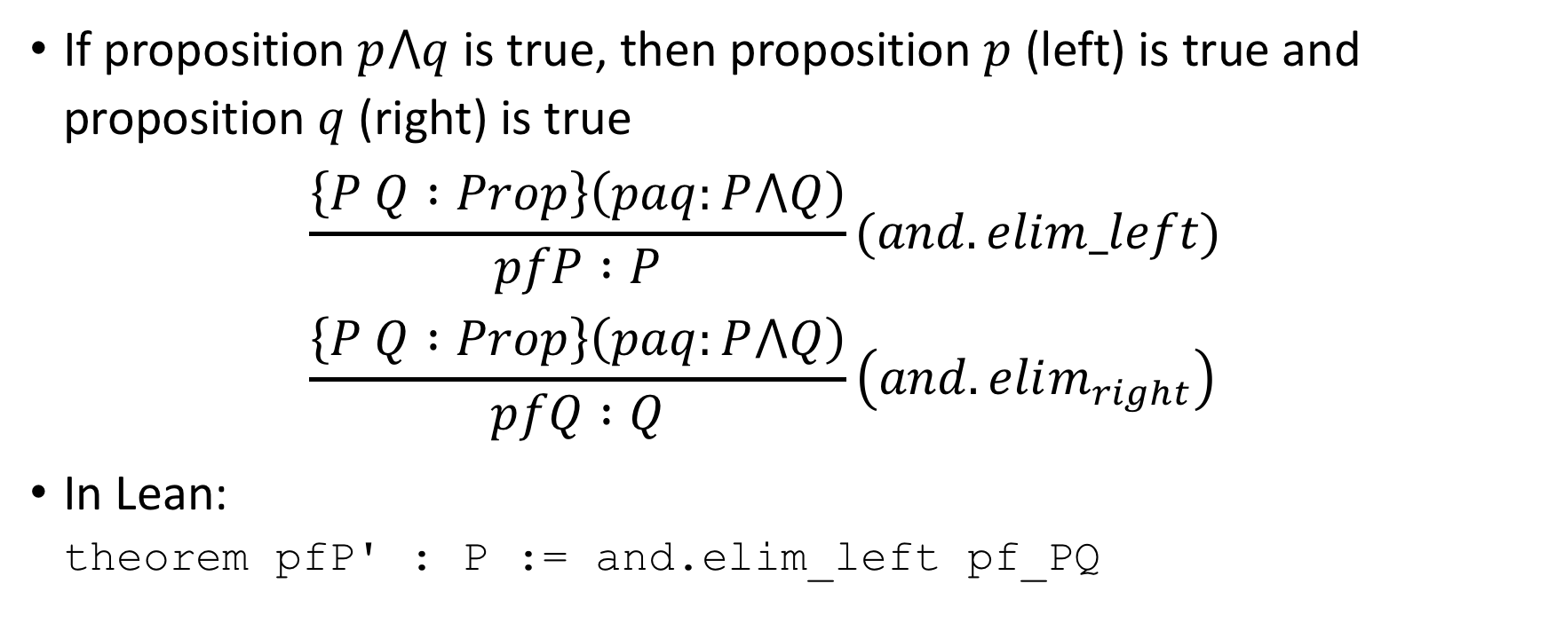
And elimination
If proposition $p⋀q$ is true, then proposition $p$ (left) is true and proposition $q$ (right) is true $\frac{\left\{P Q :Prop\right\}\left(paq:P⋀Q\right)}{pfP :P}(and.elim_left)$ $\frac{\left\{P Q :Prop\right\}\left(paq:P⋀Q\right)}{pfQ :Q}\left(and.elim_{right}\right)$
In Lean: theorem pfP' : P := and.elim_left pf_PQ

Slide 25
Exercise
Fill in the "sorry" words in the following incomplete theorems with explicit proof objects obtained by applying the and elimination rules to our proof, pf_PQ, of P ∧ Q.
theorem pfQ' : Q := sorry
theorem pfQ' : Q := and.elim_right pf_PQ

Slide 26
Script-Based Proofs
theorem pfP'' : P :=
begin
exact and.elim_left pf_PQ
end
theorem pfP''' : P :=
begin
have pfP := and.elim_left pf_PQ,
exact pfP
end

Slide 27

Commutativity of Conjunction
If proposition $p⋀q$ is true, then proposition $q⋀p$ is true
Proof in Lean: theorem pfQaP : Q ∧ P := and.intro (and.elim_right pf_PQ) (and.elim_left pf_PQ)

Slide 28
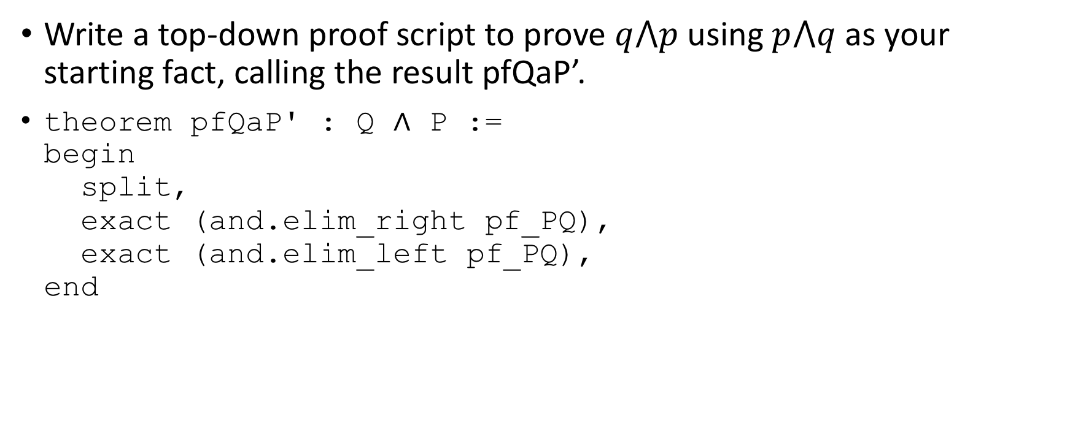
Top-Down Exercise
Write a top-down proof script to prove $q⋀p$ using $p⋀q$ as your starting fact, calling the result pfQaP’.
theorem pfQaP' : Q ∧ P := begin split, exact (and.elim_right pf_PQ), exact (and.elim_left pf_PQ), end

Slide 29
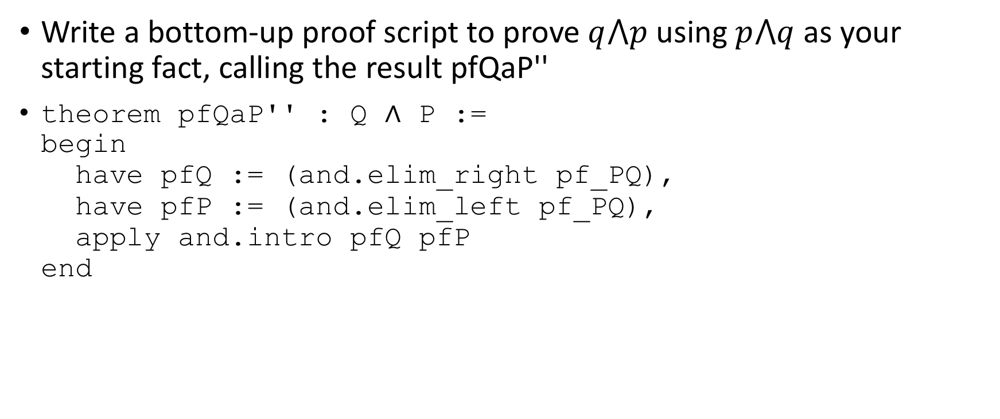
Bottom-Up Exercise
Write a bottom-up proof script to prove $q⋀p$ using $p⋀q$ as your starting fact, calling the result pfQaP''
theorem pfQaP'' : Q ∧ P := begin have pfQ := (and.elim_right pf_PQ), have pfP := (and.elim_left pf_PQ), apply and.intro pfQ pfP end

Slide 30
Creating our own tactic
Now we will create a reusable tactic in Lean, called and_commutes: def and_commutes { P Q: Prop } (paq: P ∧ Q) := and.intro (and.elim_right paq) (and.elim_left paq)
See how much easier the proof of Q ∧ P is now: theorem qap : Q ∧ P := and_commutes pf_PQ
Now, we’re cooking with gas!

Slide 31
Exercise
From a proof of 1 = 1 ∧ tt = tt, use and_commutes to prove tt = tt ∧ 1 = 1.

Slide 32

Fin

