Slide 1

Equality
Equality, type judgments, propositions, and more

Slide 2

Contents
Equality
Type judgments
Type inference
Propositions as types
Automation

Slide 3
Equality

Slide 4
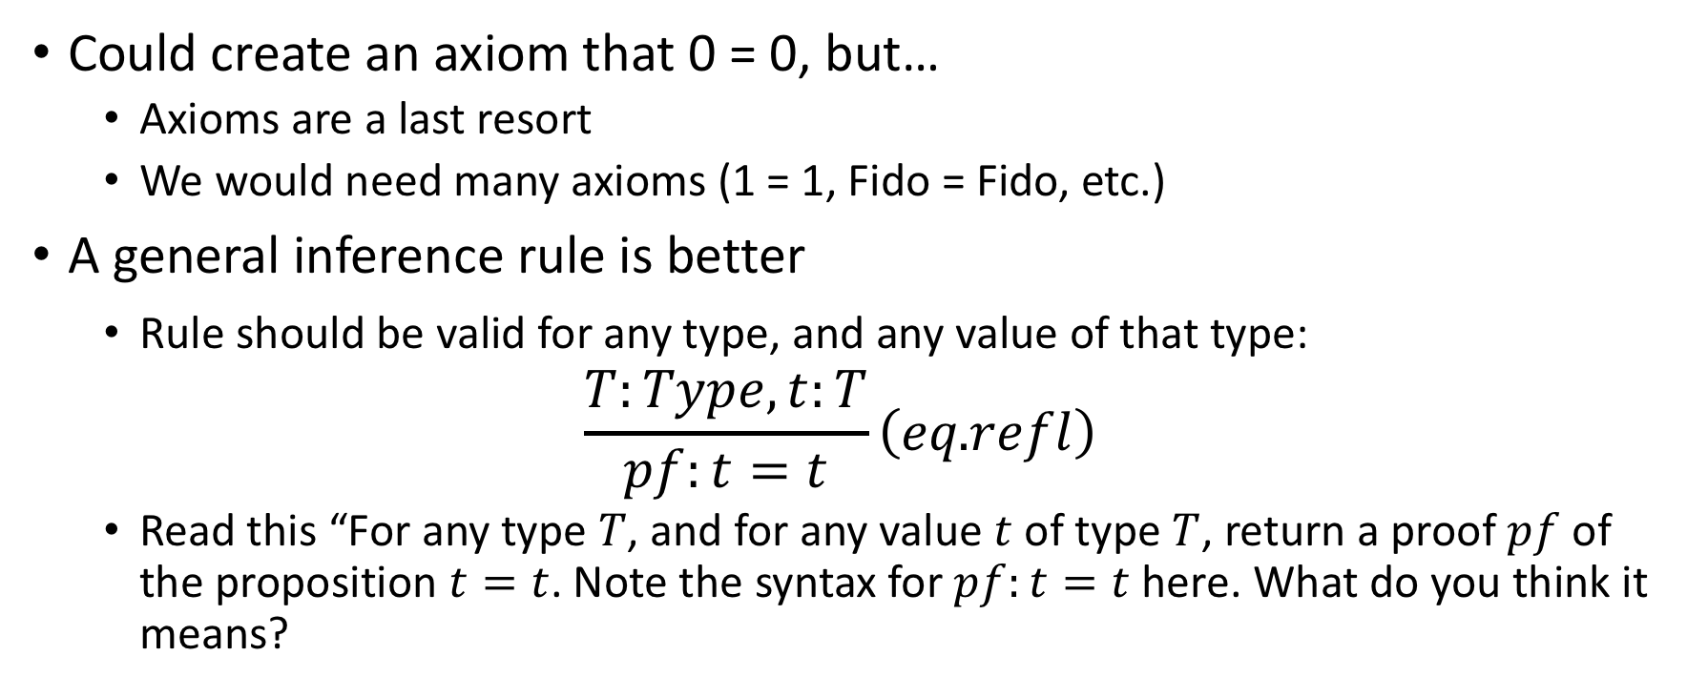
Proof that 0 = 0
Could create an axiom that 0 = 0, but…
Axioms are a last resort
We would need many axioms (1 = 1, Fido = Fido, etc.)
A general inference rule is better
Rule should be valid for any type, and any value of that type:
$$\frac{T:Type, t:T}{pf:t=t}\left(eq\text{.}refl\right)$$
Read this “For any type $T$, and for any value $t$ of type $T$, return a proof $pf$ of the proposition $t=t$. Note the syntax for $pf:t=t$ here. What do you think it means?

Slide 5
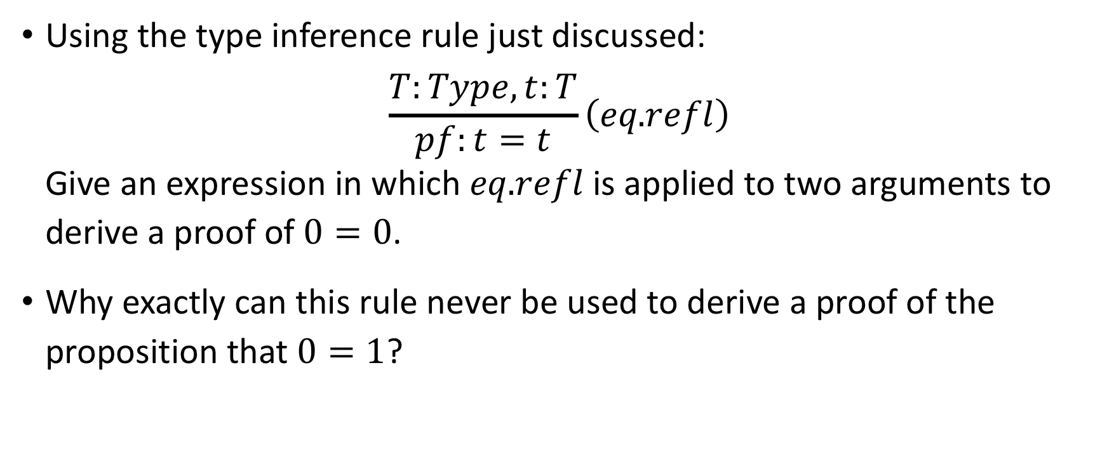
Exercises
Using the type inference rule just discussed: $\frac{T:Type, t:T}{pf:t=t}\left(eq\text{.}refl\right)$ Give an expression in which $eq\text{.}refl$is applied to two arguments to derive a proof of $0=0$.
Why exactly can this rule never be used to derive a proof of the proposition that $0=1$?

Slide 6
Type Judgments

Slide 7
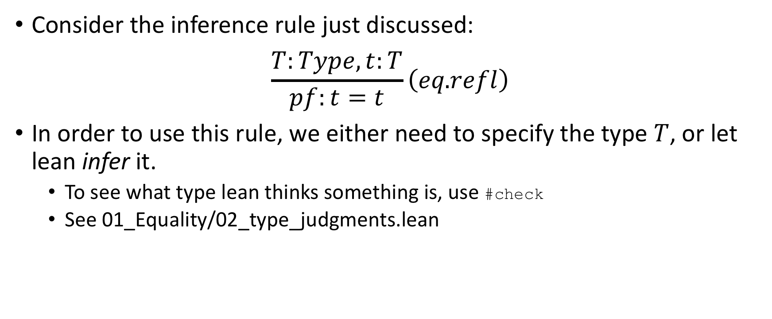
How Type Judgments Arise
Consider the inference rule just discussed: $\frac{T:Type, t:T}{pf:t=t}\left(eq\text{.}refl\right)$
In order to use this rule, we either need to specify the type $T$, or let lean infer it.
To see what type lean thinks something is, use #check
See 01_Equality/02_type_judgments.lean

Slide 8
Do Types Have Types?
What happens if we #check nat or #check bool, etc?
Types are of type Type
With one group of exceptions:
Type is of type Type 1
Type 1 is of type Type 2
Etc.
Note that Type is synonymous with Type 0.

Slide 9
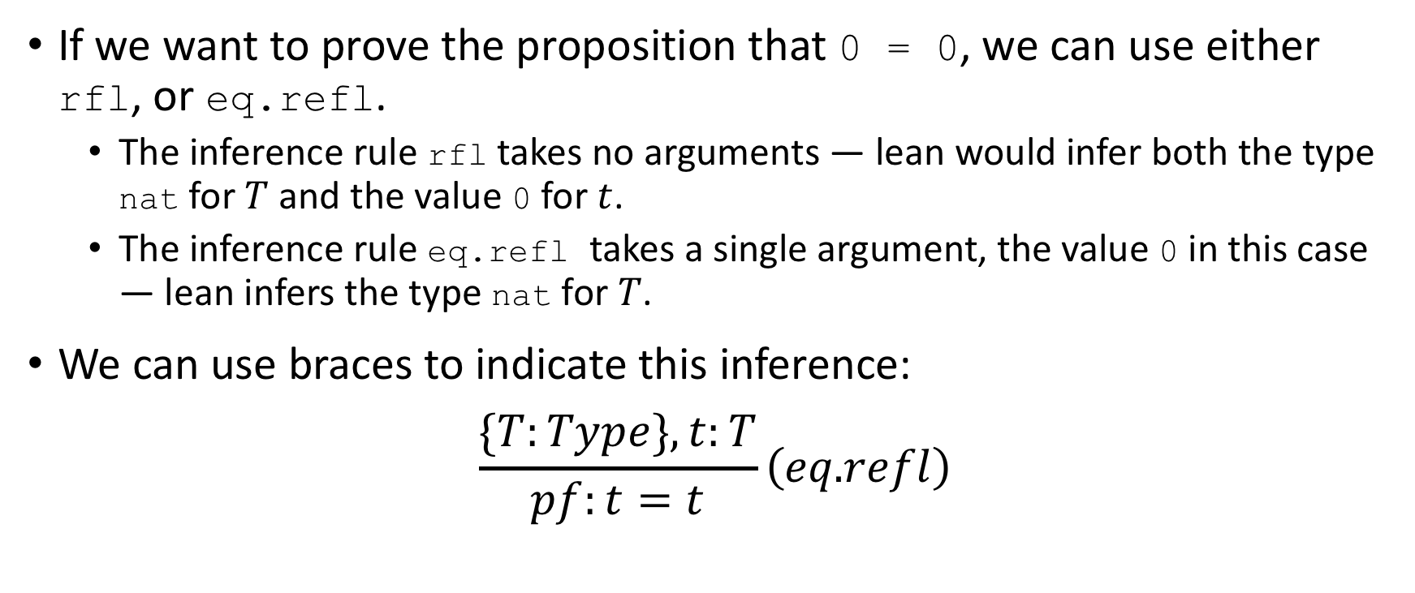
The Logical Inference Rule eq.refl
If we want to prove the proposition that 0 = 0, we can use either rfl, or eq.refl.
The inference rule rfl takes no arguments — lean would infer both the type nat for $T$ and the value 0 for $t$.
The inference rule eq.refl takes a single argument, the value 0 in this case — lean infers the type nat for $T$.
We can use braces to indicate this inference: $\frac{\{T:Type\}, t:T}{pf:t=t}\left(eq\text{.}refl\right)$

Slide 10
Exercises
If we imagine that we have a function eq_refl that takes two arguments, a type and a value and returns a proof of the proposition that the value equals itself, what would a call to that function look like when applied to:
0 = 0
eq_refl nat 0
tt
“Hello Lean”

Slide 11
Type Inference

Slide 12
Propositions as Types

Slide 13
Automation

Slide 14

Fin

