Slide 1

Implication

Slide 2
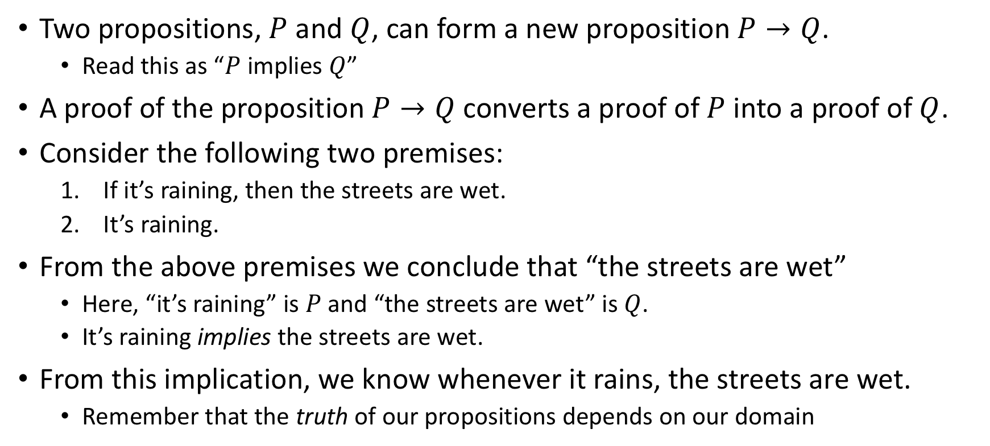
What is an implication?
Two propositions, $P$ and $Q$, can form a new proposition $P→Q$.
Read this as “$P$ implies $Q$”
A proof of the proposition $P→Q$ converts a proof of $P$ into a proof of $Q$.
Consider the following two premises:
If it’s raining, then the streets are wet.
It’s raining.
From the above premises we conclude that “the streets are wet”
Here, “it’s raining” is $P$ and “the streets are wet” is $Q$.
It’s raining implies the streets are wet.
From this implication, we know whenever it rains, the streets are wet.
Remember that the truth of our propositions depends on our domain

Slide 3
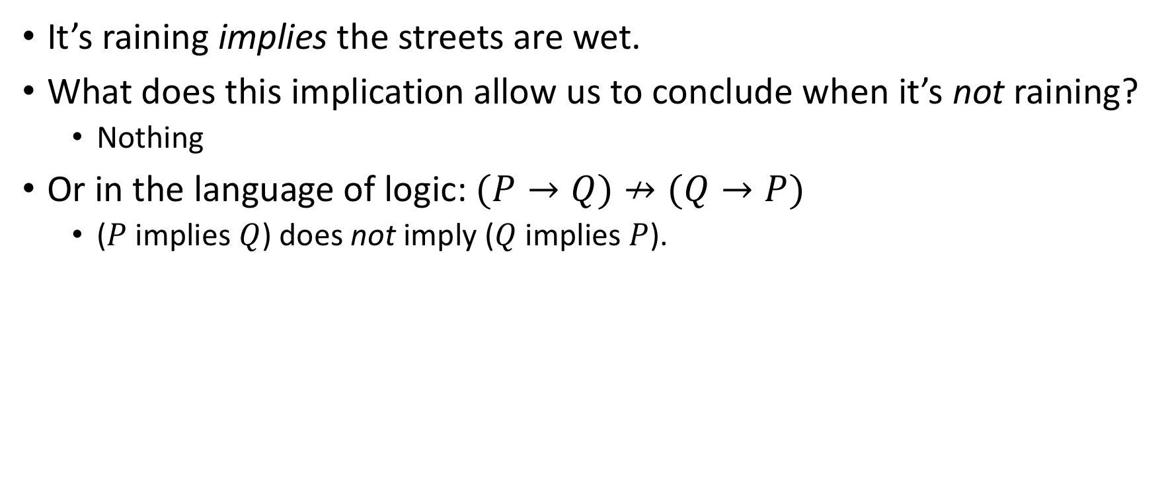
What an implication isn’t
It’s raining implies the streets are wet.
What does this implication allow us to conclude when it’s not raining?
Nothing
Or in the language of logic: $(P→Q)↛(Q→P)$
($P$ implies $Q$) does not imply ($Q$ implies $P$).

Slide 4
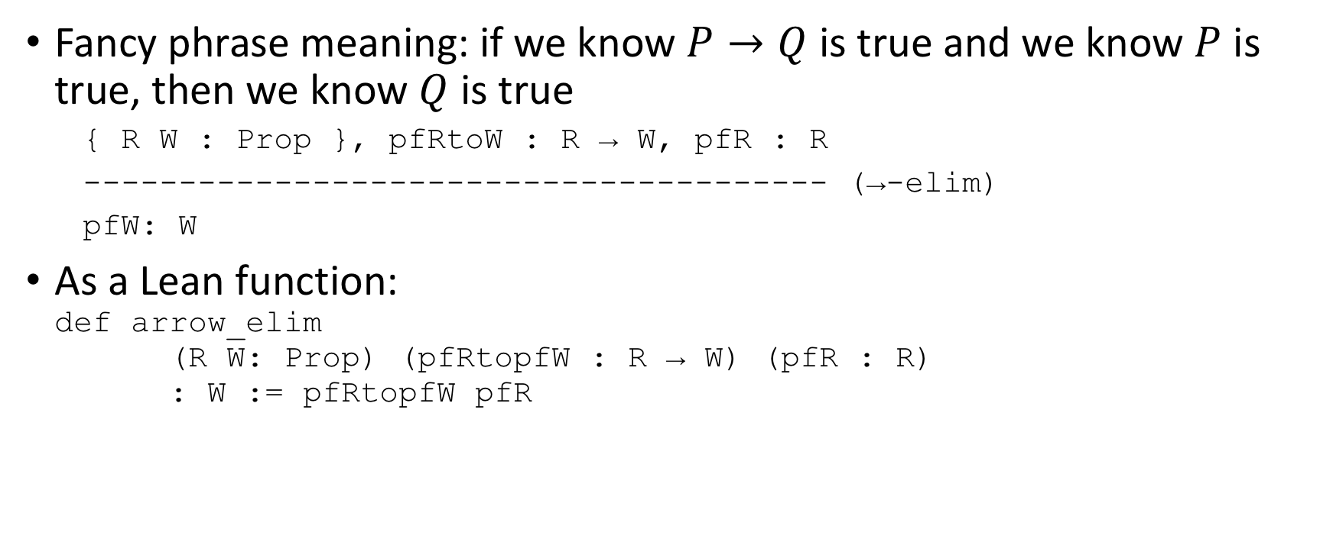
Modus Ponens
Fancy phrase meaning: if we know $P→Q$ is true and we know $P$ is true, then we know $Q$ is true
{ R W : Prop }, pfRtoW : R → W, pfR : R
--------------------------------------- (→-elim)
pfW: W
As a Lean function: def arrow_elim (R W: Prop) (pfRtopfW : R → W) (pfR : R) : W := pfRtopfW pfR

Slide 5
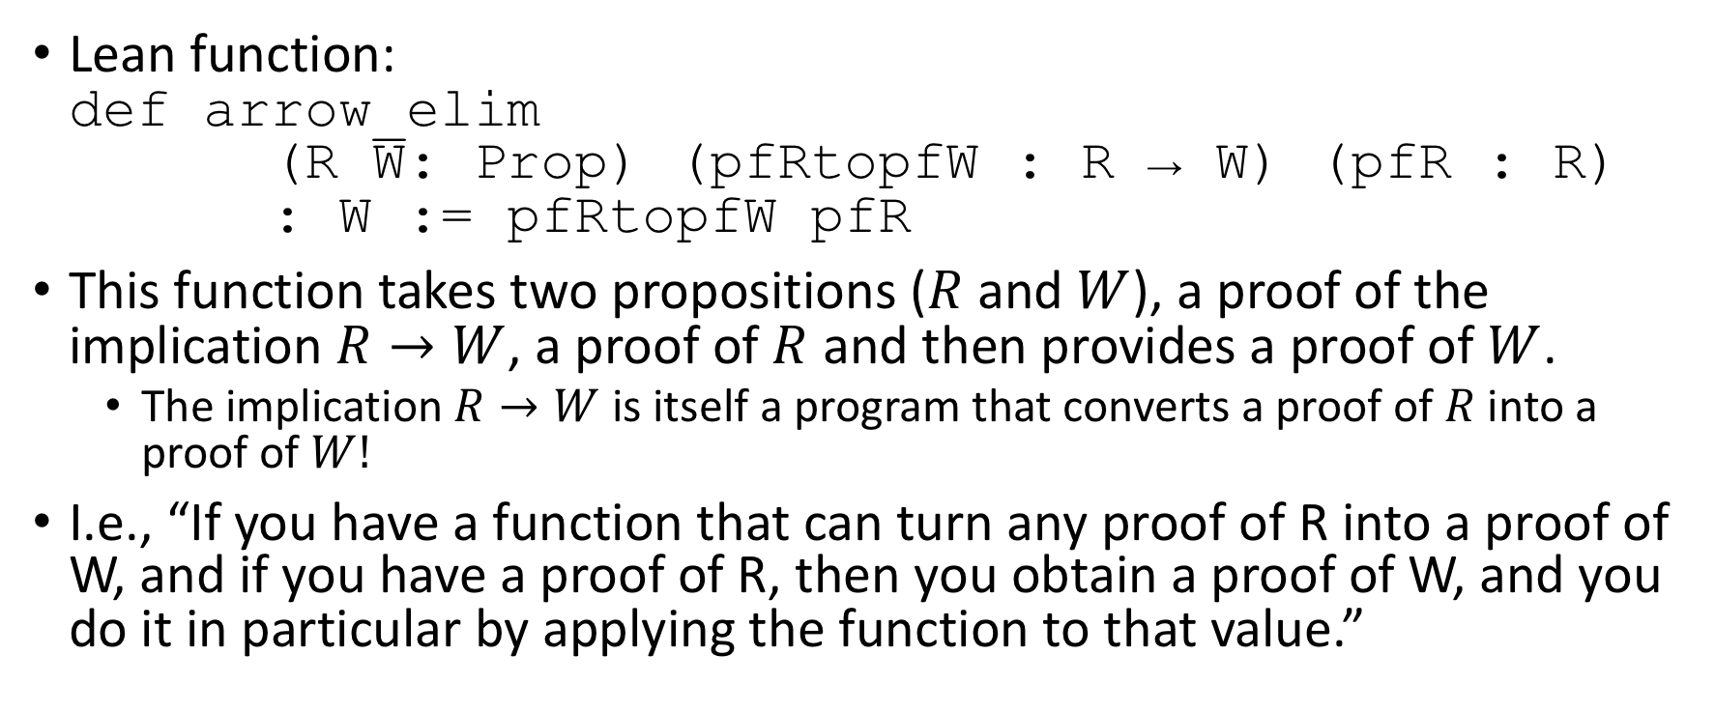
Analysis of Lean function
Lean function: def arrow_elim (R W: Prop) (pfRtopfW : R → W) (pfR : R) : W := pfRtopfW pfR
This function takes two propositions ($R$ and $W$), a proof of the implication $R→W$, a proof of $R$ and then provides a proof of $W$.
The implication $R→W$ is itself a program that converts a proof of $R$ into a proof of $W!$
I.e., “If you have a function that can turn any proof of R into a proof of W, and if you have a proof of R, then you obtain a proof of W, and you do it in particular by applying the function to that value.”

Slide 6
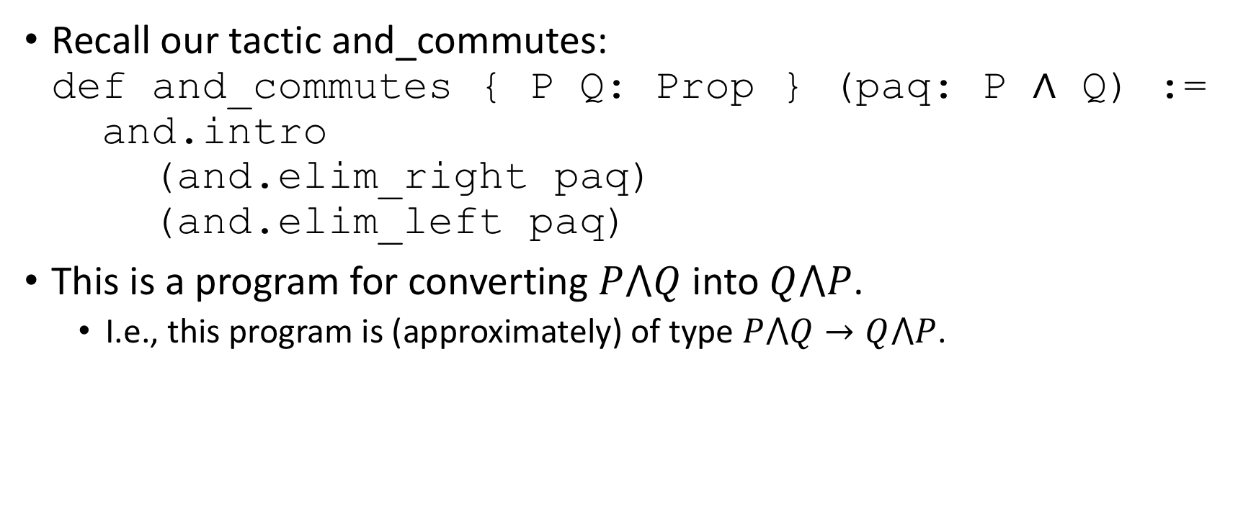
Creating an implication program
Recall our tactic and_commutes: def and_commutes { P Q: Prop } (paq: P ∧ Q) := and.intro (and.elim_right paq) (and.elim_left paq)
This is a program for converting $P⋀Q$ into $Q⋀P$.
I.e., this program is (approximately) of type $P⋀Q→Q⋀P$.

Slide 7
Quick-and-dirty declaration of implication
We can use the Lean keyword variable to introduce variables of whatever type we choose: variables P Q : Prop variable impl : P → Q variable pfP : P #check impl pfP
Note that we should be careful! variable fimpt : true → false theorem zeqo : (0 = 1) := false.elim (fimpt true.intro) #check zeqo

Slide 8
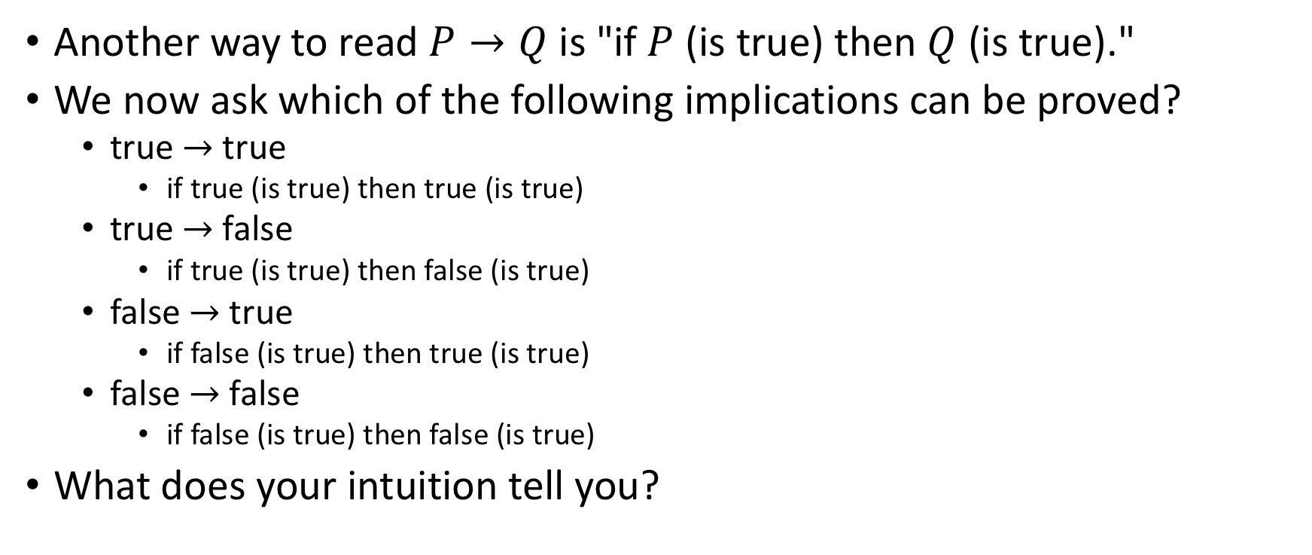
What implications can be proved?
Another way to read $P→Q$is "if $P$ (is true) then $Q$ (is true)."
We now ask which of the following implications can be proved?
true $→$ true
if true (is true) then true (is true)
true $→$ false
if true (is true) then false (is true)
false $→$ true
if false (is true) then true (is true)
false $→$ false
if false (is true) then false (is true)
What does your intuition tell you?

Slide 9
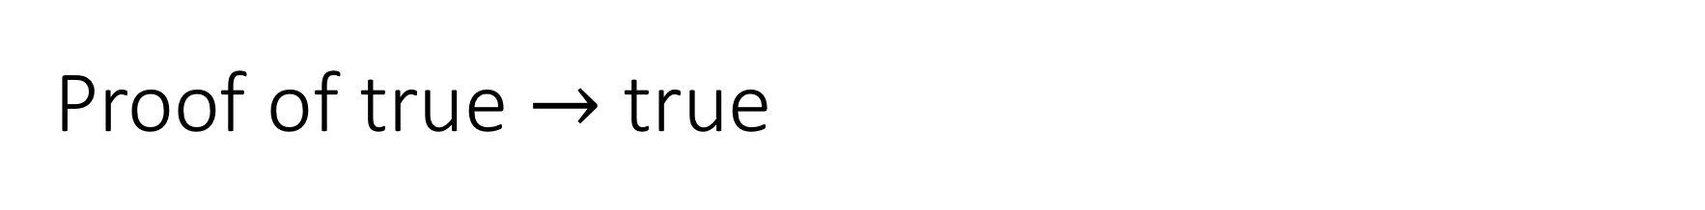
Proof of true $→$ true
def timpt ( pf_true: true ) : true := pf_true
#check timpt

Slide 10
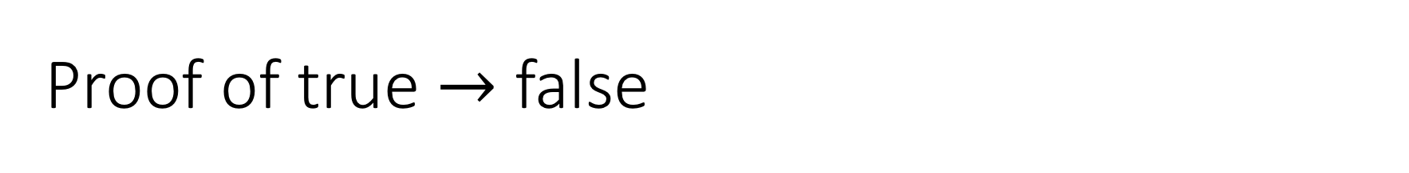
Proof of true $→$ false
axiom f : false -- cheating!! Do not actually do this!
def timpf (t: true): false :=
false.elim f
#check timpf

Slide 11
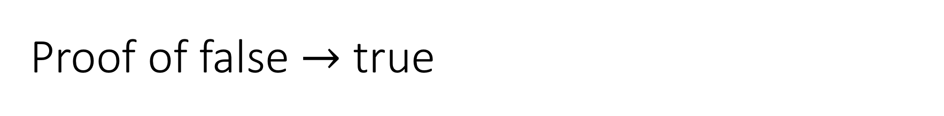
Proof of false $→$ true
def fimpt ( pf_false: false ) : true := true.intro
#check fimpt

Slide 12
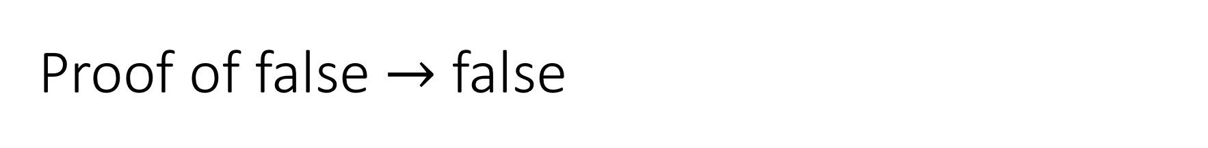
Proof of false $→$ false
def fimpf (pf_false: false ) : true := pf_false
#check timpt

Slide 13
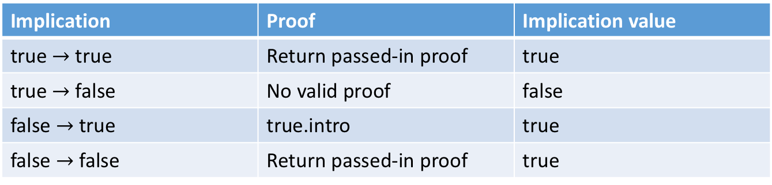
Truth table for implication
We summarize our findings in the following table for implication.
Remember: implications have truth values
Implications are propositions themselves
Implication | Proof | Implication value
true $→$ true | Return passed-in proof | true
true $→$ false | No valid proof | false
false $→$ true | true.intro | true
false $→$ false | Return passed-in proof | true

Slide 14
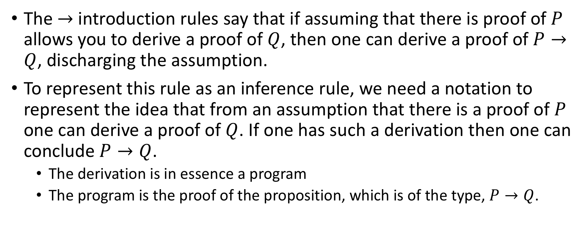
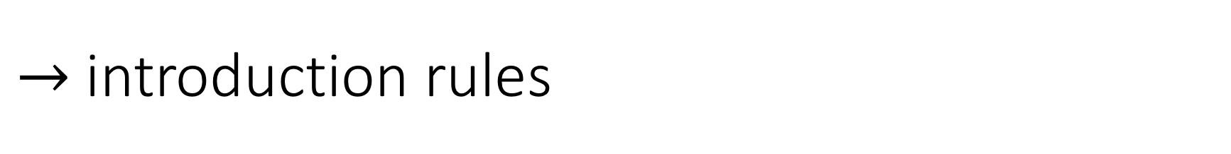
$→$ introduction rules
The $→$ introduction rules say that if assuming that there is proof of $P$ allows you to derive a proof of $Q$, then one can derive a proof of $P→Q$, discharging the assumption.
To represent this rule as an inference rule, we need a notation to represent the idea that from an assumption that there is a proof of $P$ one can derive a proof of $Q$. If one has such a derivation then one can conclude $P→Q$.
The derivation is in essence a program
The program is the proof of the proposition, which is of the type, $P→Q$.

Slide 15

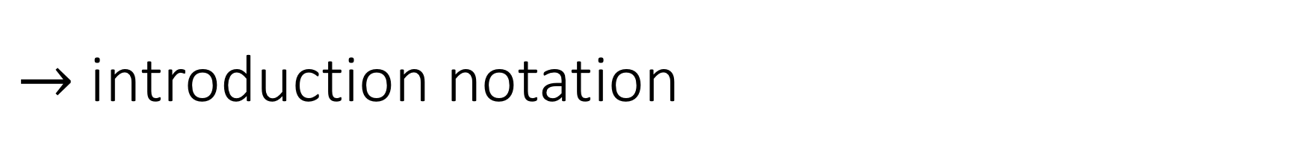
$→$ introduction notation
P
|
|
Q
-----
P → Q
The proof of a proposition, $P→Q$, in Lean, is a program that takes an argument of type $P$ and returns a result of type $Q$.

Slide 16
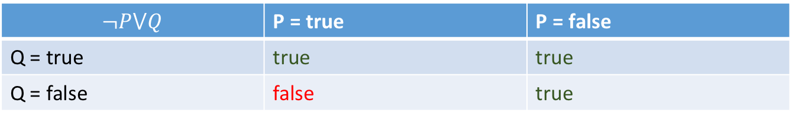

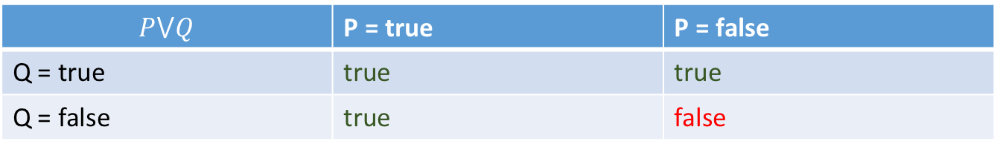
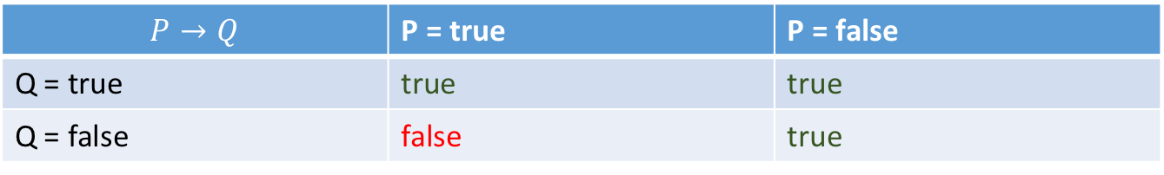
Teaser: Alternate formulation (Classical logic)
Alternate view of implication truth table
What is the truth table for $P⋁Q$ (“P or Q”)?
What is the truth table for $¬P⋁Q$ (“(not P) or Q”)?
$$P→Q$$ | P = true | P = false
Q = true | true | true
Q = false | false | true
$$P⋁Q$$ | P = true | P = false
Q = true | true | true
Q = false | true | false
$$¬P⋁Q$$ | P = true | P = false
Q = true | true | true
Q = false | false | true

Slide 17

Fin

