Slide 1

Implication

Slide 2
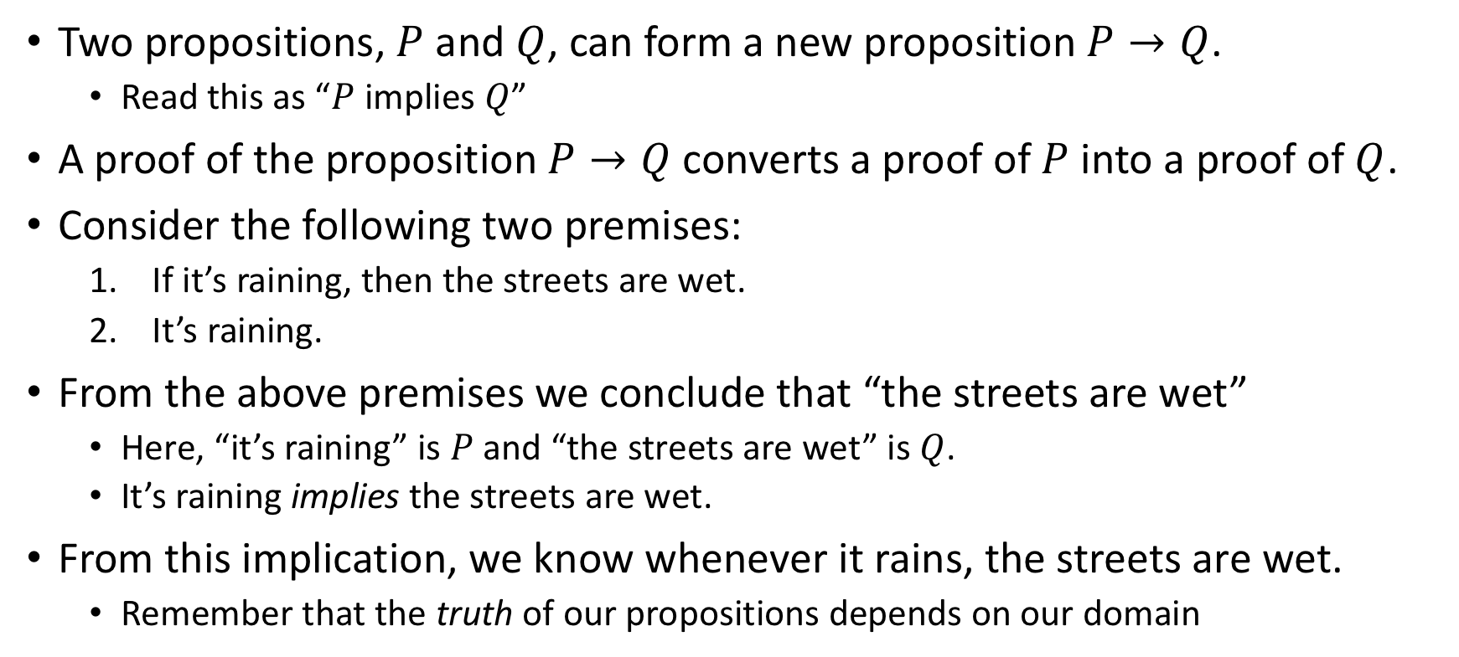
What is an implication?
Two propositions, $P$ and $Q$, can form a new proposition $P→Q$.
Read this as “$P$ implies $Q$”
A proof of the proposition $P→Q$ converts a proof of $P$ into a proof of $Q$.
Consider the following two premises:
If it’s raining, then the streets are wet.
It’s raining.
From the above premises we conclude that “the streets are wet”
Here, “it’s raining” is $P$ and “the streets are wet” is $Q$.
It’s raining implies the streets are wet.
From this implication, we know whenever it rains, the streets are wet.
Remember that the truth of our propositions depends on our domain

Slide 3
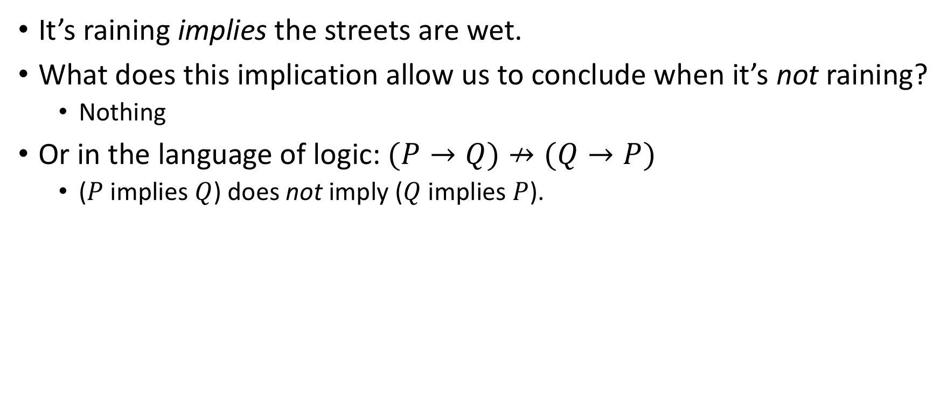
What an implication isn’t
It’s raining implies the streets are wet.
What does this implication allow us to conclude when it’s not raining?
Nothing
Or in the language of logic: $(P→Q)↛(Q→P)$
($P$ implies $Q$) does not imply ($Q$ implies $P$).

Slide 4
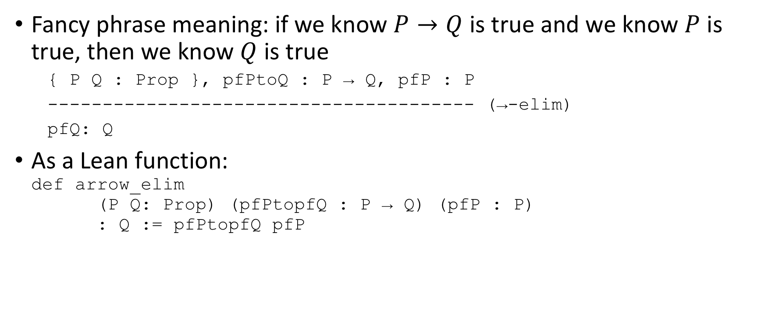
Modus Ponens
Fancy phrase meaning: if we know $P→Q$ is true and we know $P$ is true, then we know $Q$ is true
{ P Q : Prop }, pfPtoQ : P → Q, pfP : P
--------------------------------------- (→-elim)
pfQ: Q
As a Lean function: def arrow_elim (P Q: Prop) (pfPtopfQ : P → Q) (pfP : P) : Q := pfPtopfQ pfP

Slide 5
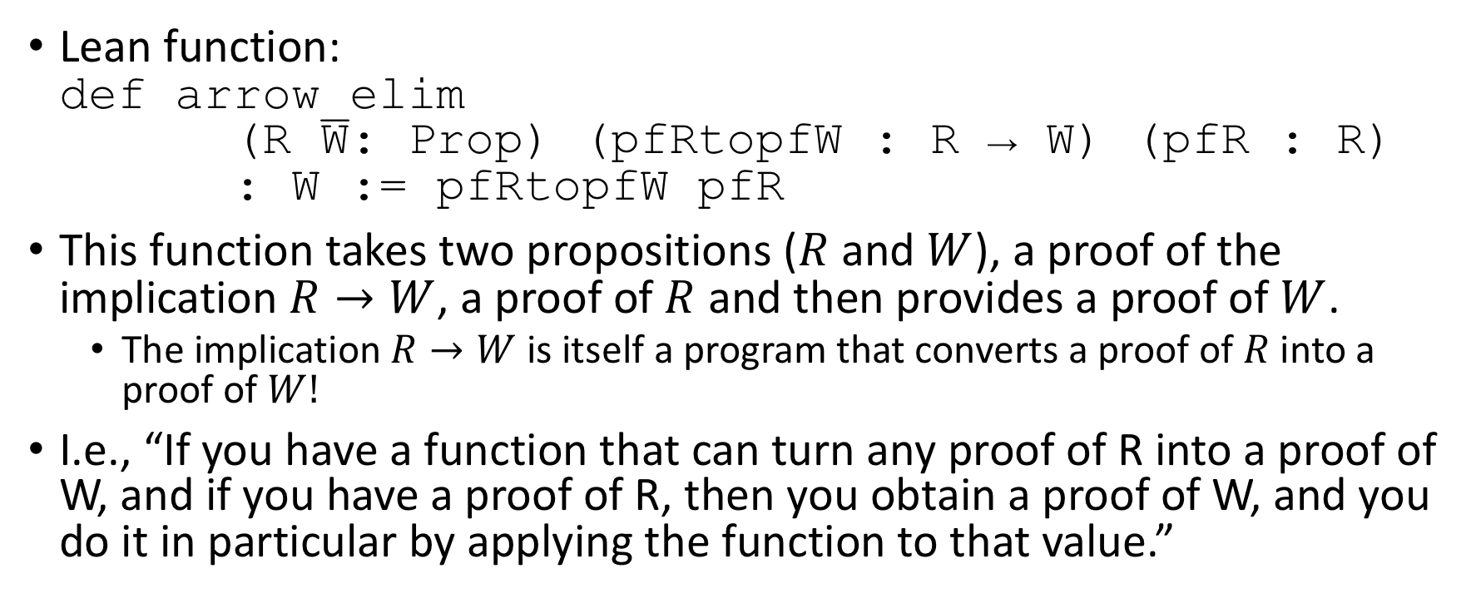
Analysis of Lean function
Lean function: def arrow_elim (R W: Prop) (pfRtopfW : R → W) (pfR : R) : W := pfRtopfW pfR
This function takes two propositions ($R$ and $W$), a proof of the implication $R→W$, a proof of $R$ and then provides a proof of $W$.
The implication $R→W$ is itself a program that converts a proof of $R$ into a proof of $W!$
I.e., “If you have a function that can turn any proof of R into a proof of W, and if you have a proof of R, then you obtain a proof of W, and you do it in particular by applying the function to that value.”

Slide 6
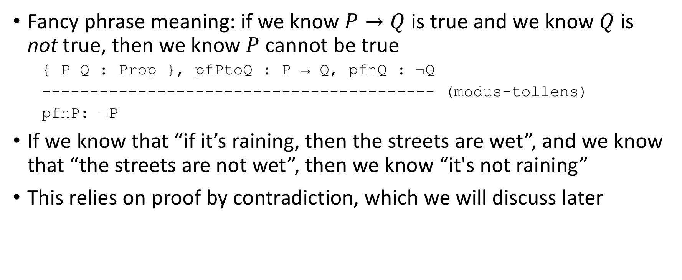
Modus Tollens
Fancy phrase meaning: if we know $P→Q$ is true and we know $Q$ is not true, then we know $P$ cannot be true
{ P Q : Prop }, pfPtoQ : P → Q, pfnQ : ¬Q
----------------------------------------- (modus-tollens)
pfnP: ¬P
If we know that “if it’s raining, then the streets are wet”, and we know that “the streets are not wet”, then we know “it's not raining”
This relies on proof by contradiction, which we will discuss later

Slide 7
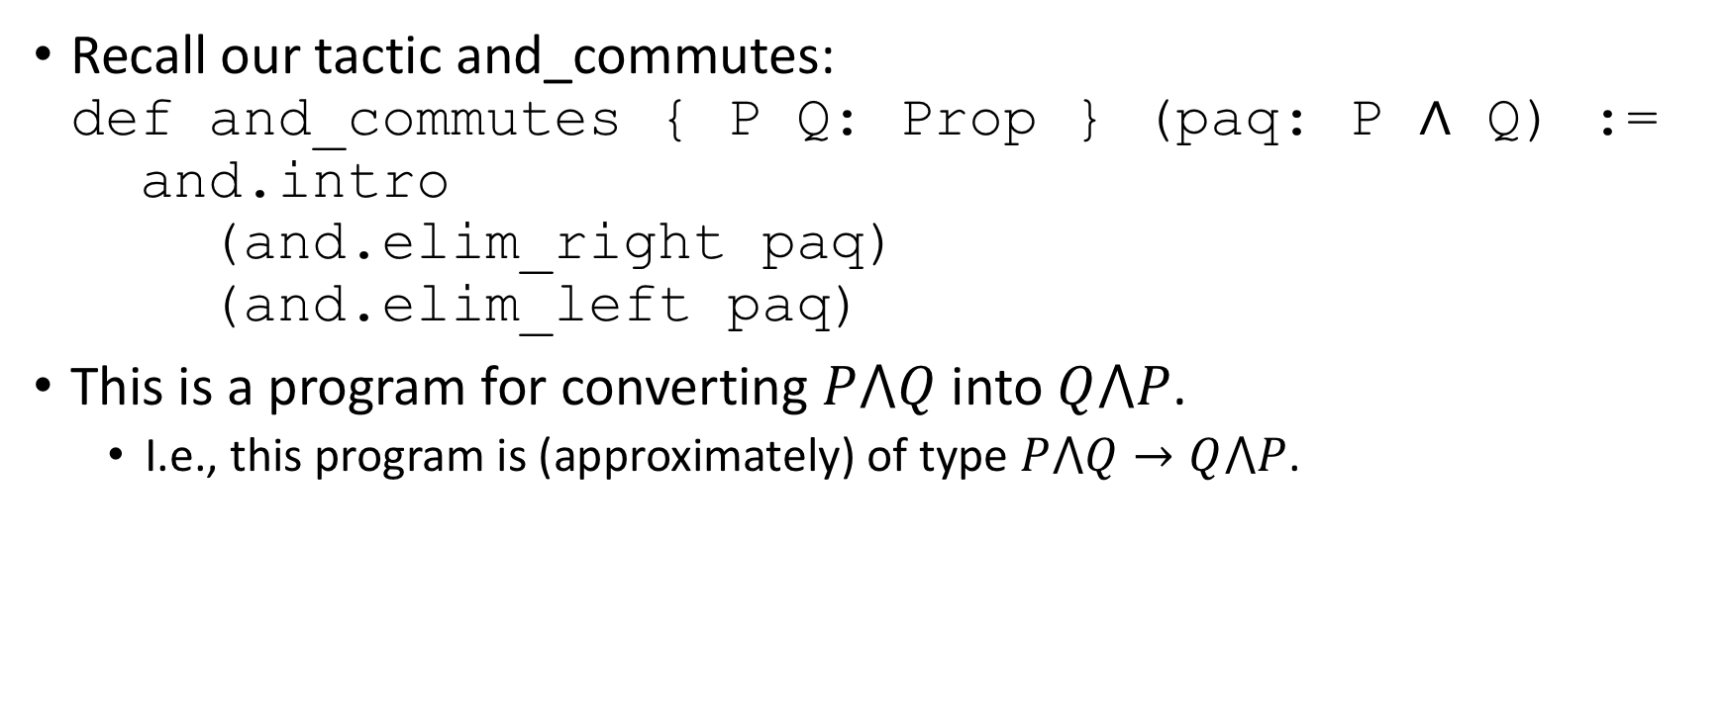
Creating an implication program
Recall our tactic and_commutes: def and_commutes { P Q: Prop } (paq: P ∧ Q) := and.intro (and.elim_right paq) (and.elim_left paq)
This is a program for converting $P⋀Q$ into $Q⋀P$.
I.e., this program is (approximately) of type $P⋀Q→Q⋀P$.

Slide 8
Quick-and-dirty declaration of implication
We can use the Lean keyword variable to introduce variables of whatever type we choose: variables P Q : Prop variable impl : P → Q variable pfP : P #check impl pfP
Note that we should be careful! variable fimpt : true → false theorem zeqo : (0 = 1) := false.elim (fimpt true.intro) #check zeqo

Slide 9
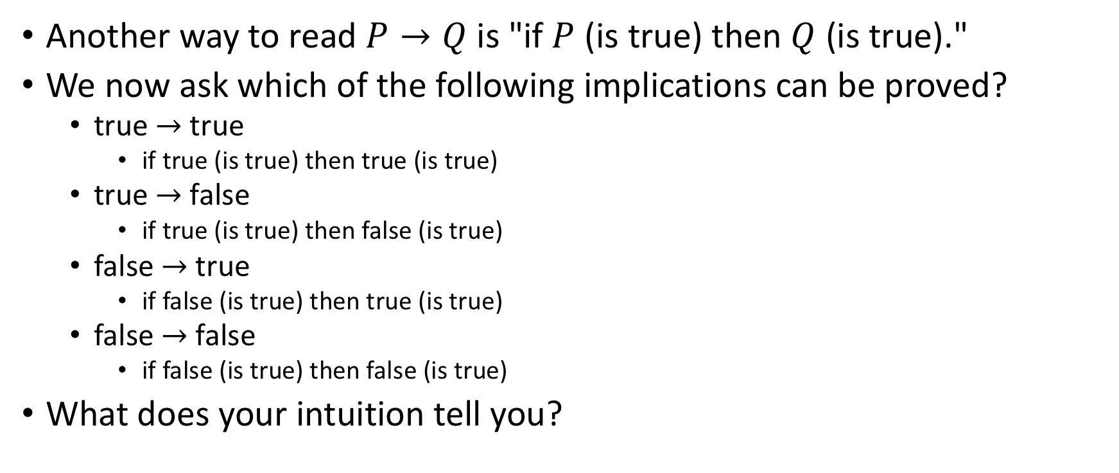
What implications can be proved?
Another way to read $P→Q$is "if $P$ (is true) then $Q$ (is true)."
We now ask which of the following implications can be proved?
true $→$ true
if true (is true) then true (is true)
true $→$ false
if true (is true) then false (is true)
false $→$ true
if false (is true) then true (is true)
false $→$ false
if false (is true) then false (is true)
What does your intuition tell you?

Slide 10
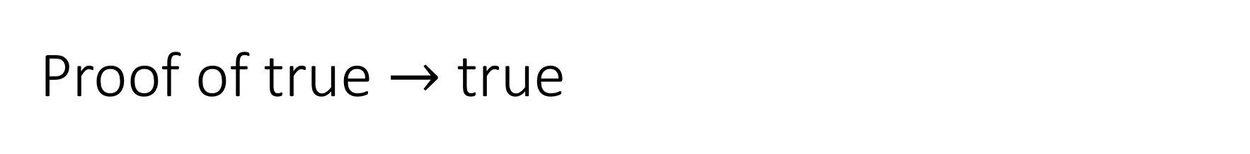
Proof of true $→$ true
def timpt ( pf_true: true ) : true := pf_true
#check timpt

Slide 11
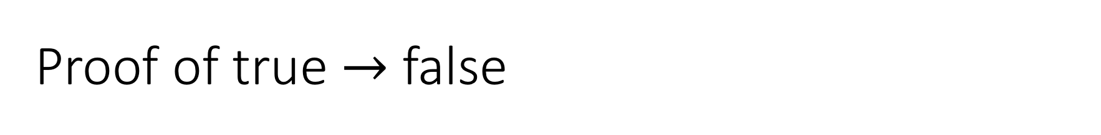
Proof of true $→$ false
axiom f : false -- cheating!! Do not actually do this!
def timpf (t: true): false :=
false.elim f
#check timpf

Slide 12
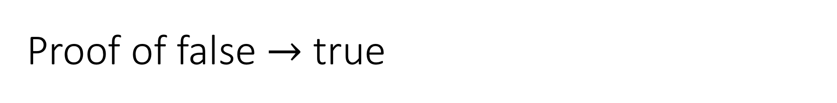
Proof of false $→$ true
def fimpt ( pf_false: false ) : true := true.intro
#check fimpt

Slide 13
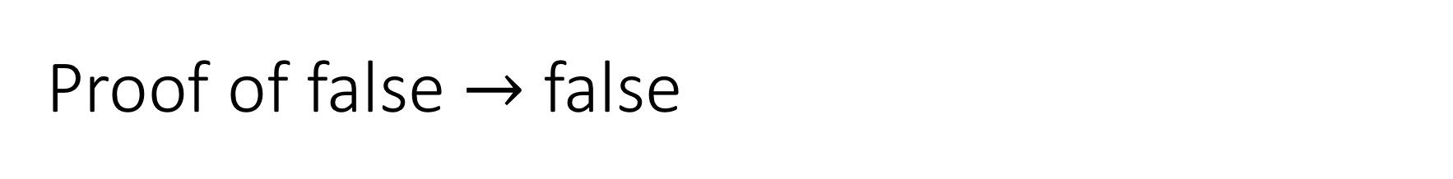
Proof of false $→$ false
def fimpf (pf_false: false ) : true := pf_false
#check timpt

Slide 14
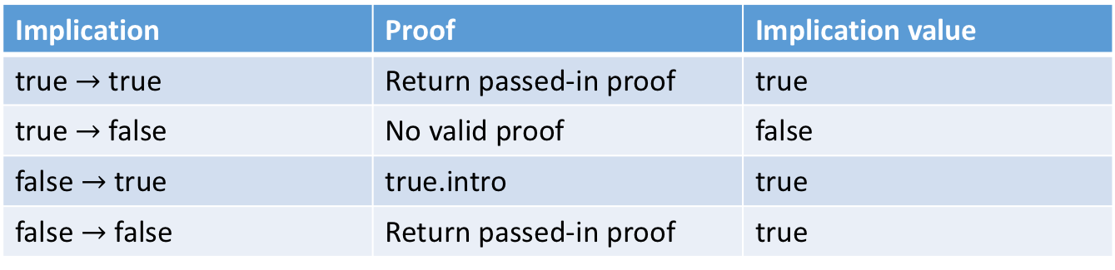
Truth table for implication
We summarize our findings in the following table for implication.
Remember: implications have truth values
Implications are propositions themselves
Important to note: a proposition implies false iff if the proposition is false, but implying true does not mean the proposition is true
Implication | Proof | Implication value
true $→$ true | Return passed-in proof | true
true $→$ false | No valid proof | false
false $→$ true | true.intro | true
false $→$ false | Return passed-in proof | true

Slide 15
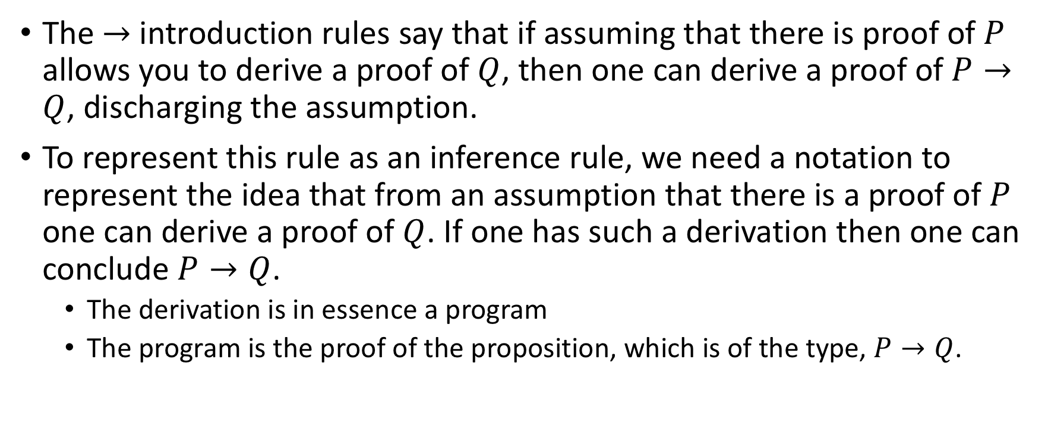
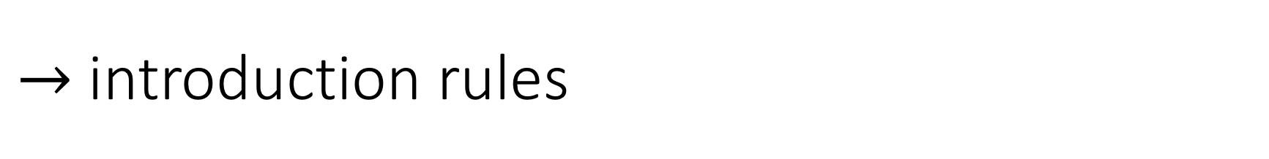
$→$ introduction rules
The $→$ introduction rules say that if assuming that there is proof of $P$ allows you to derive a proof of $Q$, then one can derive a proof of $P→Q$, discharging the assumption.
To represent this rule as an inference rule, we need a notation to represent the idea that from an assumption that there is a proof of $P$ one can derive a proof of $Q$. If one has such a derivation then one can conclude $P→Q$.
The derivation is in essence a program
The program is the proof of the proposition, which is of the type, $P→Q$.

Slide 16

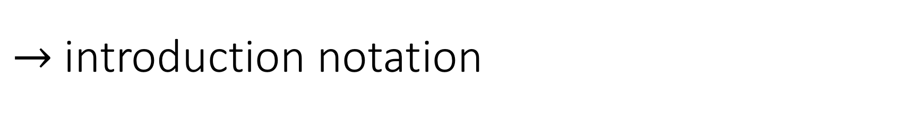
$→$ introduction notation
P
|
|
Q
-----
P → Q
The proof of a proposition, $P→Q$, in Lean, is a program that takes an argument of type $P$ and returns a result of type $Q$.

Slide 17
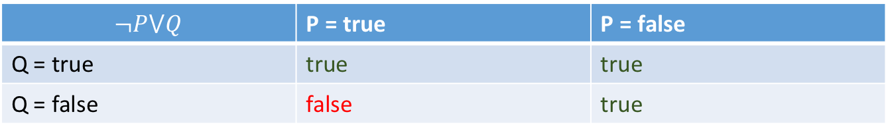

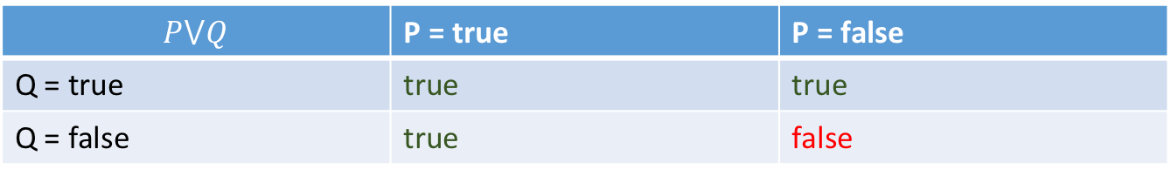
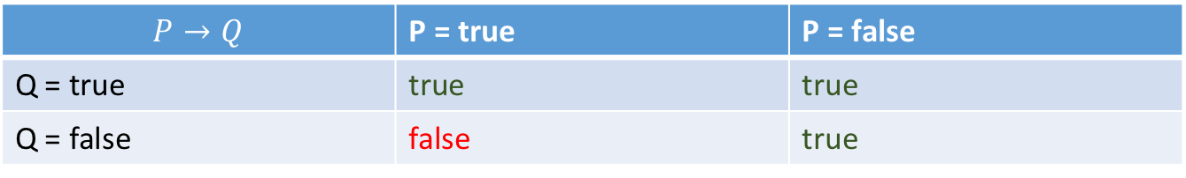
Teaser: Alternate formulation (Classical logic)
Alternate view of implication truth table
What is the truth table for $P⋁Q$ (“P or Q”)?
What is the truth table for $¬P⋁Q$ (“(not P) or Q”)?
$$P→Q$$ | P = true | P = false
Q = true | true | true
Q = false | false | true
$$P⋁Q$$ | P = true | P = false
Q = true | true | true
Q = false | true | false
$$¬P⋁Q$$ | P = true | P = false
Q = true | true | true
Q = false | false | true

Slide 18

Fin

