Slide 1
Credit Card Fraud Detection Using
Multi-Layer Perceptrons and Focal Loss
Optuna Hyperparameter Tuning, SHAP Explainability, and Comparison with XGBoost
Student: George-Cătălin Rece
Course: Advanced AI & Machine Learning Research (AAIMR) - Prof. Dr. Costin Bădică
Assignment: Research Project #1 (Section 2.1)
Notes:
Hello everyone. My project is Topic #1, Credit Card Fraud Detection using Multi-Layer Perceptrons. I will present the dataset, how we handled the class imbalance using Focal Loss and class weights, as well as the three extensions: Optuna tuning, XGBoost comparison, and SHAP explainability.

Slide 2
1. Problem Context and Main Challenges
Binary Classification on Strongly Imbalanced Transaction Data
Practical Motivation
• Card issuers process large transaction volumes and need fast, automated fraud filtering.
• Two types of costly errors:
• - False Negatives (missed frauds): direct financial loss.
• - False Positives (false alarms): normal customer transactions get blocked.
• Goal: catch as many frauds as possible while keeping false alarms very low.
Technical Challenges
• Severe Class Imbalance: in the ULB dataset, only 492 out of 284,807 transactions (0.1727%) are fraudulent (about 1 : 578).
• Standard accuracy is not informative: predicting class 0 for everything gives 99.83% accuracy.
• Standard BCE loss gradients are dominated by easy negative examples.
• Black-box neural networks require post-hoc explainability (SHAP) to audit flagged transactions.
Notes:
The main challenge in credit card fraud detection is the 1 to 578 class imbalance. Standard accuracy is useless here because predicting everything as normal gives 99.83% accuracy. Also, we have to balance missed frauds against false alarms.

Slide 3
2. Project Scope and Implemented Extensions
Core MLP Models and Required Extensions
Core MLP Experiments
• Built a configurable PyTorch MLP (FraudMLP) with BatchNorm1d, Dropout, and ReLU / GELU / SiLU activations.
• Compared three loss functions:
• 1. Standard Binary Cross-Entropy (Baseline MLP)
• 2. Cost-Sensitive Weighted BCE (w+ = 24.05)
• 3. Binary Focal Loss (Lin et al., 2017) with prior bias initialization (b0 = -6.36).
• Selected the optimal classification threshold (τ*) on the validation PR curve.
Project Extensions
• Extension 1 - Explainable AI (SHAP): computed global and local feature attributions using GradientExplainer.
• Extension 2 - Hyperparameter Tuning (Optuna): ran a 20-trial TPE search over layer sizes, activations, dropout, LR, and Focal Loss (α, γ).
• Extension 3 - XGBoost Comparison: trained a histogram-based XGBoost model on the exact same splits.
• Extra: built an interactive Streamlit web dashboard (app.py).
Notes:
On the left are the core MLP models we trained, comparing standard BCE, weighted BCE, and Focal Loss. On the right are the three extensions from the project guide: SHAP, Optuna hyperparameter tuning, and the comparison with XGBoost, plus a Streamlit dashboard.

Slide 4
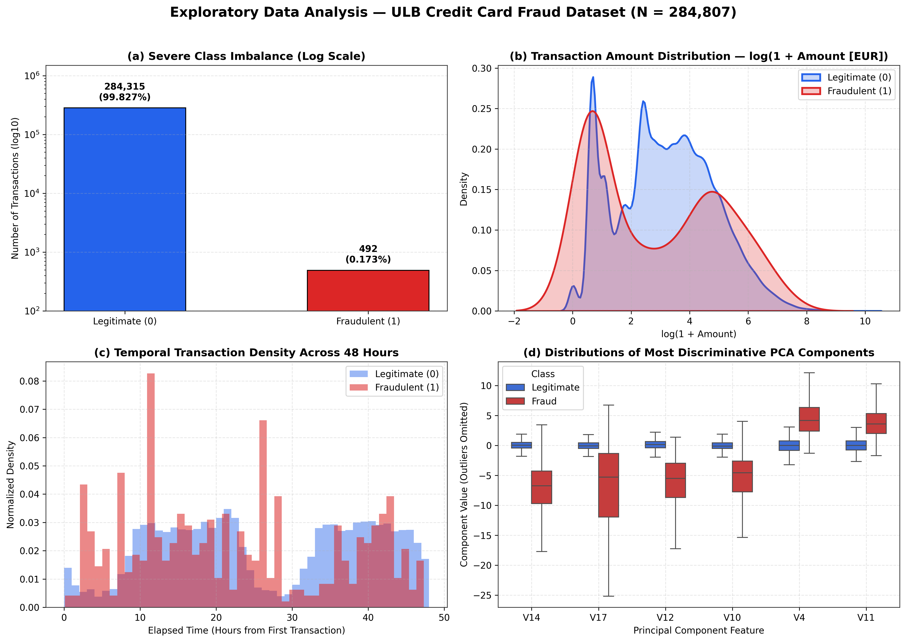
3. Dataset and Exploratory Data Analysis
ULB Credit Card Fraud Dataset (284,807 Transactions | 492 Frauds)
Dataset & Split Details
• 284,807 European card transactions over 48 hours (Sept 2013).
• Features: V1-V28 (PCA components) plus Time and Amount.
• Stratified 70% / 15% / 15% Split (SEED=42):
• - Train: 199,364 (344 frauds)
• - Val: 42,721 (74 frauds)
• - Test: 42,722 (74 frauds)
• Scaling: RobustScaler (median/IQR) fitted only on X_train['Time', 'Amount'] to avoid data leakage.
• PCA components V14, V17, V12, V10, and V4 show the clearest separation.
Notes:
We split the dataset 70/15/15 using stratified sampling so each split has the same 0.173% fraud ratio. Time and Amount are scaled using RobustScaler fitted only on the training set. In the plots on the right, we can see the class imbalance, the distribution of transaction amounts, and the boxplots of top PCA features.

Slide 5
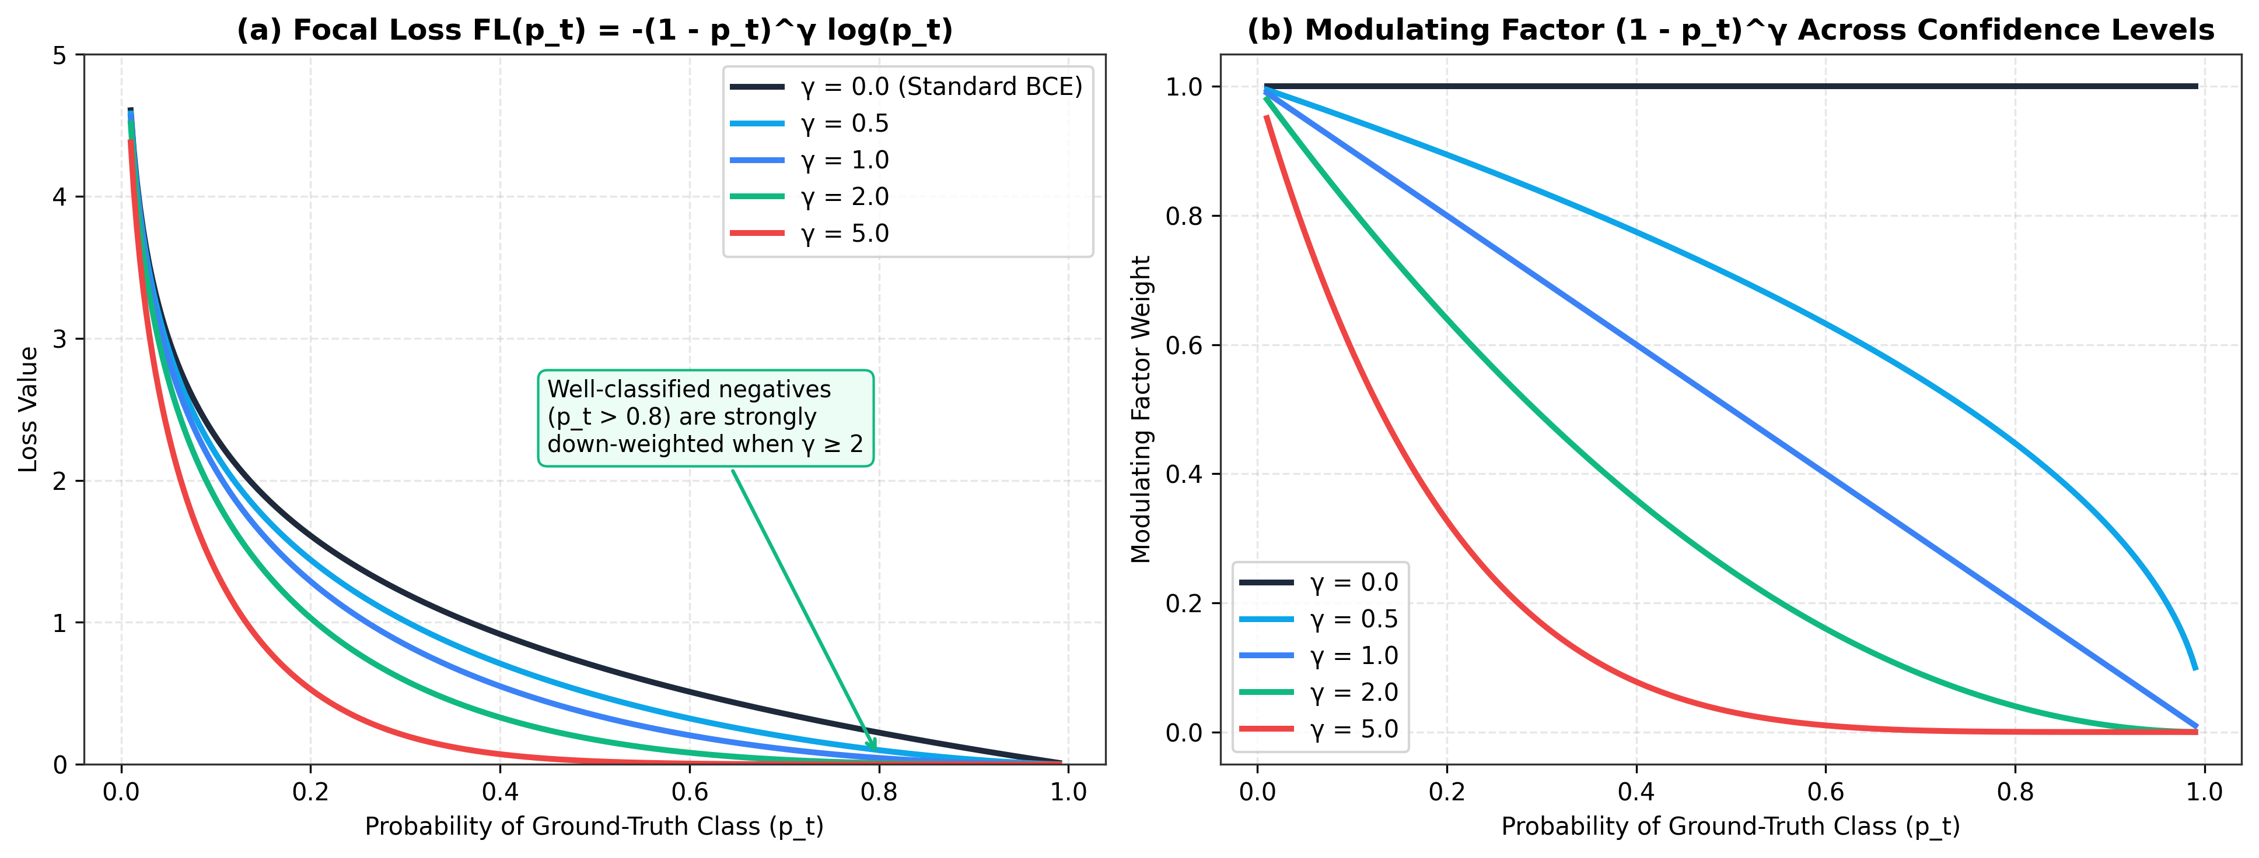
4. Deep Learning Methodology: Focal Loss
Down-Weighting Easy Negatives During Training (Lin et al., 2017)
MLP Block & Focal Loss Formula
• Hidden Block: Linear -> BatchNorm1d -> Activation (ReLU / SiLU) -> Dropout(p).
• Binary Focal Loss:
• FL(p_t) = - α_t · (1 - p_t)^γ · log(p_t)
• How the modulating factor (1 - p_t)^γ works:
• - Easy negative (p_t = 0.99, γ = 2): weight is scaled by (1-0.99)² = 0.0001.
• - Misclassified example (p_t < 0.2): keeps almost its full weight.
• Prior Bias Initialization (π = 0.001725):
• b_0 = -log((1 - π)/π) = -6.36 keeps initial predictions near the true fraud rate.
Notes:
Focal Loss adds the (1 - p_t)^gamma term in front of cross-entropy. When a normal transaction is already classified with 99% confidence, its weight drops by 10,000 times for gamma=2, so the network focuses its updates on harder fraud examples.

Slide 6
5. Software Design and Implementation
Modular PyTorch Pipeline (src/)
Code Organization
• src/download_data.py: downloads and verifies creditcard.csv.
• src/data_utils.py: fixed seeds (SEED=42), stratified 70/15/15 split, and RobustScaler.
• src/losses.py: log-space BinaryFocalLoss on raw logits.
• src/models.py: FraudMLP class with BatchNorm, Dropout, and prior bias initialization.
• src/train_eval.py: AdamW training loop, PR-AUC early stopping, and metric computation.
• src/plotting.py: scripts generating figures 1 to 9.
Practical Implementation Choices
• No Data Leakage: RobustScaler and decision thresholds are fitted on Train/Validation only.
• Early Stopping on Validation PR-AUC: different loss functions have different scales, so PR-AUC is a much cleaner stopping criterion than validation loss.
• Validation Threshold Calibration (τ*): we pick τ* that maximizes F1 on the validation set and evaluate the test set at both τ* and τ = 0.50.
Notes:
We structured the code into separate modules inside src/ so that all models share the exact same data splits, early stopping logic, and evaluation functions.

Slide 7
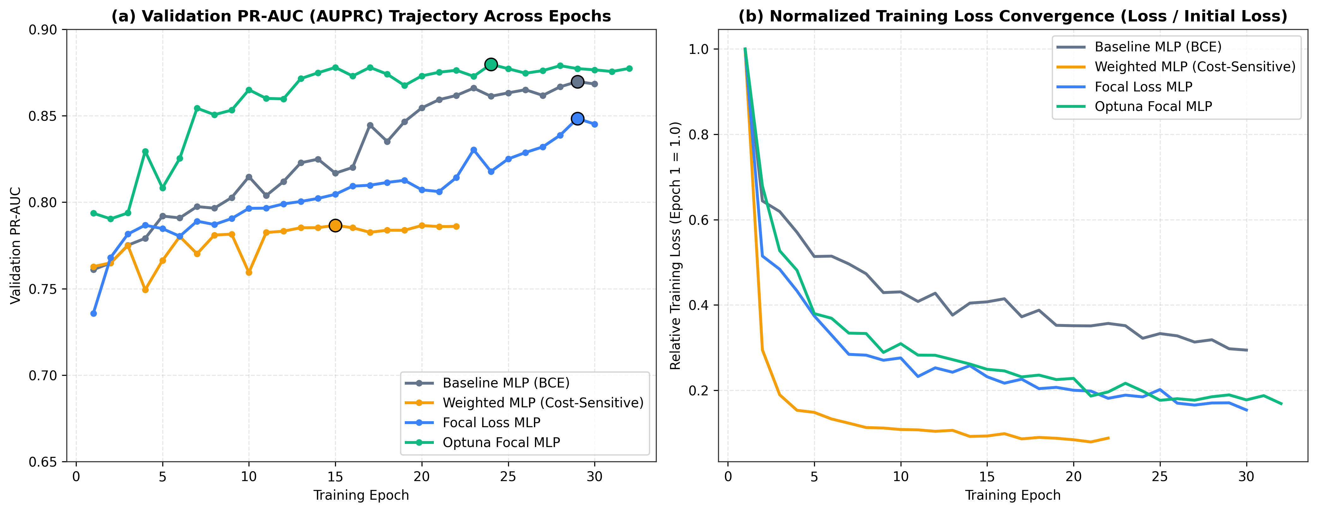
6. Training Convergence Across MLP Variants
Validation PR-AUC and Normalized Training Loss per Epoch
Training Behavior
• Optuna Focal MLP (green) reaches the highest validation PR-AUC (0.8798 at Epoch 24).
• Baseline MLP (grey) and untuned Focal Loss MLP (blue) improve steadily up to Epoch 29.
• Weighted MLP (orange, w+ = 24.05) stops improving after Epoch 15 (Val PR-AUC = 0.7867) because static class weighting over-amplifies noisy examples.
Notes:
Here we see the validation PR-AUC across epochs. The Weighted MLP plateaus early around 0.787, whereas the Focal Loss models keep improving and the Optuna-tuned MLP reaches nearly 0.88 on the validation set.

Slide 8
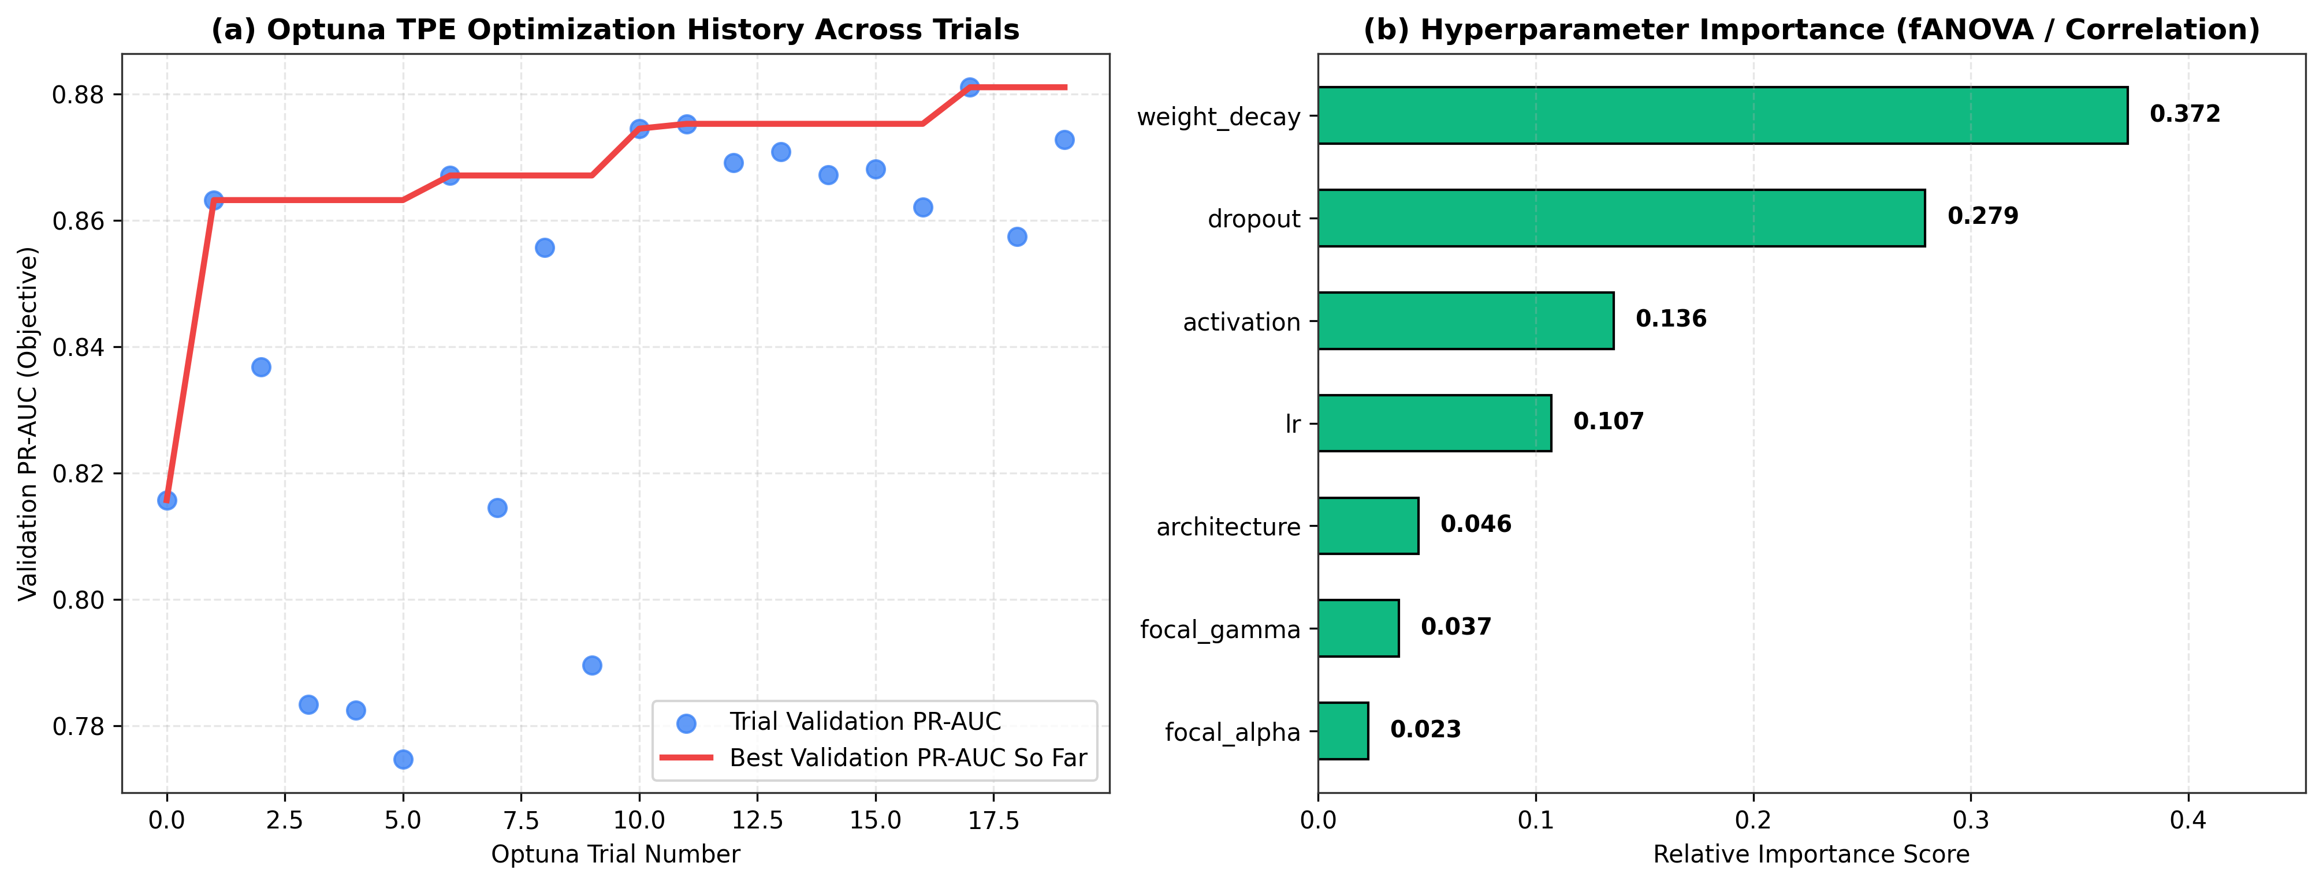
7. Extension 2: Hyperparameter Tuning with Optuna
20-Trial TPE Study and Parameter Importance
Best Configuration Found (Trial #17)
• Best Validation PR-AUC: 0.8811
• Hidden Layers: 256 -> 128 -> 64
• Activation: SiLU (Swish)
• Dropout: 0.25
• Learning Rate: 0.0012
• Weight Decay: 2.62 × 10^-4
• Focal Loss: α = 0.65, γ = 1.75
• Most important parameters (fANOVA): weight_decay (37.2%), dropout (27.9%), activation (13.6%).
Notes:
In Extension 2, we ran 20 Optuna trials. Trial 17 gave the best validation PR-AUC of 0.8811 using a 256-128-64 network with SiLU activation, 0.25 dropout, alpha=0.65, and gamma=1.75. The parameter importance plot shows that weight decay and dropout had the biggest impact.

Slide 9
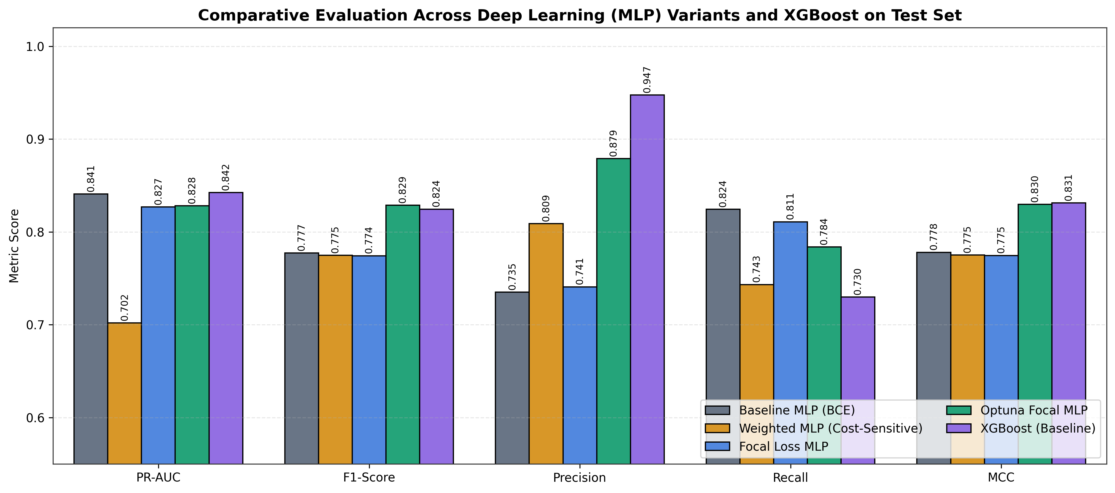
8. Extension 3: Test Set Comparison (MLP vs. XGBoost)
Evaluation on the Held-Out Test Split (42,722 Transactions | 74 Frauds)
Main Test Set Findings
• Optuna Focal MLP achieves the highest calibrated Test F1-Score (0.8286) among all 5 models.
• At the default τ=0.50 threshold, Optuna Focal MLP gets F1 = 0.8451 vs. 0.7703 for the untuned Focal MLP.
• False Positives dropped from 21 down to 8 out of 42,648 normal test transactions.
• Optuna Focal MLP vs. XGBoost:
• - MLP catches 58/74 frauds (78.4% Recall) vs. XGBoost's 54/74 (73.0% Recall).
• - XGBoost gets slightly higher PR-AUC (0.8422 vs 0.8280) and Precision (94.7%, 3 FP).
Notes:
Comparing the five models on the test set: Optuna tuning improved the Focal MLP F1 score from 0.774 to 0.829 by cutting false positives from 21 to 8. Compared to XGBoost, the tuned MLP catches 4 more frauds on the test set, while XGBoost has fewer false positives.

Slide 10
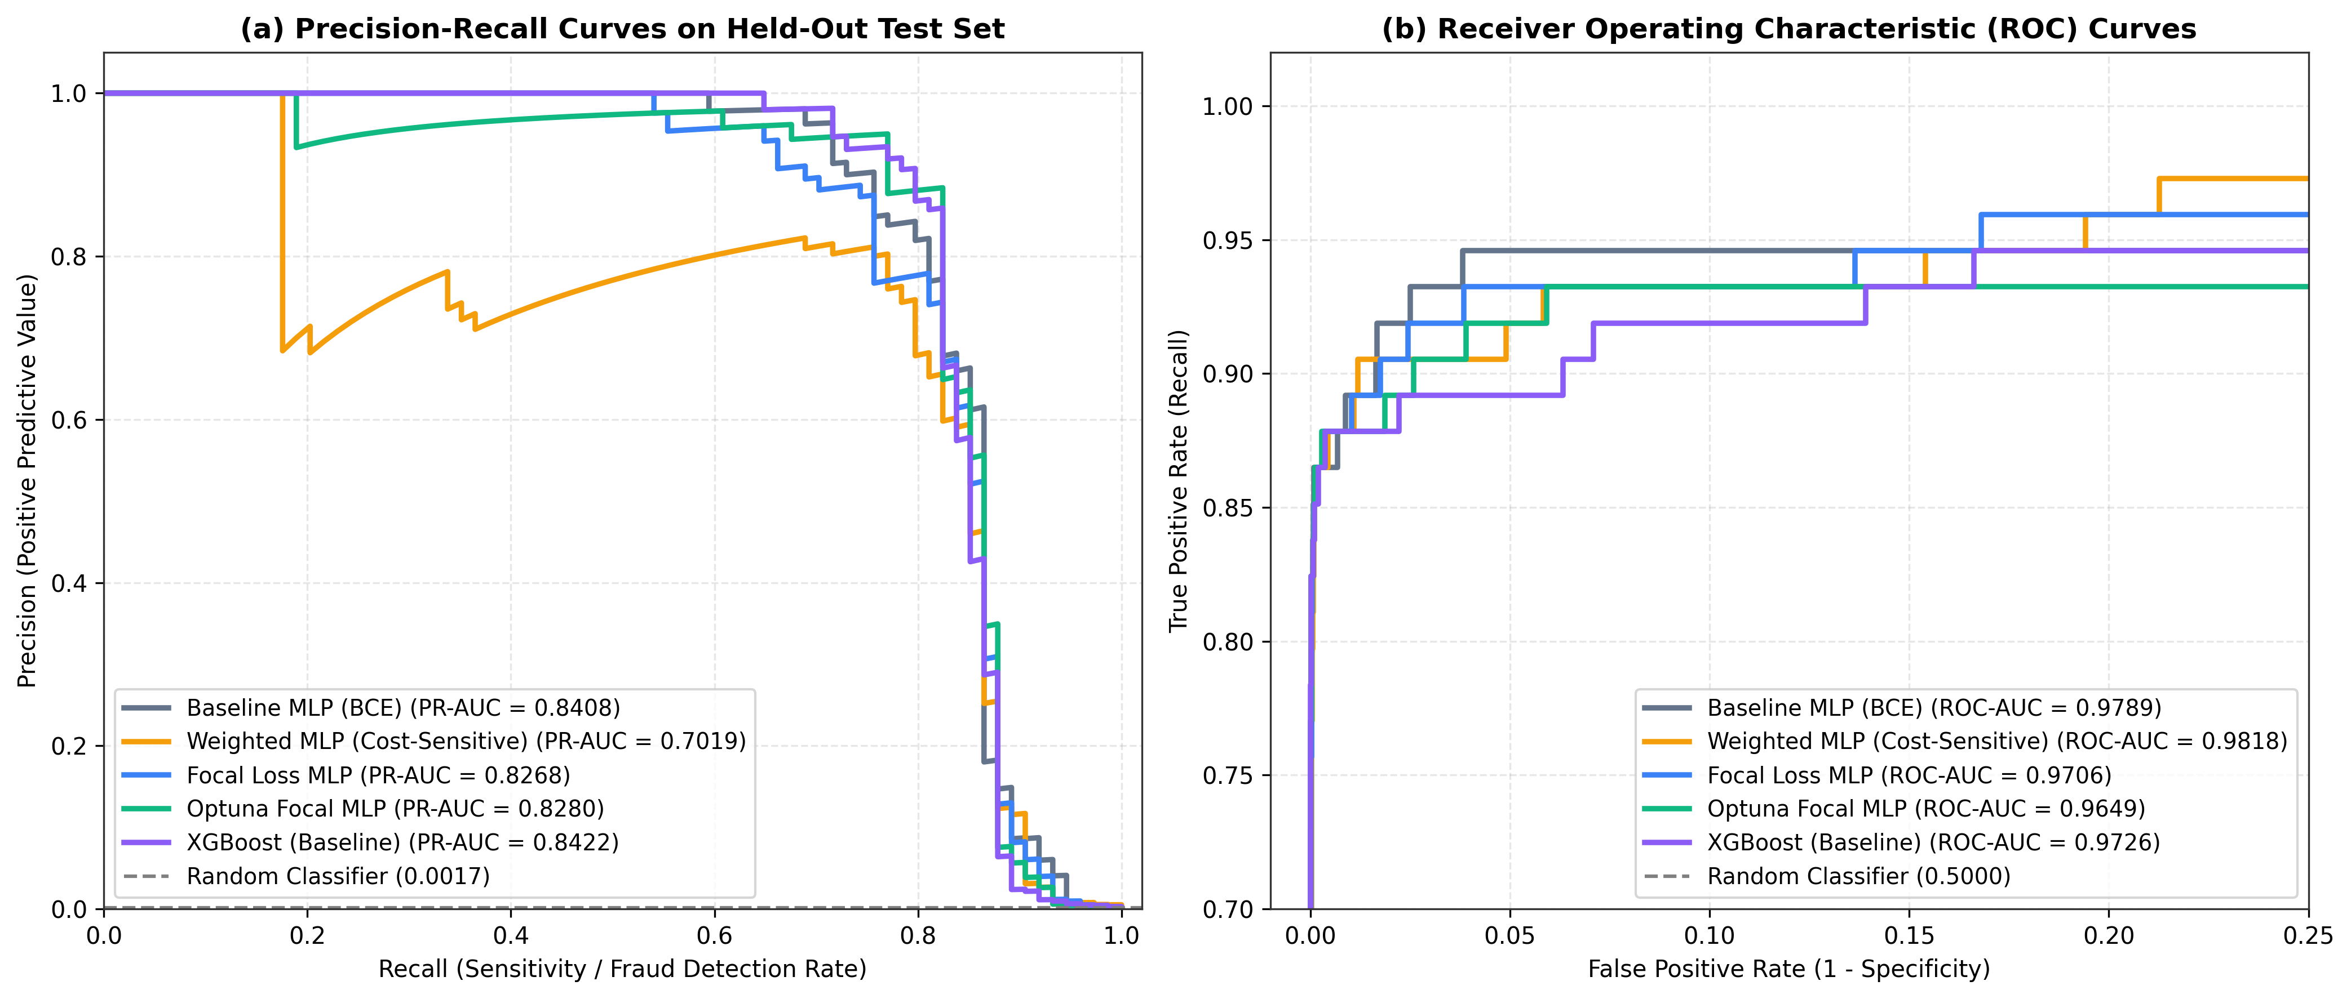
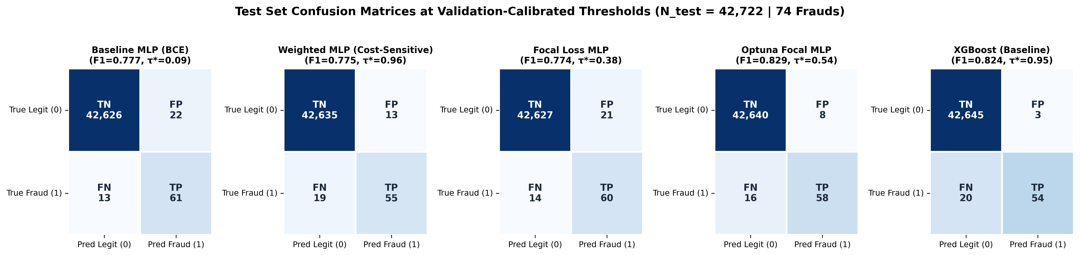
9. Precision-Recall Curves and Confusion Matrices
Test Set Curves and Error Breakdown
PR-AUC vs. ROC-AUC
• Weighted MLP has the highest ROC-AUC (0.9818) but the lowest PR-AUC (0.7019).
• Because TN = 42,648, false alarms barely affect FPR in the ROC curve, whereas Precision drops immediately.
Notes:
This slide shows why PR-AUC is much more informative than ROC-AUC on imbalanced data: the Weighted MLP has the highest ROC-AUC at 0.9818, but its PR-AUC is only 0.7019. At the bottom we can see the exact confusion matrices for all five models.

Slide 11
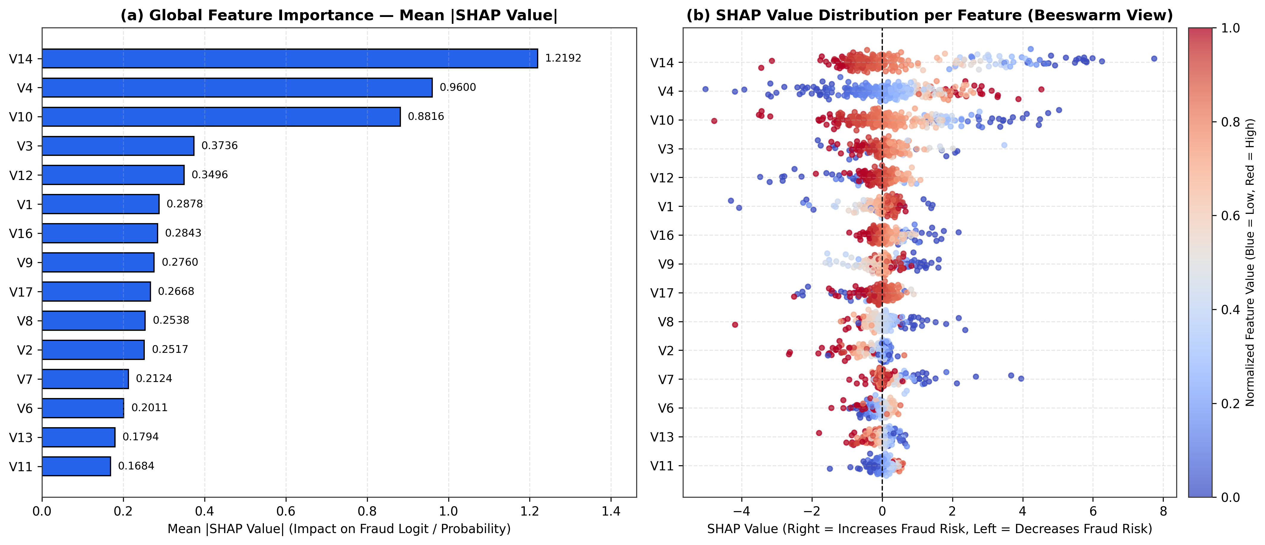
10. Extension 1: Global SHAP Feature Importance
Explaining the Optuna Focal MLP Predictions
Global SHAP Results
• Computed SHAP values with GradientExplainer across 300 test transactions (74 frauds + 226 normal).
• Top 5 Features by Mean |SHAP|:
• 1. V14 (1.219)
• 2. V4 (0.960)
• 3. V10 (0.882)
• 4. V3 (0.374)
• 5. V12 (0.350)
• Strongly negative V14 and V10 values, and positive V4 values, push predictions toward Fraud.
Notes:
For Extension 1, we used SHAP GradientExplainer on our best MLP. Globally, V14, V4, and V10 have the largest impact on the model output, while raw Time and Amount have much smaller direct effects.

Slide 12
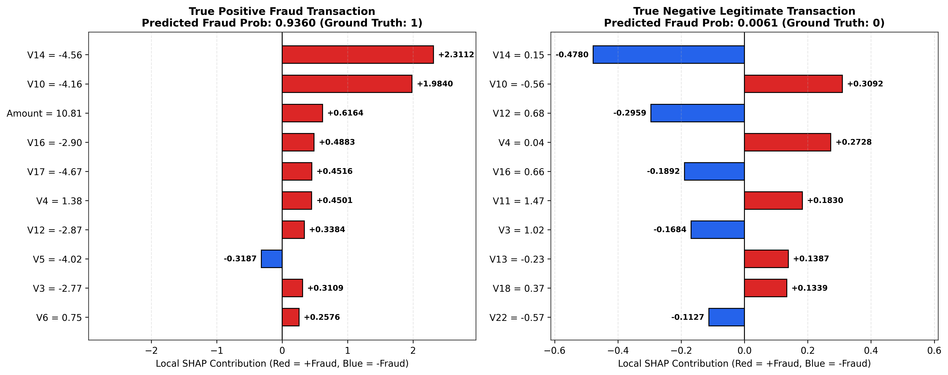
11. Extension 1: Local SHAP Explanations per Transaction
Comparing a Flagged Fraud vs. a Normal Transaction
Individual Case Breakdown
• True Positive Fraud (predicted p = 0.9360):
• - V14 = -4.56 (+2.31 SHAP)
• - V10 = -4.16 (+1.98 SHAP)
• - Scaled Amount = 10.81 (+0.62)
• - V16 = -2.90 (+0.49), V17 = -4.67 (+0.45)
• True Negative Normal (predicted p = 0.0061):
• - Near-zero V14 = 0.15 (-0.48 SHAP) and V12 = 0.68 (-0.30 SHAP) keep the fraud score low.
Notes:
We can also inspect individual transactions. On the left is a true fraud where negative values on V14 (-4.56) and V10 (-4.16) push the predicted probability to 0.936. On the right is a normal transaction where near-zero PCA values keep the score at 0.006.

Slide 13
12. Conclusions, Limitations, and Future Work
Summary of Findings
Main Conclusions
• Focal Loss with prior bias initialization handles the 1:578 imbalance while keeping probabilities well calibrated near τ = 0.50.
• Optuna tuning (256-128-64, SiLU, dropout 0.25) improved test F1 to 0.8286 and reduced false positives from 21 to 8.
• Optuna Focal MLP caught more frauds than XGBoost (58 vs 54), while XGBoost had fewer false positives (3 vs 8) and trained faster.
• Interactive Streamlit app (app.py) allows live transaction inspection and threshold adjustment.
Limitations and Future Work
• Limitations:
• - Anonymized PCA features (V1-V28) prevent domain-specific feature engineering.
• - Dataset covers only 48 hours, so long-term concept drift cannot be tested.
• Future Work:
• - Combine the Optuna Focal MLP and XGBoost into an ensemble.
• - Test tabular transformers (FT-Transformer / TabNet) and longer multi-month datasets.
Notes:
To conclude, Focal Loss combined with Optuna tuning allowed the MLP to match XGBoost in F1 score while catching slightly more frauds. We also packaged everything into a Streamlit dashboard. Thank you, and I am happy to take any questions.

