Slide 1
Customer Journey Mapping

Slide 2
What is Customer Journey Mapping?
Visual representations of customer experiences with an organization
Provide a 360-degree view of how customers engage with a brand over time
Used to uncover customer needs and their routes to reach a product or service
Outlines the steps a customer takes from the first interaction with the brand to the final purchase

Slide 3
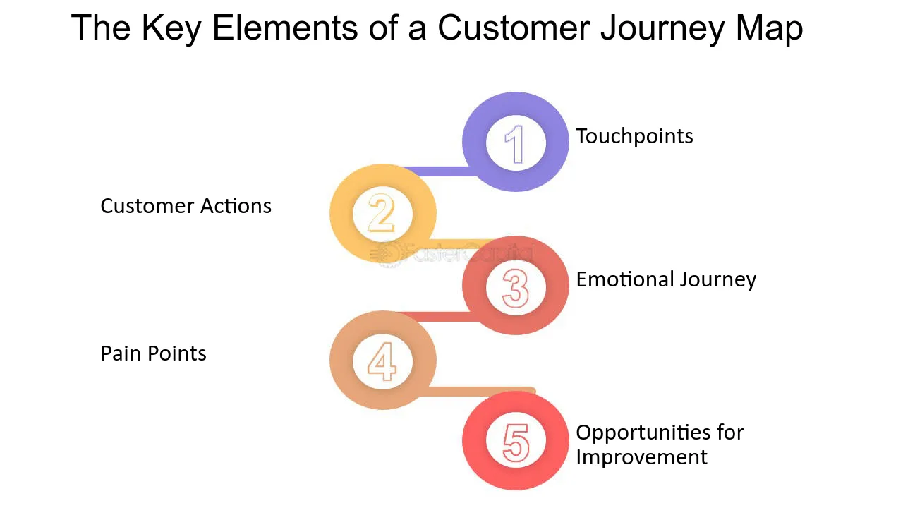

Slide 4
Elements of Customer Journey Mapping
Customer Persona
Phases
Touchpoints
Actions
Emotions and Pain points
Opportunities

Slide 5
1.Customer Persona
Definition: A semi-fictional representation of the target customer, based on market research and real data about existing customers
Purpose: To humanize and personalize the journey map, ensuring it reflects the needs, goals, and pain points of the customer segment being analyzed

Slide 6
2.Phases
Definition: The different phases a customer goes through from initial awareness to post-purchase behavior
Purpose: To break down the journey into manageable parts, allowing for a detailed analysis of each phase

Slide 7
Common Phases
Awareness: The customer becomes aware of a need or problem.
Consideration: The customer researches and evaluates options.
Purchase: The customer decides to purchase a product or service.
Post-Purchase: The customer uses the product/service and forms opinions.
Loyalty/Retention: The customer decides whether to continue with the brand.

Slide 8
3.Touchpoints
Definition: The specific interactions or points of contact between the customer and the brand throughout the journey.
Examples: Website visits, social media interactions, customer service calls, in-store visits.
Purpose: To identify where the brand interacts with the customer and assess the effectiveness of these interactions.

Slide 9
4. Action
Definition: The specific actions or steps taken by the customer at each stage of their journey.
Examples: Searching for information online, comparing products, making a purchase, leaving a review.
Purpose: To understand what customers are doing at each stage and how these actions impact their overall experience.

Slide 10
5. Emotions & Pain points
Definition: The feelings and challenges experienced by the customer during their journey.
Purpose: To identify moments of frustration, confusion, or delight that influence customer satisfaction and decision-making.

Slide 11
6. Opportunities
Definition: Areas identified for improvement or innovation within the customer journey.
Purpose: To highlight gaps in the experience and propose ways to enhance customer satisfaction and loyalty.

Slide 12
Case Study
Starbucks Mobile App – Enhancing Customer Experience through Journey Mapping
Background
Starbucks, a global coffee chain, sought to enhance its customer experience by focusing on mobile engagement. The company introduced the Starbucks Mobile App to streamline the customer journey, increase convenience, and drive customer loyalty.

Slide 13
Objective
Starbucks aimed to improve the customer experience by understanding the journey from their perspective. The goal was to reduce friction in ordering, enhance loyalty, and personalize interactions through mobile engagement.

Slide 14
Step 1
Define Buyer Persona
Name: Sarah, 30 years old
Occupation: Digital Marketing Manager
Goals: Grab her morning coffee quickly without waiting in line, earn rewards for frequent purchases, and discover new seasonal drinks.
Challenges: Busy schedule, hates waiting in lines, and prefers digital solutions for ordering.

Slide 15
Step 2
List Customer Touchpoints
Awareness: Sarah becomes aware of the app via in-store posters and a promotion offering bonus stars for signing up.
Consideration: She visits the Starbucks website and app store to learn about the app, reads reviews, and downloads it.
Purchase: Sarah orders her daily coffee via the mobile app, customizes it, and pays digitally. She also earns rewards (Stars) for her purchase.
Post-Purchase: After her purchase, Sarah gets notifications about her accumulated stars, promotional offers, and personalized recommendations based on her past orders.
Loyalty: She continues using the app, participating in promotions and collecting rewards, which encourages her to stay loyal to Starbucks.

Slide 16
Step 3
Identify Customer Actions
Awareness: Sarah sees promotions in-store and on social media encouraging her to download the Starbucks app.
Consideration: She researches the app by checking reviews and the benefits of using the mobile order feature.
Purchase: She orders her drink through the app, paying and collecting loyalty rewards, which is faster than ordering in person.
Post-Purchase: She gets a personalized email thanking her for her purchase, with information on how many stars she earned.
Loyalty: Over time, she earns free drinks through the loyalty program, and Starbucks uses push notifications to keep her engaged.

Slide 17
Step 4
Take Business Action
Action 1: Starbucks optimized mobile order timing by allowing stores to manage order flow during peak hours more efficiently.
Action 2: They improved payment reliability by partnering with payment gateways to streamline the checkout process.
Action 3: The app was updated to offer more personalized promotions and tailored push notifications based on customer preferences and previous orders.

Slide 18
Step 5
Results
Through this journey mapping process, Starbucks improved its customer experience, leading to significant results:
Increased Loyalty Program Engagement: A substantial number of users began using the app regularly, collecting stars and redeeming rewards, which encouraged repeat purchases.
Faster Transactions: The mobile app reduced wait times in stores, increasing customer satisfaction.
Increased Revenue: By streamlining the mobile ordering process and incentivizing frequent purchases through the rewards program, Starbucks saw a rise in both app usage and overall sales.

