Slide 1
DOUBLE DIAMOND

Slide 2
WHAT IS DOUBLE DIAMOND?
The Design Council introduced the Double Diamond in 2004
It presents a framework that allows companies to apply design characteristics to find creative solutions and innovative ideas.
It presents a framework that allows companies to apply design characteristics to find creative solutions and innovative ideas.

Slide 3
DOUBLE DIAMOND
In his approach, the design process can be divided into
Problem space.
Solution space.
Problem Space - What seems to be the problem?,what exactly is theProblem?
Solution Space - Build Prototypes,Mockups or Solutions,Deliver and Test.

Slide 4
PRE - PROCESS
The Double Diamond design process is a highly collaborative team practice .
The team members should represent different areas where they are relevant to the project.

Slide 5
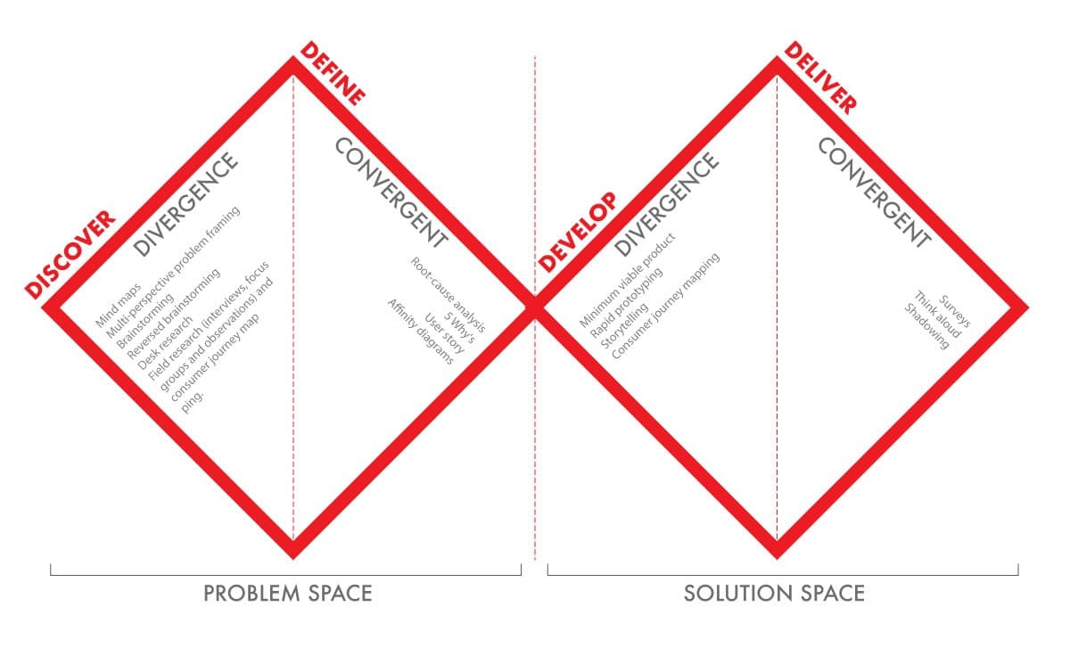
DOUBLE DIAMOND DESIGN PROCESS

Slide 6
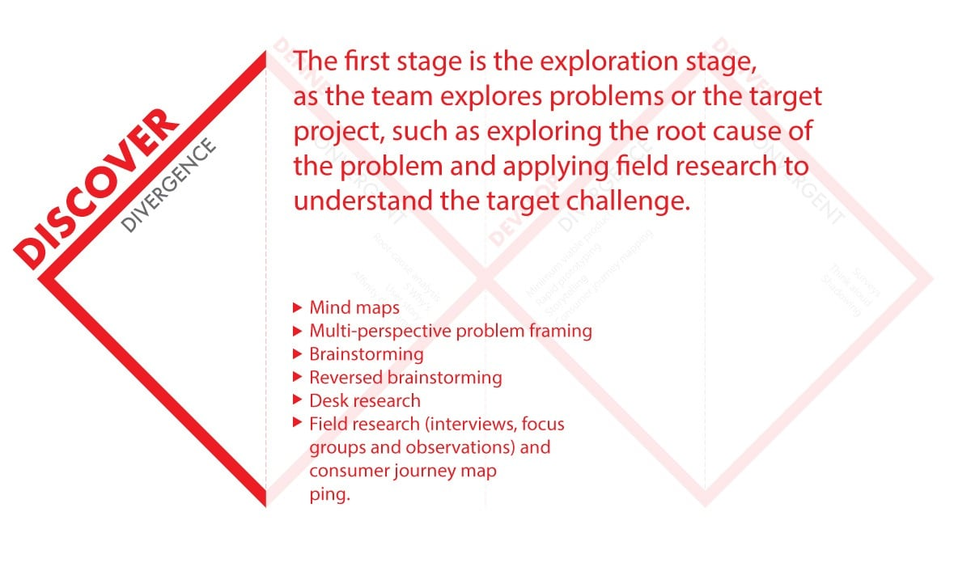
STEP1:DISCOVER
It is the exploration stage.
The target of this step is to examine and collect information about the design challenge.
The Discover step is divergent

Slide 7
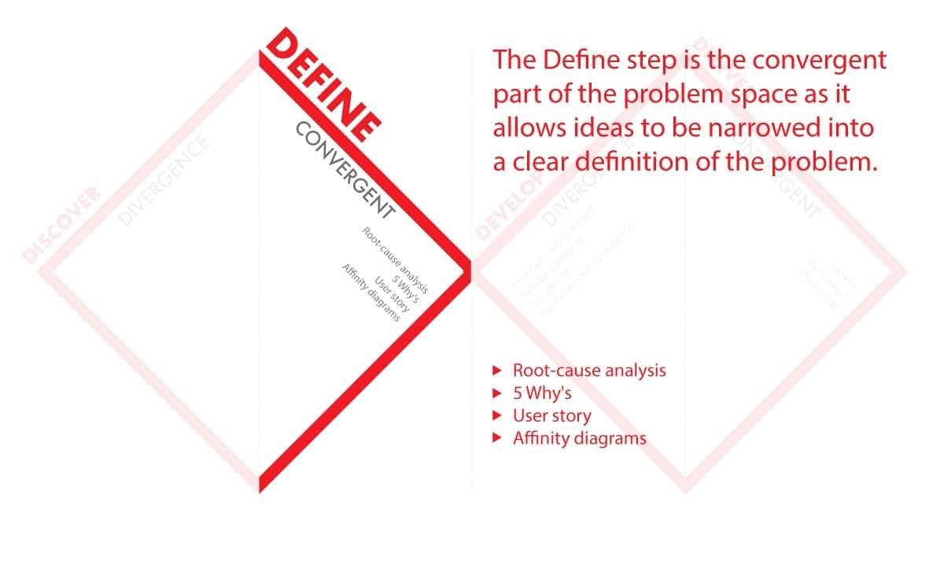
STEP2: DEFINE
This definition is the one that will lead the team into the following prototyping and testing steps.
The Define step is the convergent.
This convergent step involves analysing evidence and filtering ideas to reach a workable clear brief.

Slide 8
Tools
Root-cause analysis
5 Why
User story
Affinity diagrams

Slide 9
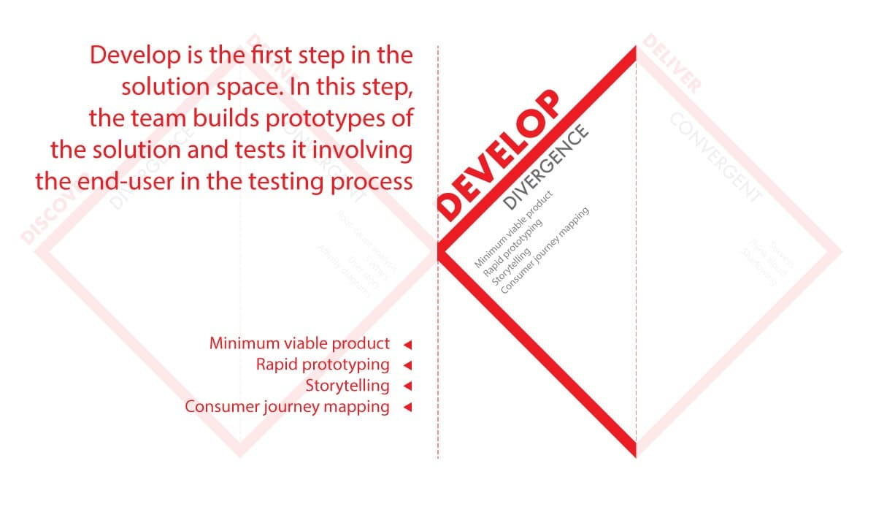
STEP3:DEVELOP
In this the team builds prototypes of the solution and tests it involving the end-user in the testing process through a divergent approach.
The team builds prototypes of the solution and tests it involving the end-user in the testing process through a divergent approach.
Tools are used in this process ,
Rapid prototyping
Storytelling
Consumer Journey Mapping

Slide 10
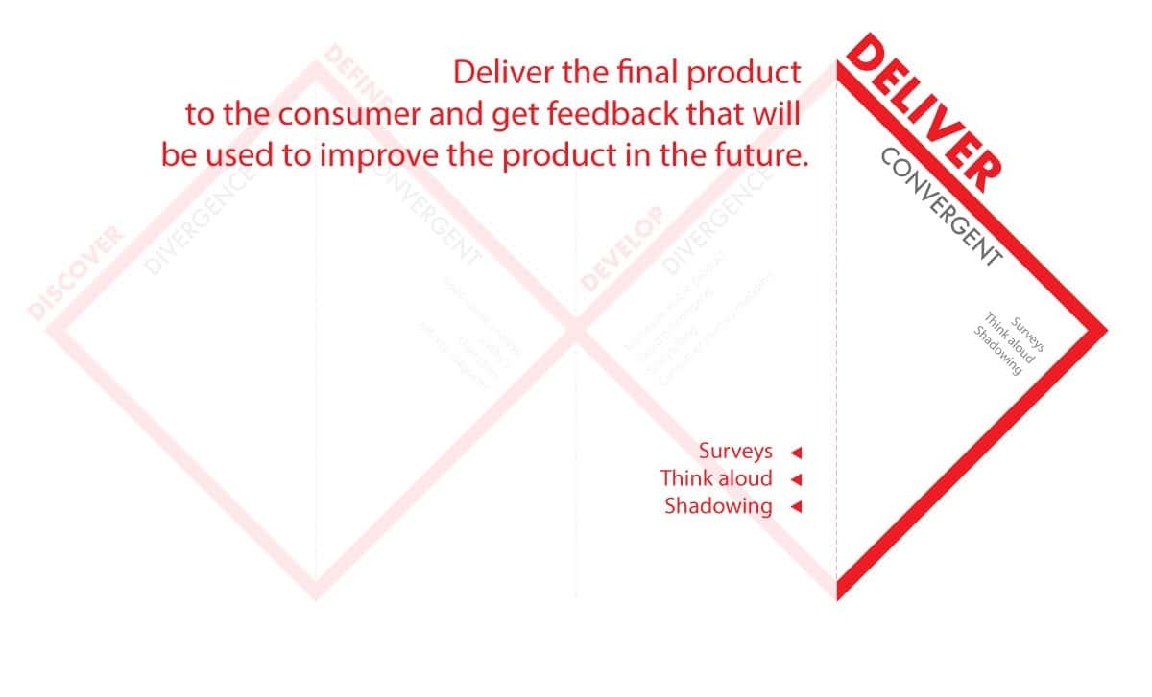
STEP4:DELIVER
Once the product is delivered, the team starts to collect user feedback and expertise evaluation.
Tools are used in this process ,
Surveys
Think Aloud
Shadowing

