Slide 1




PLANT DISEASE PREDICTION SYSTEM FOR SUSTAINABLE AGRICULTURE USING AI MODEL

Slide 2
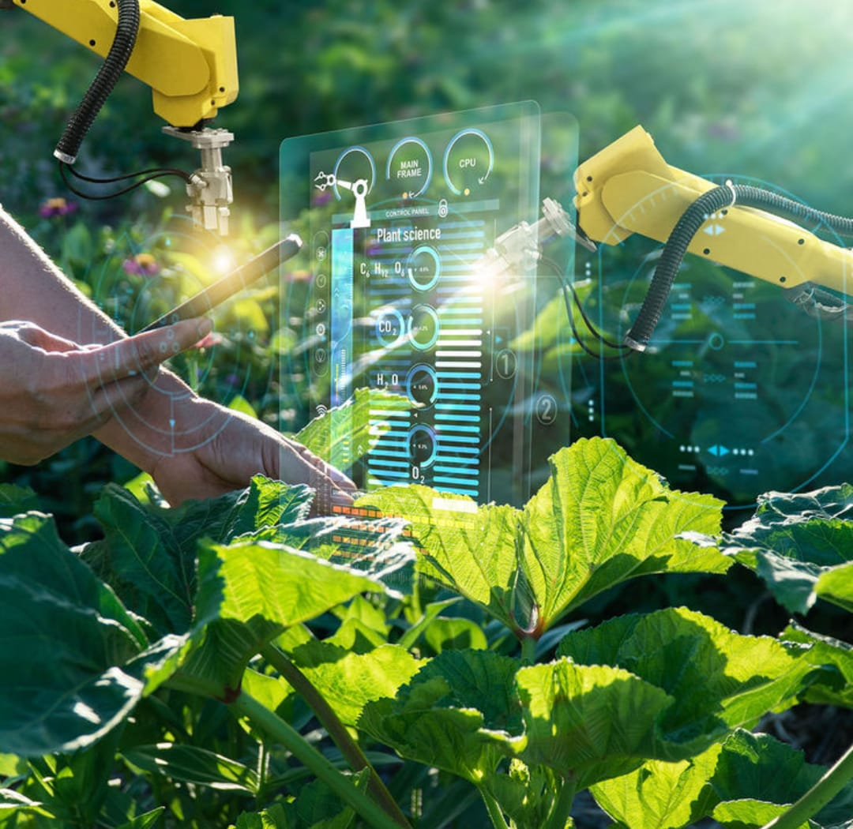
Learning Objectives
Plant diseases and pests can cause up to 40% of global crop production to be lost annually. This can lead to the following consequences :
Economic costs : Plant diseases cost the global economy around $220 billion each year.
Higher food prices : Reduced crop yields can lead to higher food prices for consumers.
Food shortages : Reduced crop yields can lead to food shortages.
One such example of such plant disease :
Cassava mosaic begomovirus : This virus causes an annual crop loss of 25 million tons.
In order to overcome these issues on a larger scale we can implement a better plant disease detection model rather than the existing models to achieve better outcomes.
Develop a user-friendly interface for uploading plant disease images and retrieving diagnosis results
Implement a system for data collection and annotation of plant disease images.
Integrate the plant disease prediction model with other agricultural systems or tools.
Develop a plan for deploying and maintaining the plant disease prediction model in real-world scenarios.
Source : www.Nifa.usda.gov

Slide 3

Tools and Technology used
# Front-end Development
Collab Visual Studio - Collaborative Coding Platform
Streamlit - Interactive App Builder
HTML/CSS/JavaScript - Web Development Essentials
# Back-end Development
Python - Open source programming Language
TensorFlow / Keras - Machine Learning Frameworks
NumPy / Pandas - Data Analysis Libraries
Seaborn - Data Visualization Tool
# Data Storage and Management
Google Drive - Cloud Storage Solution
Google Colab - Cloud Computing Platform
# Model Training and Deployment
Google Colab - Cloud Computing Platform
TensorFlow Serving - Model Deployment System
# Miscellaneous Tools
Jupyter Notebook - Interactive Coding Environment
Matplotlib / Seaborn - Data Visualization Libraries
GitHub - Version Control System

Slide 4
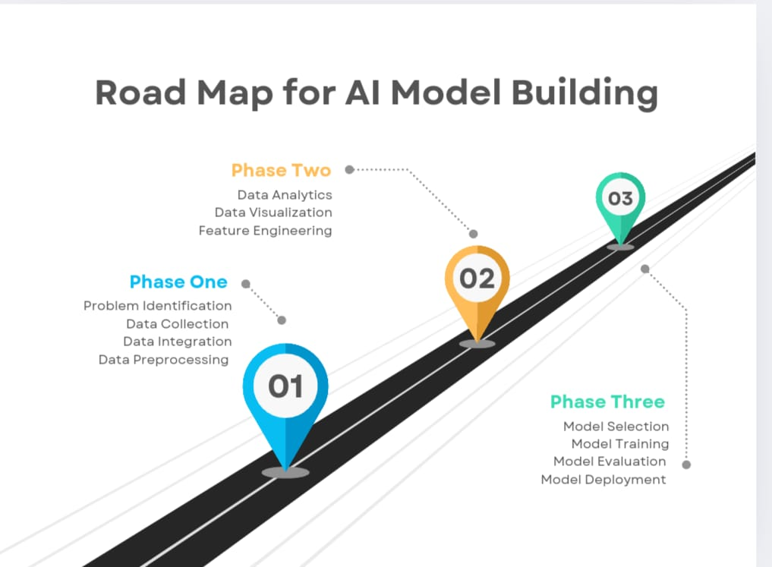
Methodology
Data Collection :
1. Collect a large dataset of plant disease images from various sources.
2. Ensure the dataset is diverse, representing different plant species, diseases and environmental conditions
2. Data Preprocessing :
1. Resize images to a uniform size.
2. Normalize pixel values to improve model performance.
3. Split the dataset into training, validation, and testing sets.
3. Model Development :
1. Design a CNN architecture suitable for plant disease classification.
2. Train the model using the training dataset.
3. Fine-tune hyperparameters to optimize model performance.
4. Model Evaluation :
1. Evaluate the model's performance using the testing dataset.
2. Calculate metrics such as accuracy, precision, recall and validation sets.
3. Compare the model's performance with existing models.
4.Implement the validation dataset

Slide 5

Problem Statement:
PROBLEM STATEMENT : Plant Disease Prediction System for Sustainable Agriculture using Artificial Intelligence Model
BACKGROUND : Agriculture is the backbone of many economies, providing food and livelihoods for 7 billions of people. However, plant diseases pose a significant threat to crop yields, food security, and the environment. Traditional methods of disease detection rely on manual inspection, which is time consuming, labour intensive and often inaccurate.
PROBLEM : The lack of efficient and accurate plant disease detection methods hinders sustainable agriculture practices which leads to :
Reduced crop yields and lower quality produce
Increased use of chemical pesticides and fungicides, harming the environment and human health
Economic losses for farmers and the agricultural industry as a whole
GOAL : Develop a plant disease prediction system using Artificial Intelligence (AI) and Machine Learning (ML) that can accurately detect and classify plant diseases from images, enabling sustainable agriculture practices
OBJECTIVES :
Collect and preprocess a large dataset of images of healthy and diseased plants
Develop and train an AI model using Google Colab and Visual Studio (VS) to classify plant diseases with high accuracy
Design a user-friendly interface for farmers and agricultural experts to upload images and receive disease diagnosis results
Evaluate the system's performance and provide insights for improvement

Slide 6
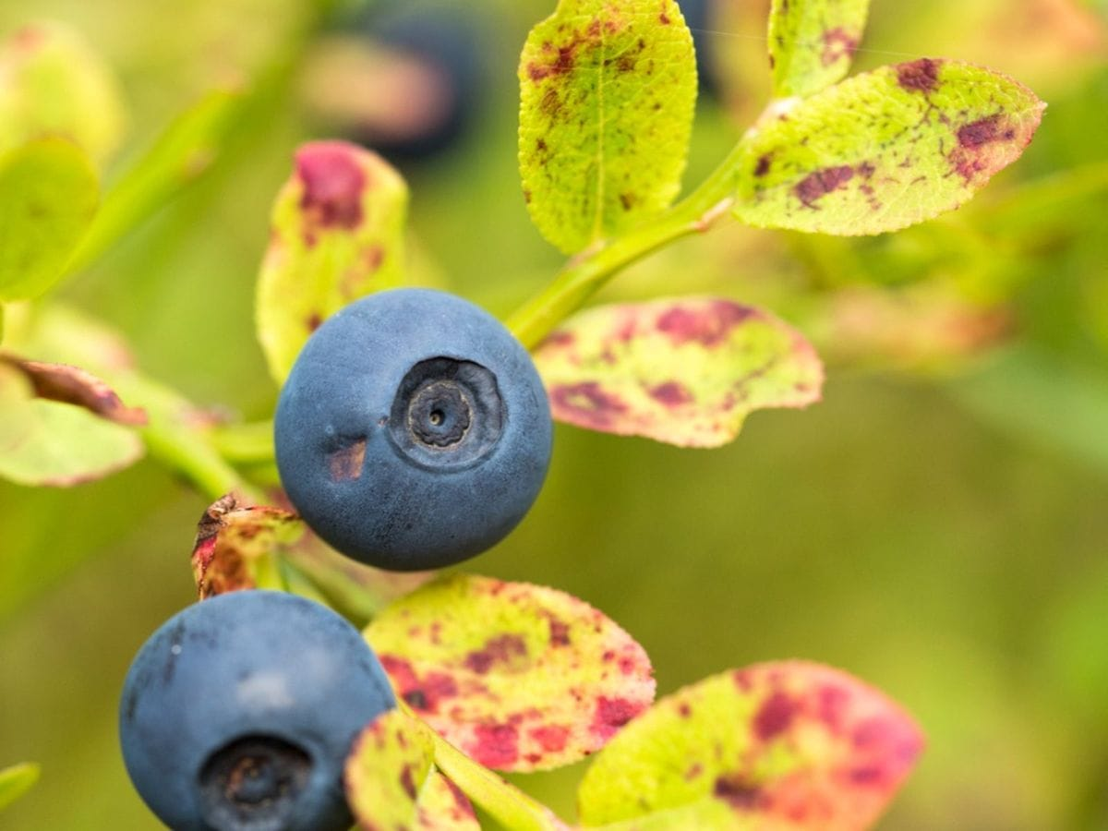
Solution:
COMPONENT
TECHNICAL
DETAILS
CNN Architecture : Use a pre-trained CNN architecture and hypertune it for plant disease classification. Dataset : Use a dataset of at least 1000 images of healthy and diseased plants, with at least 25-37 classes of diseases. Data Augmentation : Use techniques such as rotation, flipping, and color jittering to augment the dataset and improve model generalization. Model Evaluation : Evaluate the model performance using metrics such as accuracy, precision, recall, and testing set. Model Optimization : Optimize the models hyperparameters using techniques such as grid search, random search or Bayesian optimization.
TOOLS AND TECHNOLOGY
1. Google Colab : Use Google Colab for model development, training, and testing. 2. TensorFlow : Use TensorFlow as the deep learning framework for model development. 3. Keras : Use Keras as the high-level API for building and training the CNN model. 4. Visual Studio : Use Visual Studio (VS) for developing the user interface.
Data Collection : Collect a large dataset of images of healthy and diseased plants from various sources. Data Preprocessing : Preprocess the images by resizing, normalizing, and augmenting the data. Model Development : Develop a CNN model using TensorFlow and Keras to classify plant diseases. Model Training : Train the model on the preprocessed dataset using Google Colab. Model Deployment : Deploy the trained model using TensorFlow Serving and build UI inference. User Interface : Develop a user-friendly interface using Visual Studio (VS) for users to upload images and receive disease diagnosis results

Slide 7
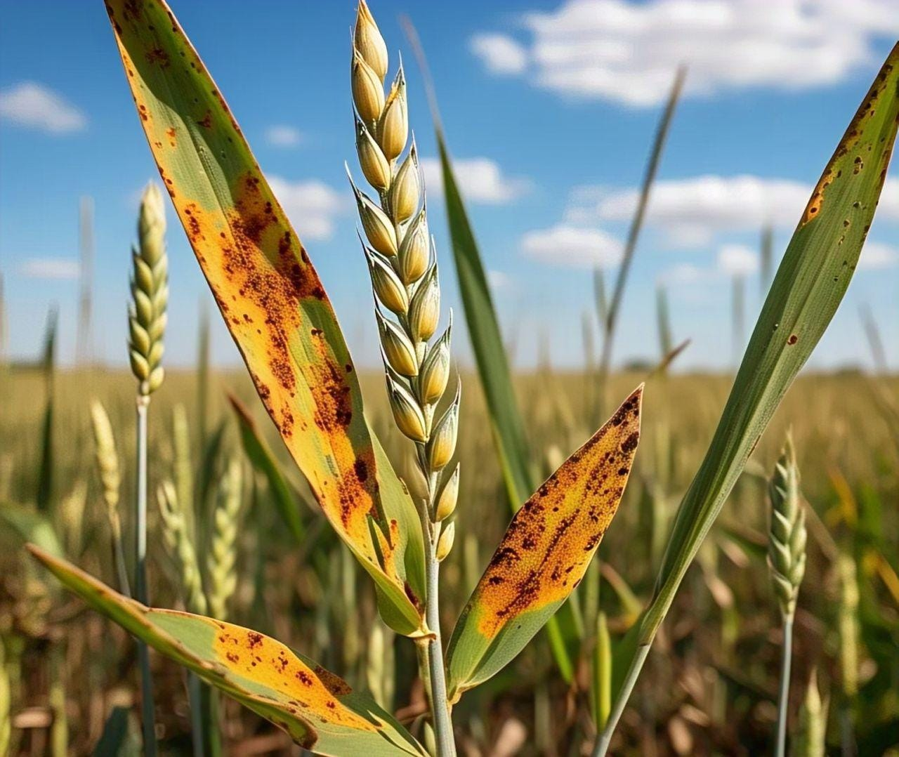
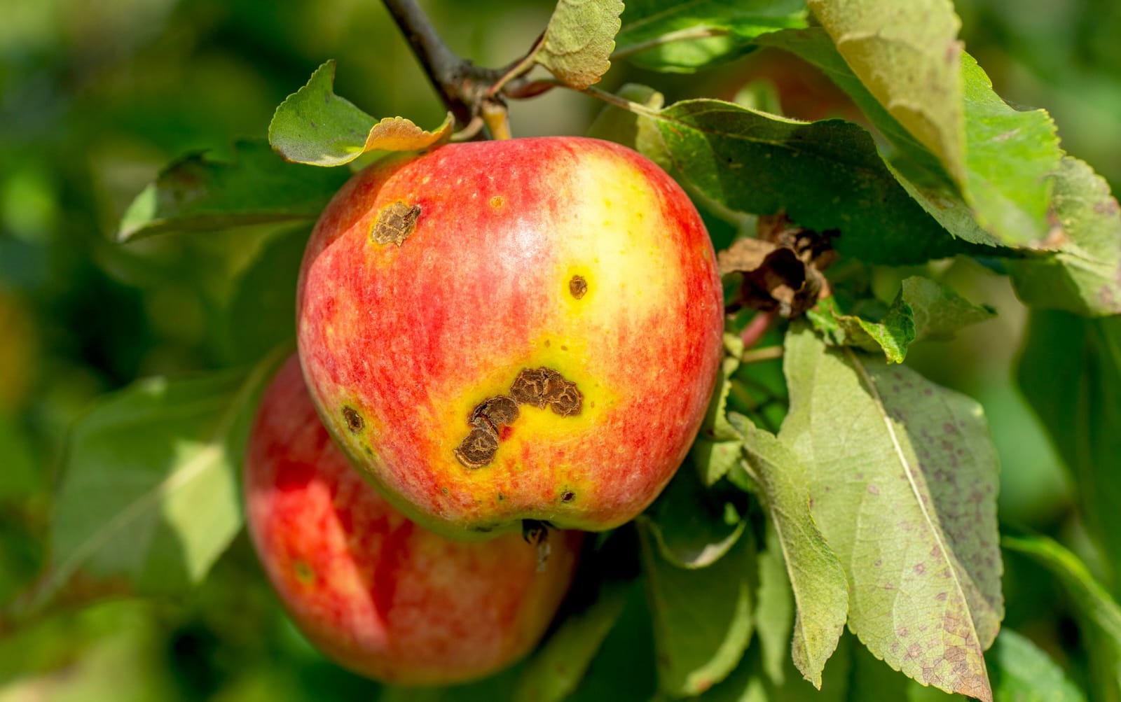
Conclusion:
OVERVIEW : The Plant Disease Prediction System using a Convolutional Neural Network (CNN) model for image classification has demonstrated extreme potential in revolutionizing the agricultural industry. By utilizing the concept of deep learning techniques and a large dataset of images, the system has achieved remarkable accuracy in detecting and classifying plant diseases.
ACHIEVEMENTS :
Improved Accuracy : The CNN model has attained high accuracy in detecting and classifying and outperforming traditional methods.
Increased Efficiency : The system automates the disease detection process, reducing the need for manual inspection and saving time for farmers and agricultural experts.
Enhanced Decision-Making : The system provides farmers and agricultural experts with accurate and reliable information to make informed decisions about crop management and disease control.
IMPACTS AND BENEFITS :
Boosted Crop Yields : By enabling early detection and treatment of plant diseases, the system can help increase crop yields and reduce economic losses for farmers.
Reduced Chemical Use : The system's ability to accurately detect plant diseases can help reduce the unnecessary use of chemical pesticides and fungicides, promoting sustainable agriculture practices.
Improved Food Security : By enhancing crop yields and reducing disease-related losses, the system can contribute to improved food security

