Slide 1
Fundamentals of Transportation and logistics

Slide 2
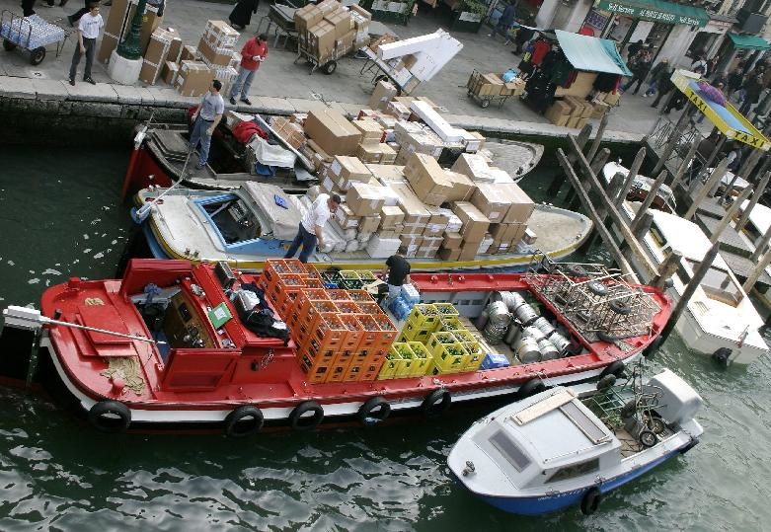
Transportation
Goods are transported through various modes like – Trucks, rail, air, package carriers, water, pipeline
Selection of modes of transport based on
Product options
Delivery speed
Accessibility
Cost
Intermodal transport

Slide 3
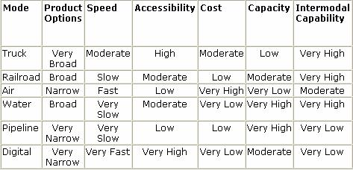
Comparison of Transportation Modes
Transportation modes are selected based on following parameters. While cost remains as most important element, product requirement, market demand and strategic positioning governs control over network and subsequent mode selection.
3
Notes:
3
3

Slide 4
Transportation Network Model – Direct Shipment network
Direct shipment network
All shipments are made from each supplier to each buyer
Decisions to be made includes quantity to be shipped and mode of transport
Transportation time is minimum due to absence of any mediator
Suppliers
Buyers

Slide 5
Transportation Network Model – Milk run
Milk-run is described as a concept that is a sequential collection of goods from multiple sources and the direct service to the customers without intermediate handling features of the goods.[As a prerequisite for the Milk-Run approach is the spatial proximity between the supplier and the customer
Direct shipment with Milk Run
Milk run from single supplier to multiple buyers
Milk run from multiple suppliers to single buyer
Suppliers
Buyers
Suppliers
Buyers

Slide 6
Transportation Network Model -DC
All shipments via central distribution center (DC)
Suppliers send their shipment via DC
DC serve as a transfer location and inventory storage point
Economies of scale can be achieved as single DC is serving all suppliers
Distribution Center
Suppliers
Buyers

Slide 7
Transportation Network Model – DC + Cross docking
All shipments via central DC with cross-docking
Each inbound truck at DC contains product from a supplier for several buyers
No storage at DC, breaking inbound shipment lot into smaller shipments
Each outbound truck contains product for a buyer location from various suppliers
No stock!
Customer Order
Receipt
Despatch
DC
Notes:
7

Slide 8
Transportation Network Model – DC + Milk run
Shipment via DC using milk run
Milk run can be used from DC when lot sizes to be delivered to each buyer location are small
Reduction of outbound transportation cost by consolidating the shipments
Distribution Center
Suppliers
Buyers

Slide 9
Comparison of Various Models
Network Structure | Pros | Cons
Direct Shipping | No intermediate warehouse, simple to coordinate | High inventories (due to large lot size)
Direct shipping with milk run | Lower transportation cost, lower inventories | Increased coordination complexity
All shipments via central DC | Lower inbound transportation cost through consolidation | Increased handling at DC
All shipments via central DC( cross dock) | Very low inventory requirement, lower transportation cost through consolidation | Increased coordination complexity
Shipping via DC using milk run | Lower outbound transportation cost | Further increased coordination complexity

Slide 10
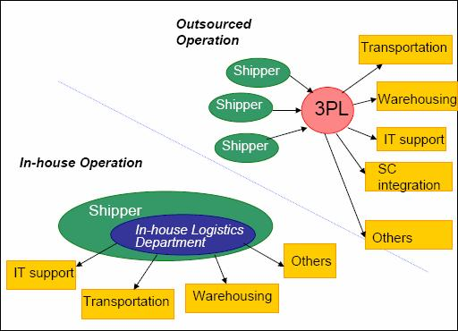
Third Party Logistics (3PL)
Third party logistics (3PL) is a firm to whom one or more logistics activities are outsourced. It owns logistics assets itself and focuses on areas like transportation, warehousing and IT within supply chain.
Advantages:
Outsourcing helps organizations to focus on their core competency
Cost competitiveness
Use of Specialized logistics solutions
Disadvantages:
Loss of firms control over logistics activities
Risk of information sharing
Organization ‘distanced’ from customer

Slide 11
3PL Services
Service Category | Services Provided
Transportation | Inbound, outbound operations by ship, truck, rail and air, tendering, mode conversion, freight pay
Warehousing | Cross dock, in-transit merge, pick/pack, knitting, labeling, order fulfillment,
Information Technology | TMS, WMS, Network modeling and site selection, freight management, EDI, worldwide track and trace using GPS
Reverse Logistics | Recycling, used assets disposition, repair/ refurbish

Slide 12
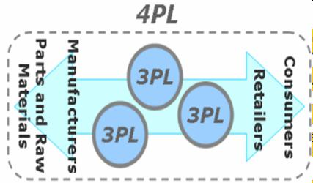
Fourth Party Logistics (4PL)
Concept developed by Anderson consulting
A 4PL integrates resources of producers, retailers and 3PL logistics providers in view to build a system-wide improvement in supply chain management
3PL targets a function, 4PL targets complete solution/ management of logistics process.
4PL is a non–asset based firm i.e. they only provide organization expertise without owning any asset

Slide 13

Reverse Logistics
Reverse Logistics is process of planning, implementing, and controlling efficient, cost effective flow of raw materials, in-process inventory, finished goods and related information from point of consumption till point of origin for purpose of recapturing value or proper disposal.
Some areas of application
Publication house
Beverage industry
Heavy industries
Pharmaceutical industries
Automobile industries
Importance of reverse logistics
Asset utilization
Asset recovery
Profit maximization
Fulfillment of environment obligations
13
Notes:
13
13

