Slide 1
Fundamentals of Warehousing

Slide 2
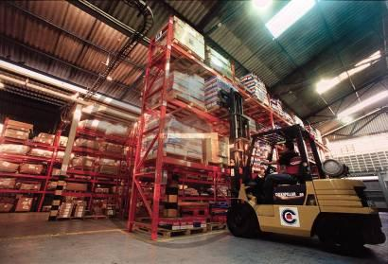
Warehousing
A warehouse is a commercial building used to store goods, by manufactures, importers, exporters, wholesalers, transport business and customs
Types of warehouses:
Private – owned for personal or group storage e.g. retail chain
Public – leased on short-term in part or full
Automated – advanced storage and retrieval system and automated guided vehicles
Climate-controlled – suitable for perishable items such as milk, vegetables, fish
Distribution center – used for very short duration like transit across routes
Notes:
2

Slide 3

Warehousing Activities
Major warehouse activities are:
Receiving
Put-away
Order allocation
Order-reallocation
Kitting and packaging
Order waving
Picking
Packing
Shipping
Cycle-count
Inventory control
Inbound
Outbound
Receiving
Put-away
Storage
Picking
Loading/ Shipping
Notes:
3
3

Slide 4
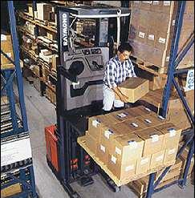
Order Picking
Process of finding and removing stock from the storage location. It is the most costly activity involved and accounts for 50% of cost involved in managing a warehouse.
Types of picking activities:
Single order picking – each order picker completes one order only at a time
Batch picking – multiple orders are picked up at a time
Zone picking – entire area is divided in multiple zones, and a dedicated order picker picks line items only from his/ her assigned zone
Wave picking – a combination of batch and zone picking, where all zones are picked up simultaneously, and items are later sorted into individual orders/ shipments
Notes:
4
4

Slide 5
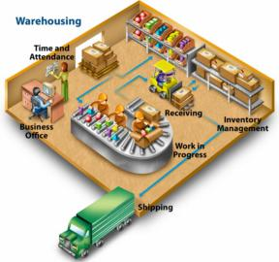
Warehouse Management System (WMS)
Warehouse management systems (WMS) use advanced technology to optimize major warehousing functions. These functions typically begin with receipts from suppliers and end with shipments to customers, and include all inventory movements and information flows in between.
Some functionalities possessed by a WMS
Receiving and Shipping
Appointment Scheduling
Stock locater system
RF directed Operation
Packing and consolidation
Notes:
5

Slide 6

How WMS helps in bringing efficiency in logistics?
Through transparency of Records
How much inventory exists in warehouse
How many orders are currently being shipped
Goods shipped by warehouse over a period of time
Access to pending order details
Through better Management of resources
Faster inventory turns
More efficient use of available warehouse space
Reduction in inventory paperwork
Improved cycle counting
Enhanced customer service
Improved labor productivity
Notes:
6

