Slide 1
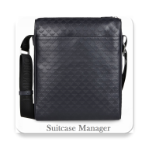
Suitcase Manager Travel Plan Made Easy!!
Guided By – Dr. Elizabeth Diaz
Akshay Sarkar – akshay.sarkar@mavs.uta.edu
Jeyanth Chandru – jeyanth.chandru@mavs.uta.edu
Karuna Sathyanarayana – karunap.sathyanarayana@mavs.uta.edu

Slide 2
The Problem
Are you worried about loss of your bags or items inside while you are travelling by Air?
Do you feel its difficult to track the number of bags you are carrying on a family trip?
Is it difficult for you to remember which of your stuff is in which bag?

Slide 3
Suitcase Manager
App helps in travel plan well-in-advance.
It let you manage your upcoming trips, bags inventory and individual items with minimum effort.
Helps you in situation of bag misplacement as it captures images of the bag.
Generate QR-Code for Item list.
Quick Access to Airline Information.

Slide 4
Suitcase Manager
Secure authentication, with the Google Sign In.
Bag Images are captured and tagged with location.
In situation of a lost bag or a misplaced item the above details could be really handy in proving to the Airline Authorities with the relevant information.
Claims are made easy.

Slide 5
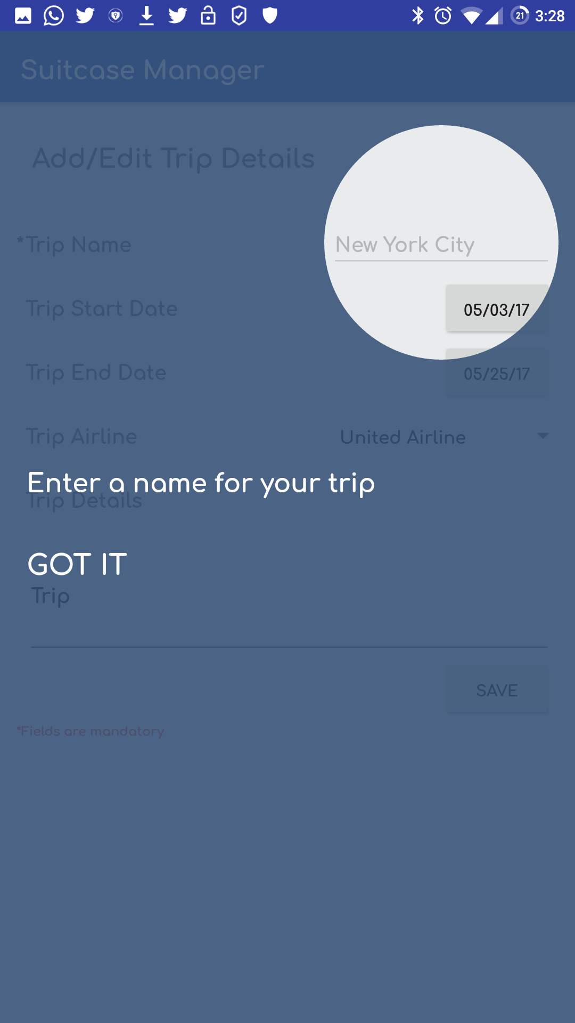
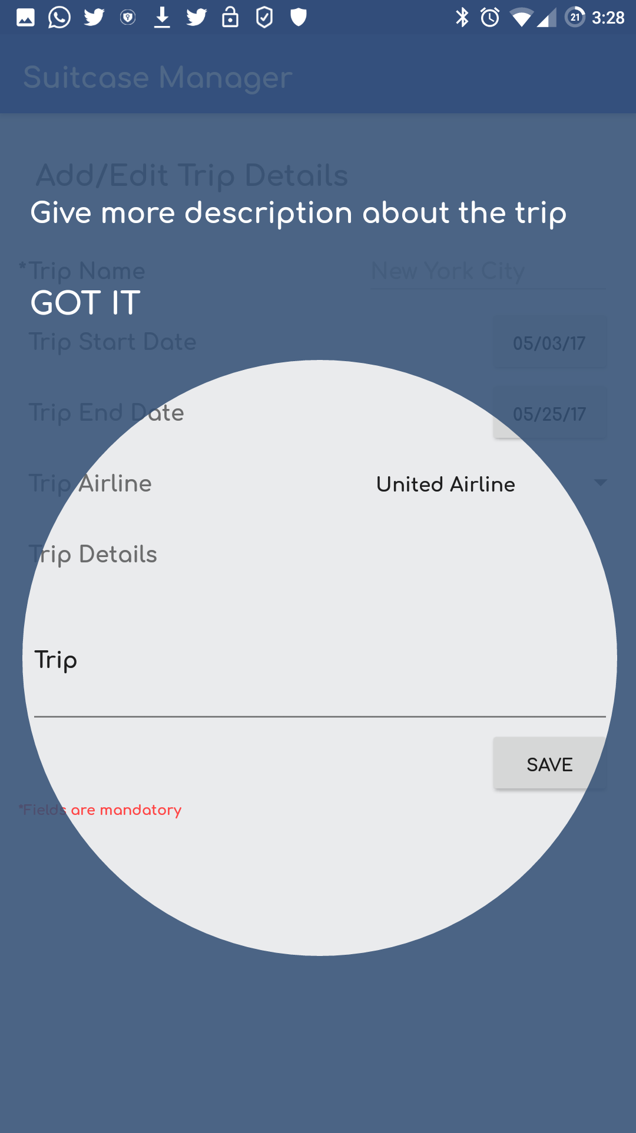
Tutorial Page

Slide 6
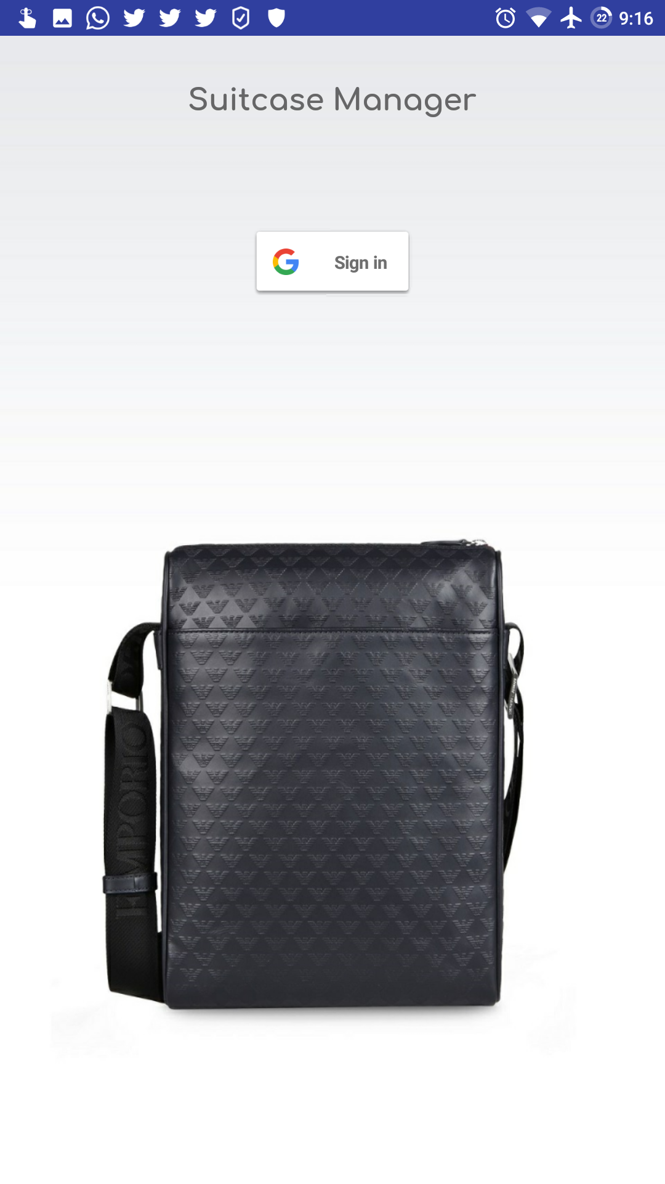
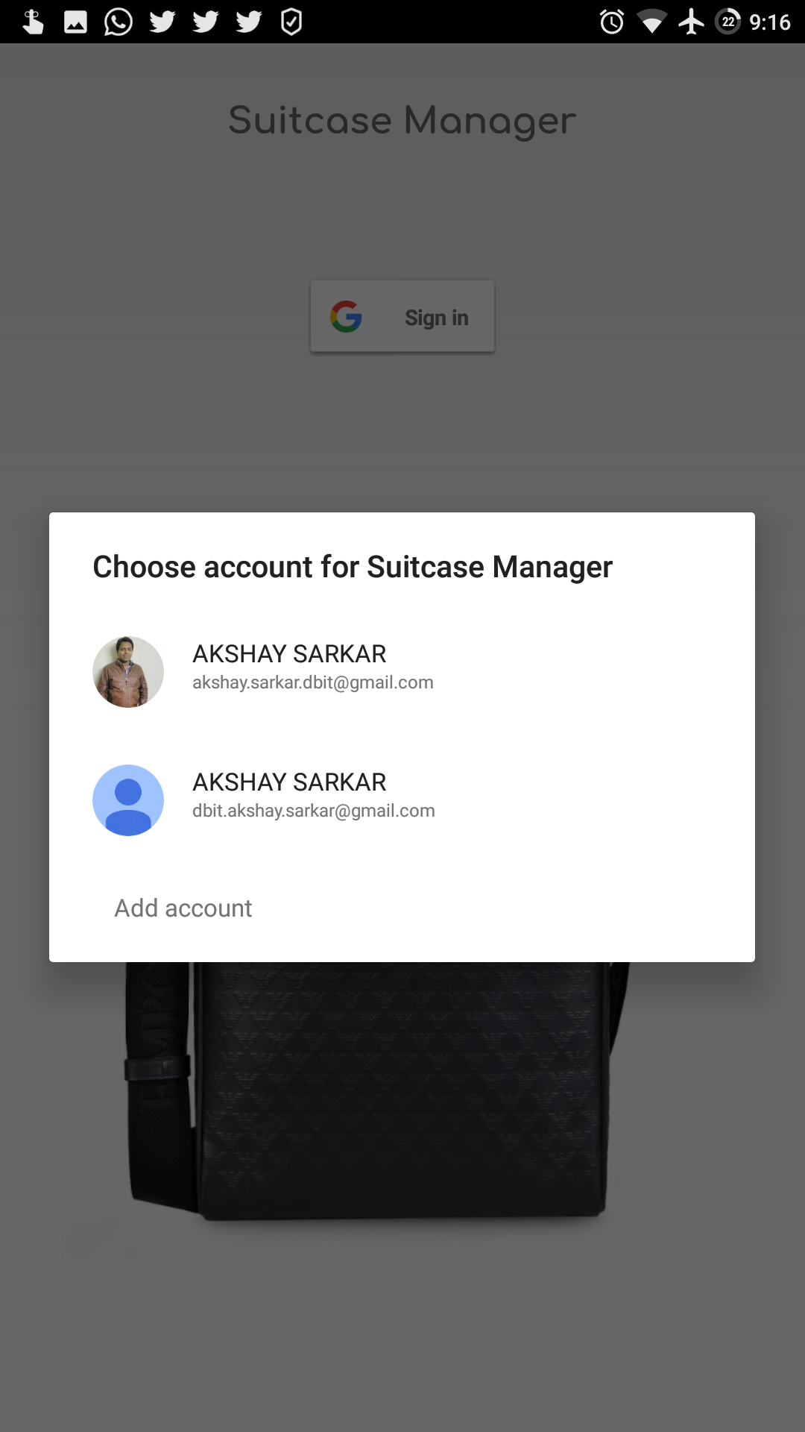
Login Screen

Slide 7
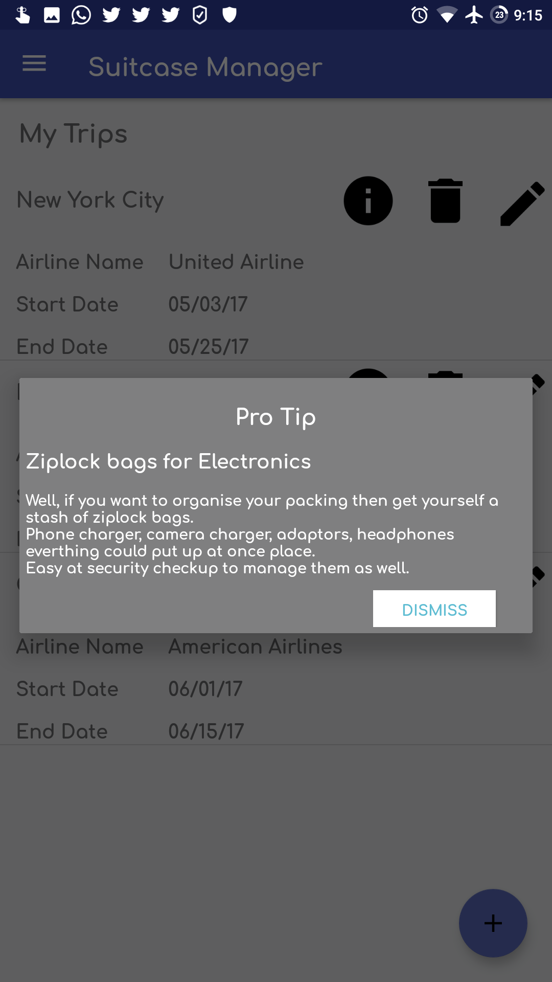
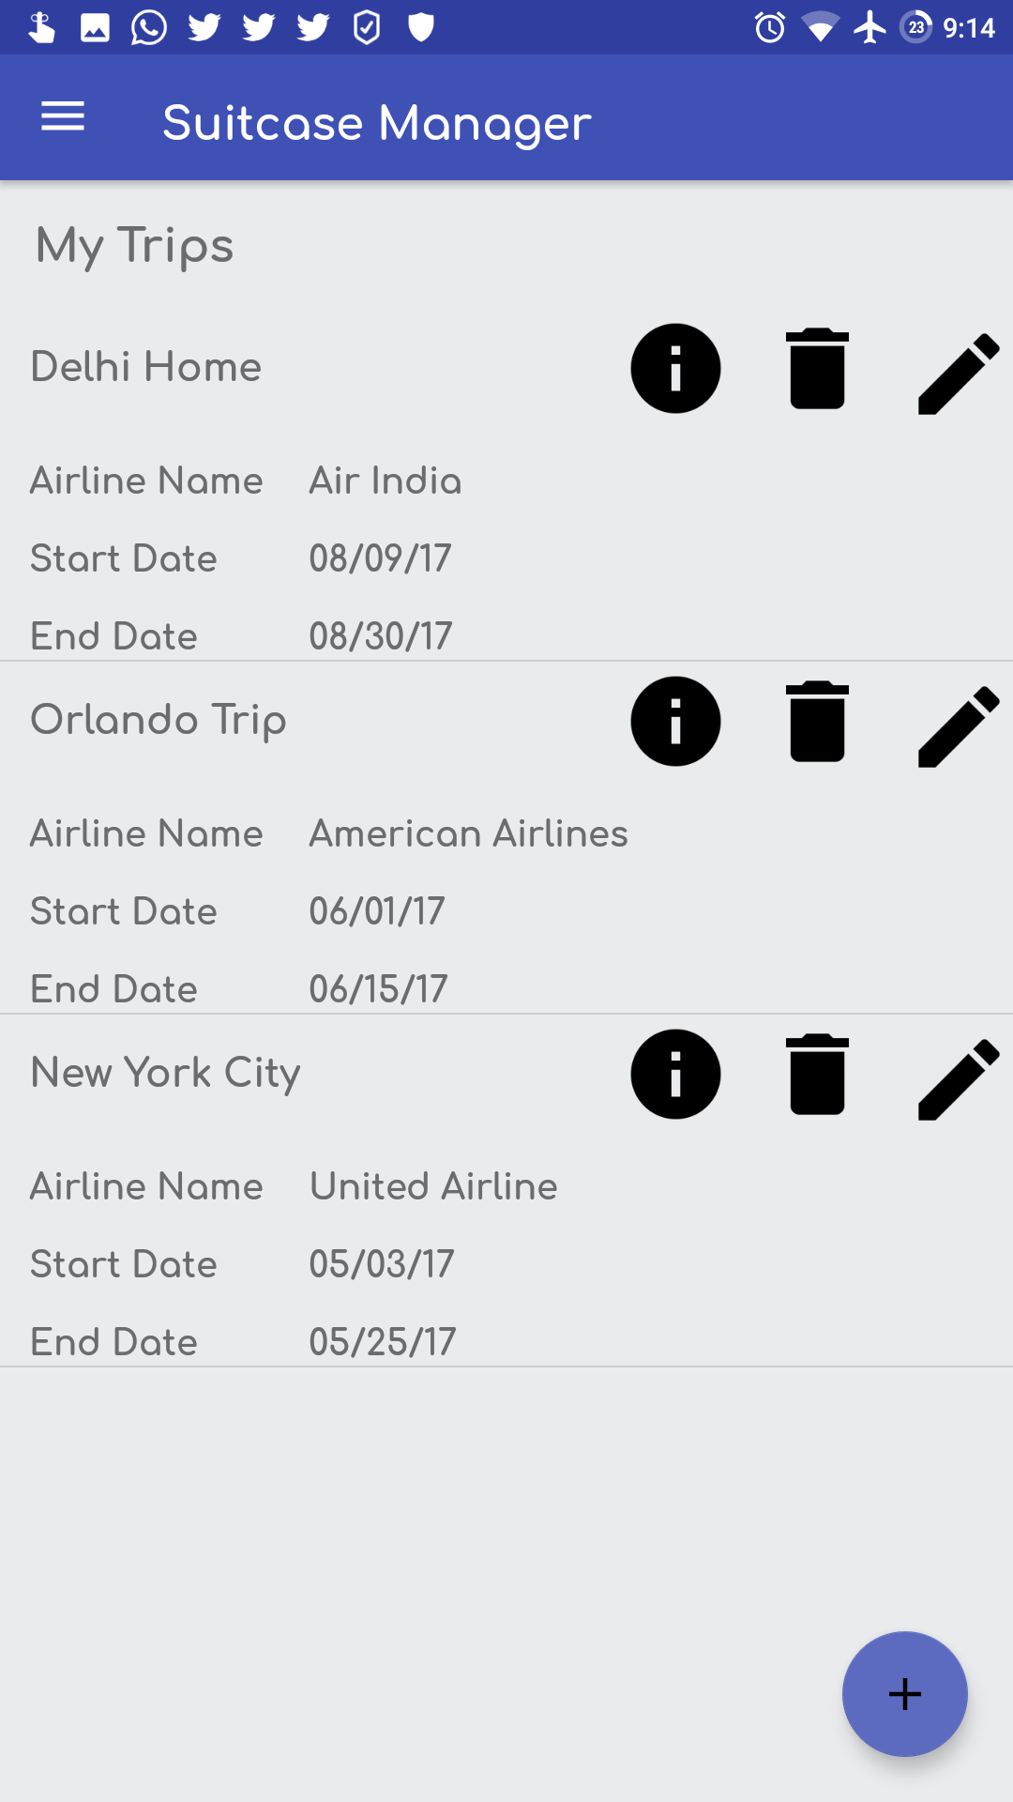
Tip Dialog, Trip Summary

Slide 8
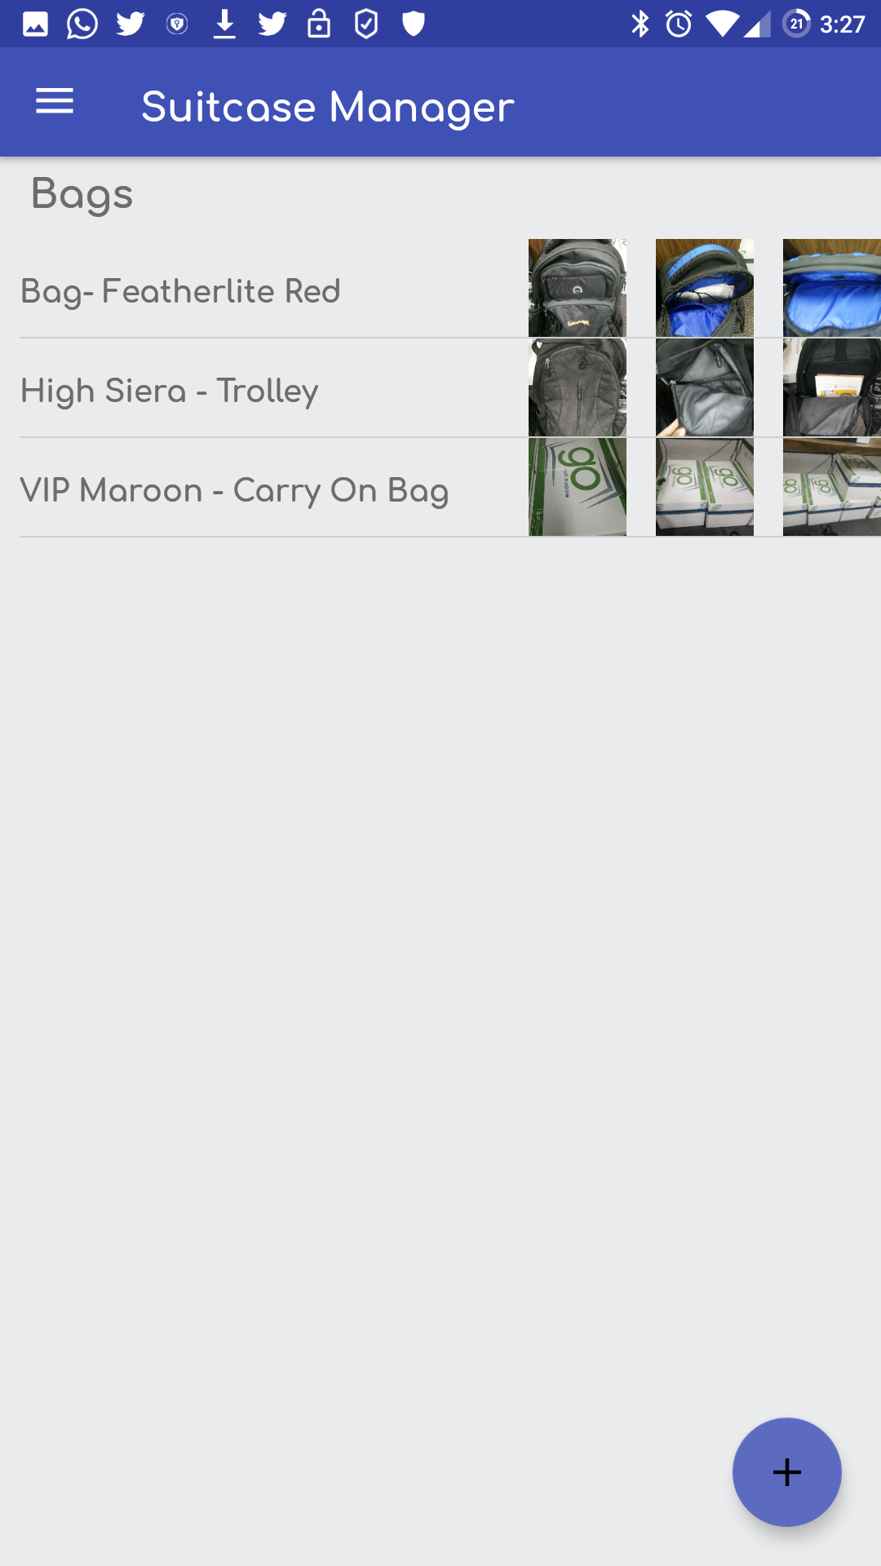
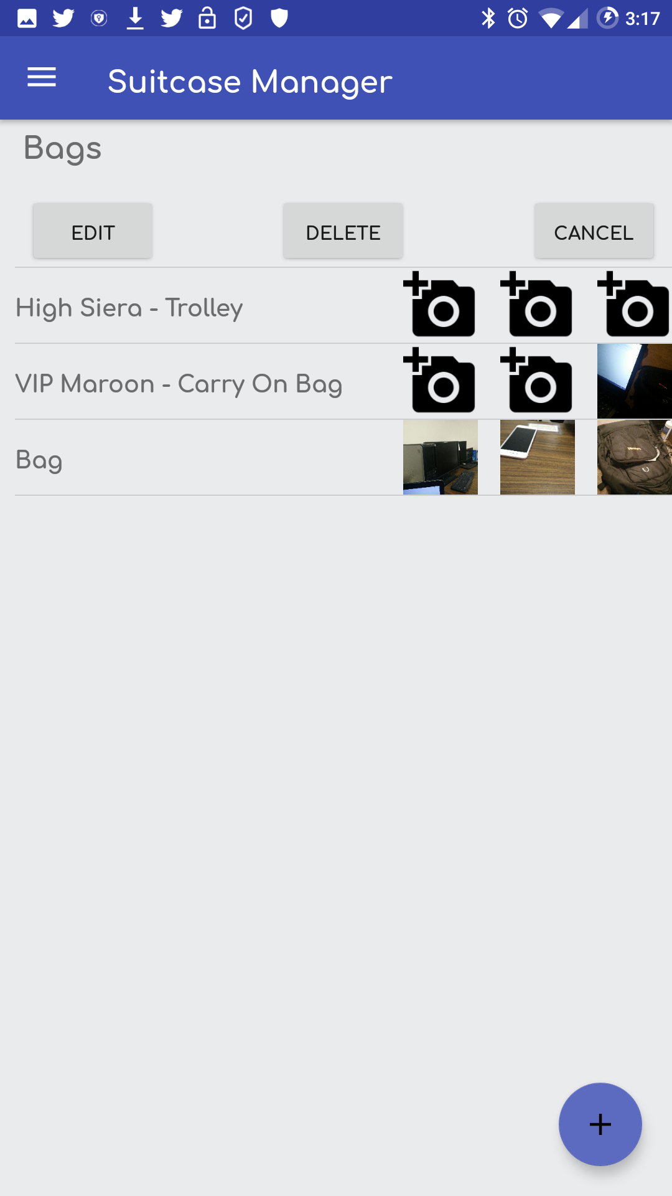
Bags Page, Bag Edit

Slide 9
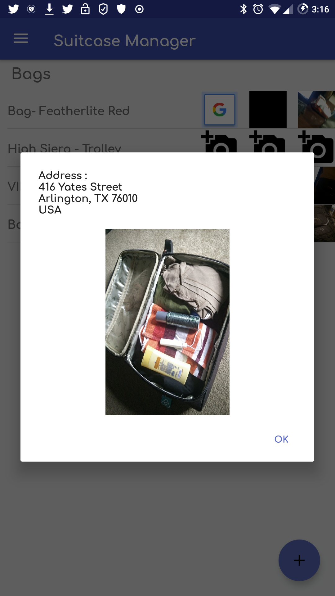
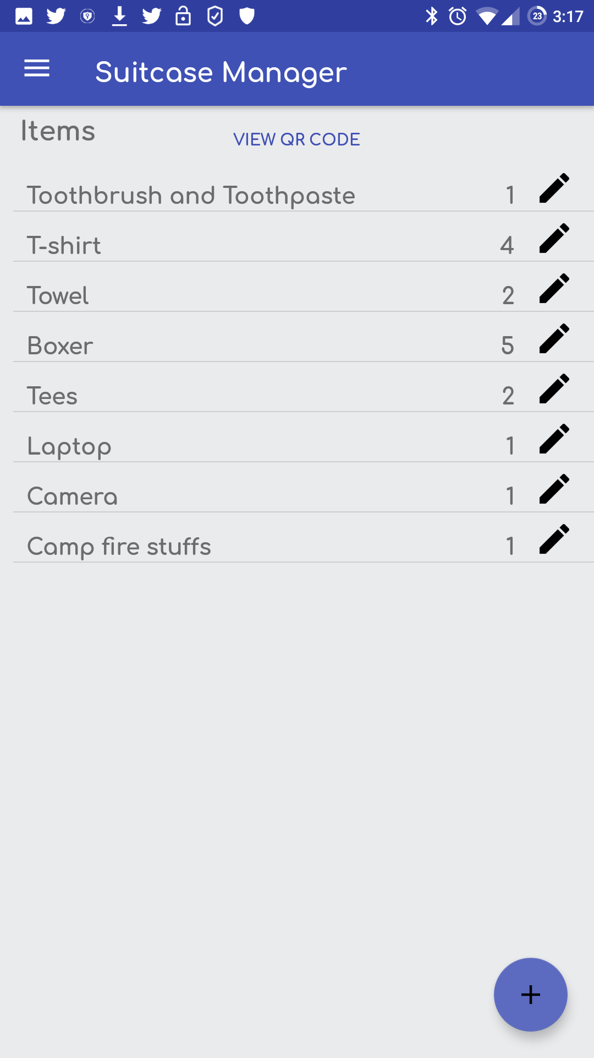
Bag Image with Address, Items Page

Slide 10
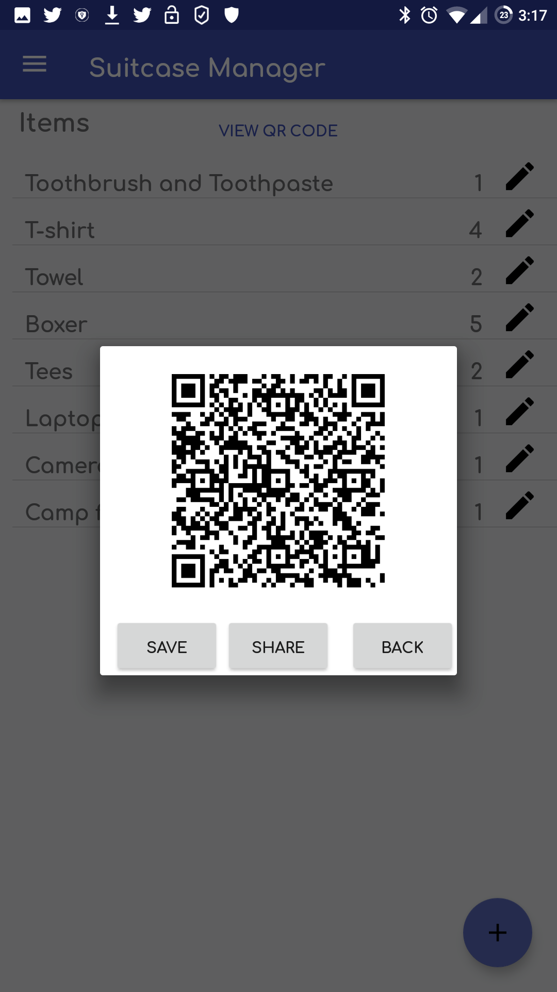
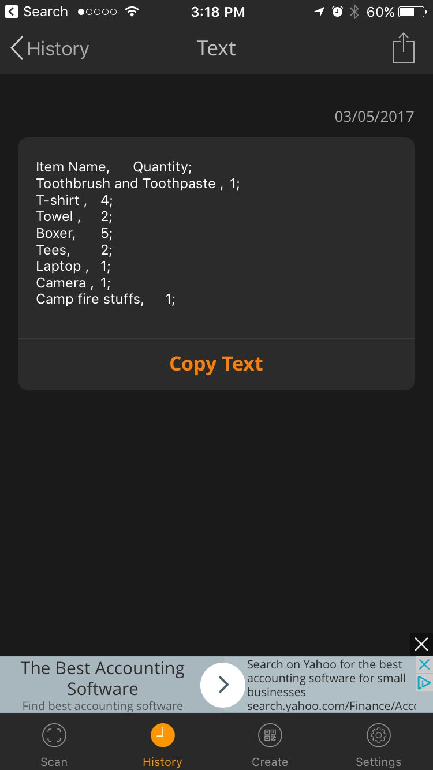
QR Code

Slide 11
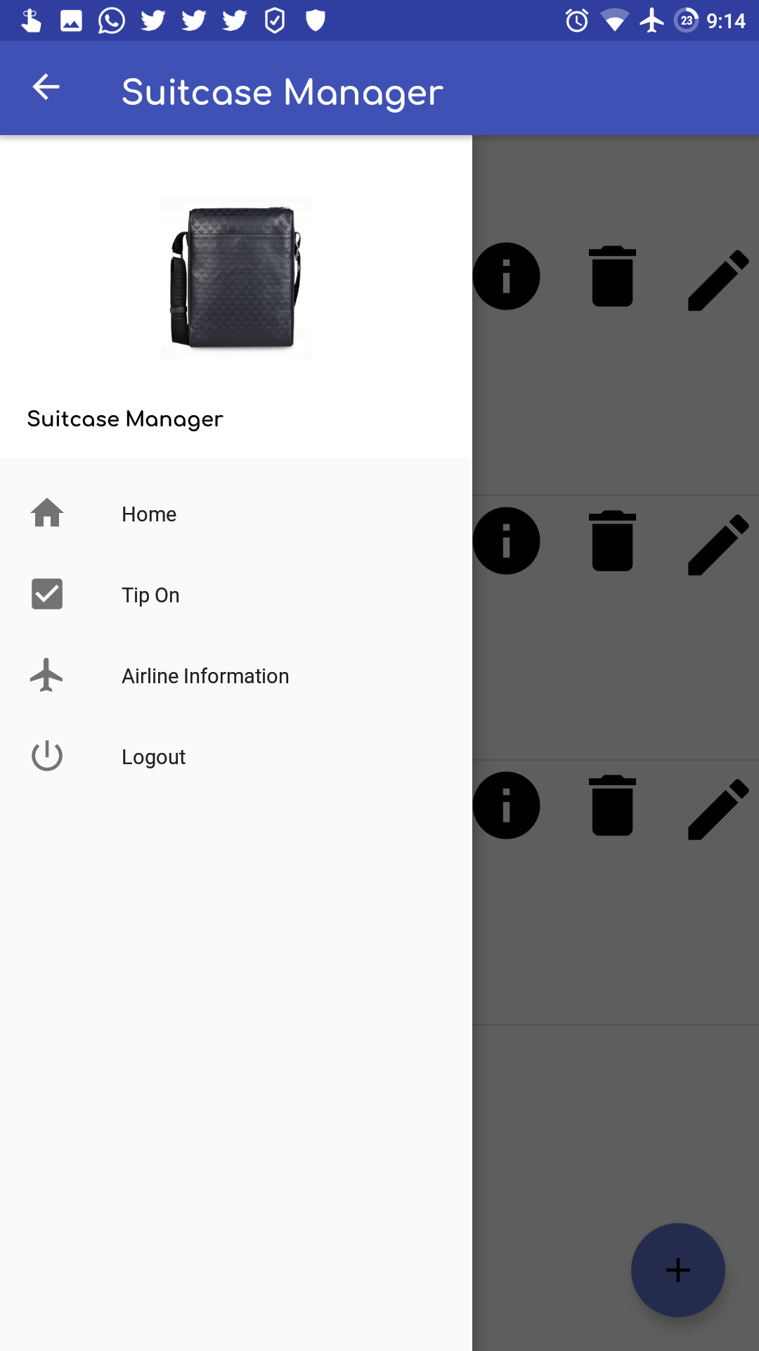
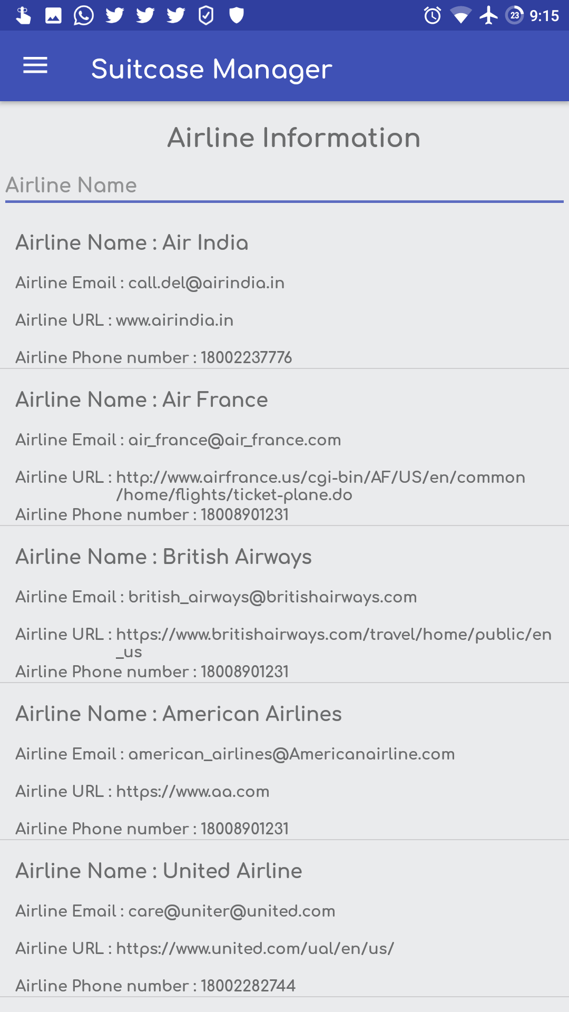
Menu, Airline Information

Slide 12
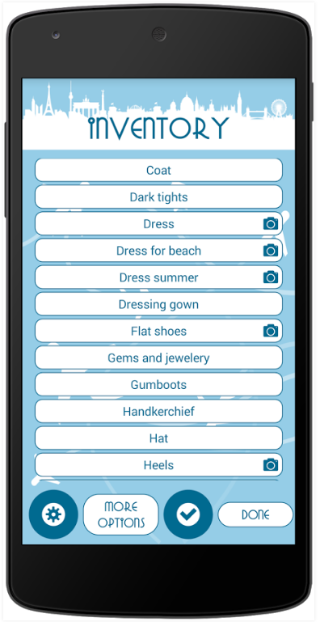
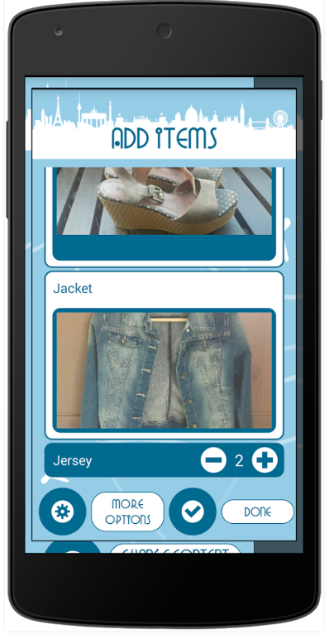
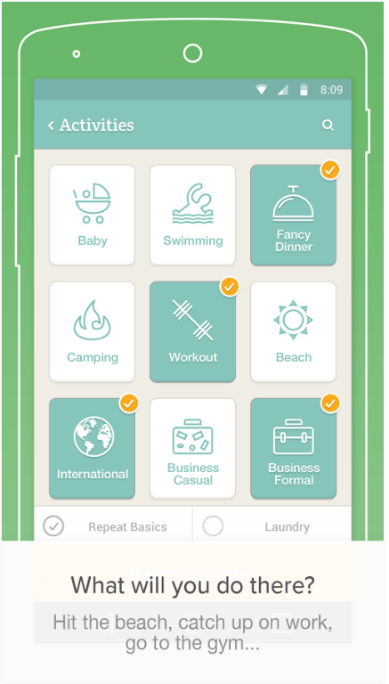
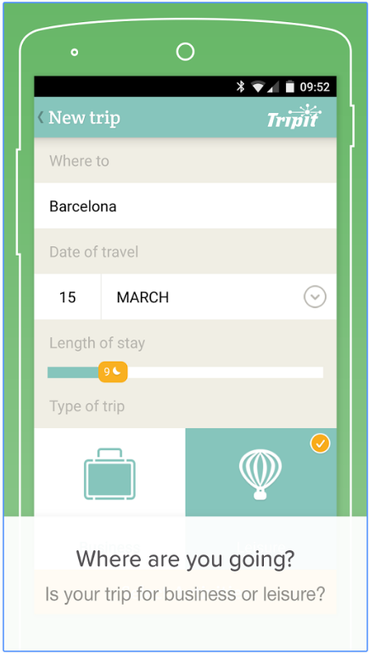
Competition
Suitcase & Luggage Lite PackPoint

Slide 13
Innovation
Reverse Geo tagging on the images captured
Images captured should preferably at the airline counter with the barcode attached to the bag
Helpful while tracking down lost bags
Notes:
Picture should be taken at home , flight
Open, close, barcode
Address at airline counter

Slide 14
Innovation
Our app uses firebase - state of the art
Spark version (free)
100 active connections
1GB real time data
5GB storage
Other versions – flame and blaze
Flame is $25/mo
Blaze is pay as you go - unlimited

Slide 15
Tricky programming problem
Choosing online secure database -cloud
We needed a technology that would provide backend and let us focus on the frontend
How we overcame this problem
Chose Firebase
Learning curve involved
Going through tutorials

Slide 16
Tricky programming problem
Handling ImageView in an adapter
Complex image transformations with minimal memory use
How we overcame this problem
Picasso framework
Hassle free image loading in our application
Automatic memory and disk caching

Slide 17
Tricky programming problem
How to find the location of the image at the time of capture.
How we overcame this problem
Geotagged the image – lat & long
During display, reverse geotagging was performed

Slide 18
Acknowledgements
Material UI Design & Icons – Google
Picasso
Firebase
Zebra Crossing – QR Code
Tvac Studio –firebase tutorials https://www.youtube.com/playlist?list=PLGCjwl1RrtcTXrWuRTa59RyRmQ4OedWrt
The vast resource of Internet!!

Slide 19
The future
UI betterment
Larger database of Airline information
Widget support for application
Support for android wear
Notification for trips

Slide 20
Suitcase Manager
Catalogs your items
Easy management
Easy retrieval of your items from bags
Review your luggage. Make sure you haven’t forgotten something.
Geotagging of images

