Slide 1
ONLINE TMS
Name : Jeya Preetha.M
Roll No : 2013242009
Course & Branch : M.Sc. IT

Slide 2
Objective
This project, “Life Saver” is an emergency alerting application for the older people and medically disabled persons who are in need of support and always need to take care of the person.
The benefits of Life Saver will be especially for the elderly who live alone, or spend a lot of time on their own at home.
These benefits of these services are best felt during emergency situations.

Slide 3
General Process
The modules of the project are as follows:
        Shake module
        Alarm module
        Voice Recognition module
        SMS alert module
        Location module

Slide 4
Process
Just a shake gives a alert message and sends a emergency message to the contact person that you saved.
A alarm sound is generated to alert the surroundings that you are in need of help.
Next, by clicking the voice button, we can give the input voice which automatically converts into text and attached to the emergency message.
Your current location also found and attached with the message.
By the message that you need to convey, the person can easily understood your emergency situation and reach you quickly.

Slide 5
Requirements
Operating System : Windows 7
RAM : 2GB
IDE : Android Studio
OPERATING SYSTEM : Windows7
LANGUAGE : Java
DATABASE : SQLite
PROCESSOR : All newer version Processors
RAM : 1GB
ANDROID VERSION : Version 4 and above
HARD DISK : 120GB

Slide 6
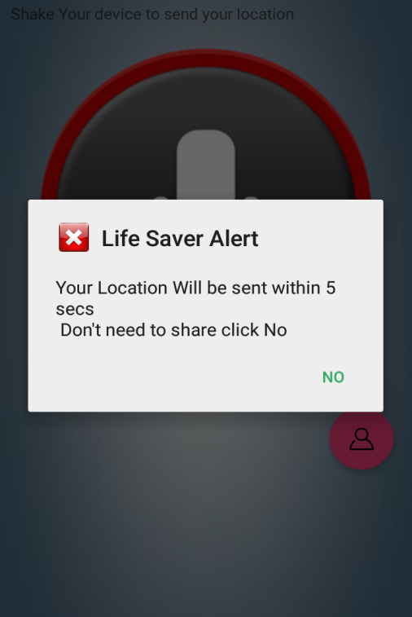
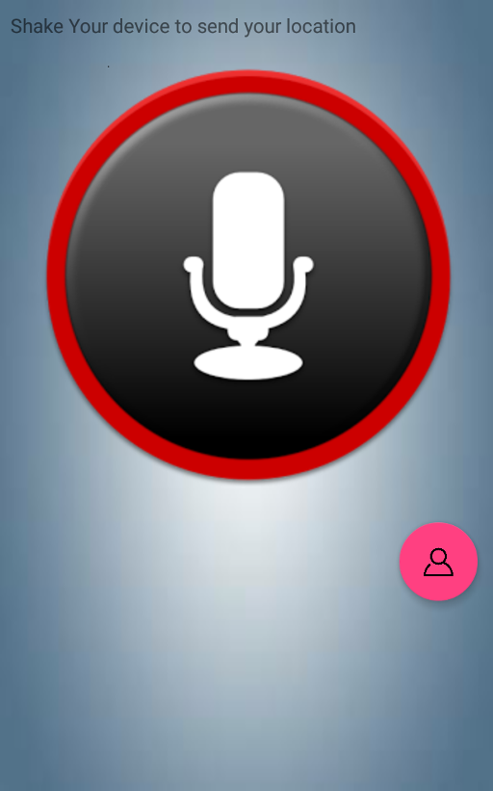
SCREEN SHOT:
Alert to send message:
Voice recognition:

Slide 7
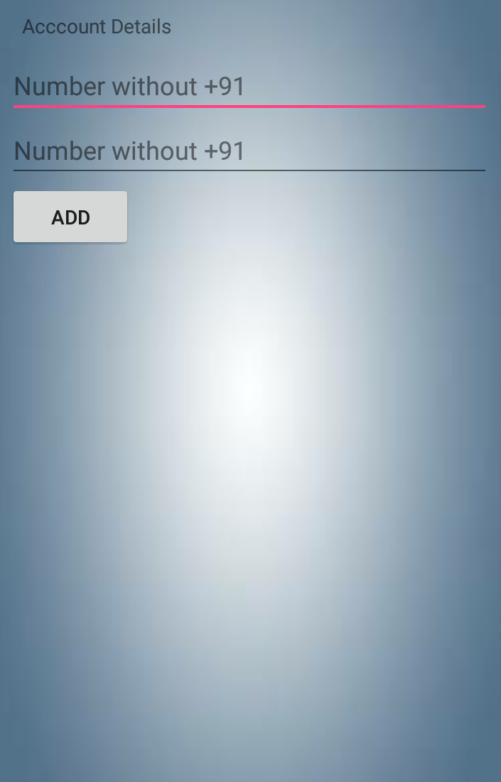
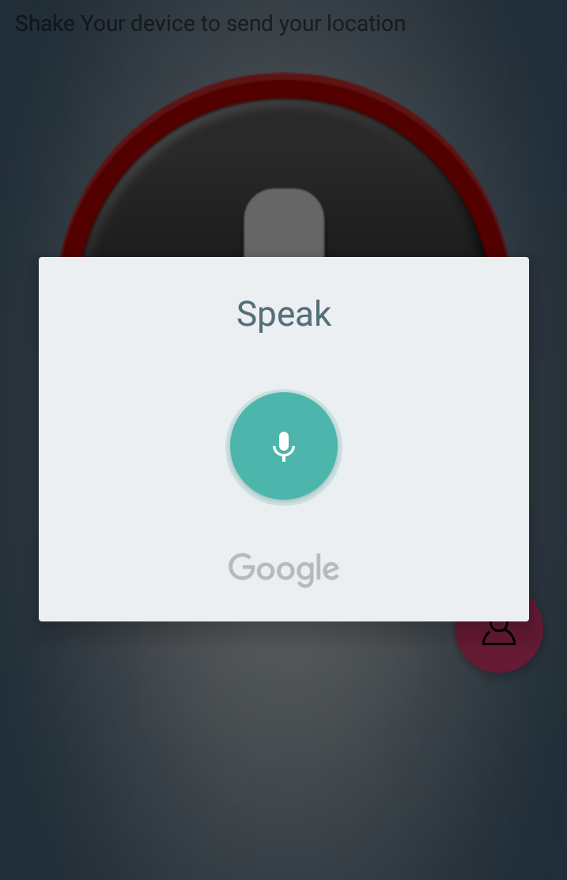
SCREEN SHOT:
Add Contacts:
Convert Voice to text:

Slide 8
Thank you.

