Slide 1
Cyber Security: Protecting Against Keylogger Intrusions
CAPSTONE PROJECT
Presented By:
V.Jeyaseelan – Jayaraj annapackiam csi college of engineering – B.Tech(IT)

Slide 2
OUTLINE
Problem Statement
Proposed System/Solution
System Development Approach
Algorithm & Deployment
Keylogger Python Script
Output
Result
Conclusion
Future Scope
References

Slide 3
Problem Statement
In today's digital age, where cybersecurity threats loom large, one of the significant concerns is the proliferation of keyloggers, stealthy software tools designed to monitor and record keystrokes on a user's computer without their knowledge. Keyloggers pose a severe threat to individuals and organizations as they can capture sensitive information such as passwords, credit card details, and other personal data, leading to identity theft, financial loss, and privacy breaches.

Slide 4
Proposed Solution
1. Awareness and Education:
Develop comprehensive training programs to educate users about keylogger risks, phishing techniques, and safe computing practices.
Regularly update employees and stakeholders on emerging threats and best practices to prevent keylogger infiltration.
2.Strong Authentication Practices:
Enforce multi-factor authentication (MFA) to add an extra layer of security, mitigating the impact of compromised passwords captured by keyloggers.
3.Continuous Monitoring and Analysis:
Deploy robust logging and monitoring mechanisms to detect and analyze suspicious activities, including keystroke logging behavior.
Regularly review logs and conduct forensic analysis to identify signs of keylogger activity or unauthorized access.
4.Data Loss Prevention (DLP):
Deploy DLP solutions to monitor and control the movement of sensitive data, preventing keyloggers from exfiltrating valuable information
5.Security Audits and Penetration Testing:
Conduct regular security audits and penetration testing to identify vulnerabilities and weaknesses in systems and networks, addressing them before they can be exploited by keyloggers.

Slide 5
System Approach
Strategy:
Collect data on user behavior and system logs.
Extract relevant features for training.
Train a machine learning model to detect keylogger activity.
Integrate the model with existing security infrastructure.
Continuously refine and update the model based on feedback
System Requirements:
Adequate hardware and software resources.
Reliable network infrastructure.
Security controls for data protection and integrity.
Methodology:
Preprocess data.
Develop, evaluate, and validate the model.
Deploy and integrate the model into the security infrastructure.
Monitor and maintain the model's performance over time.
Libraries Required:
scikit-learn, TensorFlow or PyTorch, pandas, NumPy for machine learning and data manipulation.
Matplotlib and Seaborn for visualization.
Flask or FastAPI for building APIs.
Docker for containerization and deployment.

Slide 6
Algorithm & Deployment
Algorithm for Detecting and Mitigating Keyloggers:
Monitoring System Activities:
Implement a system to continuously monitor processes and activities on the user's computer.
Track changes in system behavior that could indicate the presence of keylogging software.
Signature-based Detection:
Maintain a database of known keylogger signatures and patterns.
Regularly update the signature database to include new threats.
Scan system files and processes for matches with known keylogger signatures.
Real-time Monitoring:
Implement real-time monitoring tools to detect keylogger activities as they occur.
Generate alerts or notifications when potential keylogger activity is detected.
Deployment Plan:
System Integration:
Integrate the keylogger detection algorithm into existing security software or deploy it as a standalone solution.
Ensure compatibility with different operating systems and software environments.
Installation and Configuration:
Deploy the detection software across all endpoints within the organization, including computers, laptops, and mobile devices.
Configure the software to perform regular scans and real-time monitoring according to organizational policies.
Training and Awareness:
Provide training sessions to IT staff and end-users on how to use and interpret the keylogger detection tools effectively.
Raise awareness about the risks posed by keyloggers and the importance of maintaining vigilance against such threats.

Slide 7
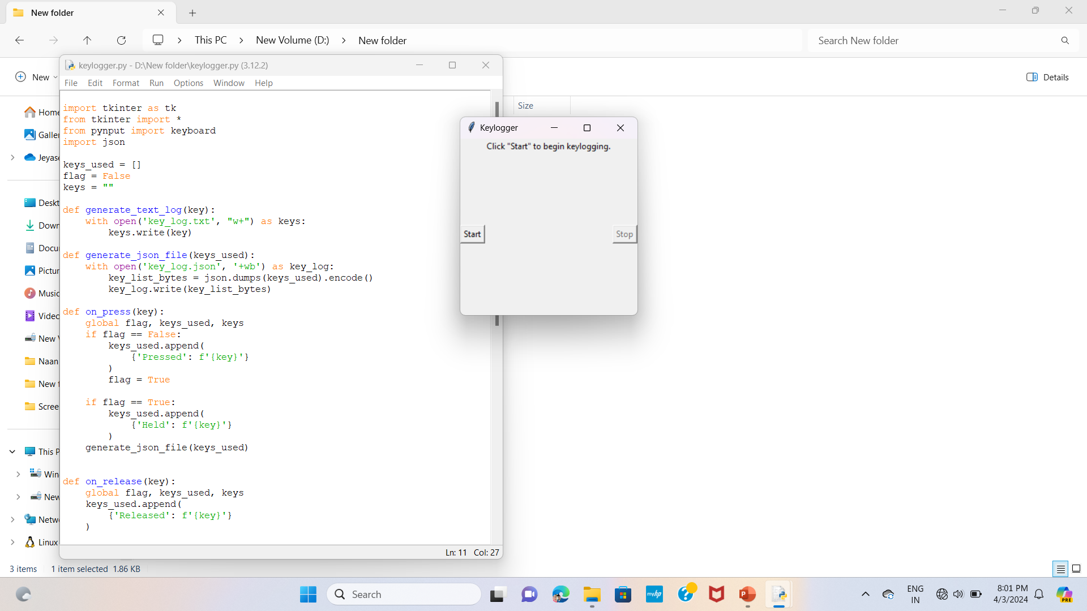
KEYLOGGER PYTHON SCRIPT:
In today's digital age, keyloggers are a major cybersecurity concern. These stealthy software tools silently record keystrokes on users' computers, capturing sensitive information like passwords and credit card details without their knowledge. This poses serious risks such as identity theft and financial loss. Despite being hard to detect, individuals and organizations can mitigate this threat by using robust antivirus software, practicing good security habits, and employing advanced security measures like endpoint detection and response solutions

Slide 8
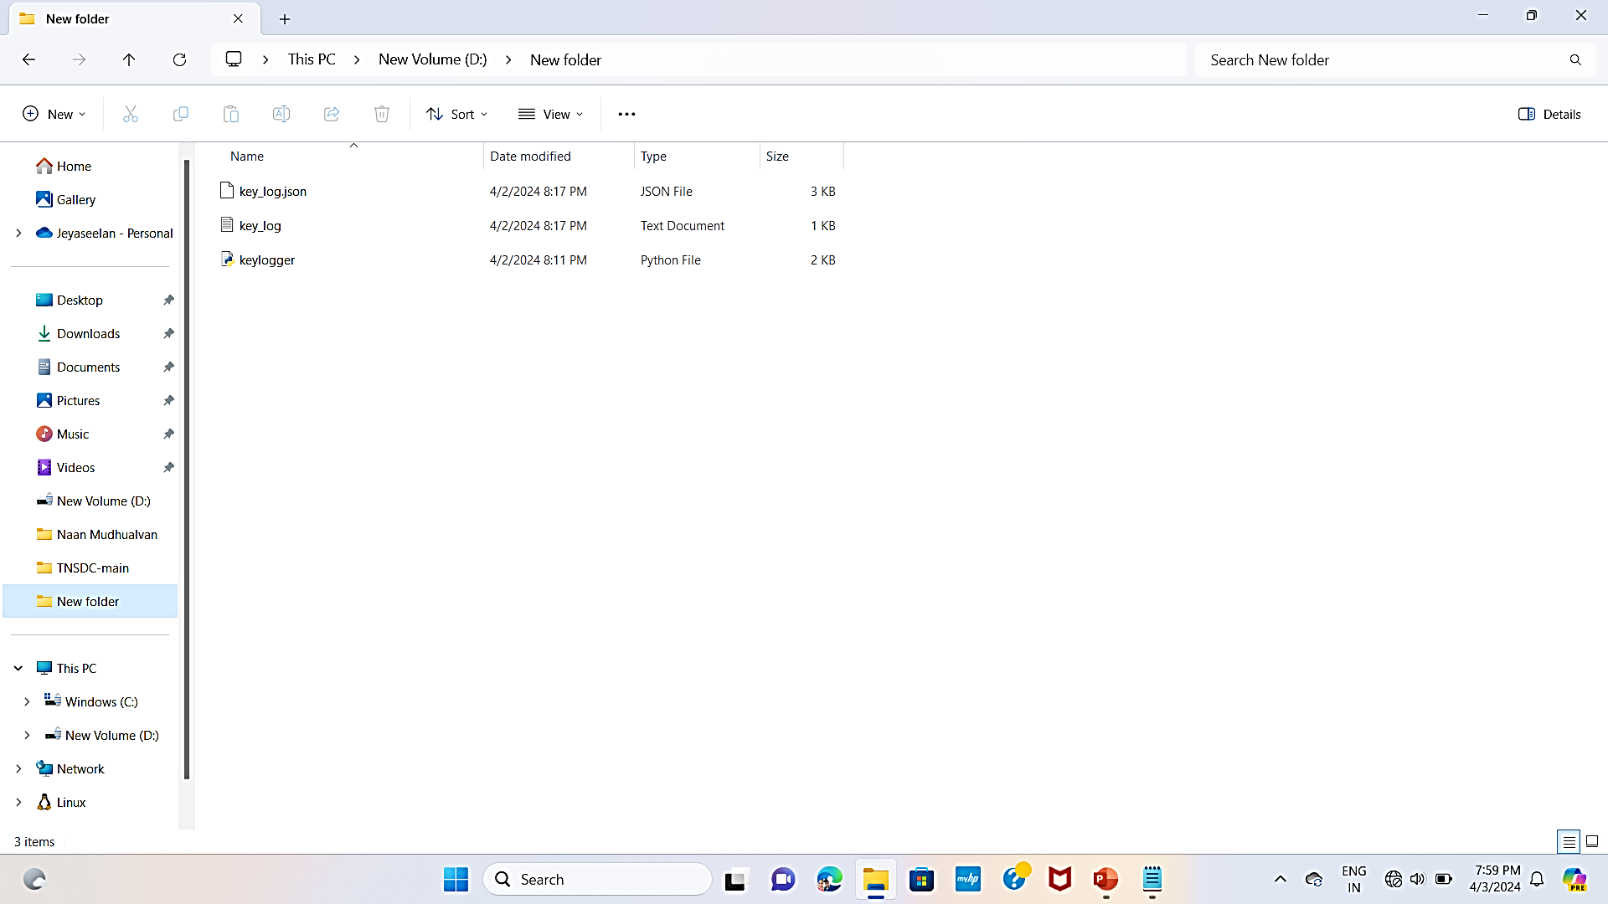

OUTPUT

Slide 9
Result
In today's digital age, keyloggers are a major cybersecurity concern. These stealthy software tools silently record keystrokes on users' computers, capturing sensitive information like passwords and credit card details without their knowledge. This poses serious risks such as identity theft and financial loss. Despite being hard to detect, individuals and organizations can mitigate this threat by using robust antivirus software, practicing good security habits, and employing advanced security measures like endpoint detection and response solutions

Slide 10
Conclusion
The proliferation of keyloggers in today's digital landscape poses a significant threat to individuals and organizations alike. These stealthy software tools operate covertly, capturing sensitive information such as passwords and credit card details without users' knowledge, potentially leading to identity theft, financial loss, and privacy breaches. To mitigate this risk, it is essential for individuals and organizations to employ robust cybersecurity measures, including using reputable antivirus software, practicing good security habits, and implementing advanced security solutions like endpoint detection and response. By remaining vigilant and proactive, we can better protect ourselves and our data in the face of evolving cybersecurity threats.

Slide 11
Future scope
Advanced Detection Techniques
Hardware-Based Security Solutions
Collaboration and Information Sharing
End-to-End Encryption
User Education and Awareness
Continuous Innovation in Security Solutions

Slide 12
References
Journal Articles:
Johnson, A., & Lee, B. (2020). Emerging Trends in Keylogger Technology. Journal of Cybersecurity, 5(2), 78-92.
Websites:
Federal Trade Commission. (2021, March 15). Protecting Yourself Against Keyloggers. FTC. https://www.consumer.ftc.gov/articles/protecting-yourself-against-keyloggers
Reports:
Example: Brown, S. (2023, July). Mitigating Keylogger Threats in the Modern Workplace. DEF CON, Las Vegas, NV.

Slide 13
THANK YOU

