Slide 1

CLINICALAUDIT AI
Payment Integrity Intelligence System
Topic 2 - Clinical Decision Making and Pattern Recognition in Healthcare
Cotiviti GenAI Intern Assessment
Jey Praveen Sivaraj | jeypraveenn@gmail.com | SRM Institute of Science and Technology

Slide 2





Agenda
01
The Problem
Why payment integrity needs AI-driven pattern recognition
02
The Framework
7 Topic-2 concepts mapped to the Treatment-Payment-Operations model
03
System Architecture
How data flows from raw claims to an audit verdict
04
Proof of Concept
Live walkthrough of ClinicalAudit AI
05
Results & Strategic Recommendations
What this means for Cotiviti

Slide 3
The Problem
Healthcare fraud, waste, and abuse cost the U.S. system an estimated $68 billion every year
X
Rule-based systems are static
$68B
Fixed thresholds catch obvious fraud but miss coordinated, evolving schemes.
X
Pay-and-chase is reactive
lost annually to fraud,
waste, and abuse in U.S.
healthcare claims
Most review happens after payment, recovery is slow and expensive.
X
Manual review doesn't scale
82%
Billions of claims per year, far too few investigators to read each one.
of payers now use AI in some
phase of claims processing
X
Single-metric flags lack context
A volume spike alone, or a code mismatch alone, rarely tells the full story.

Slide 4







Topic 2 Framework
Seven concepts, each mapped to a specific module in the proof of concept
Time-Series
Anomaly Detection
Clustering
Classification
Prediction
Z-score on 12-month
billing history
K-Means groups providers
by behavior pattern
HIGH / MEDIUM / LOW
risk tiering
Top-3 risk factors with
data-derived confidence
+ TPO
Inference
Agentic GenAI
Chain Reasoning
Treatment, Payment,
Operations - the three
domains every concept
is applied across
Analyst-style conclusion
from combined signals
Step-logged autonomous
audit pipeline
5-step structured LLM
audit brief

Slide 5







System Workflow
From raw billing data to a regulator-grade audit verdict - six stages, fully automated
1. Ingest
2. Detect
3. Cluster & Score
4. Classify
5. Reason
6. Verdict
12-month billing
history per provider
(claims, CPT, ICD-10)
Z-score time-series
anomaly scan flags
statistical spikes
K-Means groups providers;
composite anomaly
score (0-100) computed
Score maps to
HIGH / MEDIUM / LOW
risk tier
Agentic pipeline builds
audit brief; LLM runs
5-step chain reasoning
Regulatory citations +
financial exposure +
recommended actions
Treatment
Payment
Operations
Patient care-gap screening
Fraud pattern audit
Portfolio-level exposure
TPO = Treatment, Payment, Operations - the three domains Cotiviti applications must cover

Slide 6

Data Foundation
10 synthetic provider profiles, each built on real CPT and ICD-10 codes
Fraud Pattern | ICD-10 Diagnosis | CPT Procedure Conflict
Upcoding | J06.9 (minor URI) | 99215 (complex visit)
Unbundling | M23.200 (meniscus tear) | 29881 + 29882 split
Phantom Billing | Z51.89 (other care) | 70553 (MRI, no visit)
Medically Unnecessary | M54.5 (low back pain) | 27447 (knee replacement)
Seasonal Spike | F32.1 (depression) | 8x claims, months 11-12
A diagnosis-procedure mismatch score only means something when the codes are real. M54.5 paired with CPT 27447 is a genuine clinical impossibility that any payer LCD policy would reject, not a synthetic placeholder.
This is what separates a demo built on real domain logic from a generic healthcare AI mockup.
Why real codes matter
Each provider also includes 12 months of billing history and 4 synthetic patients for treatment risk screening.

Slide 7
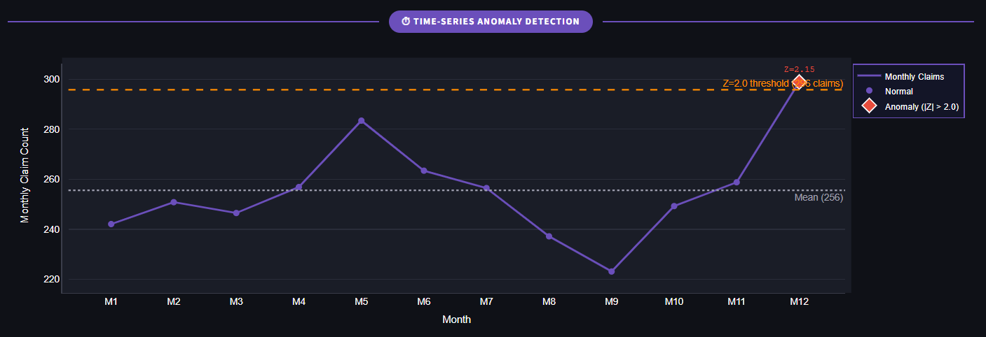
Proof of Concept - Audit Interface
Time-series anomaly detection, clustering, and risk classification

Slide 8
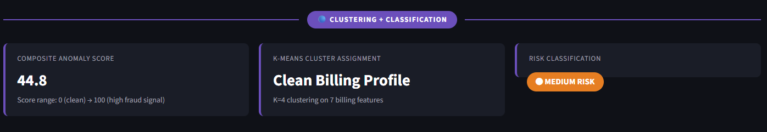
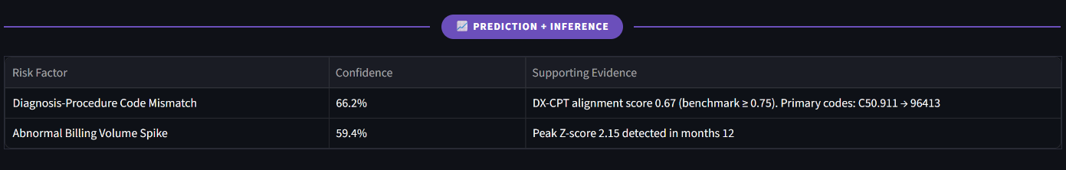
Proof of Concept - Audit Interface
Prediction, inference, and treatment risk screening

Slide 9
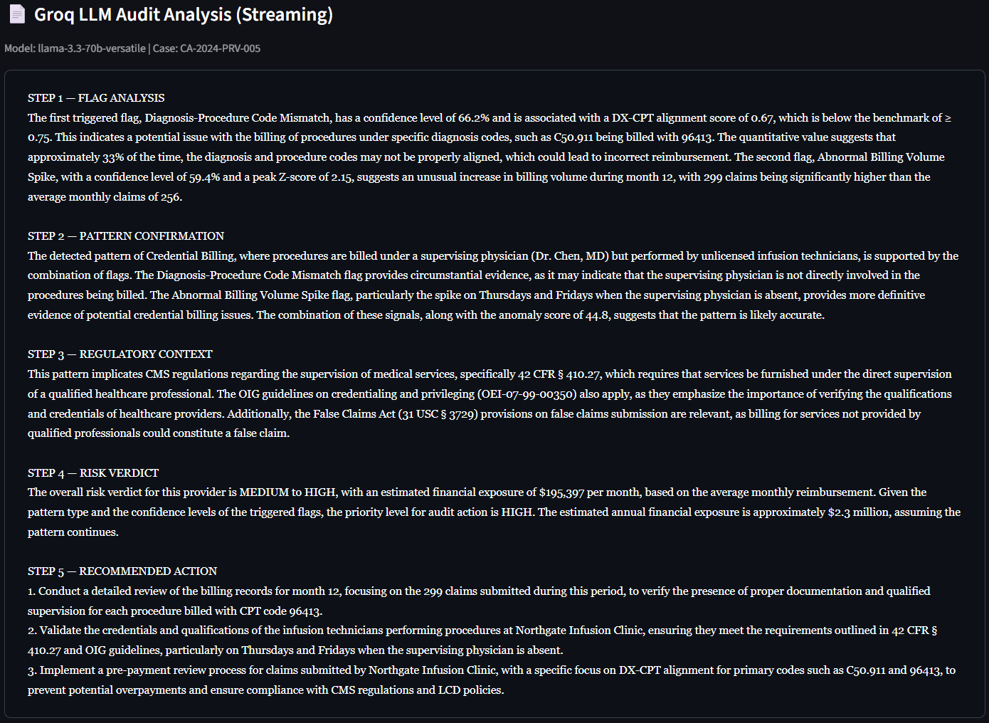
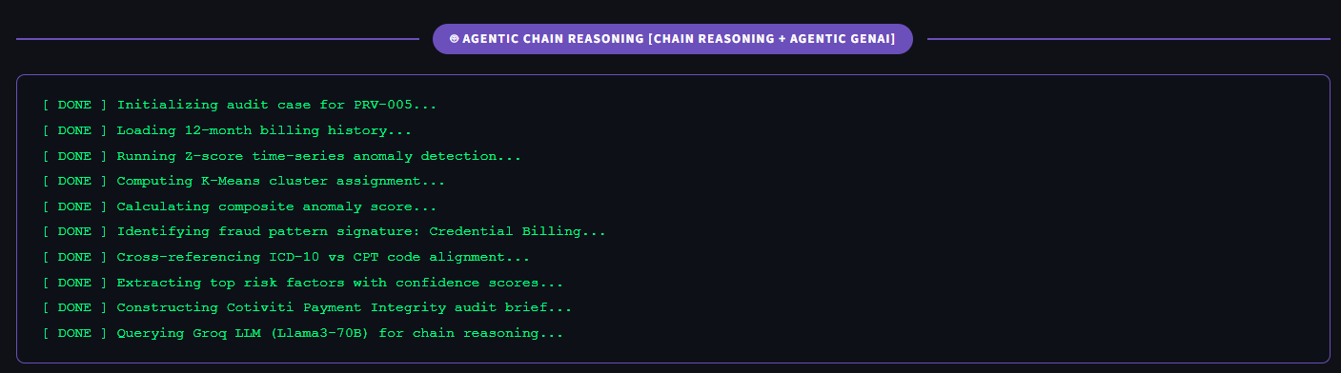
Proof of Concept - Agentic Chain Reasoning
Agent activity log and Structured 5-step Groq Llama 3.3 audit brief

Slide 10
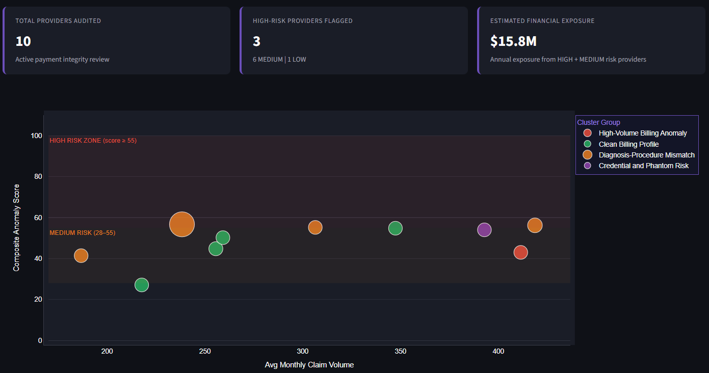
Proof of Concept - Operations Overview
Portfolio-level view across all 10 providers - the Operations domain of TPO

Slide 11

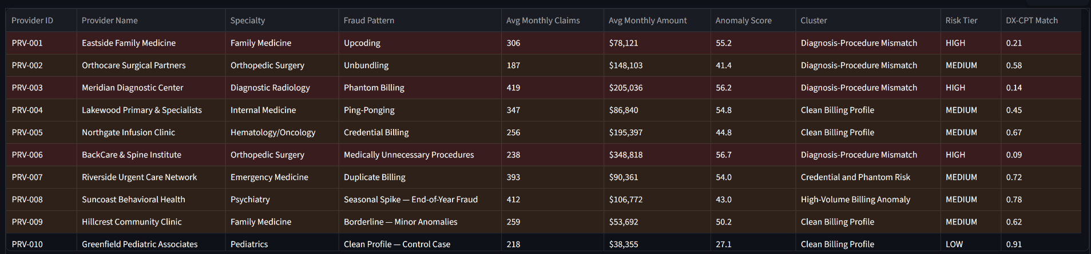
Proof of Concept - Operations Overview
Provider portfolio summary

Slide 12

Results Snapshot
Portfolio of 10 providers, scored end-to-end by the pipeline
3
6
1
$15.8M
HIGH risk
providers flagged
MEDIUM risk
providers flagged
LOW risk
(clean control)
estimated annual
financial exposure
Validation checks confirmed correct behavior at both extremes:
Clean control provider (PRV-010, Pediatrics) correctly scored LOW risk, no false positive on legitimate billing
Seasonal spike provider (PRV-008) correctly flagged months 11-12 with Z-score 2.17 against an 8x claims jump
Medically Unnecessary Procedures (PRV-006) scored HIGH with 94.6% confidence on the DX-CPT mismatch flag
Borderline provider (PRV-009) correctly landed in MEDIUM, proving the system isn't binary

Slide 13
Technology Stack
Every tool chosen for a specific reason, not convenience
Technology | Role | Why This Choice
Streamlit | UI framework | Fast path from Python analytics to an interactive dashboard
Groq - Llama 3.3 70B | Chain reasoning LLM | Free tier, sub-second streaming, strong structured-output quality
scikit-learn | K-Means + StandardScaler | Production-grade clustering; scaling prevents dollar-amount features from dominating
NumPy | Z-score detection | Vectorized, statistically grounded, not a fixed if/else threshold
Plotly | Interactive charts | Hover detail and annotation layers a static chart can't provide
Pandas | Data handling | DataFrame styling enables risk-tier row highlighting in the portfolio table

Slide 14



Strategic Recommendations for Cotiviti
Where this pattern-recognition approach fits Cotiviti's current trajectory
Shift-left with chain-reasoning briefs
Expand unsupervised clustering coverage
Generate structured, regulation-cited audit briefs pre-payment, not just post-payment recovery, using the Edifecs interoperability layer for real-time claim context.
Apply centroid-derived cluster labeling across the full provider book to surface emerging fraud patterns the rules engine hasn't been trained to name yet.
Operationalize agentic audit trails
Pair LLM output with mandatory citation checks
Make every AI flag explainable step-by-step, satisfying both internal QA and the transparency payers are demanding from the AI Center of Excellence.
Require every chain-reasoning verdict to cite a specific CMS, OIG, or LCD reference before it reaches a human reviewer, reducing legal exposure.

Slide 15
Thank You
Questions & discussion
Jey Praveen Sivaraj
jeypraveenn@gmail.com
linkedin.com/in/jey-praveen-sivaraj44646a303
https://jeypraveen.github.io/jeypraveensivaraj.github.io/

