Slide 1
Disney+HotStar Data Analysis ( Using Tableau)
SHRI JEY SURYA K | MBE 11

Slide 2
Project objective
Objective:
To perform a comprehensive analysis of a movie dataset to uncover key insights and trends that can guide us in decision-making. This analysis will focus on identifying patterns in movie attributes such as genre, running time, release year, and age rating.

Slide 3
Findings and Insights:
Analyzing the genre distribution across the years, it is found that genre like Drama, Action, Comedy, Romance, Thriller has more popularity.
Movies with U/A 13+ and U/A 16+ age ratings tend to have longer running times
Drama, Action, Thriller, Comedy, and Romance are the most represented genres in the U/A 13+ and U/A 16+ age categories, indicating these genres resonate strongly with young adult audiences.
Analyzing the line chart for number of movies’ released during each year, the chart is growing exponentially.

Slide 4
Recommendations:
Focusing on producing or acquiring more content in high-demand genres will satisfy audience expectations.
Tailor recommendations to users in the U/A 13+ and U/A 16+ age groups by prioritizing movies from these genres and with longer running times.
Running campaigns focused on these genres during weekends or holidays when audiences have more time to watch longer content.
By forecasting the line chart, it suggests that the number of movies released by 2040, will be over 500.
It is recommended to acquire movies in trending genres and age rating categories to enhance content relevance and boost overall watch time on the platform.

Slide 5
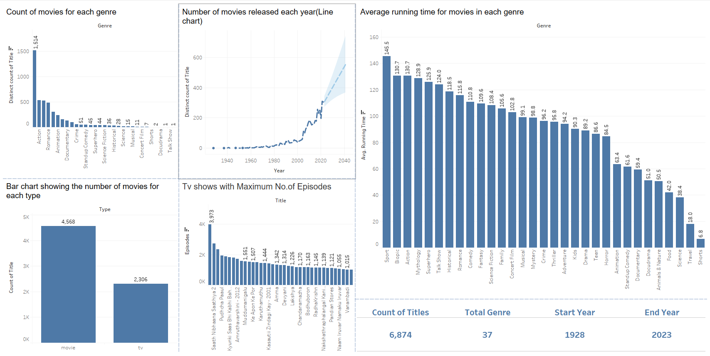

Slide 6
Thank You!

