Slide 1
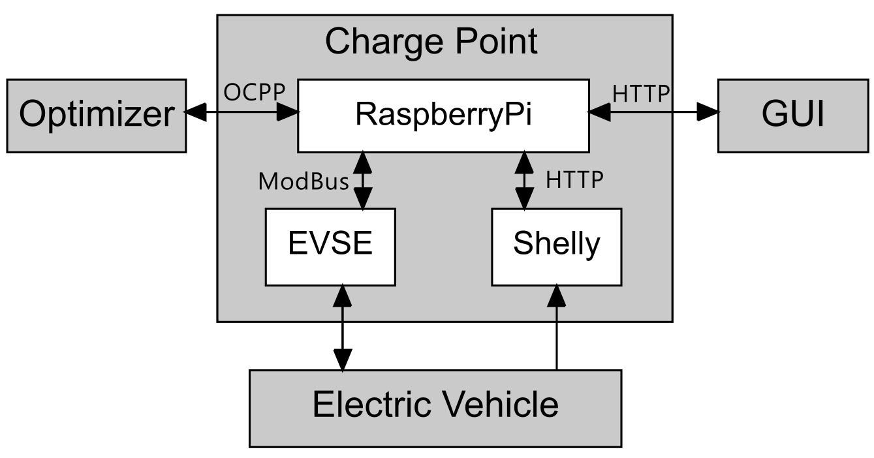
System Architecture Overview
Notes:
So I will introduce the system structure first.
This project has four main parts: the optimizer, the charging station, the vehicle, and the remote GUI control. Inside the charging station, we have the Raspberry Pi controller, the EVSE actuator, and the Shelly sensor.
For communication: the optimizer and Raspberry Pi communicate using the WebSocket protocol with OCPP. The GUI and Shelly communicate through HTTP, and the EVSE is controlled using the Modbus protocol.

Slide 2



System Architecture Requirements
Communication Protocol
Concurrent Tasks Scheduling
System Expansion
OCPP Protocol
WebSocket Communication
Message Management
GUI Control
Data Collection
Execution of Charging Logic
...
Multiple Charging Ports
Foundation of Database
...
Multiple Charging Ports
Foundation of Database
...
Notes:
We considered a few key technical points during the design:
First, the communication protocols, which must support WebSocket and OCPP;
Second, concurrent task scheduling, using coroutines and multithreading for tasks like message management, GUI control, real-time data collection, and charging logic;
And third, system expansion, with design considerations for future expansion.

Slide 3


System Architecture Implementation
Communication
Concurrent Tasks
Expansion
OCPP v2.0.1 Message (JSON)
Complex hierarchical nesting, difficult to learn structure
Frequent reference to the OCPP Standard is required when writing code
High probability of error, with significant debugging costs
Notes:
The first challenge is learning and using the OCPP protocol. The OCPP 2.0.1 message structure is complex, and there are many reference links in the standard document. Just like in this picture, it connects from one place to another, and then continues to another place. This means we often need to look up the standard. Writing the messages manually can also result in errors.

Slide 4


System Architecture
Implementation
Communication
Concurrent Tasks
Expansion
OCPP Message Generator
Use different generation functions
to generate each message part
IDE: Type annotation and Docstring
Easier to learn and use OCPP Message
Less errors
Notes:
To solve this, we designed a message generator. It works by passing parameters through functions to build the OCPP messages step by step like a production line. It can reduce errors and make it easier for developers to understand and use.

Slide 5


System Architecture
Implementation
Communication
Concurrent Tasks
Expansion
Problem
Multiple modules
complex calls
high coupling
Signal Class -- Decoupling
Supports synchronous/asynchronous calls
Lower coupling
More flexible than callback functions
Easier to expand
Func
Signal.emit
Func
Notes:
Because the system has many modules and complex function calls. So, we needed a way to reduce the coupling. we implemented a Signal class referencing the Qt Signal to decouple the system. We only need to connect functions to signals externally. When a signal is emitted, the function will be called. Compared to callback functions, this method is more flexible and has lower coupling.

Slide 6




System Architecture
Implementation
Communication
Concurrent Tasks
Expansion
System Expansion
Database Support: the foundation for Database
Support multiple charging ports for testing: dynamically add to the system
Modular Architecture Design: Easy to combine and expand
Multi-Platform GUI Control Support: Unified Control
Notes:
For system expansion, we created a data management class to handle all the data uniformly. This is a good foundation if we need to connect to a database in the future. We also thought about supporting multiple charging ports for testing, which can be dynamically added to the system. The modular design makes future expansion easier. Our GUI is web-based, but we also provide communication interfaces for desktop or mobile devices.

Slide 7
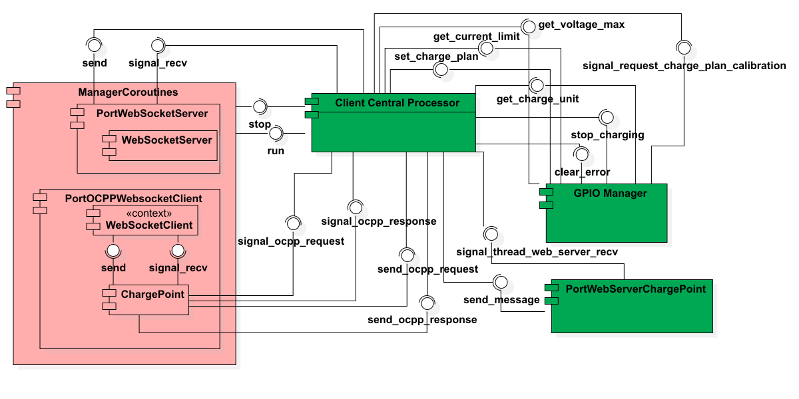
System Architecture
Charge Point
Notes:
This is the internal structure of the charging station. The pink parts are coroutines, and the green parts are threads. All modules connect to the Central Processor, which manages the scheduling.
Next, Yunan will explain the charging logic part.

Slide 8
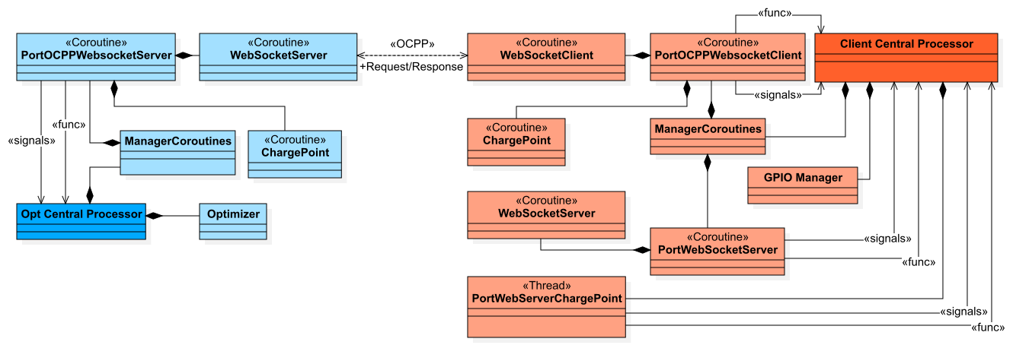
System Architecture
Project
Notes:
This is the overall system structure. On the left is the optimizer, and on the right is the charging station. They communicate through the OCPP protocol.
Next, Yunan will explain the charging logic part.

Slide 9
System Architecture Implementation
Communication
Concurrent Tasks
Expansion
OCPP v2.0.1 Message (JSON)
SetChargingProfileRequest {
"evseId": 1,
"chargingProfile": {
"id": 1,
"stackLevel": 1,
"chargingProfilePurpose": "TxProfile",
"chargingProfileKind": "Absolute",
"chargingSchedule": [{
"id": 1,
"chargingRateUnit": "W",
"chargingSchedulePeriod": [
{ "startPeriod": 0, "limit": 2845 },
{"startPeriod": 10, "limit": 2845 }, …
],
"startSchedule": "2025-04-28T15: 41: 53Z"}, … ],
…
},
"customData": { "vendorId": "001" }
}
{
"$schema": "http://json-schema.org/draft-06/schema#",
"$id": "urn:OCPP:Cp:2:2020:3:SetChargingProfileRequest",
"comment": "OCPP 2.0.1 FINAL",
"definitions": {
"type": "object",
"additionalProperties": false,
"properties": {
"customData": {
"$ref": "#/definitions/CustomDataType"
},
"evseId": {
"description": "...",
"type": "integer"
},
"chargingProfile": {
"$ref": "#/definitions/ChargingProfileType"
}
},
"required": [
"evseId",
"chargingProfile"
]
}
Notes:
The first challenge is learning and using the OCPP protocol. The OCPP 2.0.1 message structure is complex, and there are many references in the standard document. Just like in this picture, it connects from one place to another, and then continues to another place. This means we often need to look up the standard, and writing the messages manually can result in errors.

Slide 10
System Architecture
Implementation
Communication
Concurrent Tasks
Expansion
OCPP Message Generator
g = GenSetChargingProfileRequest
OCPP_Message = g.generate(
evse_id = 1,
charging_profile = g.get_charging_profile(*args),
custom_data = g.get_custom_data(*args)
)
Use different generation functions to generate each message part
IDE provides type hints and Docstring
Reduces the learning cost of the OCPP Standard documentation
Structure encapsulation significantly reduces the probability of errors
Unified standard improve team collaboration efficiency
Notes:
To solve this, we designed a message generator. It works by passing parameters through functions to build the OCPP messages step by step, reducing errors and making it easier for developers to understand and use.

Slide 11
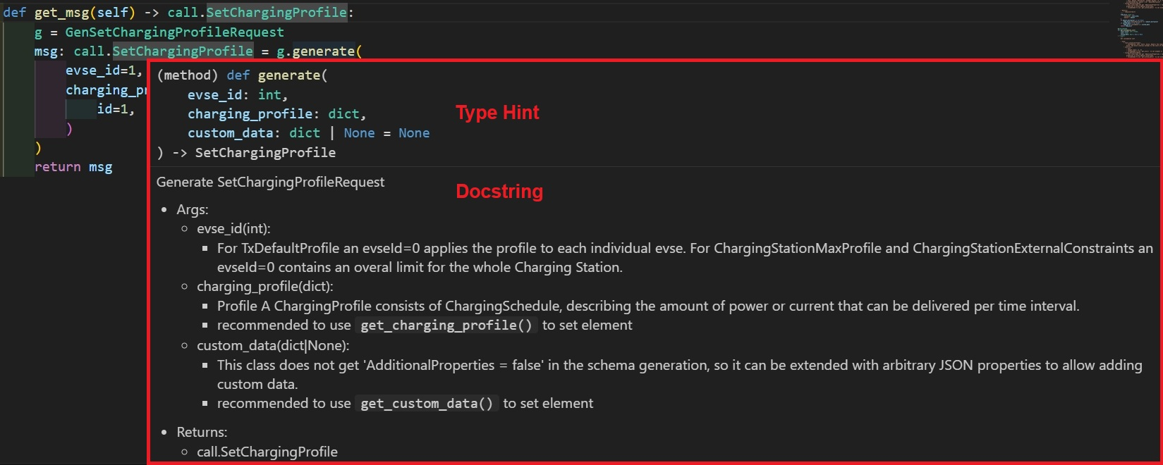
System Architecture
Implementation
Communication
Concurrent Tasks
Expansion
OCPP Message Generator
V2.0.1 —> 128 v1.6 —>78
Notes:
So using Python’s docstring and type annotations, we can see the type and description of each message part directly in the IDE. This helps developers understand the structure and improves code readability.

Slide 12
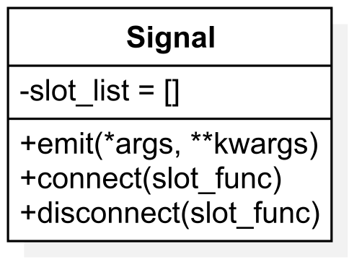
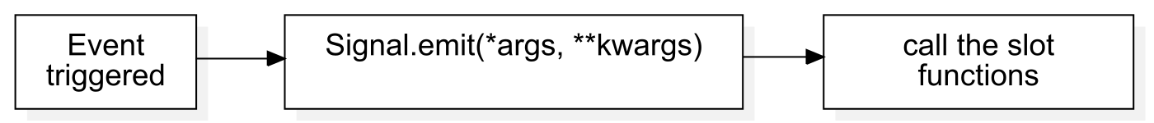
System Architecture
Implementation
Communication
Concurrent Tasks
Expansion
Problem: Multiple modules, complex calls, high coupling
Signal Class -- Decoupling
Supports synchronous/asynchronous calls
No need for fixed callback functions
Facilitates testing, debugging
and expansion
Func
Signal.emit
Func
Notes:
For concurrent task scheduling, we implemented a Signal class referencing the Qt Signal mechanism to decouple the system. We only need to connect functions to signals externally, and when a signal is emitted, the function is called. Compared to callback functions, this method is more flexible and has lower coupling.

