Slide 1
Optimization method
Why Use scipy.optimize.minimize for Optimization?
Advantages:
Simple algorithm, easy to deploy
High computational efficiency for small-scale problems
No need for large datasets or training
High interpretability, transparent optimization process
Suitable for short-term scheduling or online optimization
Notes:
We ultimately chose to use scipy.optimize.minimize for our optimization task because it’s simple, efficient, and well-suited for small-scale, short-term problems. Unlike deep learning, it doesn’t require large datasets or a training phase, which makes it quick to deploy. Its optimization process is also highly interpretable—we can easily track the objective function values and gradients.
However, there are limitations. When dealing with multiple uncertainties—like price forecasts or user behavior—this method can get stuck in local optima. It also relies heavily on gradient information, which isn’t ideal for non-differentiable or non-smooth functions. Most importantly, it lacks the ability to learn from historical patterns, making it less suitable for long-term predictive optimization where deep learning excels.

Slide 2
Optimization considerations
Predict Charging Demand & Balance Grid Load → Consider with historical data, user patterns, weather, etc. → gene_his_usage() generates realistic usage history
Optimize Charging Costs Under Dynamic Pricing → Adjust charging strategy across time periods → gene_eprices() simulates day/night dynamic pricing
Address Diverse User Preferences → customData.mode supports 3 strategies: • Fast Charge (urgent needs) • Cost-Saving (low-price periods) • Balanced (time, cost, load)
Notes:
In this project, we addressed six major challenges in EV charging optimization.
First, to forecast future charging demand and balance the grid, we use historical usage data and dynamic scheduling algorithms. Our gene_his_usage() function simulates realistic consumption profiles, laying the foundation for intelligent decisions.
Second, for optimizing charging costs under dynamic electricity pricing, we employ predictive models. Our gene_eprices() method simulates price changes between day and night, helping the optimizer adjust for cost efficiency.
Third, we recognize users have different preferences. By extending the OCPP message with a mode field, we support three strategies: fast charging, cost-saving, and balanced.

Slide 3
Optimization considerations
4. Extend Battery Lifespan → Avoid deep discharge, high-rate charging → Intelligent post-full-charge trickle to reduce battery stress
5. Achieve Grid Load Balancing (V2G) → Leverage V2G to feed power back to the grid at peak times → V2G not implemented due to vehicle limitations
6. Improve User Experience → Analyze habits and history to suggest best time & location → Real-time station recommendations, navigation integration
→ Future plan: Develop mobile app for smart personalized charging
Notes:
Fourth, to protect battery health, our strategy includes continuing low-current charging after the battery is full, reducing degradation.
Fifth, although we explored V2G concepts for load balancing, this was not implemented due to vehicle limitations.
Lastly, we aim to enhance user experience through personalization. While this feature is not yet complete, we plan to develop a mobile app that suggests optimal charging locations and times based on user habits and real-time availability.
Together, these strategies form a smart, adaptable EV charging system focused on efficiency, user needs, and grid stability.

Slide 4
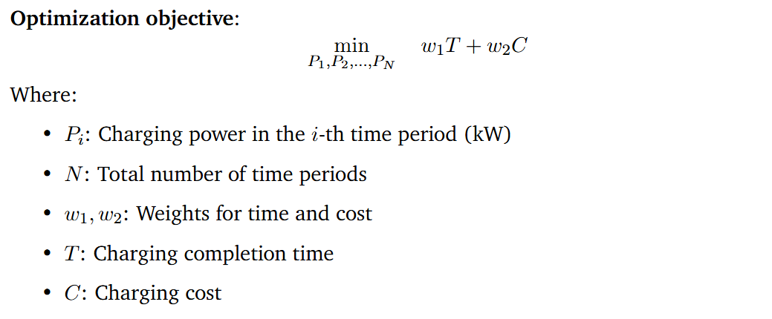
Optimization objective
Notes:
This is the core optimization objective of our charging strategy.
We aim to minimize a weighted sum of two key factors: the charging completion time T and the charging cost C.
The variables we optimize are the charging powers P1,P2,…,PNP_1, P_2, \dots, P_NP1​,P2​,…,PN​ across NNN time periods.
The weights w1w_1w1​ and w2w_2w2​ allow us to adjust the priority between speed and cost— for example, in fast charge mode, we assign a higher weight to time; in cost-saving mode, the cost term becomes more important.
This flexible formulation lets us tailor the strategy based on user preferences or grid conditions.

Slide 5
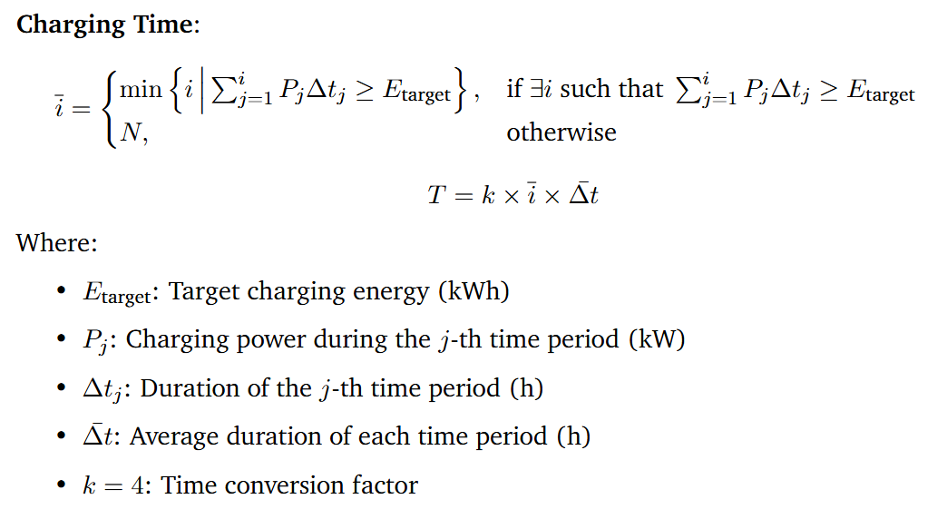
Optimization objective
Notes:
This equation defines how we calculate the charging time required to reach the energy target.
First, we identify the earliest time index i‾\overline{i}i at which the accumulated energy from charging—calculated as the sum of PjΔtjP_j \Delta t_jPj​Δtj​—meets or exceeds the target energy EtargetE_{\text{target}}Etarget​.
If the target is never met, we assume the full schedule is used.
Then, we compute the total charging time Tby multiplying i‾\overline{i}i with the average time step Δtˉ\bar{\Delta t}Δtˉ and a factor k, which adjusts the time units to match our system output—such as converting hours to time slots or cost units.
This approach allows us to evaluate and minimize charging duration as part of the overall optimization.

Slide 6
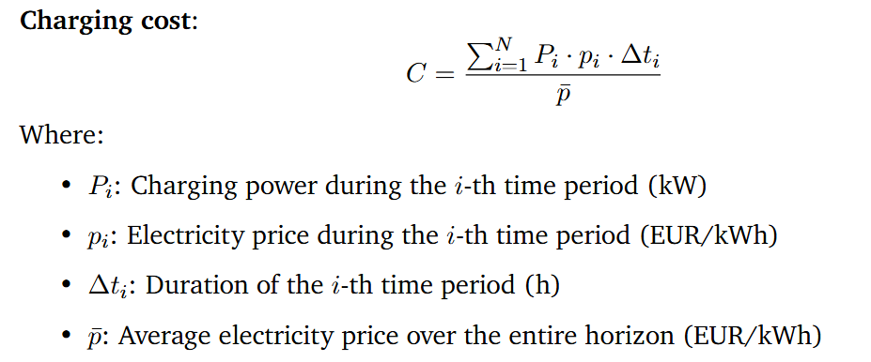
Optimization objective
Notes:
This equation defines the charging cost CCC as a normalized sum of energy consumption over time.
In each time period iii, the cost is calculated as the product of the charging power PiP_iPi​, the electricity price pip_ipi​, and the duration Δti\Delta t_iΔti​.
We then sum this over all time periods and normalize it by the average electricity price pˉ\bar{p}pˉ​.
This normalization allows us to compare cost-effectiveness under different pricing conditions and ensures the cost term is consistent with other terms in the objective function.
By optimizing this term, the system prefers charging during low-price periods while still ensuring the energy demand is met efficiently.

Slide 7


Optimization objective
Notes:
To ensure feasibility and safety, our optimization includes two key constraints.
First, the total charged energy—the sum of Pi⋅ΔtiP_i \cdot \Delta t_iPi​⋅Δti​ over all time periods—must meet or exceed the target energy EtargetE_{\text{target}}Etarget​.
Second, in each time period, the charging power PiP_iPi​ must stay within its allowed range, defined by a minimum and maximum power limit, Pmin⁡,iP_{\min, i}Pmin,i​ and Pmax⁡,iP_{\max, i}Pmax,i​. These bounds can vary depending on hardware limits or grid constraints.
For the initial guess used by the optimizer, we simply set P0P_0P0​ as the average of all maximum powers across the time horizon.
This initialization provides a reasonable starting point for the solver to quickly converge to an efficient solution.

Slide 8
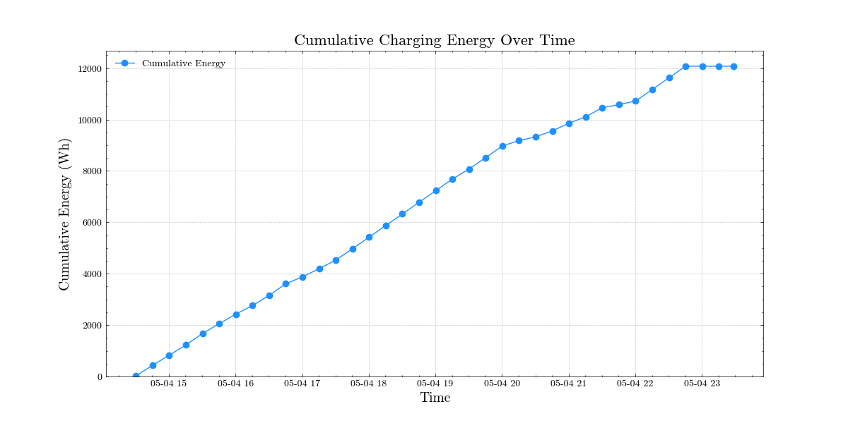
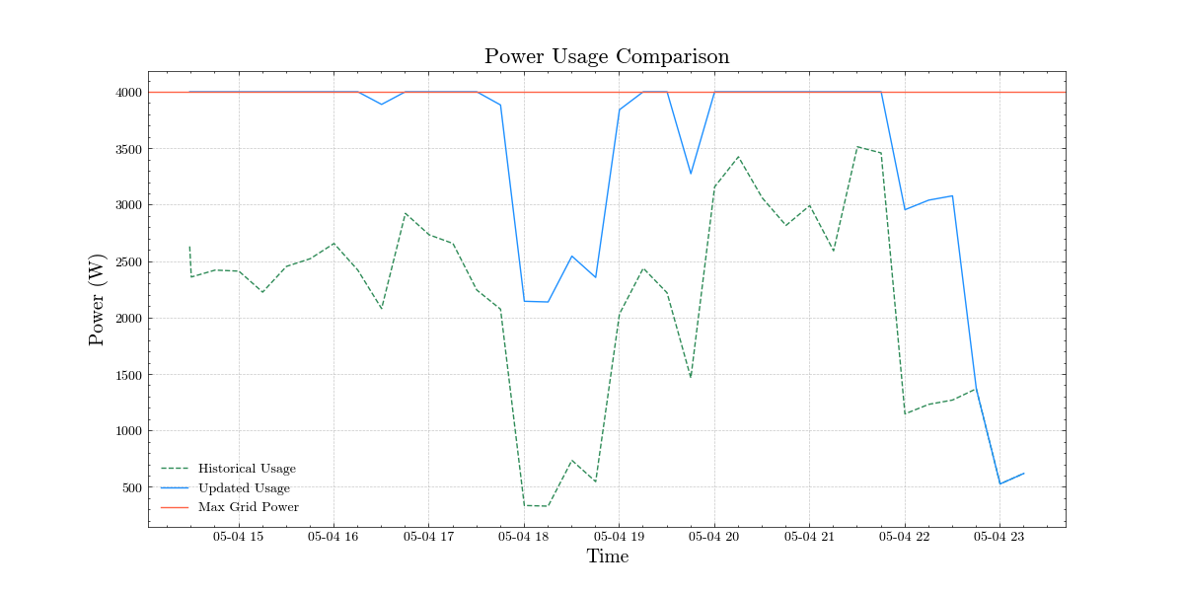
Optimization result

Slide 9
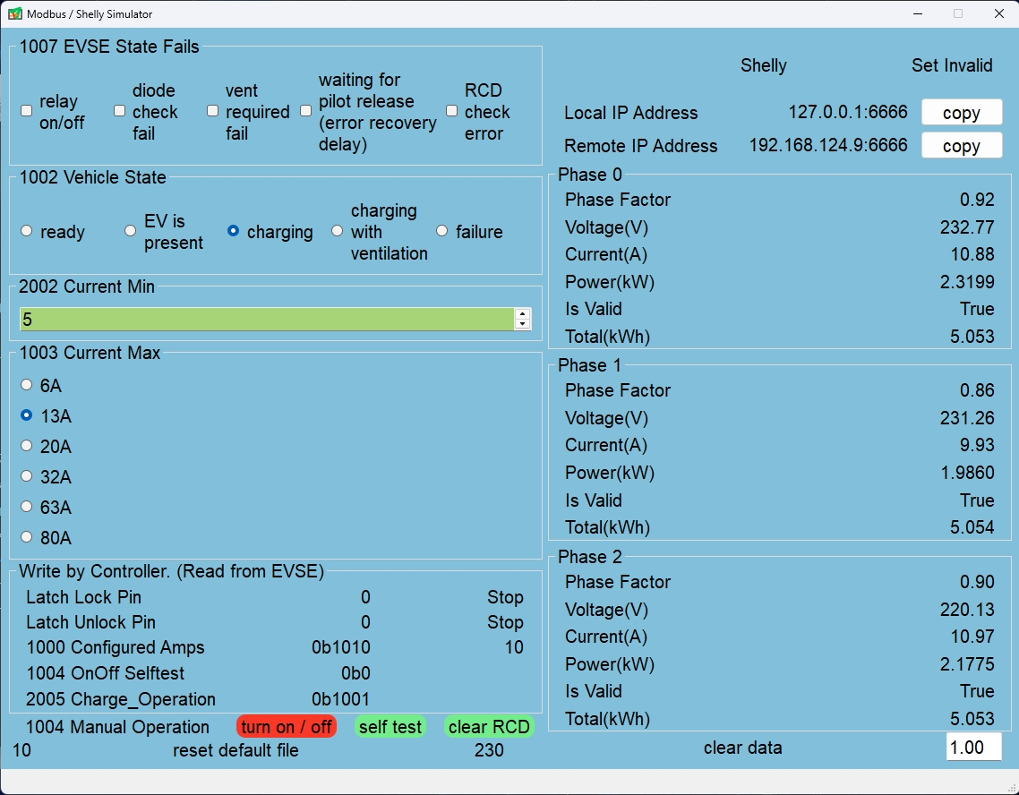
Simulation
EVSE & Shelly Simulator
Notes:
We wrote a software to simulate the reading and writing of evse and shelly, which is convenient for debugging algorithms without hardware.
The simulator is developed using PyQt5 and provides a visual interface, allowing users to view and adjust simulation parameters.
This simulator allows for the debugging and optimization of the system’s charging control logic in a safe testing environment, ensuring functionality correctness and reducing the safety risks associated with direct live testing.

