Slide 1
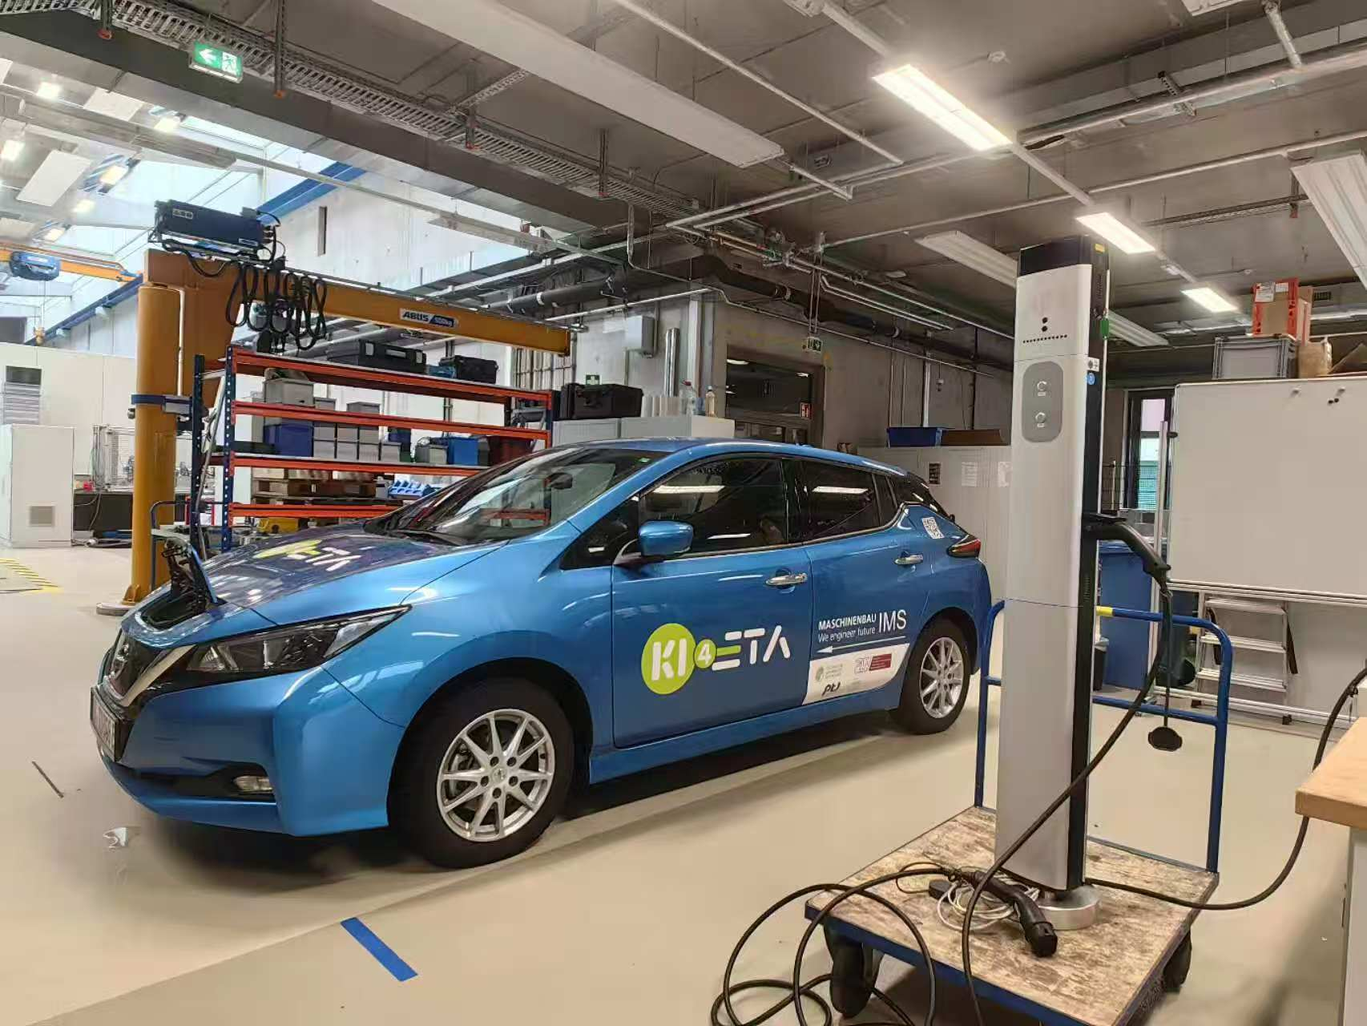
ADP - Charging Station Upgrade to OCPP Communication for Smart Charging
reported by Junfan Jin, Can Zeng, Yunan Jiang and Huang Chen

Slide 2
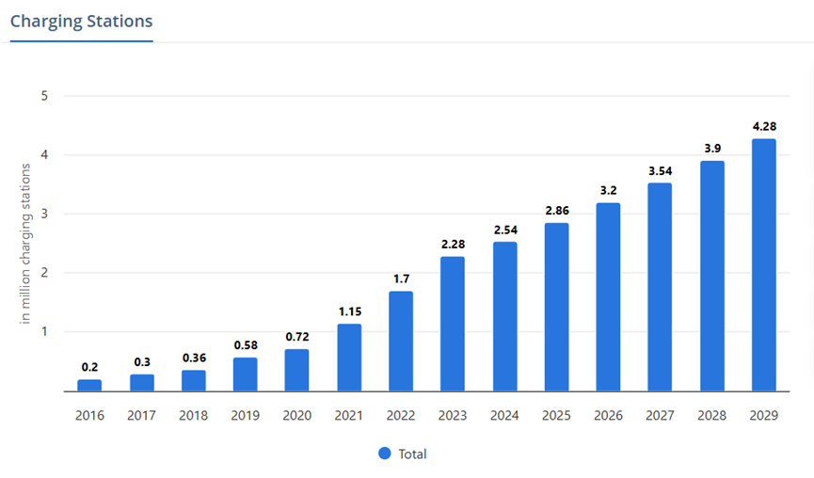
Background
1, Increasing number of
EVs & Charging Stations
2, In Germany, “plug and
charge” mode of 10 million
EVs by 2035 increase 50%
in low-voltage grid and
transformer costs [1]
Figure 1: Charge station sales increasing over the years [2]

Slide 3
Significance
OCPP
Peak shaving
Variable charging rate
Open source
Decrease overload of grid
Electricity price
Battery capacity

Slide 4
Objectives
1, Search and read existing literature on standardized charging infrastructure and smart charging
2, Learn about the existing charge point
3, Upgrade the old charge point
to support the OCPP communication protocol
4, Complete the construction of a prototype of a smart charging system
5, Test and debug the functions of the smart charge point

Slide 5

Problems during Testing
1, No indicator for charge point
Solution:
Always on ready to set current
Fast blinking 0,1s Current is set
Slow blinking 1s Charging
Blinks 2 times Error
2, Modbus port allows only one thread at
one time
Solution: first, serialize access using thread
lock (use context manager to
manage)
then ensure globlally unique
access with singelton pattern
3, Register 1006 “only readable”
Figure 2: Test in lab
Figure 3: Register 1006 status of EVSE from datasheet

Slide 6
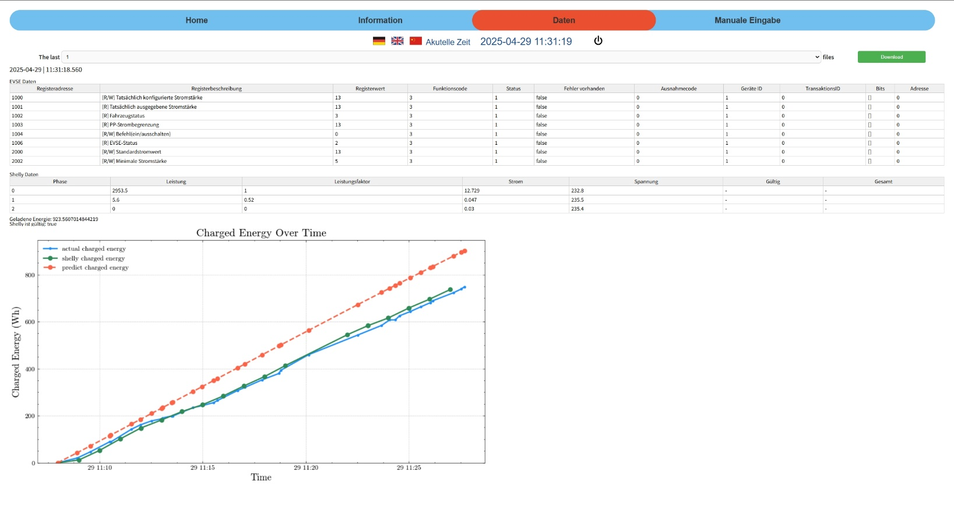
Conclusions
1, Results
1,1 Charging point control and optimization
different modes: directly charging or using charging schedule
1,2 Data visualization
Figure 4: GUI

Slide 7
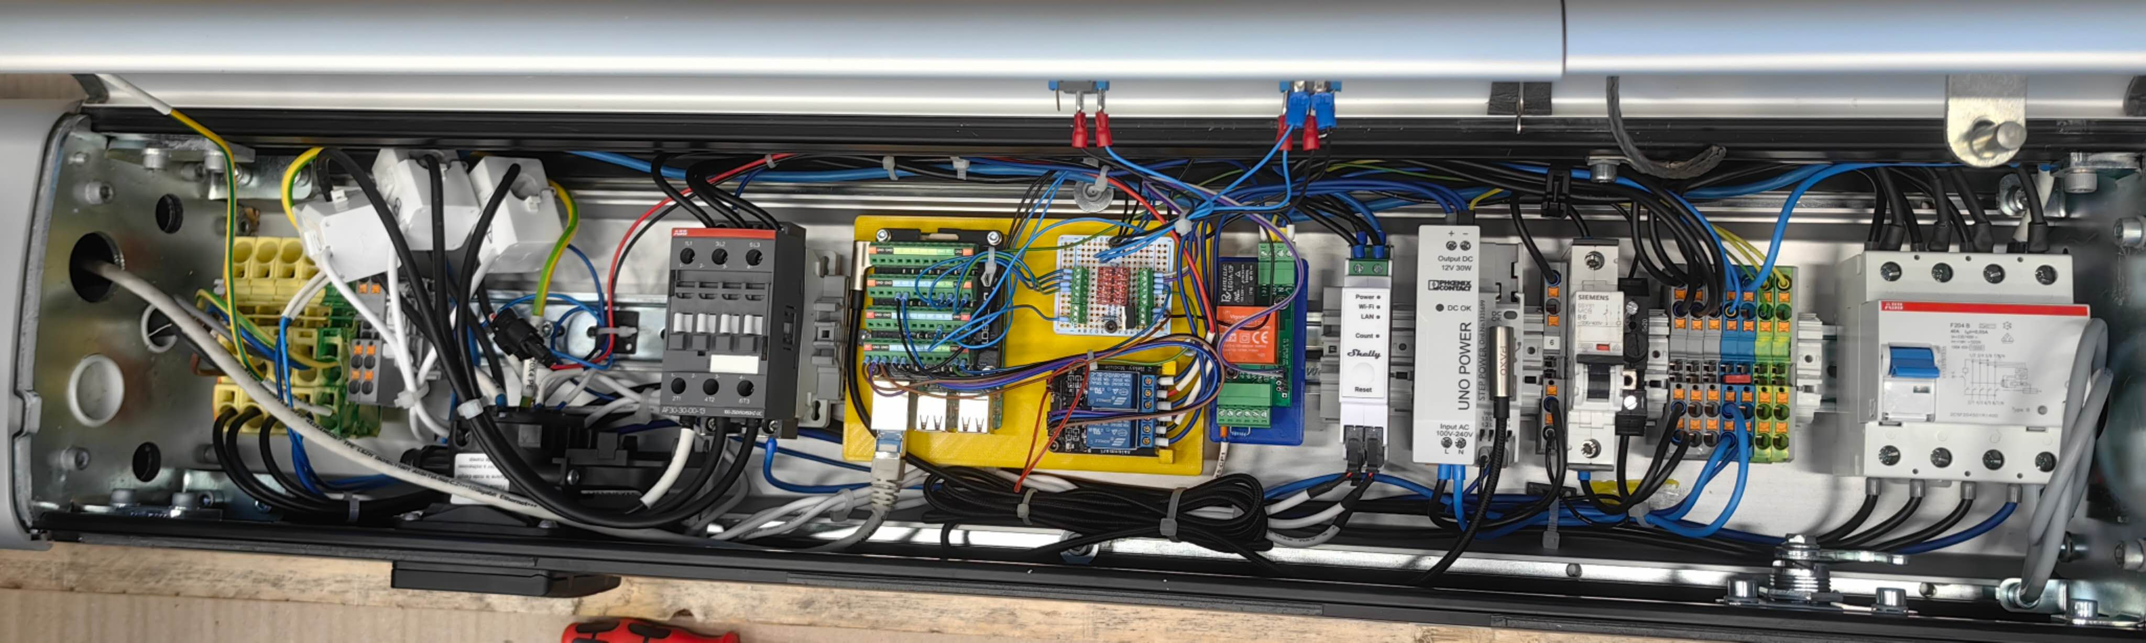
Conclusions
1,3 Communication between charge point and optimizer
1,4 GUI Deign including charging status, log information and control operations
1,5 Simulator Deign
1,6 Hardware modification (Raspberry Pi, Shelly, relay for DC-motor and LED-
indicator)
Figure 5: Hardware connection

Slide 8
Conclusions
2, Discussion
2,1 Compatibility Issues with the OCPP Python Library Versions
2,2 Current Monitoring and Safety Control
2,3 Raspberry Pi Wi-Fi Hotspot Support
2,4 Limitation on Web Terminal Message Display (memory overflow or browser crashes)

Slide 9
Literature
[1] https://www.statista.com/outlook/mmo/electric Electric Vehicles.url:vehicles/worldwide
(visited on 01/2025).
[2] International Renewable Energy Agency(IRENA). Innovation Outlook Smart Charging For Electric Vehicles.Tech. rep. International Renewable Energy Agency(IRENA), 2019

