Slide 1






Optimization considerations
Extend Battery Lifespan
4
1
Predict Charging Demand
2
Optimize Charging Costs
Achieve Grid Load Balancing (V2G)
5
3
Different charging options
Improve User Experience
6
Notes:
In the optimizer part, we considered 6 optimization directions:
1. Predict charging demand through the user's historical electricity usage. In this project, we wrote a function to generate random electricity history usage as one of the input parameters of the optimizer
2. Optimize charging costs based on dynamic electricity prices. In this project, the electricity price is converted into a list as one of the inputs of the optimizer
3. Provide users with different mode options. There are 3 modes: shortest charging time, minimum charging cost and dynamic adjustment
4. Improve battery life. We consider continuing to charge at the minimum current after full charge to extend battery life
5. Use V2G to balance the grid load, but in actual testing, our car does not have hardware support, so it is not used
6. Improve user experience. We hope to develop a mobile app in the future to intelligently recommend charging modes based on user habits, etc.
在优化器部分，我们考虑了6点优化方向：
1，通过用户的历史用电记录来预测充电需求，在本项目中，我们写了一个函数来生成随机的用电历史记录，作为优化器的输入参数之一
2，根据动态电价来优化充电开销，本项目中将电价变为一个列表成为优化器的输入之一
3，提供用户不同的模式选择，有3种模式：最短充电时间，最小充电花销和动态调整
4，提高电池寿命，我们考虑在充满电之后持续以最小电流继续充电来延长电池寿命
5，使用V2G来平衡电网负载，但在实际测试中我们的汽车没有硬件支持，所以没有使用
6，提高用户体验，我们希望后续开发手机app，根据用户习惯来智能推荐充电模式等

Slide 2
Optimization method
Why Use scipy.optimize.minimize for Optimization?
easy to deploy
Pros
Cons
Lacks learning ability
No need for training
Optimization failed
with multiple uncertainties
Fast computational speed
Notes:
After careful consideration, we chose the minimize function in scipy for optimization.
Its biggest advantage is that it is easy to develop and has fast calculation speed.
在经过考虑后，我们选择了scipy中的minimize函数来进行优化，其最大的优点在于容易开发和计算速度快

Slide 3
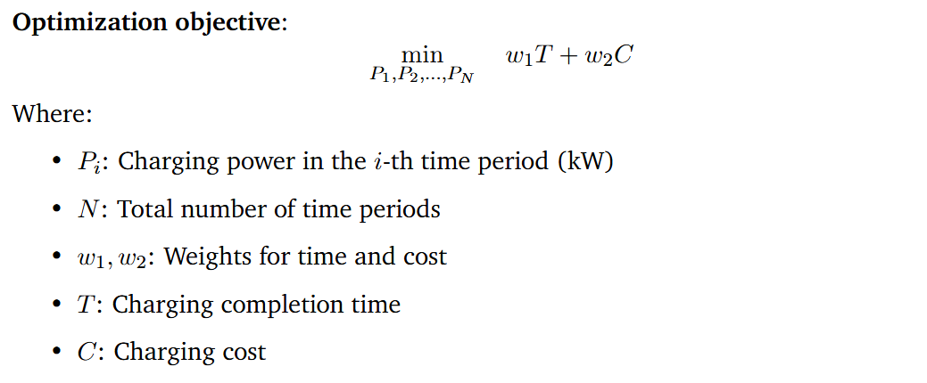
Optimization objective
Notes:
Our final optimization objective function is shown in the figure.
This cost function consists of two parts. T represents the time required to reach the target charging amount, and C represents the total charging cost.
The sum of these two parts multiplied by weights w1 and w2 is our optimization goal.
Other specific parameters are shown in the figure
我们最终的优化目标函数如图，
这个costfunction由两部分组成，T代表了达到目标充电量所需的时间，C代表了总共的充电花销，将这两部分分别乘以权重w1和w2相加便是我们的优化目标，
其他的具体参数如图

Slide 4
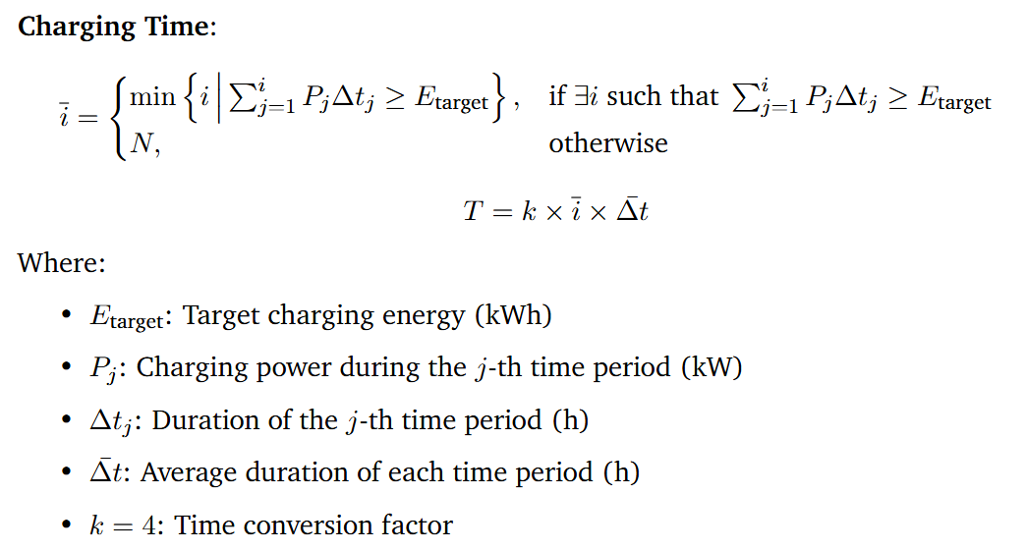
Optimization objective
Notes:
This equation defines how we calculate the charging time required to reach the energy target.
First, we identify the earliest time index i‾\overline{i}i at which the accumulated energy from charging—calculated as the sum of PjΔtjP_j \Delta t_jPj​Δtj​—meets or exceeds the target energy EtargetE_{\text{target}}Etarget​.
If the target is never met, we assume the full schedule is used.
Then, we compute the total charging time Tby multiplying i‾\overline{i}i with the average time step Δtˉ\bar{\Delta t}Δtˉ and a factor k, which adjusts the time units to match our system output—such as converting hours to time slots or cost units.
This approach allows us to evaluate and minimize charging duration as part of the overall optimization.

Slide 5
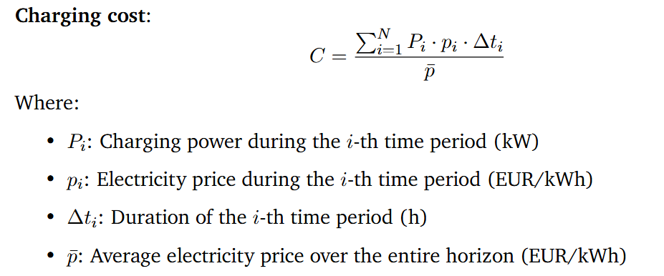
Optimization objective
Notes:
This equation defines the charging cost CCC as a normalized sum of energy consumption over time.
In each time period iii, the cost is calculated as the product of the charging power PiP_iPi​, the electricity price pip_ipi​, and the duration Δti\Delta t_iΔti​.
We then sum this over all time periods and normalize it by the average electricity price pˉ\bar{p}pˉ​.
This normalization allows us to compare cost-effectiveness under different pricing conditions and ensures the cost term is consistent with other terms in the objective function.
By optimizing this term, the system prefers charging during low-price periods while still ensuring the energy demand is met efficiently.

Slide 6


Optimization objective
Notes:
To ensure feasibility and safety, our optimization includes two key constraints.
First, the total charged energy—the sum of Pi⋅ΔtiP_i \cdot \Delta t_iPi​⋅Δti​ over all time periods—must meet or exceed the target energy EtargetE_{\text{target}}Etarget​.
Second, in each time period, the charging power PiP_iPi​ must stay within its allowed range, defined by a minimum and maximum power limit, Pmin⁡,iP_{\min, i}Pmin,i​ and Pmax⁡,iP_{\max, i}Pmax,i​. These bounds can vary depending on hardware limits or grid constraints.
For the initial guess used by the optimizer, we simply set P0P_0P0​ as the average of all maximum powers across the time horizon.
This initialization provides a reasonable starting point for the solver to quickly converge to an efficient solution.

Slide 7
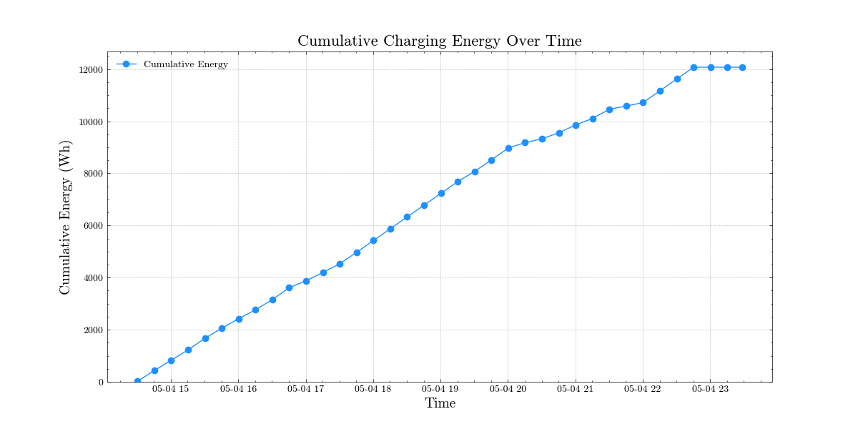
Optimization result
Notes:
This picture shows the charging amount in different modes.
You can see that the functions of different modes are perfectly realized.
这张图片展示了不同模式下的充电量，可以看到完美的实现了不同模式的功能

Slide 8
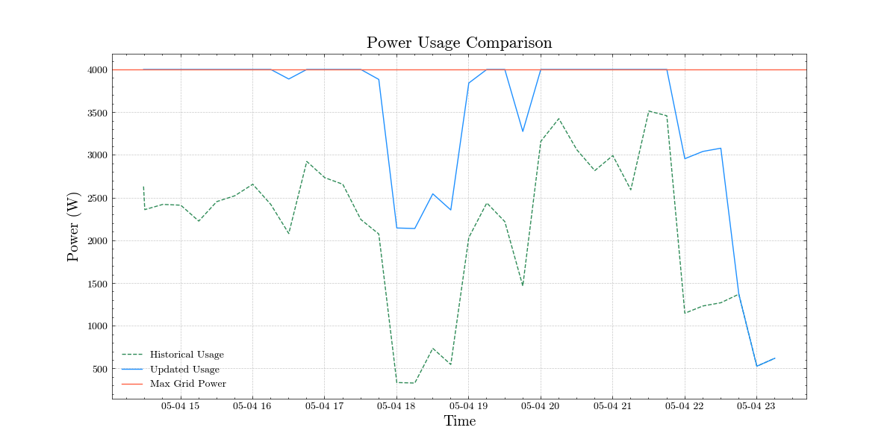
Optimization result
Notes:
This picture shows the user's grid power.
The green line represents the user's historical power consumption when not charging,
the red line represents the maximum power,
and the blue line represents the power load after adding car charging.
It can be seen that the final power does not exceed the maximum power,
and charging stops after reaching the target charging amount.
这张图片展示了用户的电网功率，图中绿线代表未充电时用户的历史用电，红线代表了最大功率，而蓝线表示了加入汽车充电后的用电负载，可以看到最终的功率没有超过最大功率，并且在达到目标充电量之后就停止充电了。

Slide 9
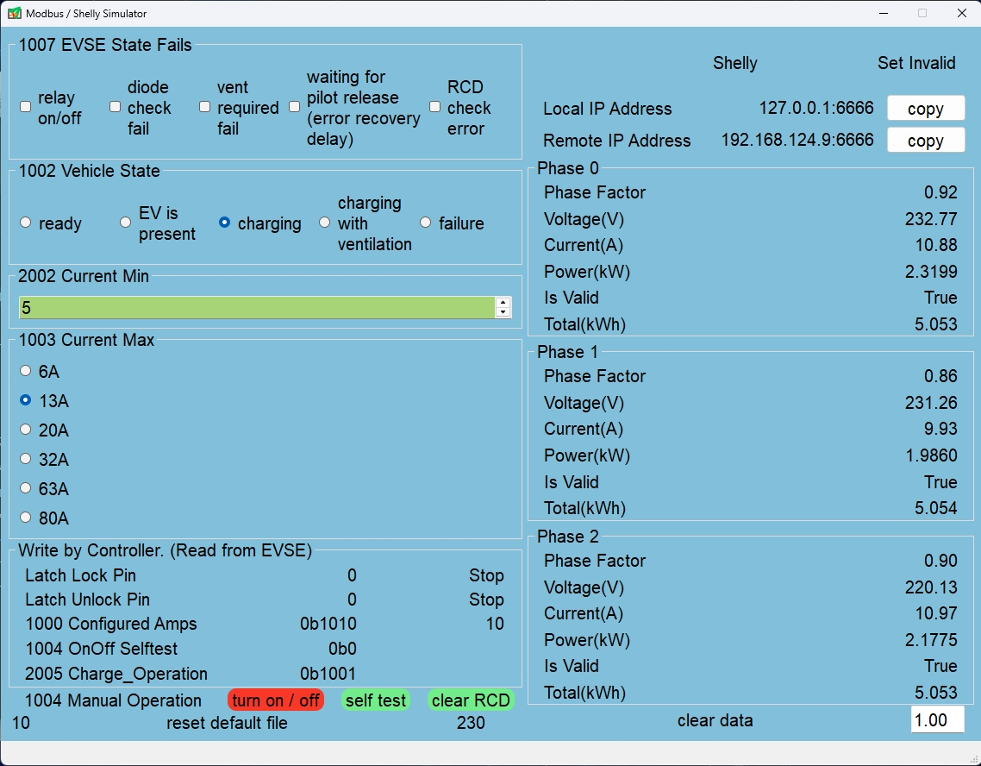
Simulation
EVSE & Shelly Simulator
Notes:
In order to simulate the test without hardware, we wrote a software to simulate the functions of evse and shelly.
It is mainly realized by reading and writing fixed json files and transferring them to the Raspberry Pi.
Later, Chen Huang will talk about things related to testing.
为了在脱离硬件也能模拟测试，我们写了一个软件来模拟evse和shelly的功能。主要是通过读写固定的json文件传输给树莓派来实现。后面由陈煌来讲和测试有关的东西

