Slide 1
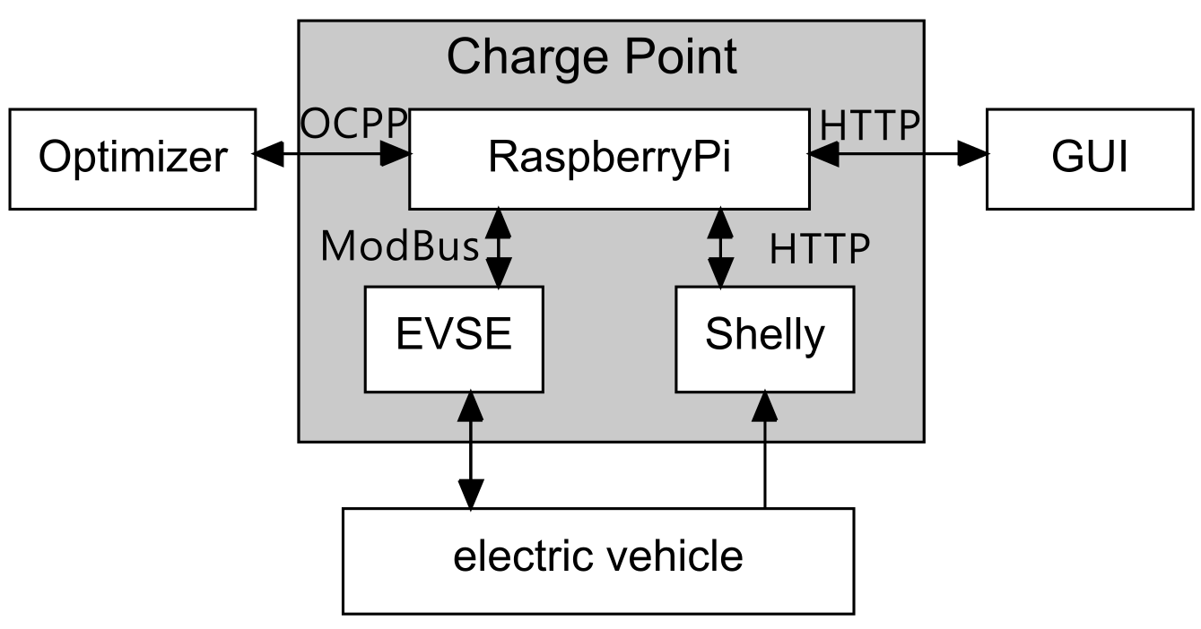
System Architecture - Overview

Slide 2



System Architecture - Requirements
Communication Protocol Support
Concurrent Tasks Scheduling
System Expansion Design
Coroutine(C),Multithreading(T)
OCPP Protocol
WebSocket Communication
Coroutine Isolation
C: Message Communication Management
C+T: GUI Remote Interaction Interface
T: Real-time Data Collection and Monitoring
T: Execution of Charging Control Logic
Support for Multi-Port Charging Management
Data Storage and Analysis (Possibility of Providing Database Support)

Slide 3


System Architecture - Implementation
Communication
Concurrent Tasks
Expansion
OCPP v2.0.1 Message (JSON)
SetChargingProfileRequest {
"evseId": 1,
"chargingProfile": {
"id": 1,
"stackLevel": 1,
"chargingProfilePurpose": "TxProfile",
"chargingProfileKind": "Absolute",
"chargingSchedule": [{
"id": 1,
"chargingRateUnit": "W",
"chargingSchedulePeriod": [
{ "startPeriod": 0, "limit": 2845 },
{"startPeriod": 10, "limit": 2845 }, …
],
"startSchedule": "2025-04-28T15: 41: 53Z"}, … ],
…
},
"customData": { "vendorId": "001" }
}
Complex hierarchical nesting, difficult to learn structure
Frequent reference to the OCPP Standard is required when writing code
High probability of error, with significant debugging costs

Slide 4

System Architecture - Implementation
Communication
Concurrent Tasks
Expansion
OCPP Message Generator
g = GenSetChargingProfileRequest
OCPP_Message = g.generate(
evse_id = 1,
charging_profile = g.get_charging_profile(*args),
custom_data = g.get_custom_data(*args)
)
Use different generation functions to generate each message part
IDE provides type hints and Docstring
Reduces the learning cost of the OCPP Standard documentation
Structure encapsulation significantly reduces the probability of errors
Unified standard improve team collaboration efficiency

Slide 5
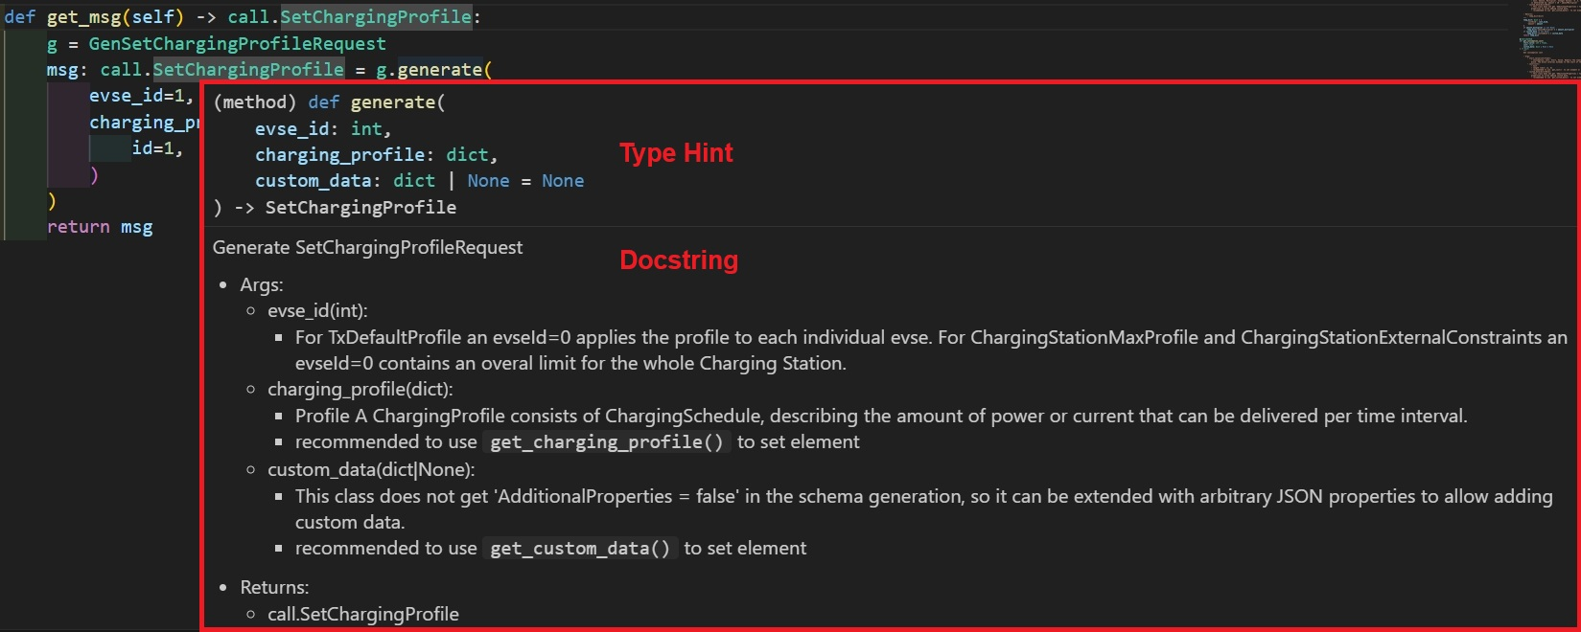
System Architecture - Implementation
Communication
Concurrent Tasks
Expansion
OCPP Message Generator
V2.0.1 —> 128 v1.6 —>78

Slide 6
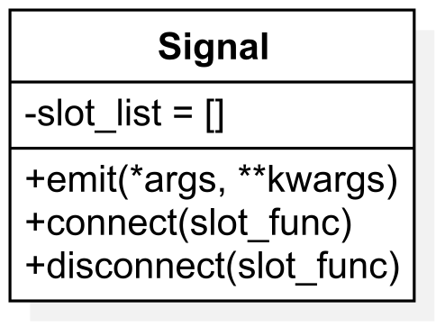


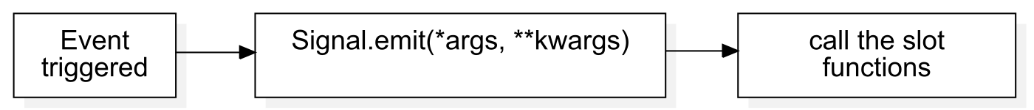
System Architecture - Implementation
Communication
Concurrent Tasks
Expansion
Problem: Multiple modules, complex calls, high coupling
Signal Class -- Decoupling
Supports synchronous/asynchronous calls
No need for fixed callback functions
Facilitates testing, debugging
and expansion
Func
Signal.emit
Func

Slide 7




System Architecture - Implementation
Communication
Concurrent Tasks
Expansion
System Expansion
Database Support: the foundation for data storage and analysis
Support for Multiple Devices (EVSEs, Shellys): Flexible hardware integration
Modular Architecture Design: Easy to combine and expand
Multi-Platform GUI Control Support: Unified Control

Slide 8
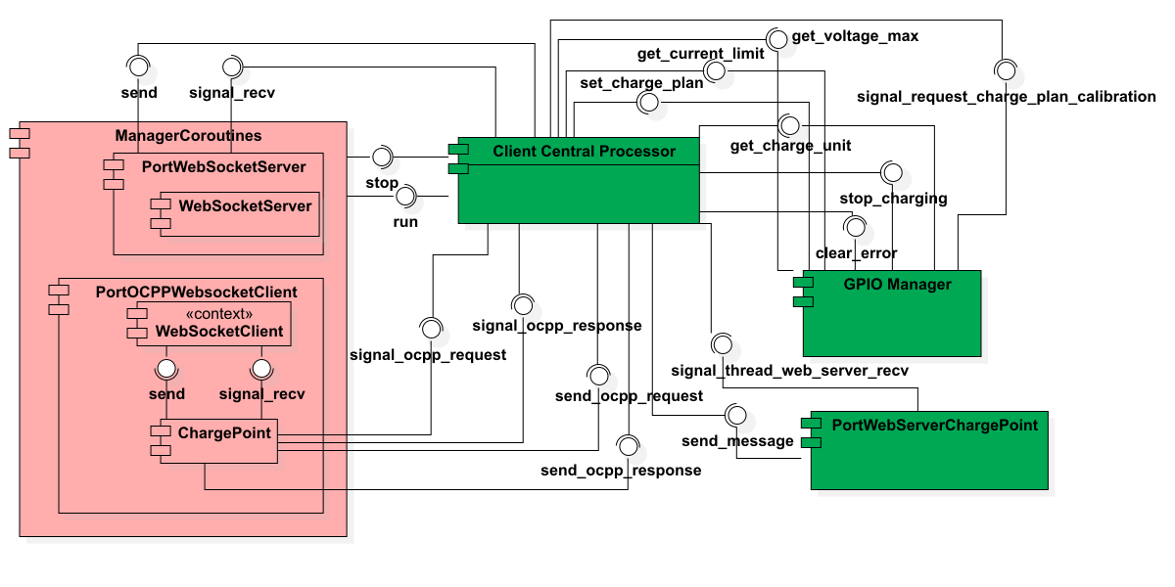
System Architecture – Charge Point

Slide 9
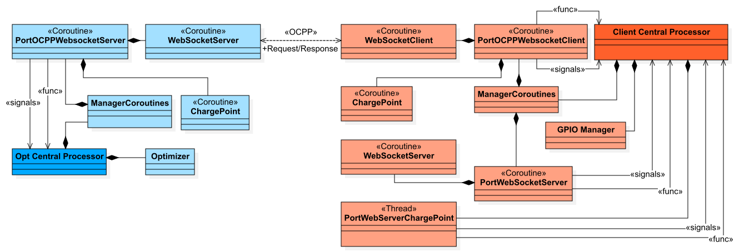
System Architecture - Project

