Slide 1
Business Analytics Competition
@ Manhattan College 2022
Lessons of COVID-19
An analysis examining global response to COVID-19 in preparation for the next public health crisis.
Minnesota State University, Mankato
Jeremy Fischer
Joseph Fussy
Advisor: Dr. Ishuan Li Simonson

Slide 2





Introduction
Data Preparation
COVID-19 pandemic
Originated in Hubei Province of China
Collection of Data:
Bloomberg_covid_resilience_ranking.xlsx
Covid_variables_and_country_specific_variables.xlsx
Oxford_covid_government_response_variables.xlsx
Variable names recoded for analysis
Were shorten for analysis
In presentation, variables presented under original names
Cases with Missing Values
Populated via external research
If else, averages used
Tools Used
BAC @ Manhattan College 2022
Fischer, Fussy

Slide 3
1
What have we learned about facing the effects of the pandemic, globally?
Case Questions
2
How did Bloomberg and Oxford construct resiliency rankings? What are their characterizations and ranges? What advice can be given from this information?
3
How do we prepare for the next public health crisis?

Slide 4
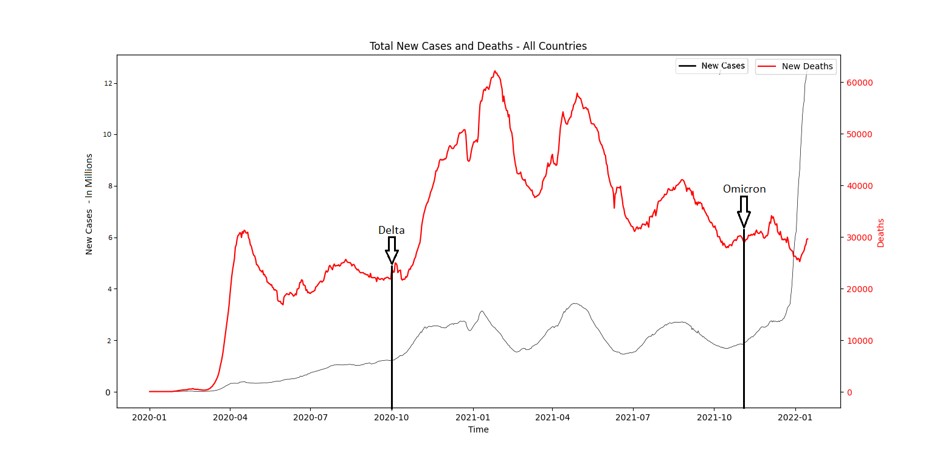
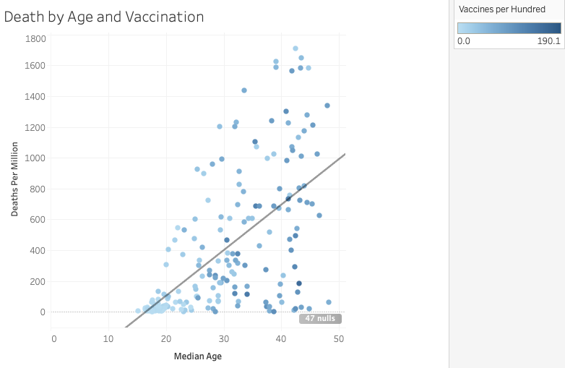
1
What have we learned about facing the effects of the pandemic, globally?
COVID Effects & Health Policies
Total Cases and Deaths – All Countries
‘Covid_variables’ file used to aggregate the total new cases/deaths
Delta and omicron start dates are the earliest documented samples reported from WHO
Increased deaths globally from Delta strain
High cases from Omicron strains
Death by Age and Vaccination
- Positive correlation between median age and death
Figure (1): Total New Cases and Deaths – All Countries
Figure (2): Death by Age and Vaccination
BAC @ Manhattan College 2022
Fischer, Fussy

Slide 5
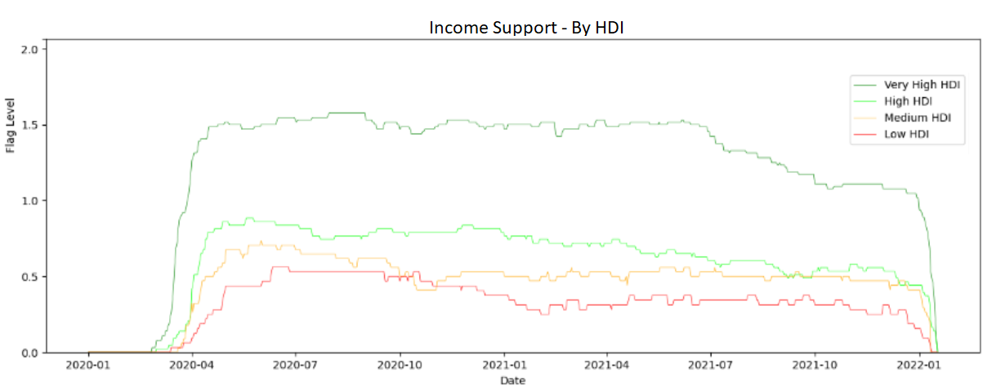
1
What have we learned about facing the effects of the pandemic, globally?
Economic Policy
HDI Effect on Income Support
Higher HDI can afford substantial economic support
Nations taper off as time progresses
Support given to:
Alleviate economic downturn
Subsidies closure of social functions
Figure (3): Income Support – By HDI
Flag Level:​
0: No income support​
1: Gov. replacing <50% lost salary​
2: Gov. Replacing >50% lost salary​
BAC @ Manhattan College 2022
Fischer, Fussy

Slide 6
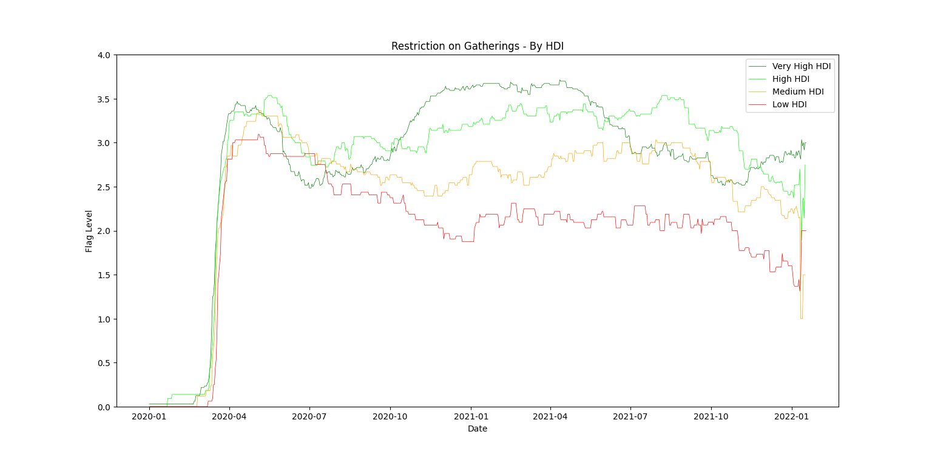
1
What have we learned about facing the effects of the pandemic, globally?
Containment Policy
Initial spike of unknown followed by a taper
Higher HDI Countries can afford longer:
Restrictions
Workplace closure
School closure
Along with the infrastructure to go online
Figure (4): Restrictions on Gatherings – by HDI
Flag Level:
0: No restrictions
1: Restrictions on gatherings >1000
2: Restrictions on gatherings 101-1000
3: Restrictions on gatherings 11-100
4: Restrictions on gatherings <10
BAC @ Manhattan College 2022
Fischer, Fussy

Slide 7
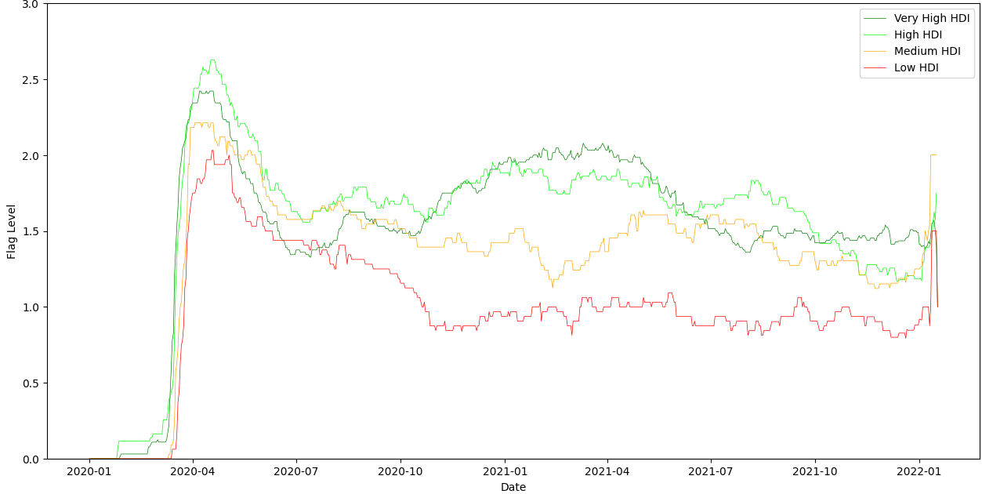
1
What have we learned about facing the effects of the pandemic, globally?
Figure (5): Workplace Closing – By HDI
Flag Level
0: No measure/requirements
1: Recommend closing
2: Require closing of some sectors
3: Require closing except essential workers
BAC @ Manhattan College 2022
Fischer, Fussy

Slide 8
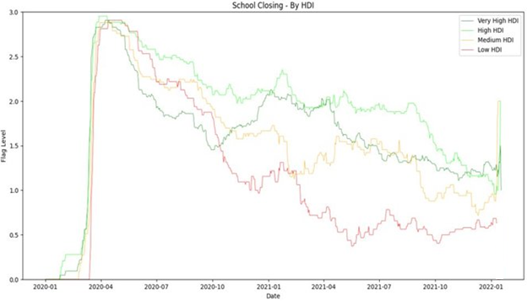
1
What have we learned about facing the effects of the pandemic, globally?
Figure (6): School Closing by HDI
Flag Level
0: No measure/requirements
1: Recommend closing or in school alterations
2: Require closing at some levels
3: Require closing at all levels
BAC @ Manhattan College 2022
Fischer, Fussy

Slide 9
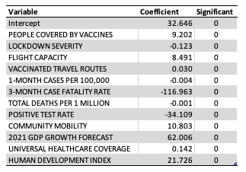
2
How did Bloomberg and Oxford construct resiliency rankings? What are their characterizations and ranges? What advice can be given from this information?
Ranking Construction:
Multiple regression model
Source: Bloomberg November 2021 tab
Dependent variable: BLOOMBERG RESILIENCY SCORE
Independent variable: Figure (?)
Mapped rank 1-to-1
Variables with largest absolute value:
3-MONTH CASE FATALITY RATE
2021 GDP ANNUAL GROWTH FORECAST
POSITIVE TEST RATE
HUMAN DEVELOPMENT INDEX
COMMUNITY MOBILITY
Figure (7): Bloomberg Resiliency Regression Results
BAC @ Manhattan College 2022
Fischer, Fussy

Slide 10
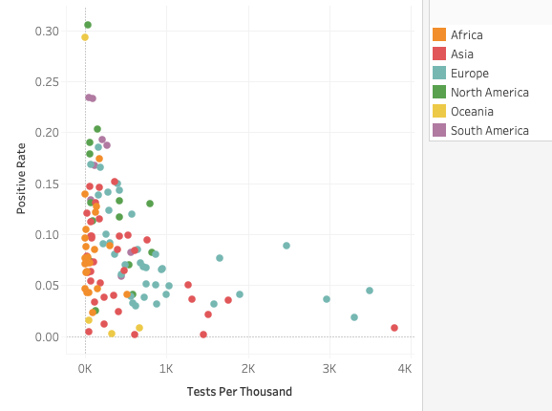
2
How did Bloomberg and Oxford construct resiliency rankings? What are their characterizations and ranges? What advice can be given from this information?
Characterizations and Ranges:
Missing values
External research to repopulate
If else, averages applied
Analysis guided by epidemiology
Omission of ‘POSTIVE TEST RATE’ and ‘3-MONTH CASE FATALITY RATE’
’POSTIVE TEST RATE’ dropped by Bloomberg (2/22)
Figure (8): Positive Test Rate and Tests per Thousand
BAC @ Manhattan College 2022
Fischer, Fussy

Slide 11
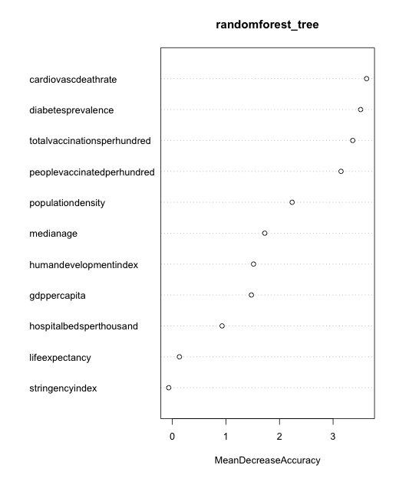
3
How do we prepare for the next public health crisis?
Major Lessons from COVID-19
Important factors:
Health of population
COVID vaccination
HDI, real GDP per capita
Recommendations, Next Health Crisis:
Short-term:
Study crisis disease, understand its properties
Invest in vaccine R&D, distribution
Long-term:
National health campaigns (cardiovascular disease, diabetes)
Focus on economic development
Broadband access, education
Figure (9): Excess Mortality: Random Forest Tree
BAC @ Manhattan College 2022
Fischer, Fussy

Slide 12
3
How do we prepare for the next public health crisis?
Major Lessons from COVID-19 (Avoiding Excess Death):
Short-term:
Placing focus off stringency
Long-term:
Invest in pandemic preparation resources
Quick education resumption
Recommendations for Next Health Crisis:
Short-term:
Understand disease’s properties, invest in vaccine R&D
Long-term:
Avoiding loss in human capital from lockdown, other restrictions
Maintaining economic strength, keeping...
BAC @ Manhattan College 2022
Fischer, Fussy

Slide 13
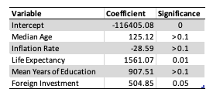
3
How do we prepare for the next public health crisis?
Economic Recommendations:
Short Run:
- "Better safe than sorry"
- Fiscal policies that support reduction of transmission
Long Run:
Focus on raising economic indicators (GDP per capita, HDI)
Increasing broadband access, virtual infrastructure
Marginal benefit must >= marginal cost.
Excessive policy can do more harm than good.
Figure (10): Real GDP Per Capita: Regression Coefficients
Figure (10) Methodology
Education Impact on Human Capital
One year missed education: loss of 907.51 U$
BAC @ Manhattan College 2022
Fischer, Fussy

Slide 14
Lessons Learned
Evolving Crisis
The virus changed from more deadly to more contagious
Policy should reflect that change
Human Development Index Impact
National response, resiliency highly linked to HDI
‘One-size fits all plan’ not possible
1
Increasing Resiliency
Mobility
Reducing lockdown duration, severity
Finding solutions to keep economy open
Vaccine Doses
Funding health professional to research, develop vaccine
Quick R&D, distribution of vaccination
2
Conclusions
Preparing for Next Heath Crisis
Policy
Must do more positives than negatives
Guide recommendations from excess death
Next Health Crisis
Long-term focus on improving population health
Preserve human capital via education alternative solutions
3

Slide 15
References
https://www.who.int/en/activities/tracking-SARS-CoV-2-variants/
https://www.mckinsey.com/industries/education/our-insights/covid-19-and-education-the-lingering-effects-of-unfinished-learning
https://www.brookings.edu/blog/brown-center-chalkboard/2022/03/03/the-pandemic-has-had-devastating-impacts-on-learning-what-will-it-take-to-help-students-catch-up/
BAC @ Manhattan College 2022
Fischer, Fussy

