Slide 1
AegisLink
Console-Based Encrypted File & Message Transfer System
Software Project Lab
Jannatul Ferdous
Roll: 1646 · Supervisor: Dr. Md. Shariful Islam

Slide 2
Table of Contents
01 — Project Description
06 — Progress
02 — Motivation
07 — Output / Demo
03 — Working Methodology
04 — Technology Used
05 — How Algorithms Work
2

Slide 3
Project Description
AegisLink is a console-based client-server application built in C++ for secure communication over TCP.
—
Send encrypted text messages between clients in real time
—
Transfer files securely over the network
—
Choose between DES or AES encryption before each transfer
—
SHA-512 hash computed and attached to every message and file
—
Server verifies integrity on arrival — flags [INTACT] or [TAMPERED!]
—
Supports multiple clients connected at the same time
—
Runs on port 346 using Winsock2 TCP sockets
3

Slide 4
Motivation
Why was this project built?
When data is sent over a network without any protection, anyone in the middle can read it or silently change it. The receiver has no way of knowing. This is a real problem — not just in theory.
What this project solves:
Can someone read my data?
No — DES or AES encryption makes it unreadable to anyone without the key.
Can someone modify my data?
Detected — SHA-512 hashing catches any change and the server flags it immediately.
Is it hard to use?
No — just run the server, connect the client, and start sending. No setup required.
4

Slide 5
Working Methodology
01
02
03
Connection
Encryption
Hashing
Client connects to server via TCP (port 314159), enters name, selects DES or AES.
Message or file is encrypted locally before leaving the client.
SHA-512 hash of the ciphertext is computed and attached to the data.
04
05
06
Transmission
Verification
Relay
Encrypted data + hash is sent over the TCP socket to the server.
Server recomputes hash and compares — flags [INTACT] or [TAMPERED!].
If intact, server decrypts and forwards to all other connected clients.
5

Slide 6
Technology Used
DES — Data Encryption Standard
AES — Advanced Encryption Standard
· 64-bit block, 56-bit key, 16 rounds
· 128-bit block, 128-bit key, 10 rounds
· Feistel network structure
· SubBytes → ShiftRows → MixColumns
· Legacy — included for comparison
· Current industry standard
SHA-512 — Hashing
TCP Socket Programming
· Produces 512-bit digest of ciphertext
· Winsock2, port 314159
· 1-bit change → completely different hash
· std::thread per connected client
· Flags [INTACT] or [TAMPERED!]
· Supports messages and file transfer
6

Slide 7
How the Algorithms Work
DES
AES
SHA-512
64-bit Plaintext
128-bit Plaintext
Ciphertext Input
Initial Permutation
AddRoundKey (Key 0)
Padding (×1024 bits)
Split: L(32) + R(32)
SubBytes
Init H0–H7
16 Feistel Rounds
ShiftRows
80 Mixing Rounds
Swap Halves
MixColumns
Add to Hash Values
Final Permutation
AddRoundKey ×10
Compare Hashes
64-bit Ciphertext
128-bit Ciphertext
[INTACT] / [TAMPERED!]
7

Slide 8
Progress
Done
TCP Server Implementation
Multithreaded, handles multiple clients
Done
TCP Client Implementation
Connect, send messages and files
Done
Client-Server Communication
Bidirectional message relay confirmed
Done
DES Algorithm
Encrypt / decrypt messages and files
Done
AES Algorithm
Encrypt / decrypt messages and files
Done
SHA-512 Integrity Verification
Hash check on every transfer
8

Slide 9
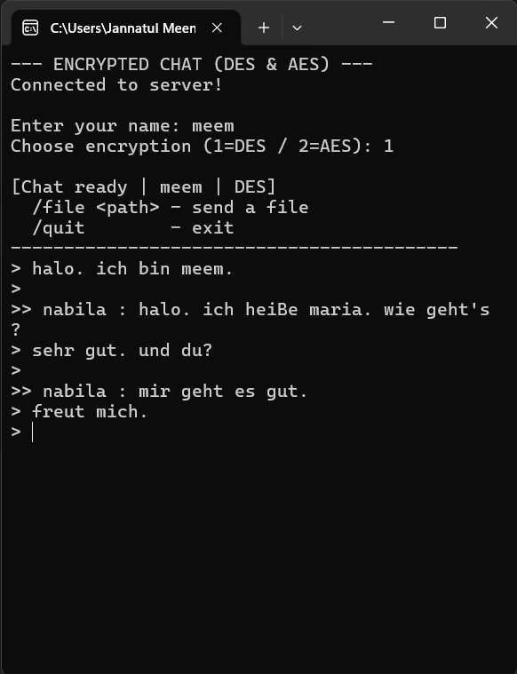
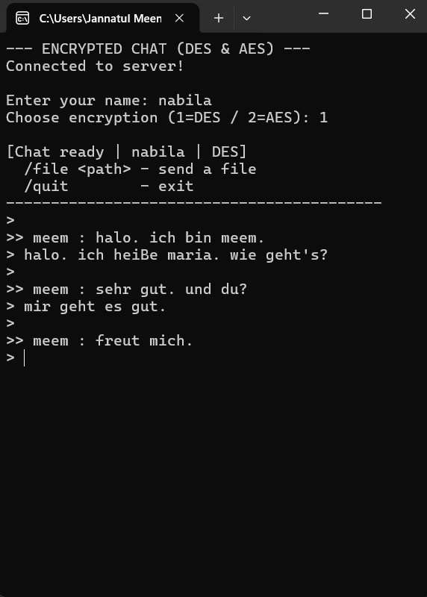
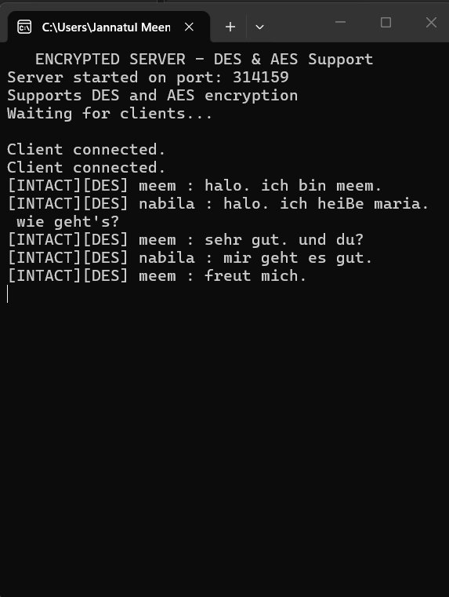
Output — Encrypted Chat (DES)
Client 1 — meem
Client 2 — nabila
Server
Server logs show [INTACT][DES] — confirming messages arrived unmodified.
9

Slide 10
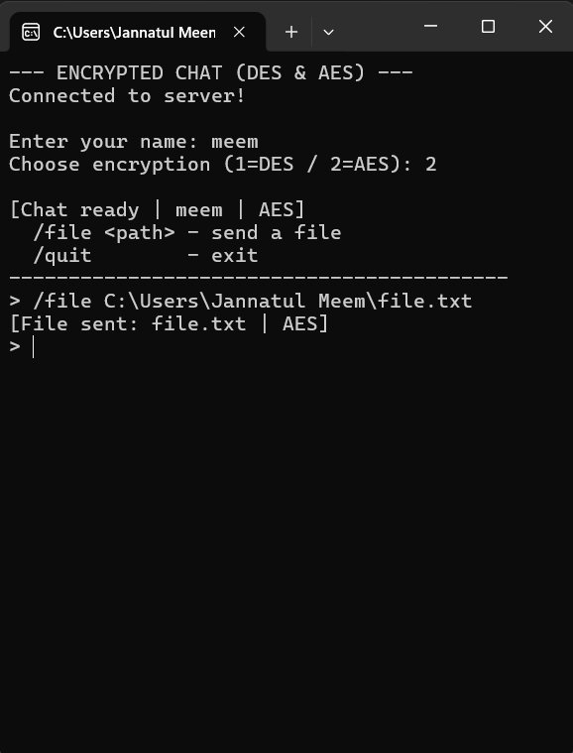
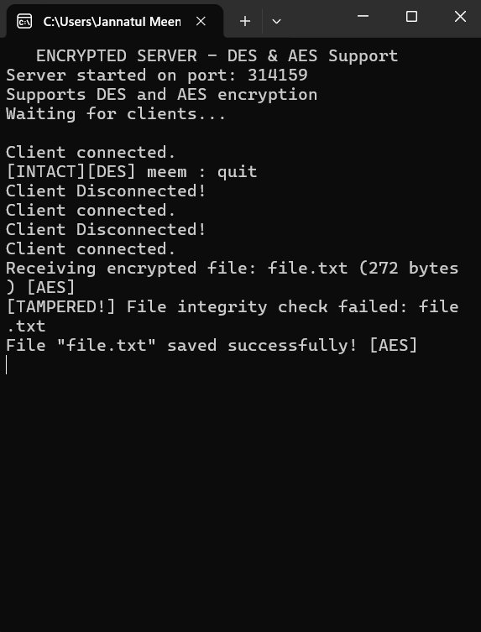
Output — File Transfer (AES) + Integrity Check
Client — sending file.txt via AES
Server — receiving, hash check, save
Server detects [TAMPERED!] on hash mismatch, then saves the file successfully with AES decryption.
10

Slide 11
Thank You
Jannatul Ferdous · Roll: 1646 · Supervisor: Dr. Md. Shariful Islam
GitHub Repository
https://github.com/Jfmeem/AegisLink

