Slide 1
How does High School AP test performance relate to ACT test performance? And how well do students need to do on their ACT tests in order to get into their college of choice?
HS Student to Target College

Slide 2
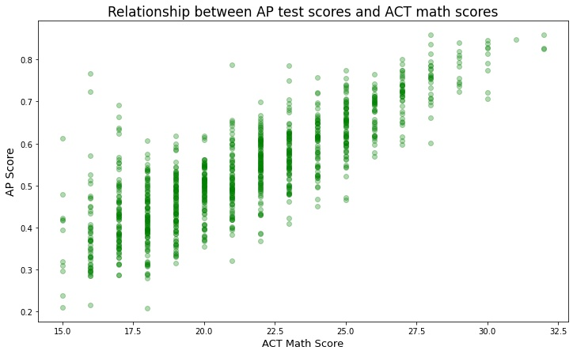
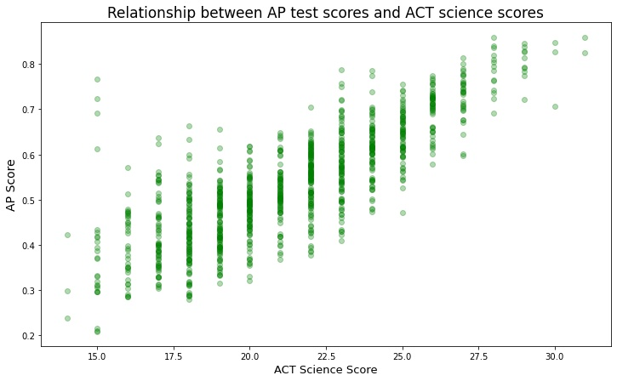
Are AP test scores related to getting into particular colleges?
In the scatterplots below we can see that as AP scores increase, so do ACT science and math scores.

Slide 3
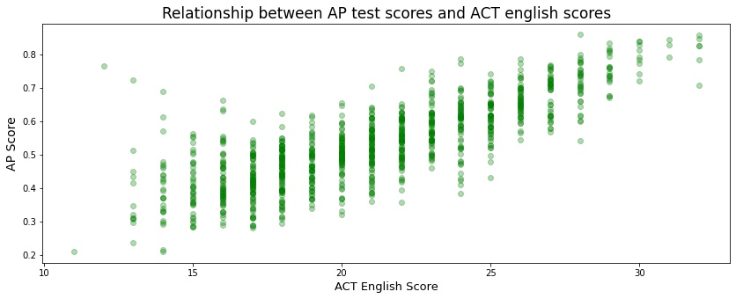
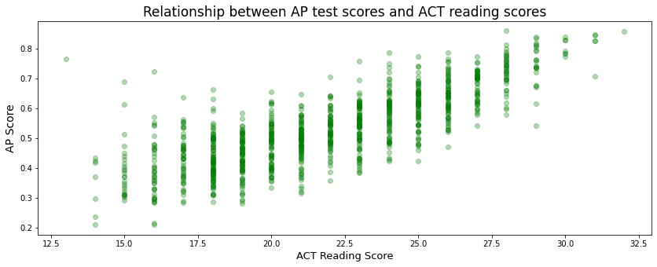
The scores that students get in their AP tests are also very indicative of the ACT scores in English and Reading they are most likely to receive. The relationship between the two illustrates how certain AP test scores are more likely to result in ACT scores within a particular range.

Slide 4
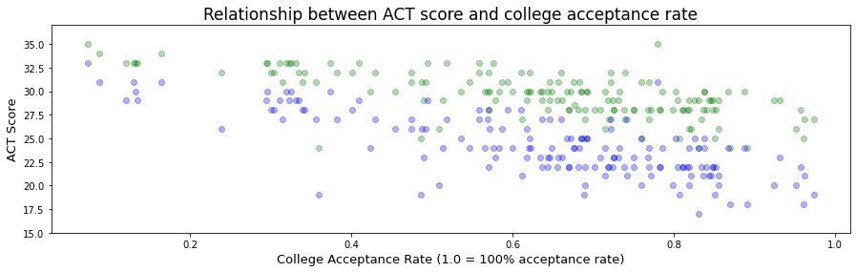
Students admitted to colleges with acceptance rates under 20% tend to have ACT scores within the 28-35 range.
Colleges with higher acceptance rates tend to accept students with a much wider range of ACT scores.

Slide 5
In summary, because AP test scores can be such valuable predictors of ACT test performance, and ultimately acceptance into choice colleges, we can set performance targets for high school students with certain colleges in mind.
We already covered how colleges with more selective acceptance rates tend to accept students with higher ACT scores, but one interesting thing to note is that with a correlation value of 0.01, the number of applicants has an extremely low level of correlation with acceptance rate, and the ACT scores of the students they admit. So even though a school may see an extremely high number of applicants, their acceptance rate is a much more meaningful metric when considering target ACT scores.

