Slide 1


Deep Learning:
Predicting Length of Stay
Presenter: Jesus Lopez
Instructor: Dr. Xinlian Liu (PhD)

Slide 2

“A deep learning approach for length of stay prediction in clinical settings from medical
records.”
Highly important
Data is fractured

Slide 3
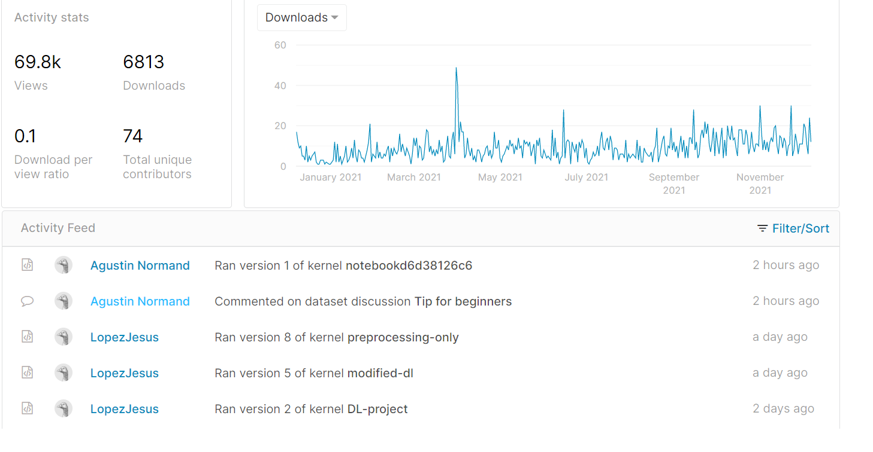
Searching Kaggle

Slide 4
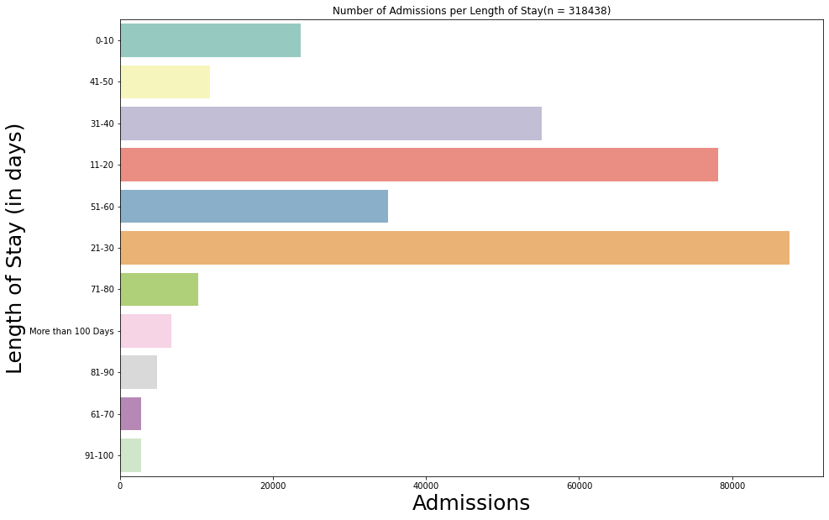

Slide 5
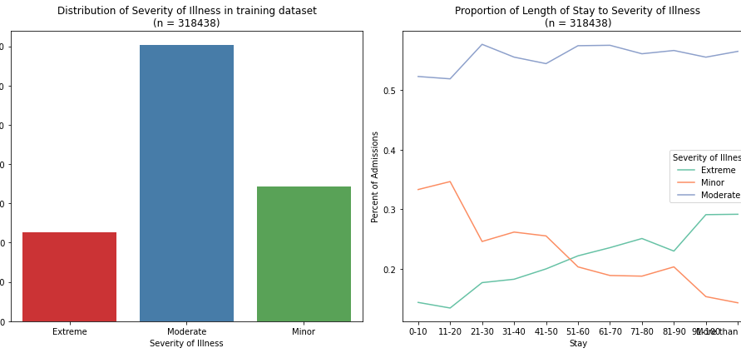

Slide 6
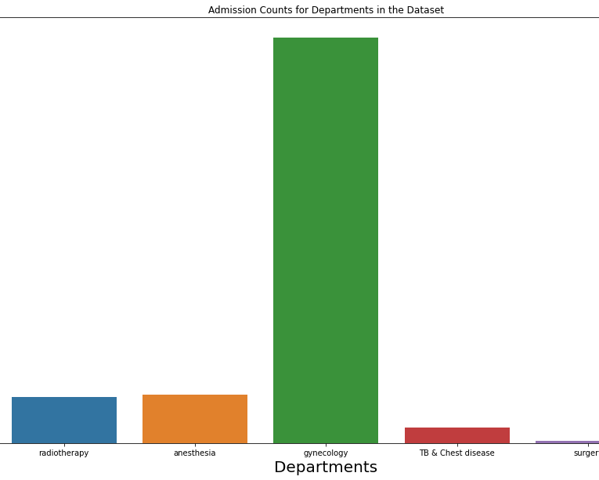

Slide 7
Different Approaches
All the Features
Most of the Features
Only Excluded :
Visitors, Admission Deposit
STEP 1
STEP 2
STEP 4
Few of the Features
STEP 3
Some of the Features
Excluded:
Visitors, Admission Deposit
Hospital_region_code,
Citiy_patient_code
Only used:
Age, Illness_Severity, Admission_Type, Hospital_Type_Code

Slide 8
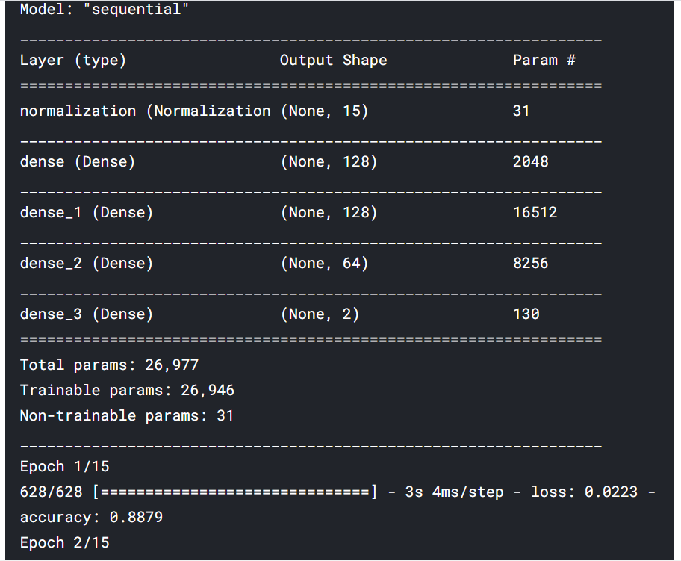
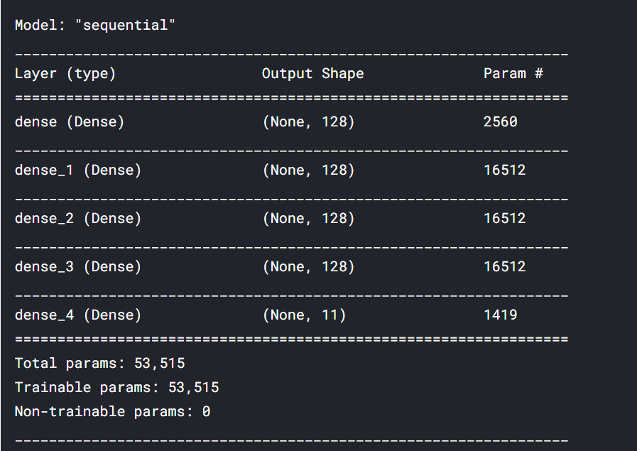
Binary Model
Multiclass Model

Slide 9
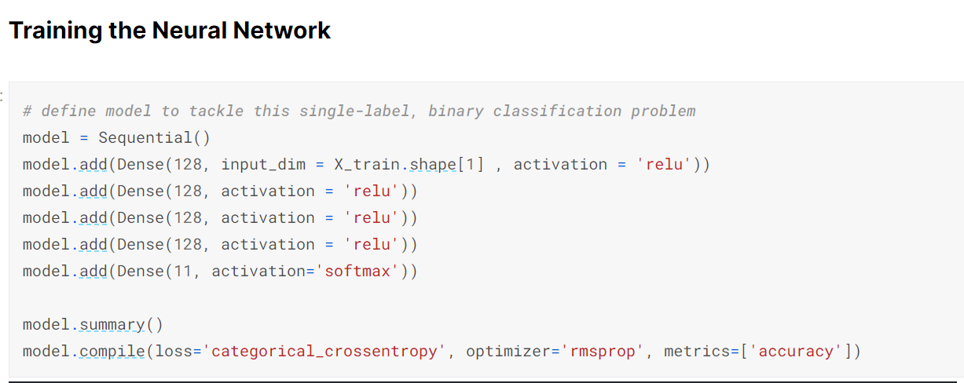
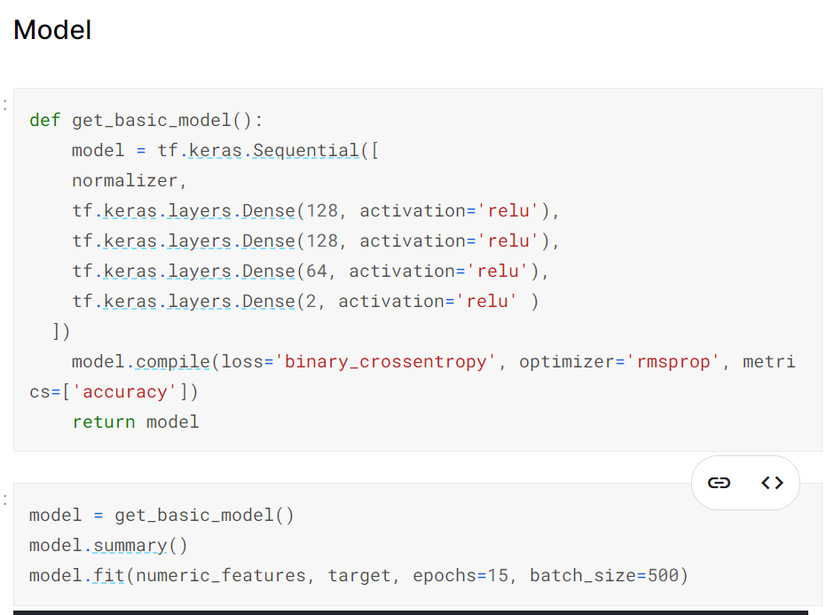
Multiclass classification approach
Binary classification approach

Slide 10
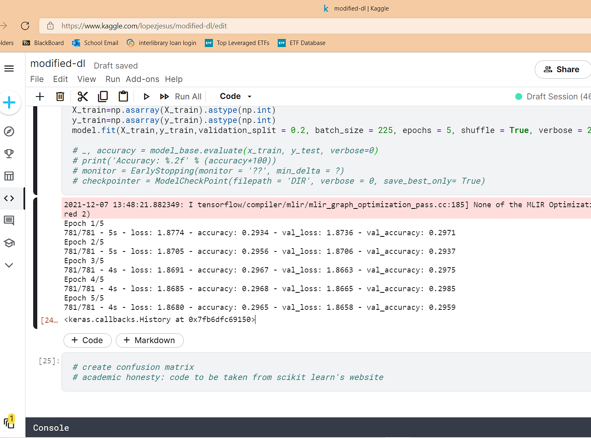

Slide 11
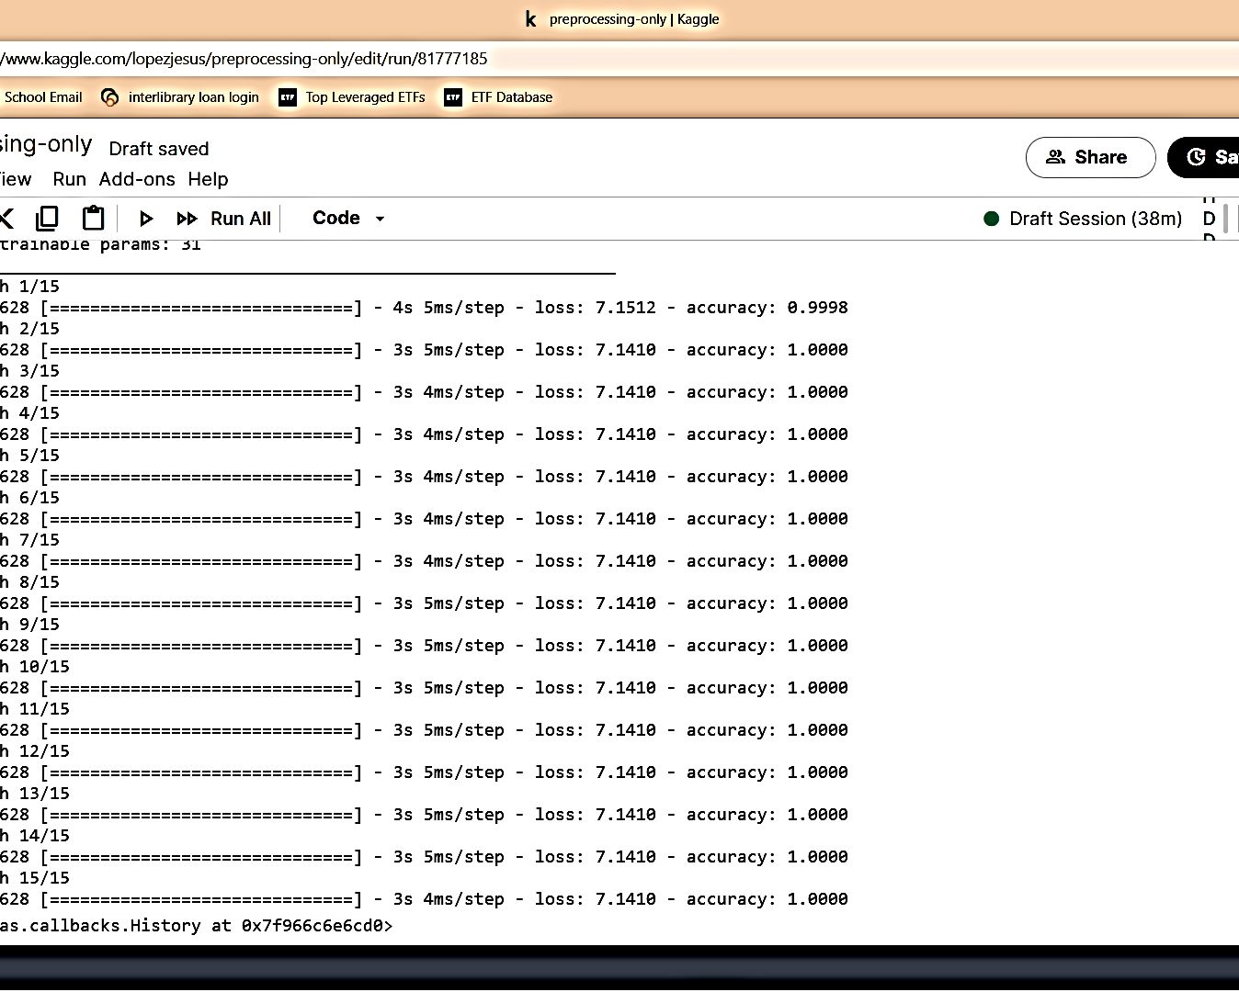

Slide 12
MULTICLASS: ELEVEN CLASSES
21%
71%
89%
42%
81%
99%
80%
91%
23%
41%
81%
LONG VS SHORT

Slide 13
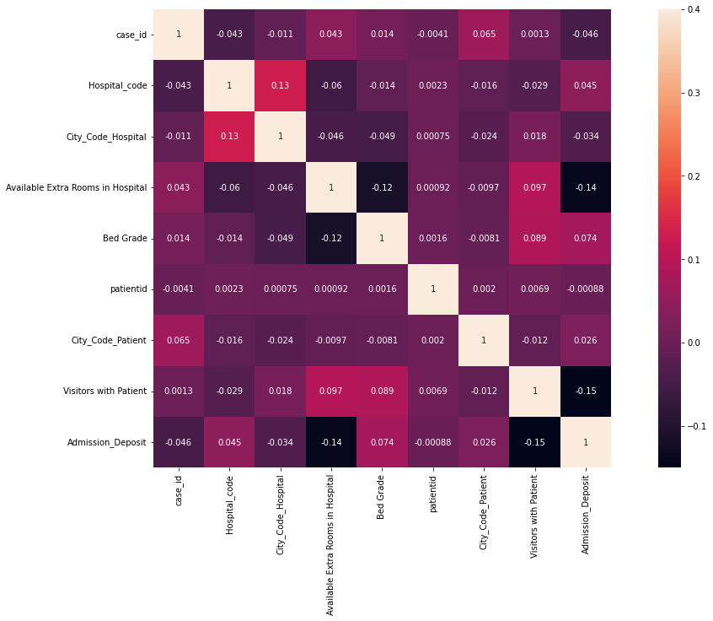

Slide 14
Results Summary
Categorical
Far less than 50/50
Both models failed to be useful
Accuracy 29%
Loss 12%
Not very good
Binary
Loss 70%
Accuracy 100%

Slide 15
FUTURE WORK
MORE DEPARTMENTS
LARGER DATASET
RESOLVE DISAMBIGUITY
i.e., ICU, Emergency,
Never enough
Bed Grade, Hospital Codes, Hospital Types
A
B
C

Slide 16


