Slide 1
Term Project
Computer Convergence, SNU Fall ‘17

Slide 2
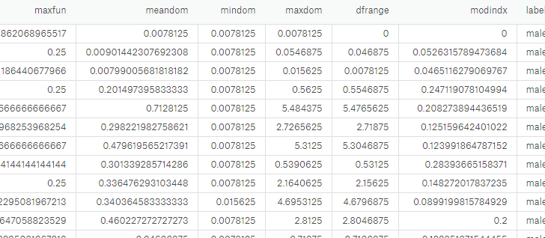
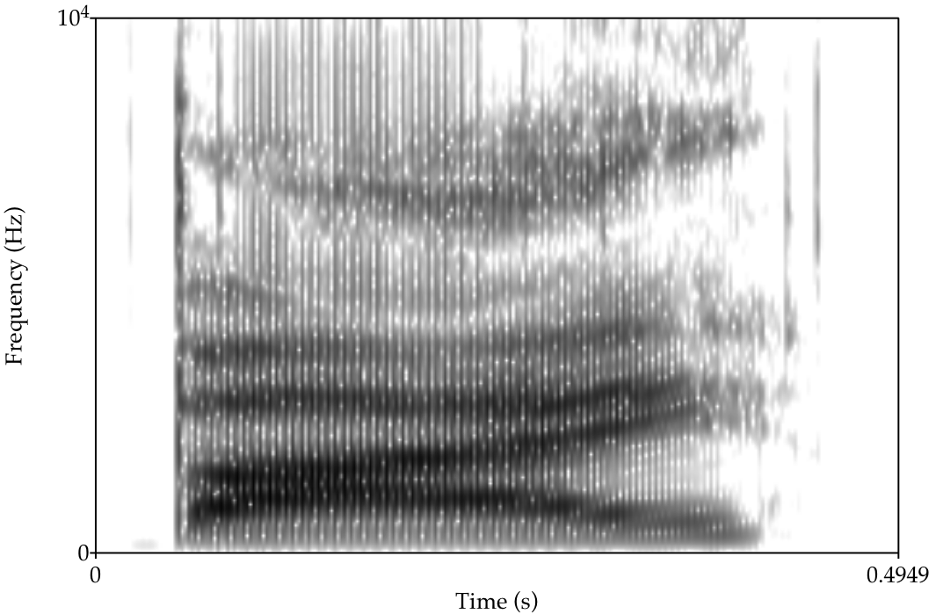
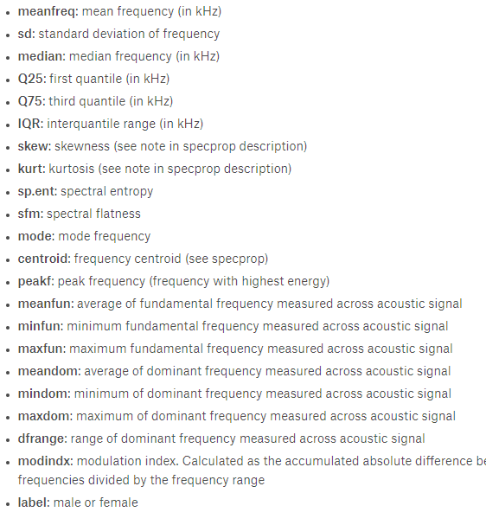
The Data
[https://www.kaggle.com/primaryobjects/voicegender]
Total: 1584 / 1584

Slide 3
The Methods: PCA

Slide 4
The Methods: Pattern Mining

Slide 5
The Methods: Classifiers

Slide 6
The Methods: Clustering

Slide 7
Lesson learned?

