Slide 1
Diversified Online Cloud Storage for Students
DOCSS

Slide 2
Group 3 BTVTE ICT CP
Group Members: Badzgan, Shaden M.
Guivencan, Jannelle E.
Judin, Lalaine G.
Ponce, Marc Rayven G.
Simon, Trisha Mae N.
Valencia, Nikka Joy V.

Slide 3
Summary:
Title:
DOCSS (Diversified Online Cloud Storage for Students)
It is an online storage for students and faculty which aims to; address the struggles of the students when it comes to saving their device storage, and to provide effective alternative storage where in students and faculty could interact and collaborate.

Slide 4
General Objective
To be able to create an online cloud storage
To be able to generate an interaction via online chat in workspace

Slide 5
Specific Objective
To create an online storage, we will be:
- Confirming the idea
- Gathering data/information
- Planning the design
- Choosing Technology
- Development
- Testing application
- User Interface Testing
- Launching Beta version of the website
- Launching of website

Slide 6
Client/s
Our clients are mainly students and faculty that seeks more file storage, and instead of putting data on a local storage device like a hard disk, the user saves it on a cloud host that can be accessed through an internet connection. Students and Faculty in BASD of TUP – Taguig will be the end user of this study.

Slide 7
Unique Features:
Student-teacher interaction and collaboration:
- File Sharing
- Chat in workspace

Slide 8
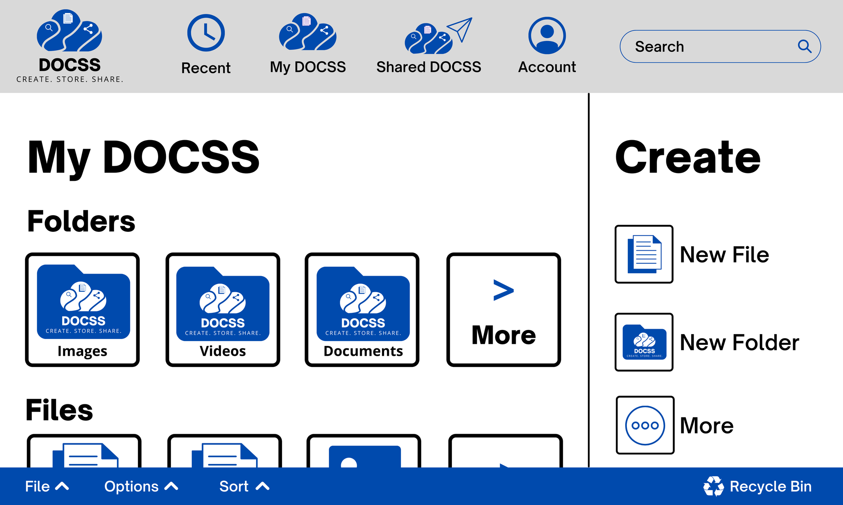
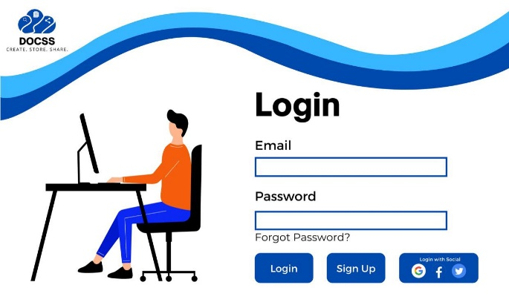
Sample Display of Project

Slide 9
Credits.
Presentation Template: SlidesMania
Sample Images: Unsplash
Fonts used in this presentation: DM Sans

