Slide 1
AI For Business Leaders Course
Project Steps: Delivering an ML/AI Strategy

Slide 2
AI for Business Leaders
Project Step 2C
First Prioritization Grid

Slide 3
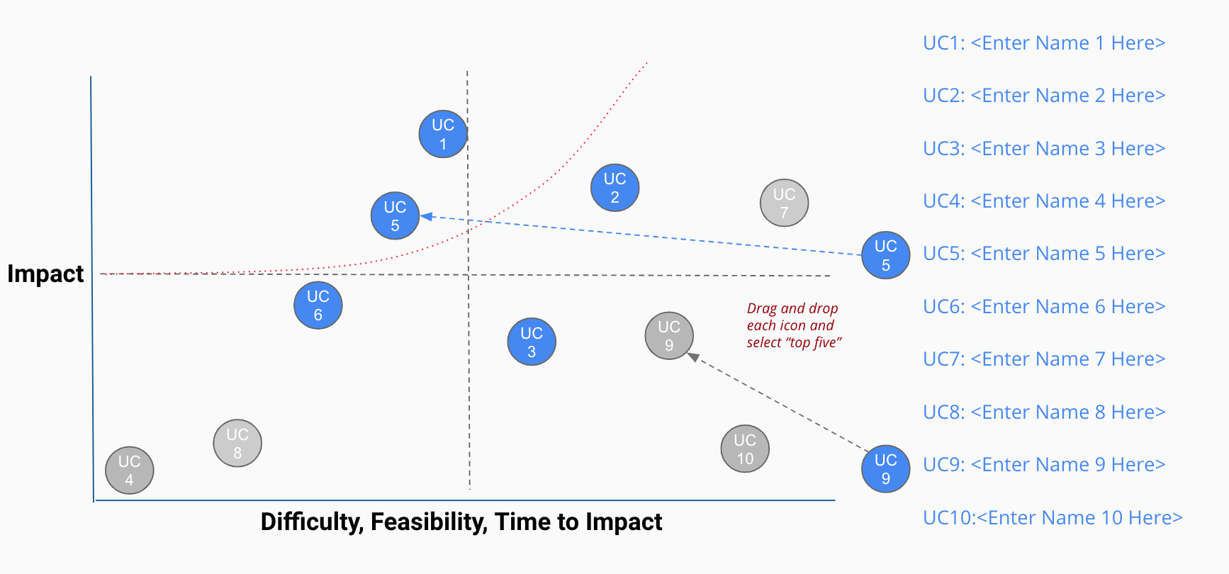
Your First Prioritization Grid
DIRECTIONS: For each of your use cases, review your answers to the 5V questions in Step 2A, and the operations you chose in Step 2B.
Then on the grid on the next slide, not this slide, move each blue use case icon to a place indicating how you see this use case’s impact and feasibility.
(Recall that the upper right quadrant is usually the most desirable, as it indicates we expect higher feasibility and greater impact.)
UC 2
Drag and drop icons for each use case
Remember to think about both axes!

Slide 4
First Prioritization Grid
(Follow directions on previous slide)
high
UC 1
UC 1
UC1: Quality Control Classifier
UC 3
UC 2
UC2: Ride Personaliser
UC 2
UC 3
UC3: Vehicle Fault Predictor
Impact
UC 5
UC 4
UC4: Manufacturing Optimiser
UC 5
UC5: Machinery Uptime Booster
UC 4
low
low
Feasibility
high

Slide 5
Now Prioritize and Eliminate Three Use Cases
1) Review the locations of your use cases on the grid on the previous slide. Remember we want to prioritize use cases for AI and ML that offer the greatest impact for the least difficulty.
2) Now in the grid on the previous slide change the color from blue to grey for two use case circles you want to de-prioritize.
3) This leaves your top three use cases in blue that you want to move forward with in the rest of the project.

Slide 6
Nice work, you’ve completed Step 2C of the project!

Slide 7
AI for Business Leaders
Project Step 3
Architectures for Top 3 Use Cases

Slide 8
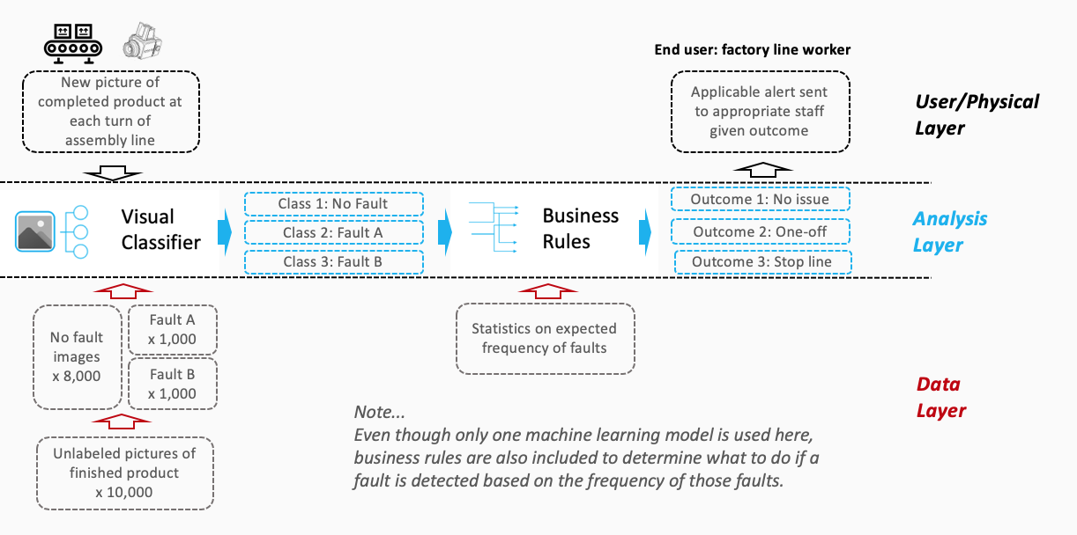

Creating High Level Architectures
Sample Completed Architecture
For the top three use cases you prioritized in Project Step 2C, you’ll now create a high level architecture for each, on slides 10-12.
For this step, be sure to review Lesson 3 but also recognize that this process allows significant creative freedom.
Keep a focus on… - Data flow/direction - Clear view on inputs/outputs - Simplicity
Write the use case name at the top of each slide.
Do all work on slides 10-12:
Copy and paste capabilities from slide 9 into Analysis Layer
Identify relevant User/Physical and Data Layer attributes
Copy and paste arrows from slide 9 to show data flow, input/output
Use annotations to help explain difficult concepts

Slide 9

















Your AI/ML Toolkit - List of Capabilities
Generic ML Capabilities
Natural Language Processing
Voice/Speech Processing
Computer Vision
Other Capabilities
Drawing Tools
User/Physical Layer
Analysis Layer
Data Layer

Slide 10
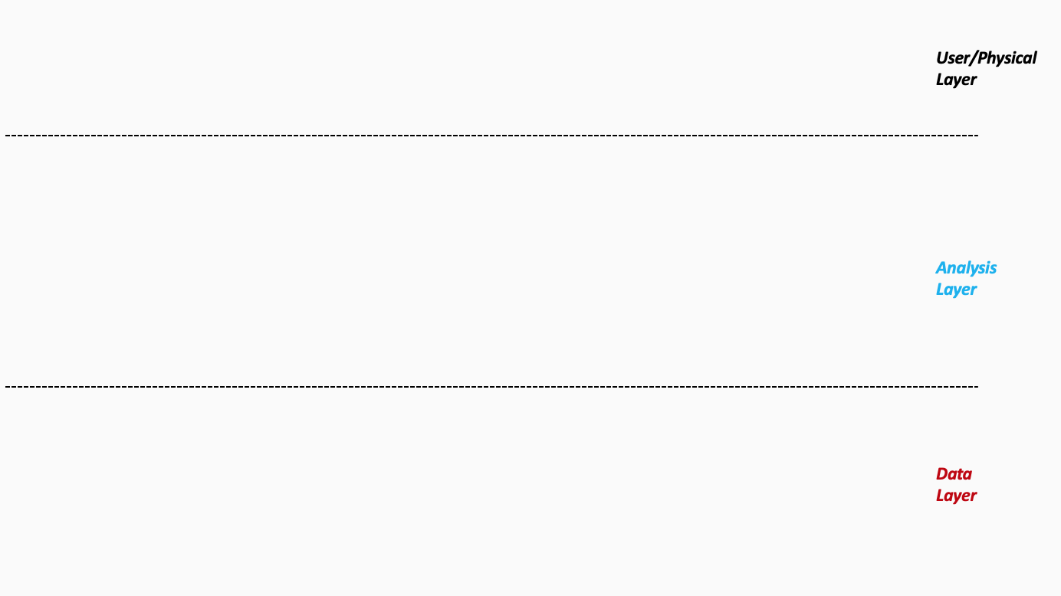
Architecture 1/3 - Quality Control Classifier
Quality Control User/Queue 1
Quality Control User/Queue 2
Feedback
Incorrect classification
Type of classification
Faulty
Faulty
Not Faulty
Faulty
Not Faulty
Business rules leveraged to allocate faulty items to different queues/users depending on type of error
Not Faulty
N classifiers based on top N error types
Images – Finished Products
Images – Finished Products
Train
Test
Test
Data
Warehouse
Continuous Improvement
Monitor for bias
Incorporate new error types
Top 50 errors may change
Re-deploy model periodically
Day Zero – Historical data
Ongoing – New Images + Other Adjustments
Ongoing – New Images
Historical Images
Images – Current
Notes:
Please follow the directions on slide 8. Copy and paste the desired icons provided you on slide 9 onto this page.

Slide 11
Architecture 2/3 – Ride Personaliser
Rider
Car – Exterior Actions
Car – Interior Actions
Unlock car
Unlock hood
Unlock boot
Music
Seat settings
Heating
…
Rider 1
Rider 2
Transfer Learning
(replace the classifier of the
Generic model with specific classifier for TeknoVe facial data)
Identified
Driver Data
Rider 1 – Emotion 1
Rider 1 – Emotion 2
Rider 2 – Emotion 1
Personaliser Use Case
This classiifier picks up on the emotional cues of the rider to take in cat actions (e.g. music)
Generic Model trained on public facial datasets
Continuous Improvement
All cars to synchronize data with company DWH
Periodic incorporation of new driver data to retrain models
Monitor for bias
Employ techniques like dropouts for the Deep NN
Over the air deployment of revised models periodically to the cars
Public Data
Rider – Facial Images
Rider - Facial Image (Regular Use)
Train
Train
Test
Rider provides images via car cameras to train the classifier
Notes:
Please follow the directions on slide 8. Copy and paste the desired icons provided you on slide 9 onto this page.

Slide 12
Architecture 3/3 – Vehicle Fault Predictor
If fault probability is high, dashboard displays relevant lights/message
Service department is notified of predicted faults to arrange for preventative fixes
Roadside assist team monitor cars where
fix/inspection hasn’t been performed after fault prediction
Car Dashboard
Service Department
Roadside Assist
Faulty (>=80%)
Faulty (>=80%)
Outcomes of the parallel regressor are matched with business rules to provide the users an explanation of the problem
! Faulty (<80%)
! Faulty (<80%)
Model predicts the probability of a vehicle fault.
Parallel Regressor
Identifies the sensors contributing the most towards the fault prediction
Continuous Improvement
All cars to synchronize data with company DWH
Periodic incorporation of new sensor and fault data to retrain models
Incorporate learning's from parallel regressor to expand library of business rules (faults)
Over the air deployment of revised models periodically to the cars
Next step R&D to assess solutions and fixes which can be done over the air or by riders themselves with instructions from the car
Historical - Sensor Data + Vehicle Fault Data
Ongoing Sensor Data
Train
Test
Test
Notes:
Please follow the directions on slide 8. Copy and paste the desired icons provided you on slide 9 onto this page.

Slide 13
Excellent, you’ve completed Step 3 of the project!

Slide 14
AI for Business Leaders
Project Step 4C
Second Prioritization Grid

Slide 15
Your Second Prioritization Grid
Based on new information from your further analyses of your use cases in step 4A and 4B, you’ll engage in the same exercise as you did before in Step 2C to update your prioritization.
Move onto the grid the three use cases that you have been working with in steps 4A and 4B.
You MAY choose different use cases and shift your focus, if you feel these exercises have caused you to significantly revise your prior evaluations.
UC 2
Drag and drop icons for each use case
Remember to think about both axes!

Slide 16
Second Prioritization Grid
high
UC 1
UC 1
UC1: Quality Control Classifier
UC 3
UC 2
UC2: Ride Personaliser
UC 2
UC3: Vehicle Fault Predictor
UC 3
Impact
UC 4
UC4: Manufacturing Optimizer
UC 5
UC5: Machinery Uptime Booster
low
Note: You only need to locate three of these onto the grid.
low
Feasibility
high

Slide 17
Now Prioritize and Eliminate One More Use Case
1) Review the locations of your use cases on the grid on the previous slide. Remember we want to prioritize use cases for AI and ML that offer the greatest impact for the least difficulty.
2) Now in the grid on the previous slide change the color from blue to grey for one use case circle you want to de-prioritize.
3) This leaves your top two use cases in blue that you want to move forward with in the rest of the project. But you may still change these later.

Slide 18
Terrific, you’ve completed Step 4C of the project!

Slide 19
AI for Business Leaders
Project Step 5
Operational Considerations:
Accuracy, Bias, and Ethics

Slide 20
Accuracy, Bias, and Ethics Concerns
For each of your two remaining use cases, on the next two slides please write 2-3 paragraphs discussing how success will be measured and monitored.
Start by focusing on how model effectiveness would be measured, and speak to what success would look like.
Comment on any other operational concerns, including bias in the data, or ethical limitations, that could influence success.
For each concern you raise, comment on how you would measure or monitor this concern on an ongoing basis.

Slide 21
First Use Case – Quality Control Classifier
Model Effectiveness
For this use case, accuracy and precision will be the key metrics which will define the success of the model and hence the effectiveness of the model. If we consider the F score, considering precision is more important than recall, we would consider an F beta score where beta = 0.5.
For our use case, the team has expressed a desire to come up with 50 different classifiers for the top 50 defects in the finished goods. The model development process would need to ensure that proposed measurement caters for what the top 50 defects are (as these may change over time), and what the accuracy or F beta score for each specific classifier (error type) is.
The business is always looking for improvement in quality and findings from the QC department should be shared with the engineers involved with the manufacturing process to improve the process, thereby reducing quality issues. The improvements brought about in manufacturing due to the findings from the QC department should be measured and captured so that the impact of this implementation can be quantified as a more fundamental impact to the manufacturing process itself, than just monitoring the finished product.
Operational Concerns
Key operational concern is the validation of an error which is microscopic in nature by the QC team. The mitigation here would be for the engineering team to investigate the faulty items in detail and identify the error. In the interest of efficiency the QC team could be trained to identify these errors with sophisticated instrumentation. This would probably be a future step in the roadmap to establish this use case.
No ethical concerns are envisaged in this model as its simply classifying the finished goods as faulty or non faulty.
There is an “overfitting” concern with the implementation. Since the team agreed that instead of building a single classifier 50 different classifiers would be the better approach to capture the top 50 errors, there is a concern that the 50 different classifiers which the product images will be run through, will only ever find the 50 errors. Other error types would not be identified. A mitigation approach for that may be to still build the generic classifier and pass the outcomes of that classifier through the 50 specific classifier and compare the results. Also, cases where items are returned by customers for issues and errors which were not picked up by the 50 classifiers, should be used to enrich the dataset, on which the models are trained and potentially identify new error types.

Slide 22
Second Use Case – Ride Personaliser
Model Effectiveness
The effectiveness of the model would be defined by the consistency with which it can identify the drivers and unlock the car for them. In summary, this would be captured by the “recall”. This is because we want the car to unlock only when the correct driver’s image is presented. We don’t want strangers to be able to unlock the car. In summary a F beta score with a beta higher than 1 would be the key metric.
For the classifier which would take in car actions based on emotional queues, we would be interested in a higher “precision” score. An f beta score with a beta of 0.5 would be considered a success.
Operational Concerns
The bias in the images which are used to train the model, will manifest itself in the model as well. If a base dataset of the company’s existing customers is used, this still may not resolve the issue. This is because customers who buy relatively expensive EV vehicles may belong to a certain demographic. The issue can be mitigated by using a large public dataset which has sufficient variety in the data.
There is an ethical concern with this model. An example would be when the model proposes a certain type of music depending on the driver. If there is a pattern with the music taste predicted based on the drivers age, sex, race or any other such factor, it would be a serious ethical concern. All relevant ML techniques will be applied during model development to avoid any bias (for e.g. dropouts in deep neural networks to cater for bias). At this stage this is a risk, and the mitigation here can be close monitoring of the outcome of the actions taken by the driver in response to the action taken by the car. For e.g. if the driver changes the music after the car changes it per the outcome of the ML model. The connected cars will provide all relevant data back to the company’s DWH in the cloud where this can be monitored for any ethical concerns and even for model improvement. While music has been used as an example here, depending on how we expand this use case, it could be other things. For e.g. the classifier recommends takeaway food joints or restaurants to the rider based on emotional queues. We wouldn’t want there to be a pattern where certain cuisines are always recommended to people of certain ethnicity.

Slide 23
Well done! You’ve completed Step 5 of the project!

Slide 24
AI for Business Leaders
Project Step 6B
Feedback and Final Prioritization Grid

Slide 25
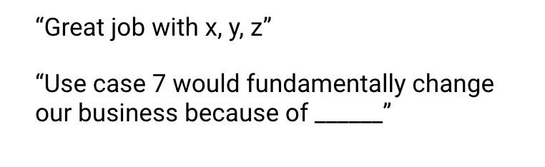
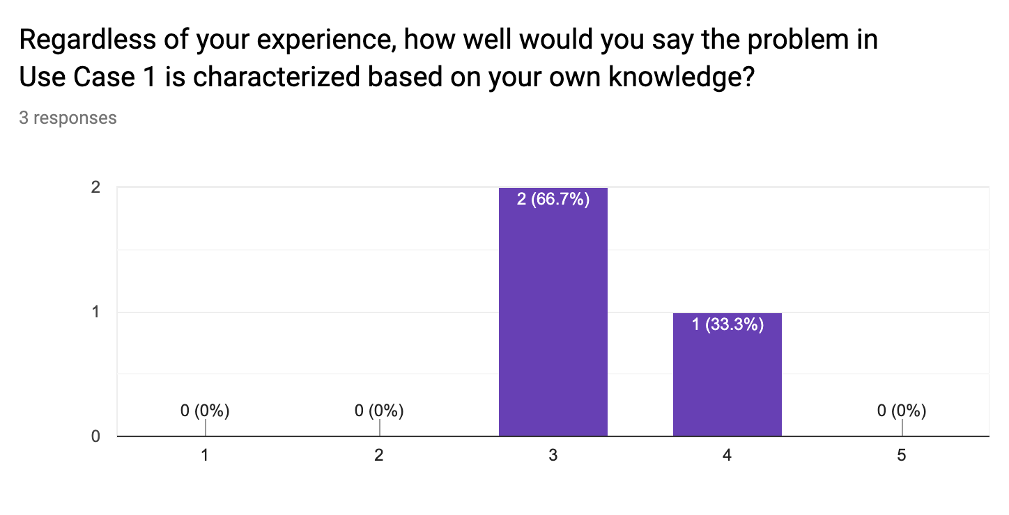
Feedback Visualization
Verbatim Quote Example
Depending on how you chose to gather feedback -- survey, phone call, etc. -- you will have a mix of quantitative and qualitative results.
Use the following pages to document your key takeaways in the form of verbatim quotes and visualizations.
For verbatim quotes, you should use direct quotes that indicate the support and critiques you encountered.
For visualizations, feel free to use the graph provided in your Google Form.
Visualization Example

Slide 26
Verbatim Quotes – Quality Control Classifier
“this use case will not only introduce cost savings into the business, but also improve our brand image with faulty goods being identified before reaching the customers”
“We can use this in our marketing and advertising campaigns talking about the cutting edge nature of our business.”
“If we can achieve what we want to with this use case, I am really excited to know all about the different types of faults in our finished goods.”

Slide 27
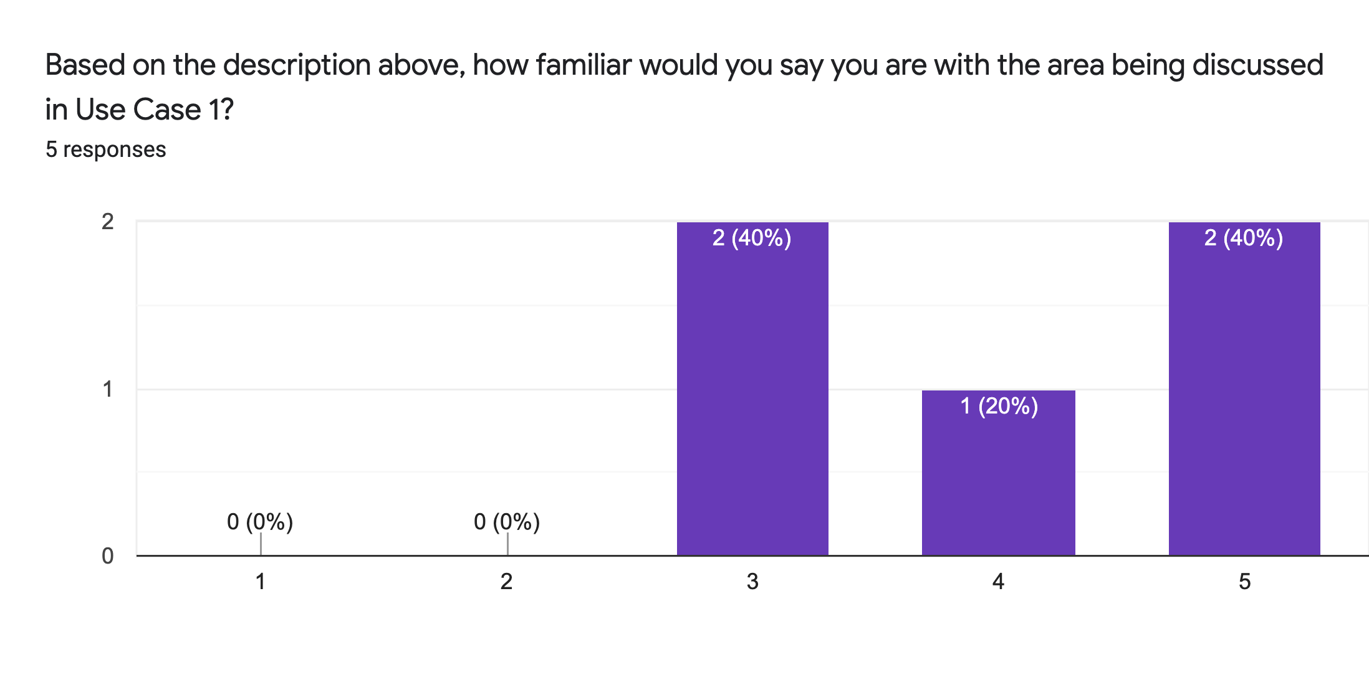
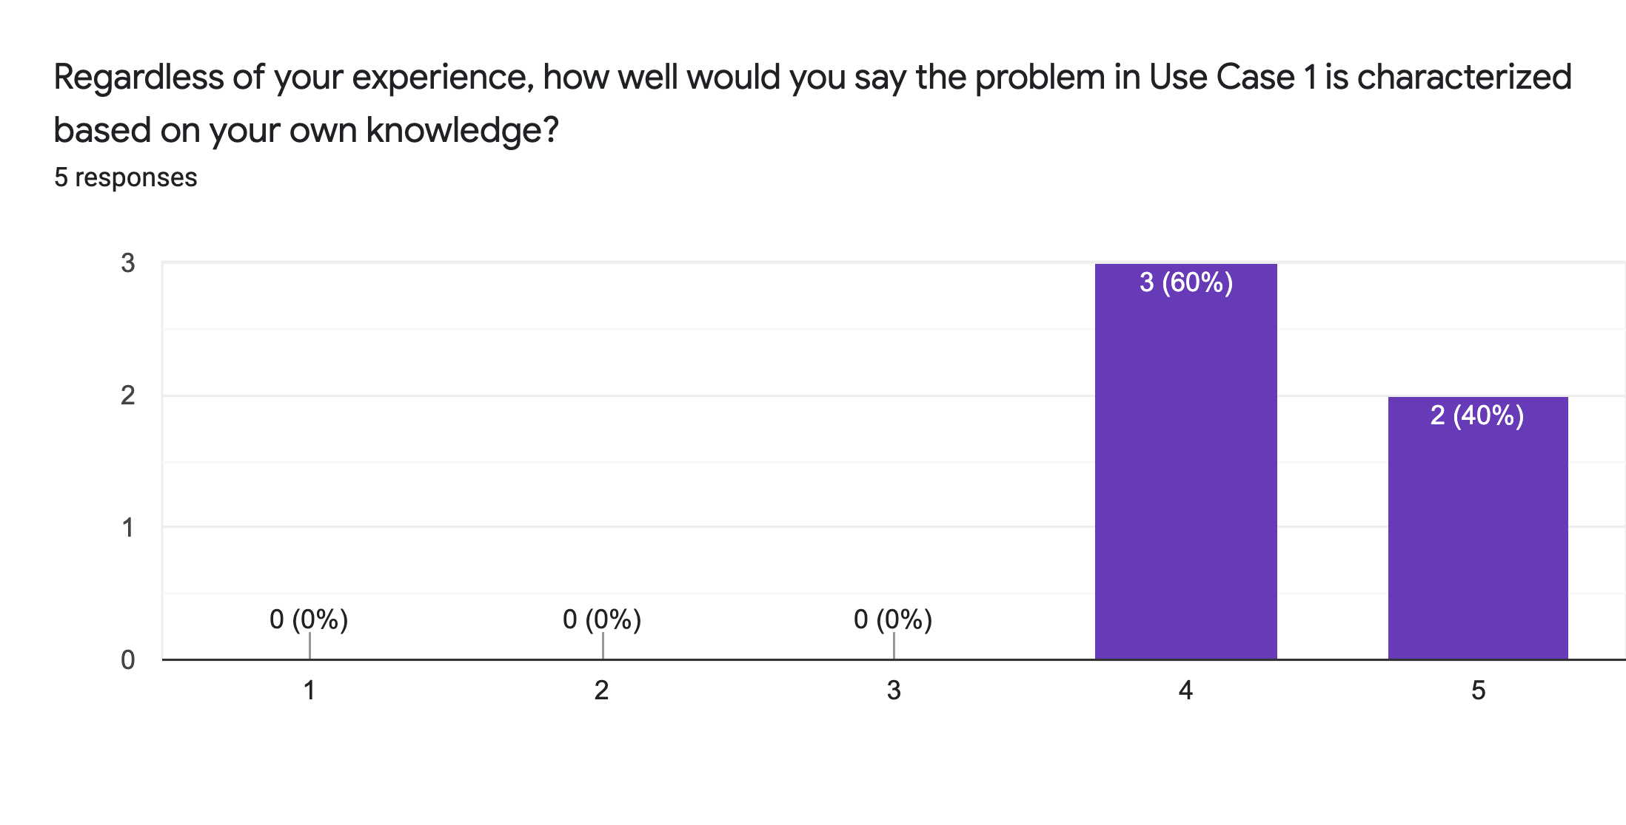
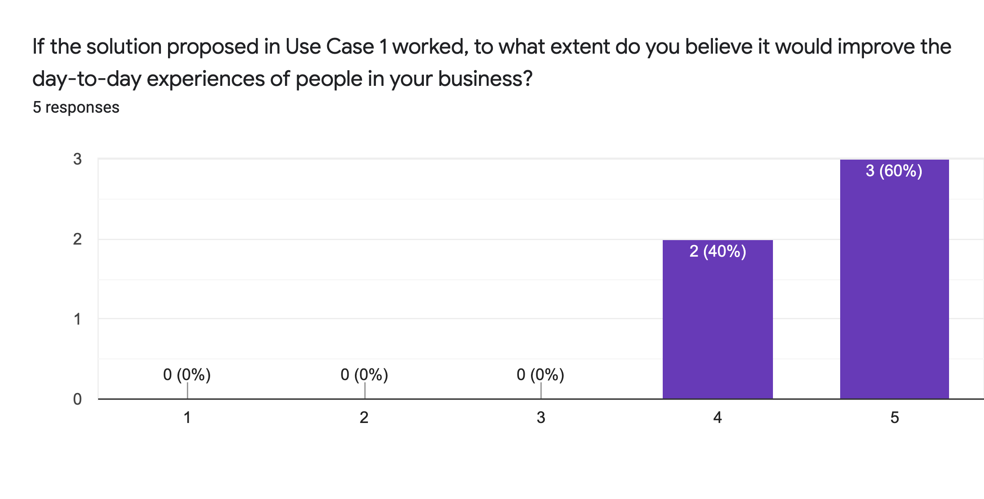
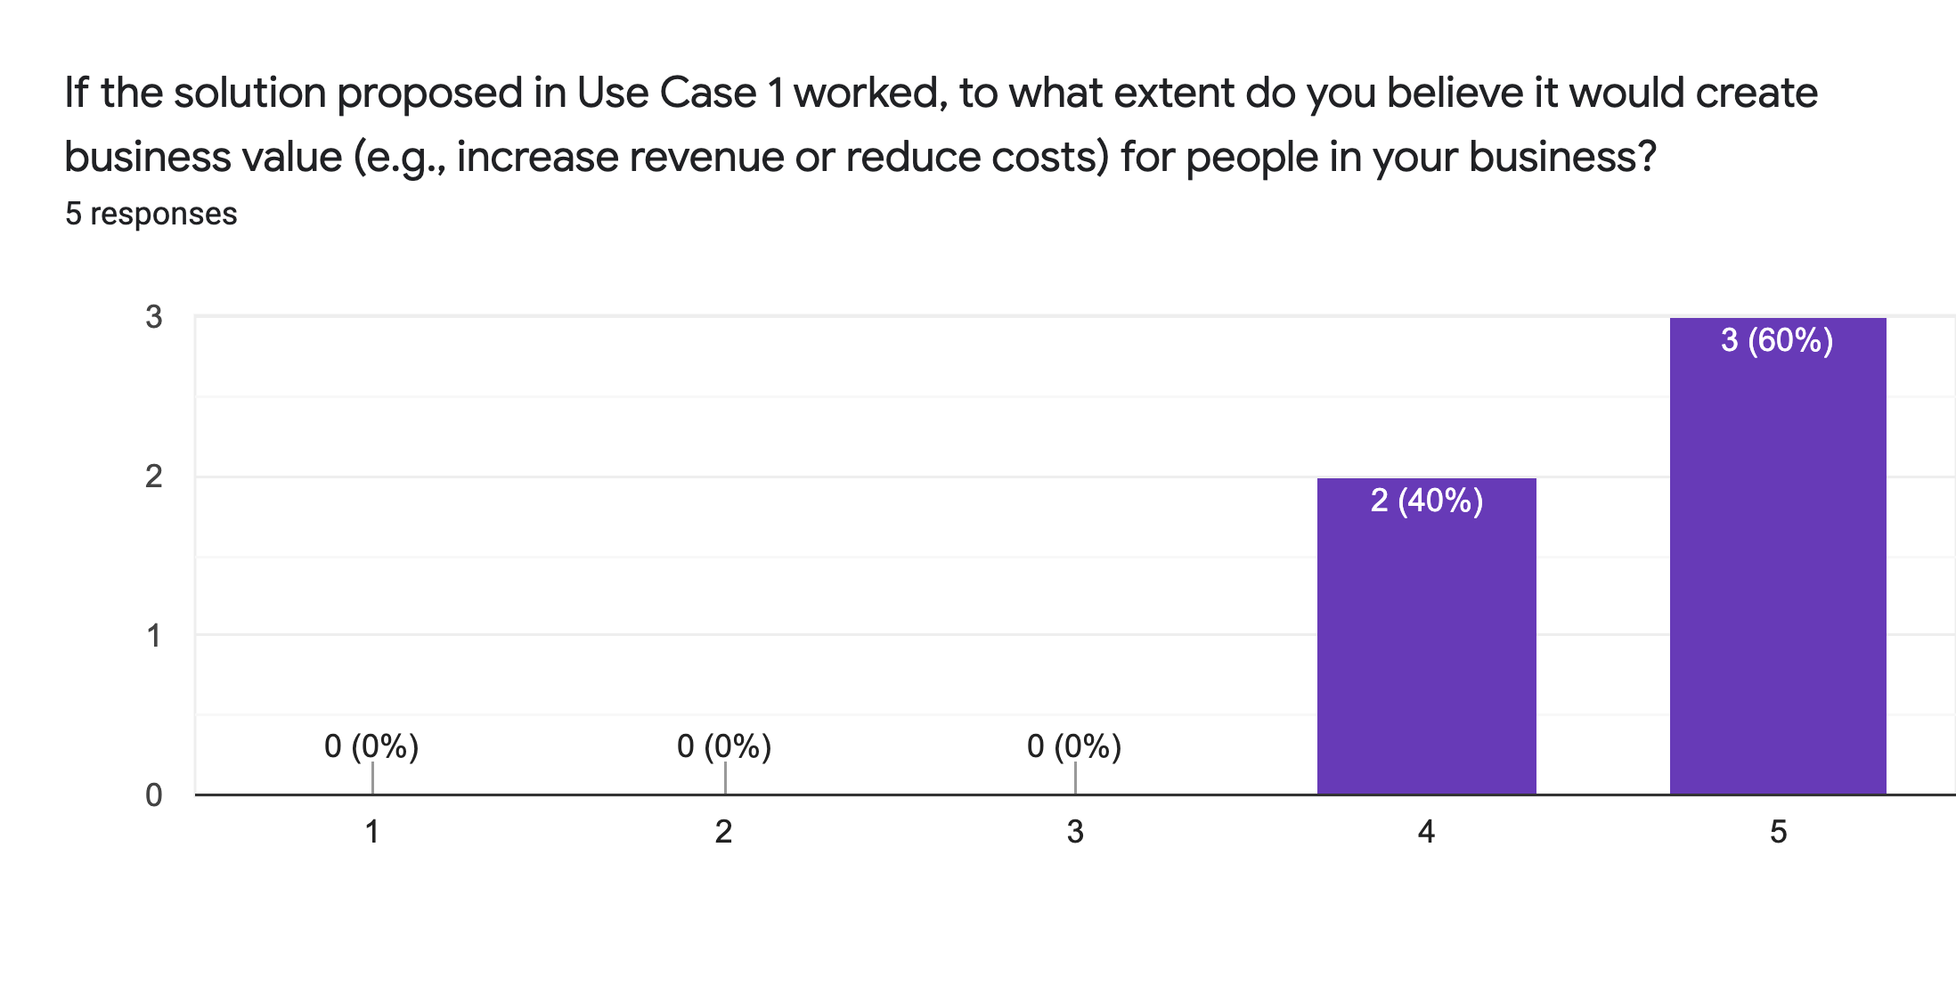
Visualization – Quality Control Classifier

Slide 28
Verbatim Quotes – Ride Personaliser
“I am excited about this use case since it provides us the opportunity for us to Wow our customers”
“Imagine not ever having the problem of forgetting where the keys are or losing them altogether!”
“something like this, can establish us as the 'Apple' of car manufacturing.”
“When it comes to machines responding to human characteristics, there is always the risk of ethics and bias being compromised”

Slide 29
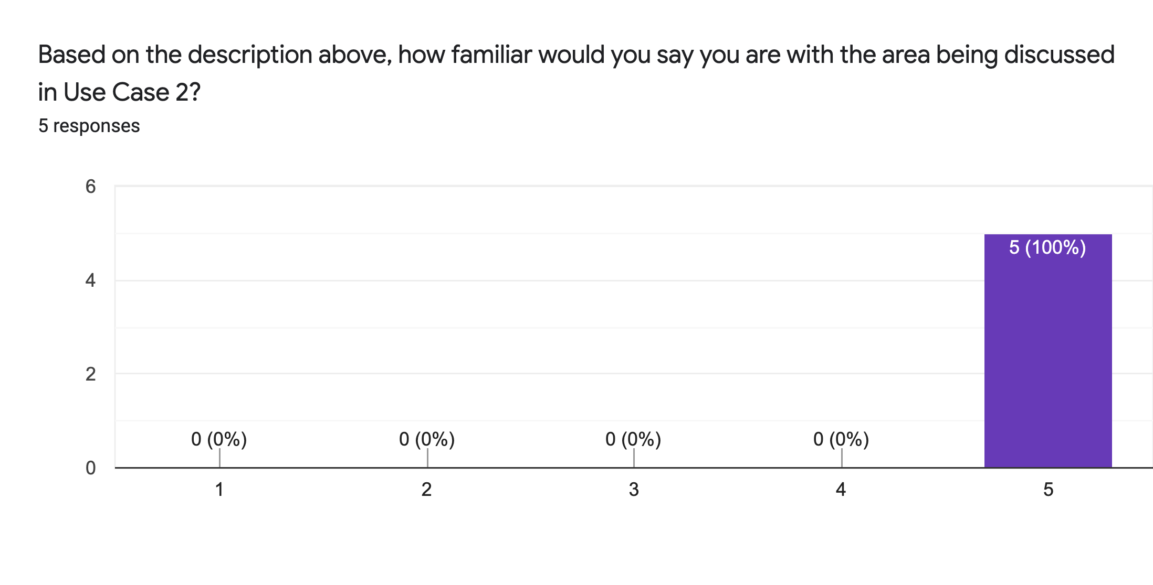
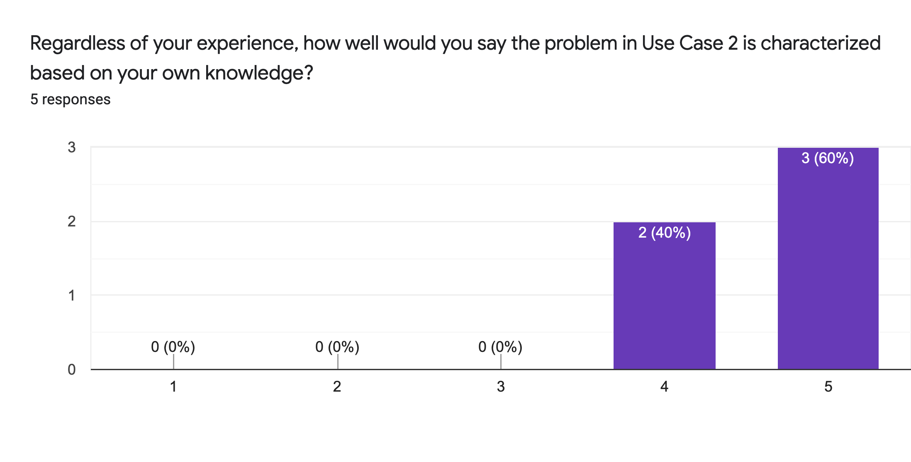

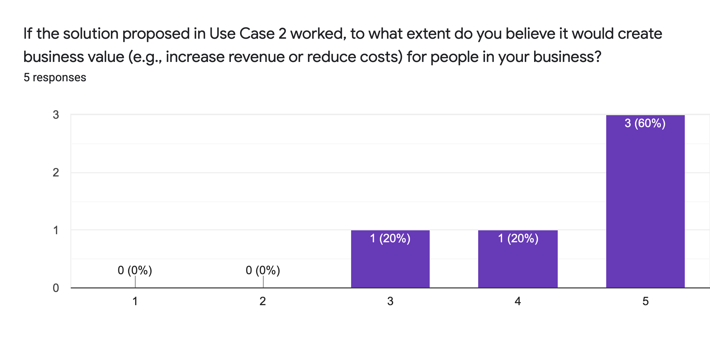
Visualization – Ride Personaliser

Slide 30
Your Final Prioritization Grid
Based on the feedback you’ve gathered, and all of the previous information for each use case, you’ll now engage in the same prioritizing exercise as you have twice before.
You MAY choose to re-prioritize use cases and shift your focus if you feel these exercises have caused you to significantly revise your prior evaluations.
At the end of this exercise, you should have a final point of view on the use cases you’ll advocate in your ML/AI strategy!
UC 2
Drag and drop icons for each use case
Remember to think about both axes!

Slide 31
Final Prioritization Grid
high
high
UC 1
UC 1
UC1: Quality Control Classifier
UC 2
UC 2
UC2: Ride Personaliser
UC 3
UC3: Vehicle Fault Predictor
Impact
Impact
UC 4
UC4: Manufacturing Optimizer
UC 3
UC 5
UC5: Machinery Uptime Booster
Note: You only need to move 2 of these use cases onto the grid.
low
low
low
low
Feasibility
Feasibility
high
high

Slide 32
Nice work, you’ve completed Step 6B of the project!

