Slide 1

Capstone Project Student Performance Analysis
SCTP-Associate Data Analyst- Capstone Project
By Haw Poh Chin-Aug 2025

Slide 2
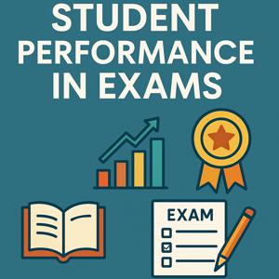
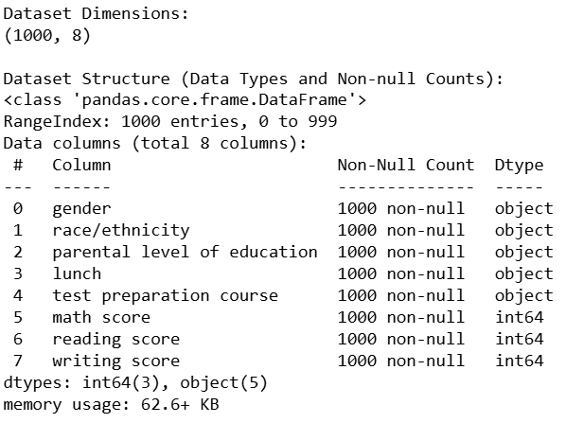
Project Overview
Objective: Identify factors influencing exam scores and recommend interventions.
Dataset: 1,000 students with:
Demographics: Gender, race/ethnicity
Socioeconomic: Parental education, lunch type
Academic: Test prep, scores (Math/Reading/Writing)

Slide 3
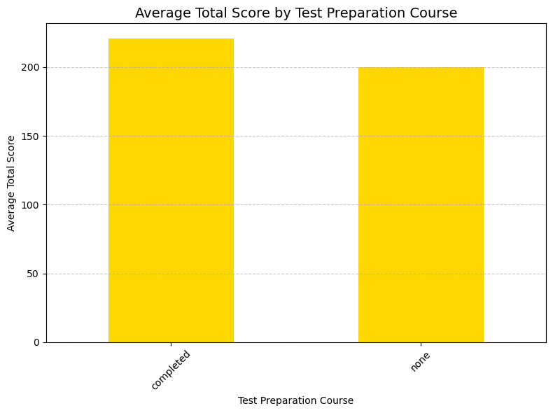
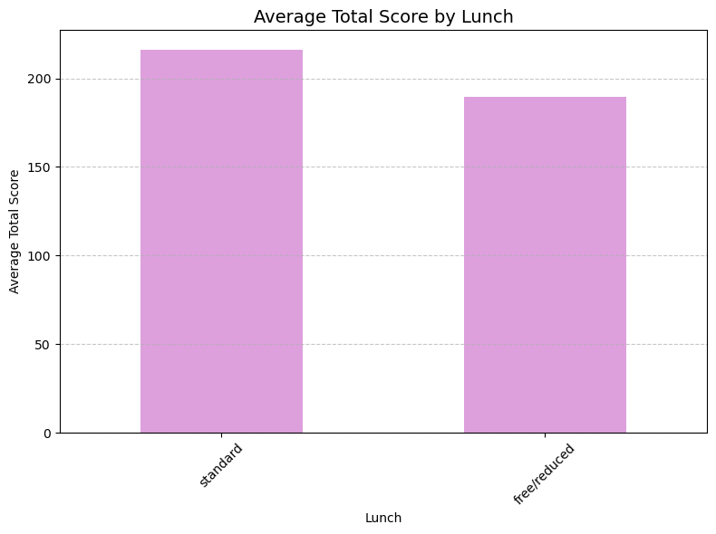
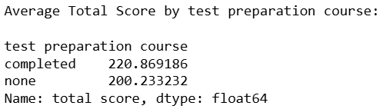
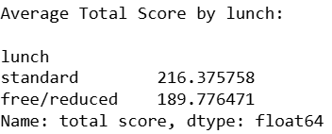
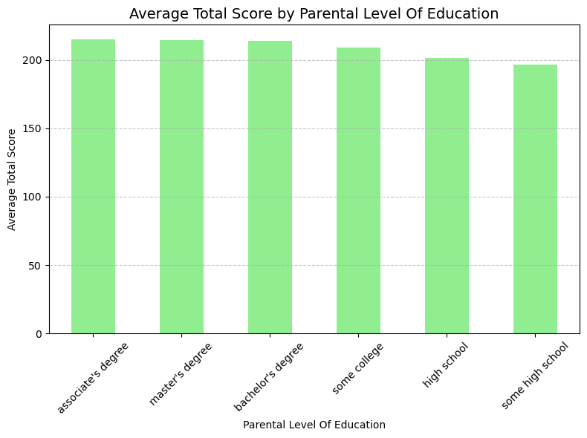
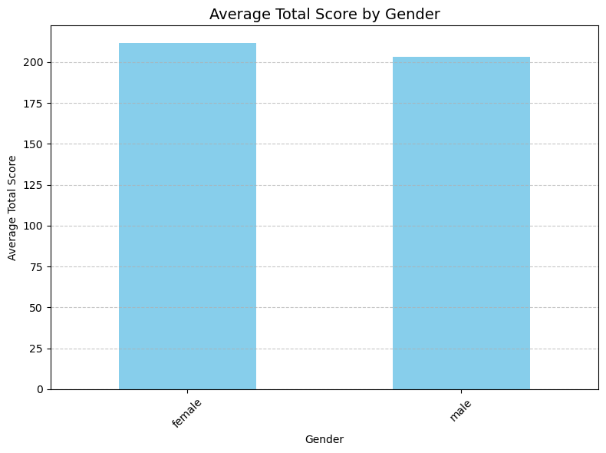
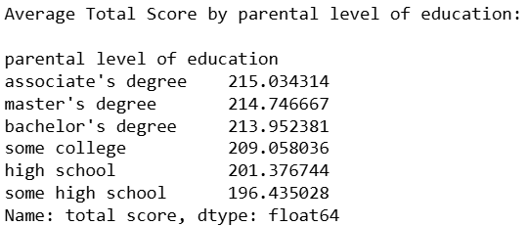
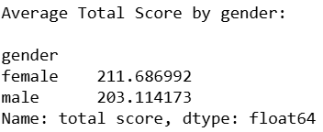
Key Findings (Summary)
Top Insights:
Test Prep Matters: Completing courses boosts scores by ~20 points.
Lunch as a Proxy: Standard lunch students outperform by 26.6 points.
Parental Education: Higher education correlates with better scores.
Gender Gap: Females lead in reading/writing; males in math.

Slide 4
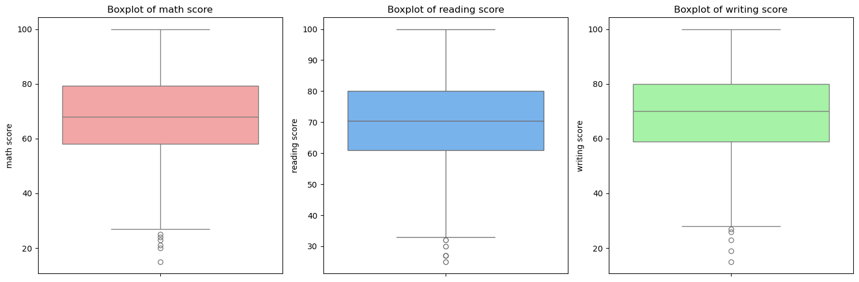
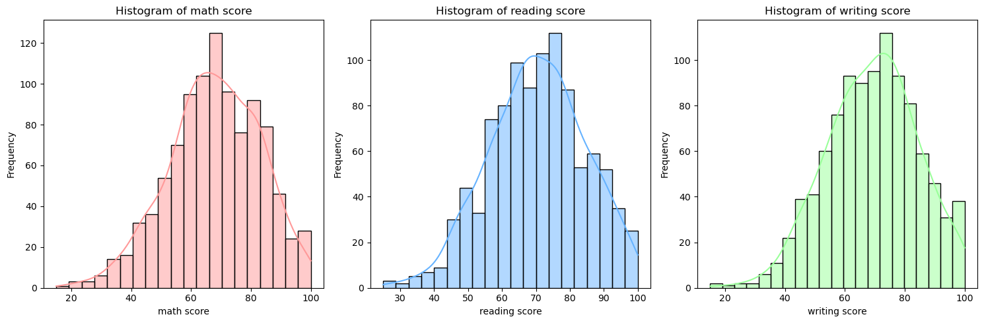
Score Distributions
Math scores slightly left-skewed; reading/writing more balanced.
Outliers in lower score ranges (boxplot highlights).
Boxplots and histograms reveal score spread

Slide 5
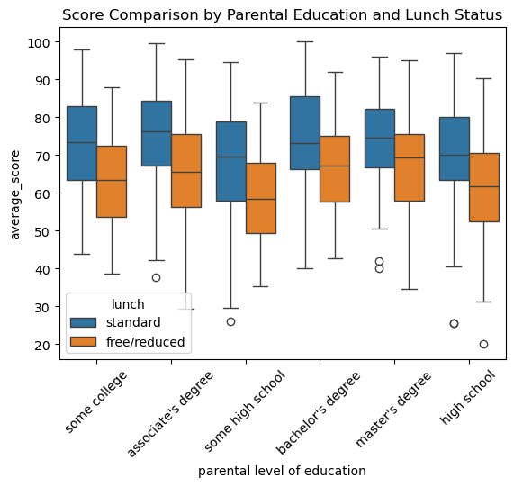
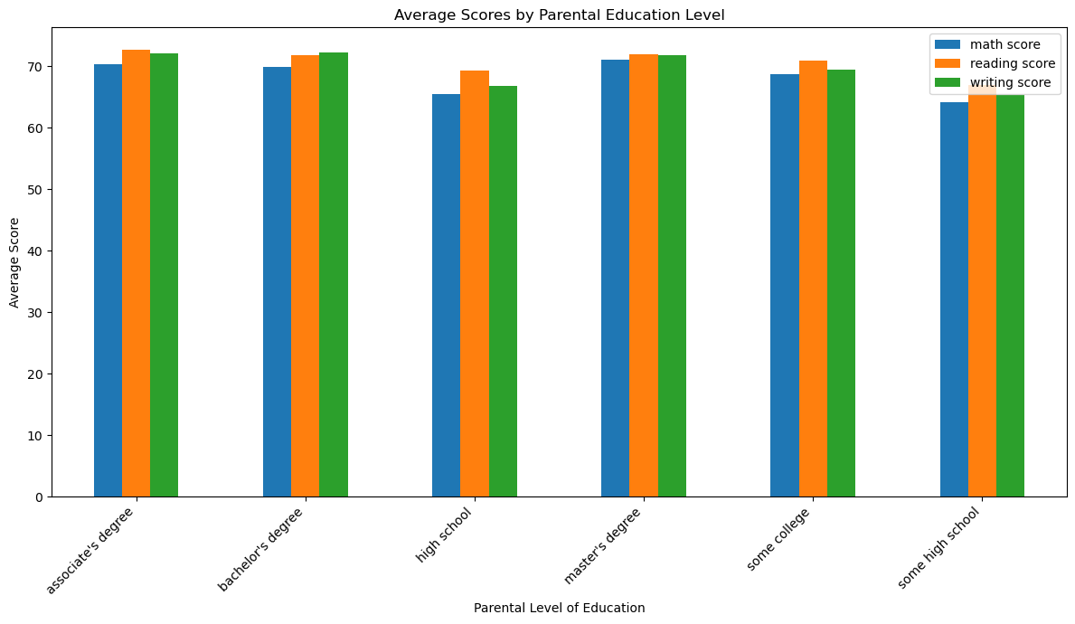
Socioeconomic Impact
Lunch Type: Standard lunch → +15% avg. score.
Parental Education: Master’s degree → 5% higher scores than high school.

Slide 6
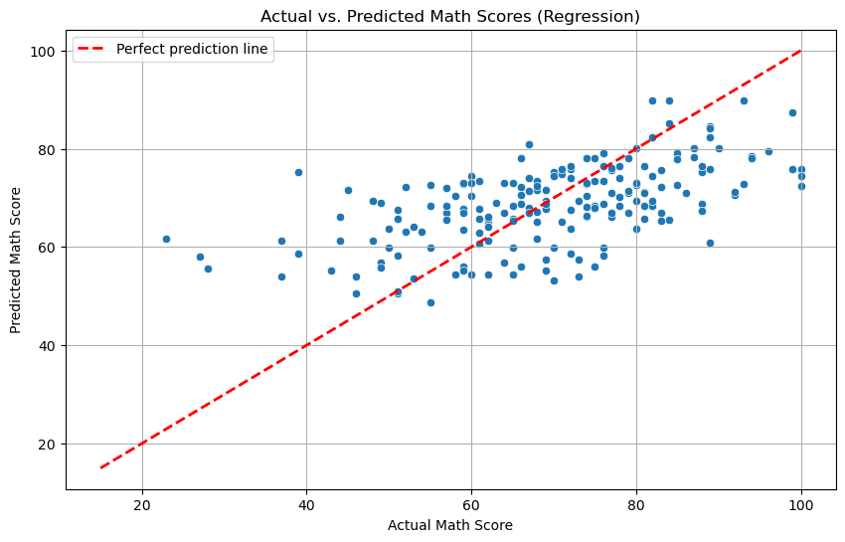
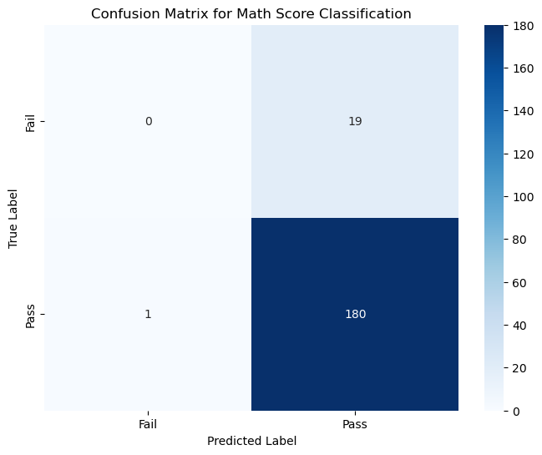
Predictive Analysis
Regression (Math Score): 34% variance explained (R²=0.34).
Classification: 90% accuracy in pass/fail prediction.
The regression analysis showed that factors such as a student's background, lunch type, and test preparation course have a moderate impact on their final math score. The model could account for about 34% of the score's variation. This suggests that while these variables are influential, there are other, unmeasured factors—like individual study habits, classroom environment, or teacher quality—that play a significant role in determining a student's exact grade.
However, when we shift the focus to a more straightforward question—will a student pass or fail the exam?—the story changes dramatically. The classification model achieved an impressive 90% accuracy, indicating that the available features are very reliable predictors of whether a student will pass (score ≥50) or fail (score <50).

Slide 7
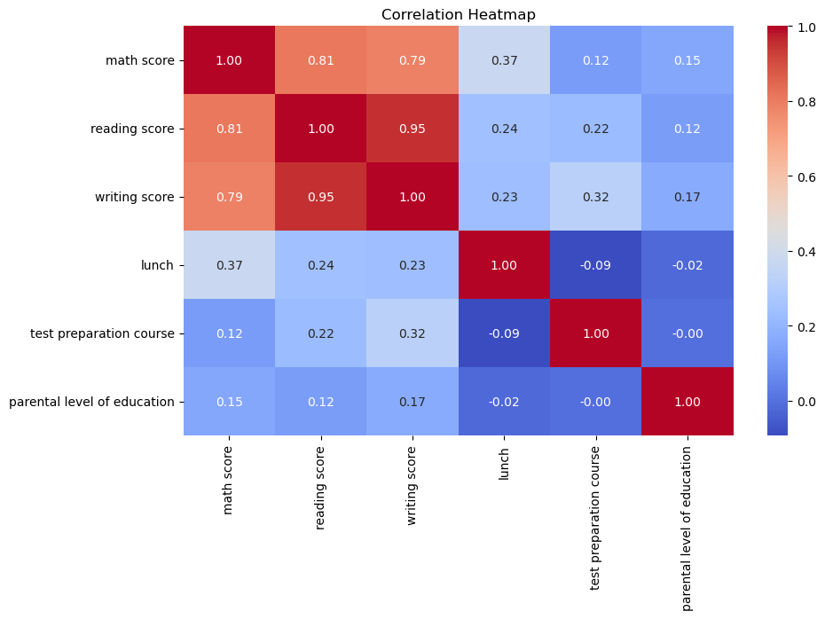
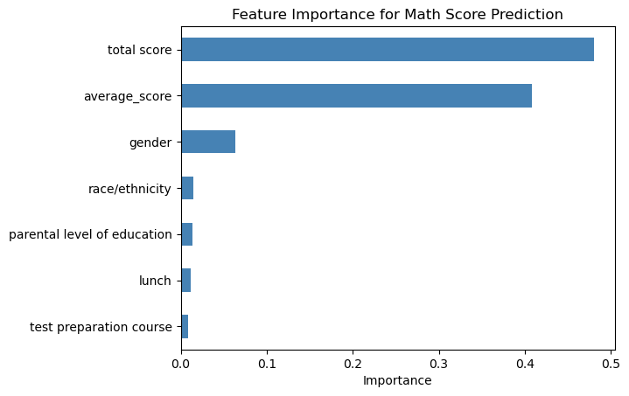
Correlation & Feature Importance
Scores strongly correlated (r=0.81–0.95).
Test prep and parental education are top predictors.

Slide 8
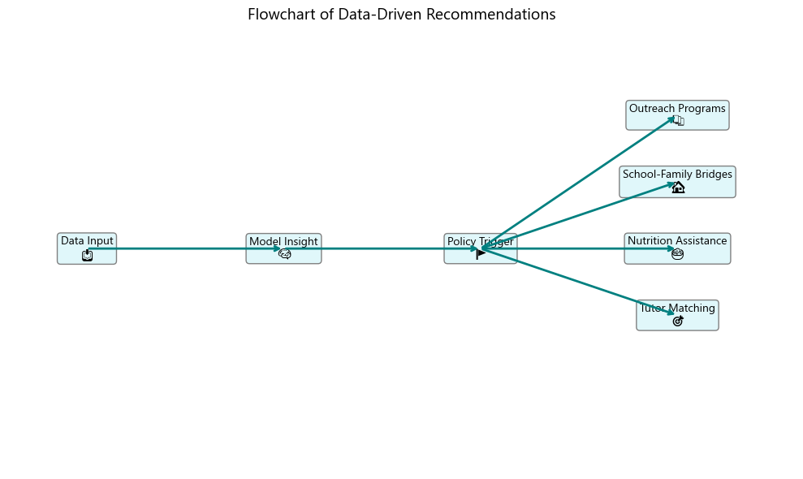
Policy & Intervention Recommendations
📚 Outreach Programs – after-school clubs, STEM workshops
🏠 School–Family Bridges – family engagement, learning kits
🥗 Nutrition Assistance – meal expansion, breakfast programs
🎯 Tutor Matching – targeted academic support

Slide 9
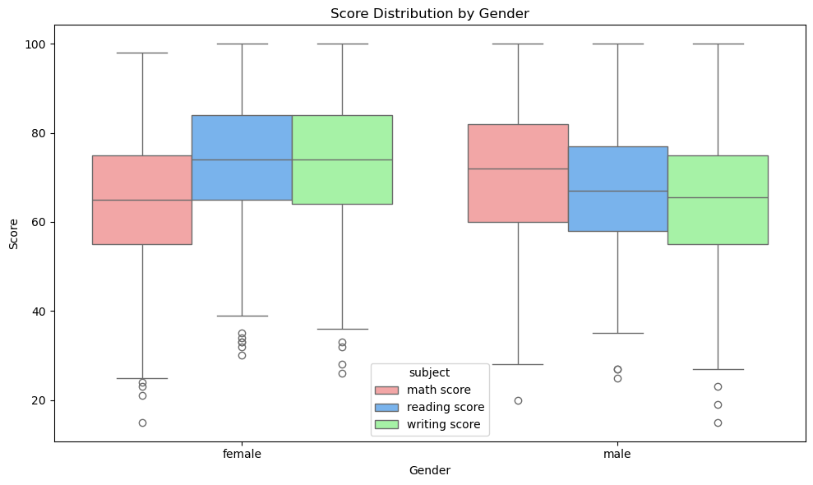
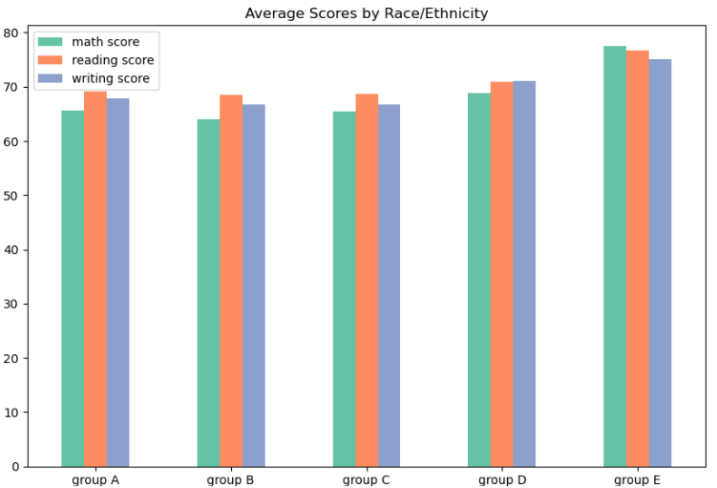
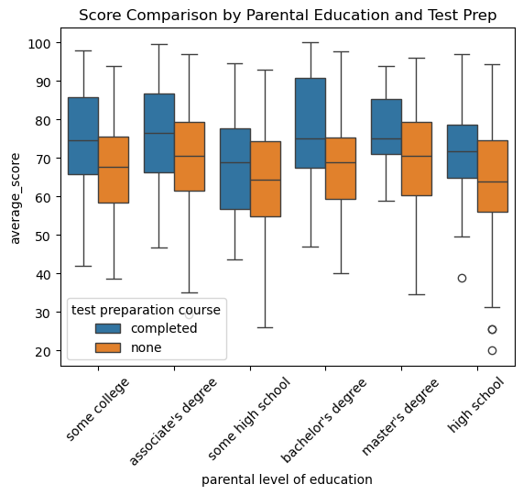
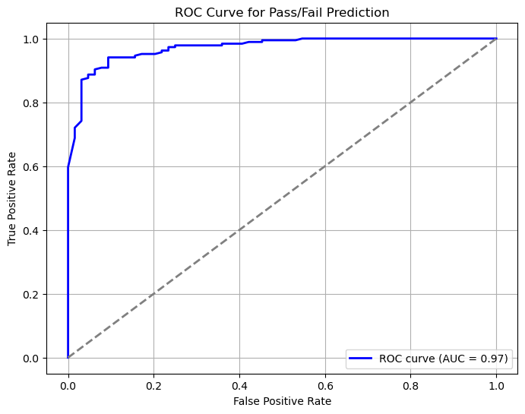
Conclusion: Bridging Gaps Through Equity-Focused Interventions
• Key Message:
“Equity-focused interventions can bridge performance gaps.”
• Call to Action:
“Leverage data to prioritize resource allocation.”
“Data-driven insights reveal where equity-focused interventions can make the greatest impact.”

