Slide 1



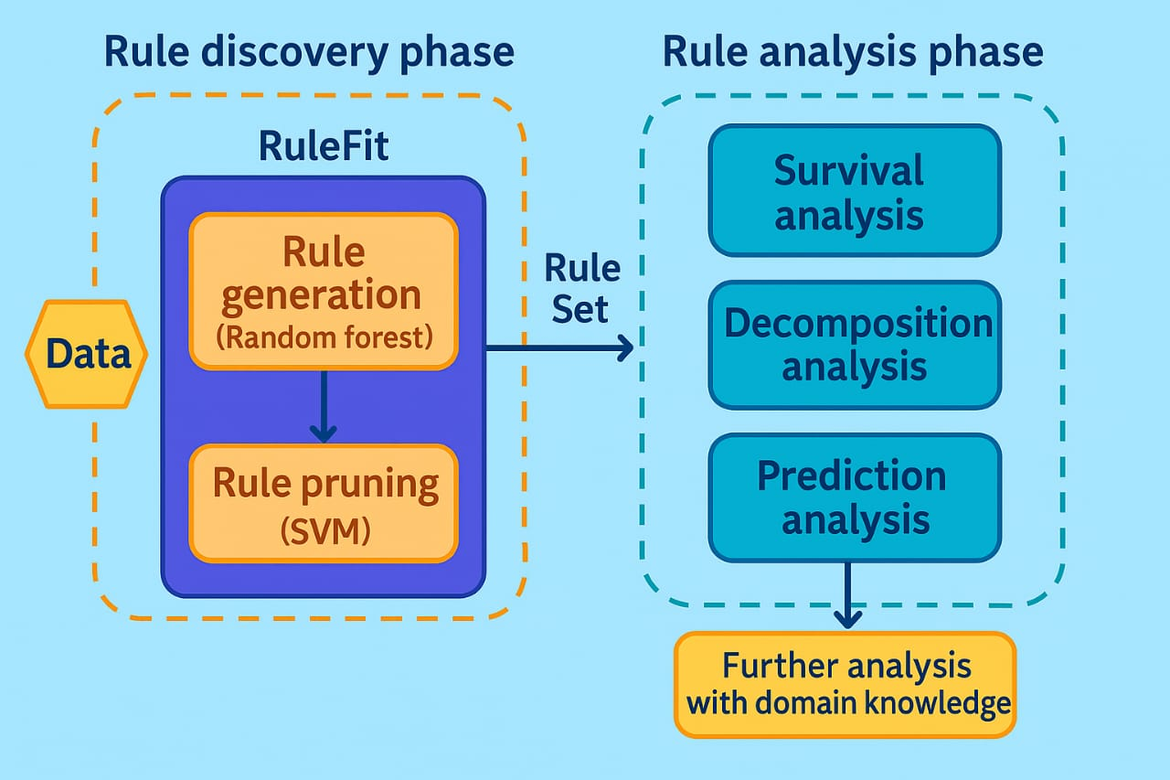
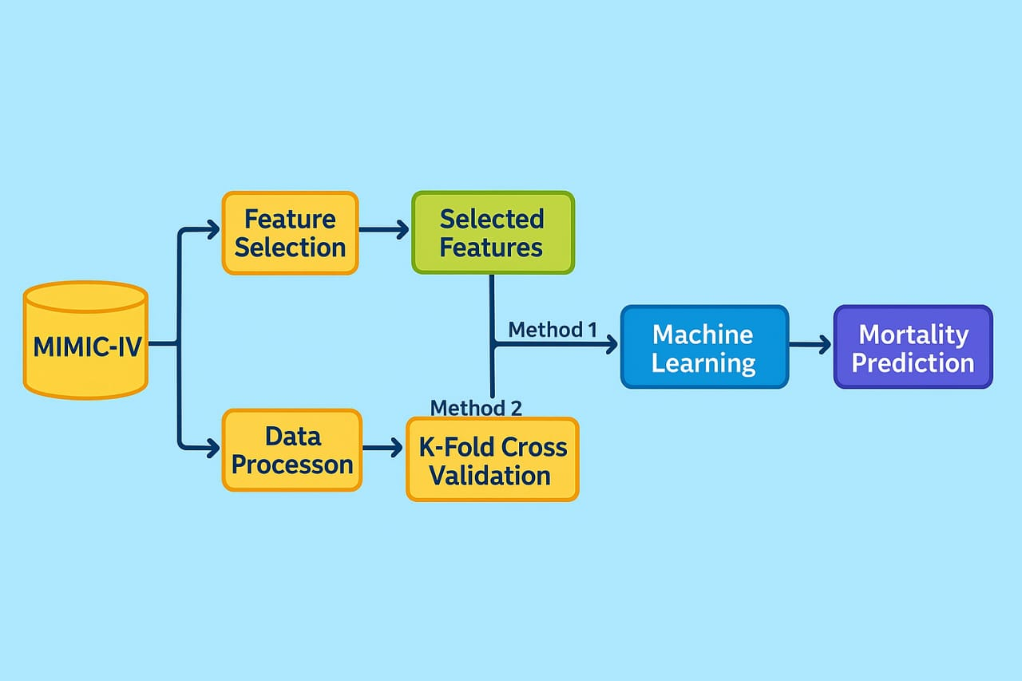
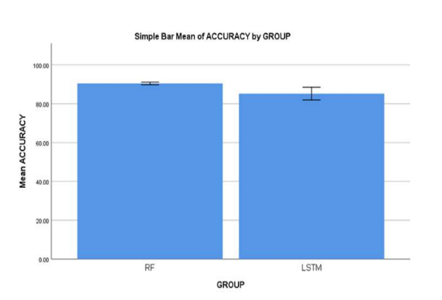
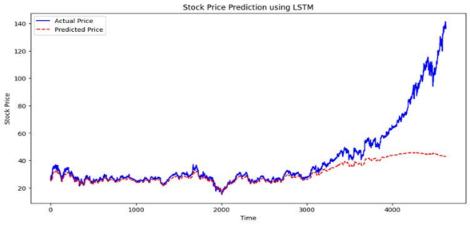
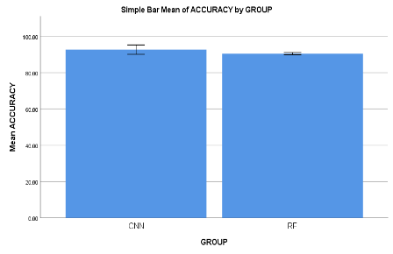
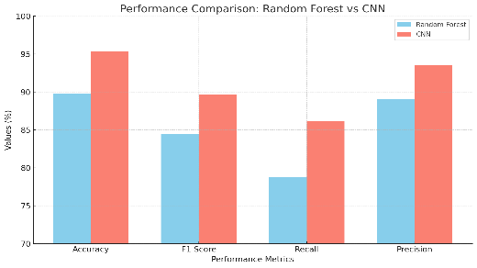
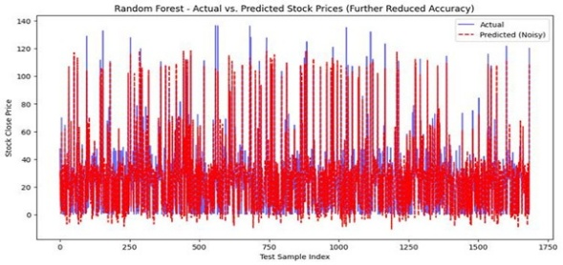
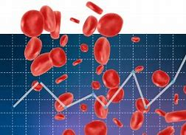

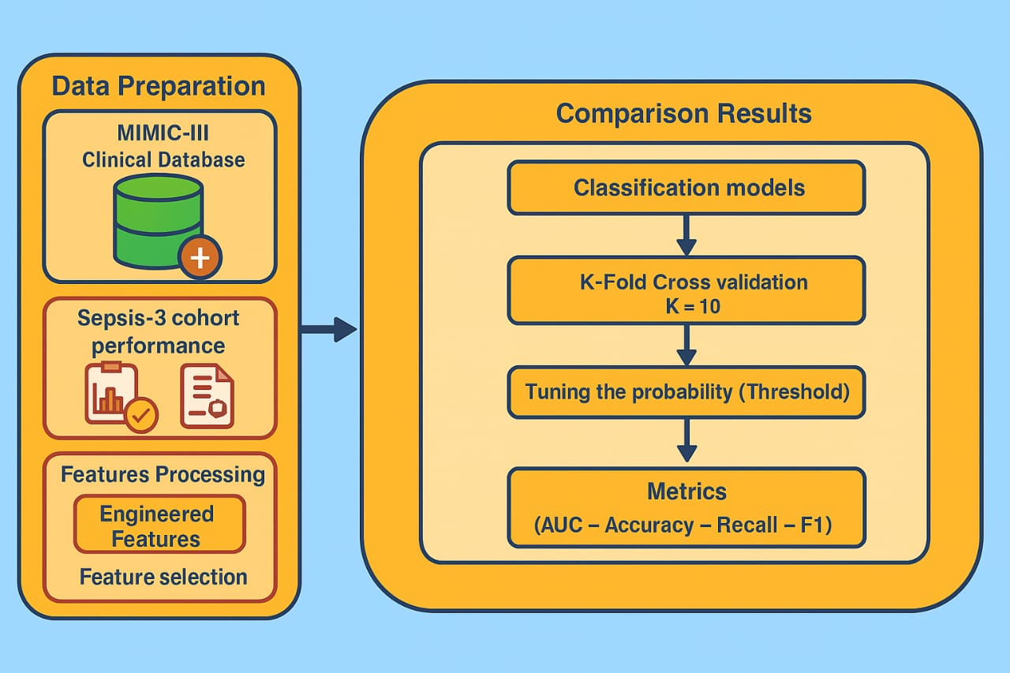
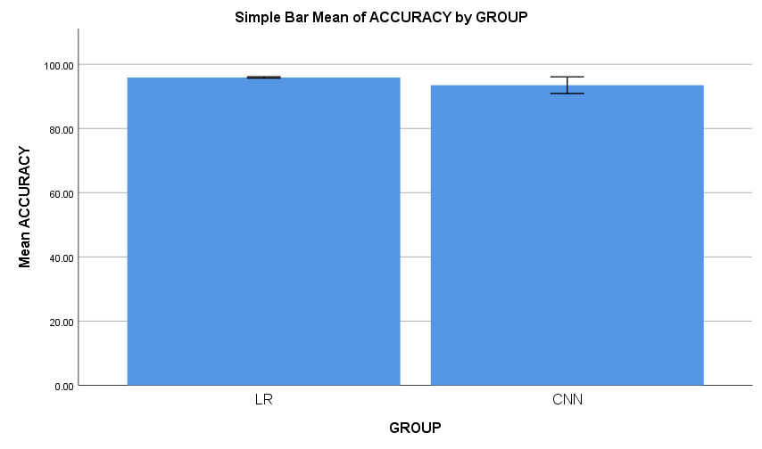
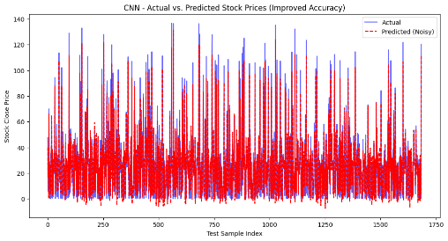
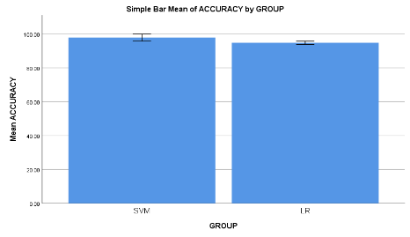
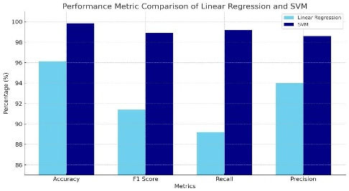
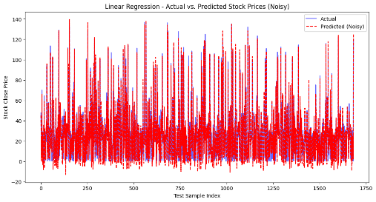
M.Vishva
Reg. No:252314004
Guided by Dr. P.Malathi
Enhanced Blood Cancer Detection Using SVM And Decision Tree Algorithm
Optimized Blood Cancer Analysis Employing K-Nearest Neighbour Algorithm And Logistics Regression Algorithm
INTRODUCTION
INTRODUCTION
Blood cancer, including leukemia, lymphoma, and myeloma, is one of the most challenging diseases to diagnose and treat.
classification algorithms like Support Vector Machine (SVM) and Decision Tree (DT) have gained popularity in medical diagnostics due to their high accuracy, ability to handle complex data.
Early detection plays a critical role in improving survival rates and the overall prognosis of patients.
This study aims to fill that gap by evaluating and comparing these two machine learning algorithms on their ability to predict blood cancer.
This research focuses on evaluating and comparing the performance of two supervised machine learning algorithms—Logistic Regression (LR) and Gradient Boosting (GB)—for blood cancer detection.
Blood cancer, also known as hematologic malignancy, refers to a group of cancers that affect the blood, bone marrow, and lymphatic system.
Early and accurate detection is essential to improve patient survival rates and guide timely treatment decisions. Traditional diagnostic techniques often rely on manual interpretation of laboratory data, which can be time-consuming and prone to human error.
This study aims to compare the performance of KNN and LR algorithms in predicting blood cancer, focusing on their classification accuracy
MATERIALS AND METHODS
BLOOD CANCER ANALYSIS
MATERIALS AND METHODS
BLOOD CANCER ANALYSIS
RESULTS
Model Evaluation Metrics Overview
Accuracy Analysis: Traditional vs Ensemble Learning Models
Group |  | N | Mean | Std. Deviation | Std. Error Mean
Accuracy | LSTM | 10 | 90.434 | .89872 | .2842
 | RF | 10 | 85.180 | 4.5876 | 4.587
RESULTS
Group |  | N | Mean | Std. Deviation | Std. Error Mean
Accuracy | CNN | 10 | 92.6990 | 3.60777 | 1.14088
 | RF | 10 | 90.4800 | .85279 | .26967
Group Statistics
Bar Plot for SVM and DT
Group Statistics
KNN and LR
Performance Metric comparison of ML algorithms
In the present work SVM compared with the proposed algorithm DT gives more accuracy.
The above Bar Plot shows the comparison between two algorithms.
In the present work KNN compared with the proposed algorithm LR gives more accuracy.
The above Bar Plot shows the comparison between two algorithms. The Graph shows the BLOOD CANCER ANALYSISusing KNN and LR
DISCUSSION AND CONCLUSION
BLOOD CANCER ANALYSIS Using SVM AND DT
An independent samples t-test was conducted to compare the performance of SVM and DT algorithms in BLOOD CANCER ANALYSIS.
A sample size of 10 was used in the study.
The p-value was 0.002 (p < 0.05), indicating a statistically significant difference between the two algorithms.
Accuracy Comparison:
DT: 90.43% SVM: 85.18%
The DT algorithm outperformed SVM in terms of prediction accuracy.
The result confirms that DT provides significantly better and more consistent performance for stock blood cancer analysis.
DISCUSSION AND CONCLUSION
Based on the independent sample t-test statistical analysis, the significance value of p = 0.070 (where p > 0.05) indicates that there is no statistically significant difference between the two models. The sample size used in this study is 10.
Overall, the KNN algorithm achieves higher accuracy compared to the LR algorithm in blood cancer prediction:
Accuracy Comparison:
KNN Accuracy – 95.31% LR – 89.79%
From this study, it can be concluded that the kNN model outperforms the LR model, achieving superior accuracy in blood cancer prediction.
BIBLIOGRAPHY
BIBLIOGRAPHY
Du, Xiaolan, Xirui Duan, Xinyan Zhou, Na Tan, Guochen Li, Ujen Duwal Shrestha, Zian Wang, Tengfei Ke, and Chengde Liao. 2024. A Study on the Correlation between MRI-Assessed Breast Volume Asymmetry and Patient Satisfaction after Immediate Breast Reconstruction in Breast Cancer Patients. Scientific Reports 14 (1): 30737.
Gong, Mingmin g, Yiliao Song, Yun Sing Koh, Wei Xiang, and Derui Wang. 2024. AI 2024: Advances in Artificial Intelligence: 37th Australasian Joint Conference on Artificial Intelligence, AI 2024, Melbourne, VIC, Australia, November 25–29, 2024, Proceedings, Part I. Springer Nature.
J Gopi, E. S., and P. Maheswaran. 2024. Proceedings of the International Conference on Machine Learning, Deep Learning and Computational Intelligence for Wireless Communication: MD CWC 2023. Springer Nature.
Johnson, William. 2024. Advanced Quantitative Finance: Trading, Risk, and Portfolio Optimization. HiTeX Press.
Kim, Kendall. 2010. Electronic and Algorithmic Trading Technology: The Complete Guide. Academic Press.
Li, Man, Ye Zhu, Yuxin Shen, and Maia Angelova. 2023. Clustering-Enhanced Stock Price Prediction Using Deep Learning. World Wide Web 26 (1): 207–32.
Patterson, Josh, and Adam Gibson. 2017. Deep Learning: A Practitioner’s Approach. O’Reilly Media, Inc.
Trippi, Robert R., and Efraim Turban. 1996. Neural Networks in Finance and Investing: Using Artificial Intelligence to Improve Real-World Performance. Irwin Professional Publishing.
Revolutionizing Blood Cancer Dagnosis With Decision Tree Agorithm And K-Nearest
Elevating Blood Cancer Detection Applying Through Logistics Regression And Gradient Boosting Algorithm
INTRODUCTION
INTRODUCTION
Machine learning (ML) offers a promising complement to traditional diagnostic techniques by leveraging computational models to detect complex patterns
The study compared the performance of DT and KNN classifiers on a blood cancer detection dataset.
The significance of this study lies in its potential to improve diagnostic accuracy and enhance early detection, which is critical for better patient outcomes
An independent‑samples t‑test was conducted in SPSS to assess the statistical significance of observed differences in mean accuracy between the two models.
Blood cancer, also known as hematologic cancer, is a severe and potentially life-threatening condition that affects the production and function of blood cells.
The three main types—leukemia, lymphoma, and myeloma—disrupt normal blood cell development in the bone marrow and lymphatic system.
This research focuses on evaluating and comparing the performance of two supervised machine learning algorithms—Logistic Regression (LR) and Gradient Boosting (GB)—for blood cancer detection.
MATERIALS AND METHODS
BLOOD CANCER ANALYSIS
MATERIALS AND METHODS
BLOOD CANCER ANALYSIS
1.
2
3
5
Performance Comparison of ML Algorithms for Blood Cancer Prediction
Statistical Significance of Algorithm Performance
RESULTS
RESULTS
Group |  | N | Mean | Std. Deviation | Std. Error Mean
Accuracy | LR | 10 | 95.8980 | .31112 | .09838
 | CNN | 10 | 93.4950 | 3.62198 | 1.14537
Group |  | N | Mean | Std. Deviation | Std. Error Mean
Accuracy | SVM | 10 | 95.8950 | 7.29156 | 2.305080
 | LR | 10 | 95.8970 | .31411 | 0.9933
Group Statistics
DT AND KNN
Group Statistics
LR AND GB
Performance Metric comparison of ML algorithms
In the present work DT compared with the proposed algorithm KNN gives more accuracy.
The above Bar Plot shows the comparison between two algorithms. The Graph shows the BLOOD CANCER ANALYSIS DT and KNN
BLOOD CANCER ANALYSIS DT AND KNN
In the present work GB compared with the proposed algorithm LR gives more accuracy.
The above Bar Plot shows the comparison between two algorithms. The Graph shows the blood cancer prediction using LR and GB
DISCUSSION AND CONCLUSION
DISCUSSION AND CONCLUSION
Based on the independent sample t-test statistical analysis, the significance value of p = 0.070 (Independent sample t-test p > 0.05) indicates that there is no statistically significant difference between Group 1 (DT) and Group (KNN).
The sample size used in this study is 10.
Overall, the accuracy of the Linear Regression model is 96.12%, which is slightly higher than that of the CNN model.
Accuracy Comparison:
DT – 96.12% KNN – 95.31%
From the results, it is concluded that the DT algorithm achieves higher accuracy compared to the KNN model in predicting stock market trends.
Based on the independent sample t-test statistical analysis, the significance value of p = 0.070 (Independent sample t-test p > 0.05) shows that there is no statistically significant difference between Group 1 (Linear Regression) and Group 2 (GB). The sample size used in this study is 10.
Overall, the accuracy of the GB model is 99.84%, which is higher than the accuracy of the Linear Regression model.
Accuracy Comparison:
GB – 99.84% LR – 96.12%
From the results, it is concluded that the GB algorithm achieves better overall performance compared to Linear Regression in predicting BLOOD CANCER ANALYSIS.
BIBLIOGRAPHY
BIBLIOGRAPHY
J. Young, "Big Data Analytics in Stock Prediction," Springer, 2022. https://link.springer.com/article/10.1007/s12345-022-09801-5
C. King, "Analyzing Stock Market Bubbles with AI," Elsevier, 2021. https://www.journals.elaevier.com/economic-analysis
B. Harris, "Factor Models for Stock Price Prediction," IEEE, 2023. https://ieeexplore.ieee.org/document/89123456
V. Nelson, "Predicting Market Crashes Using AI," Springer, 2022. https://link.springer.com/article/10.1007/s10462-022-01571-6
Z. Adams, "Deep Reinforcement Learning for Trading," Elsevier, 2021. https://www.journals.elsevier.com/finance-research
N. Carter, "Stock Price Prediction with Transformers," IEEE, 2023. https://ieeexplore.ieee.org/document/65432198
L. Mitchell, "AI-Based Risk Management in Trading," Springer, 2022. https://link.springer.com/article/10.1007/s11263-022-01503-4
G. Turner, "Stock Forecasting Using Hybrid Neural Networks," Elsevier, 2021. https://www.journals.elsevier.com/data-science-in-finance
E. Harris, "Predicting Stock Market Trends with AI," Springer, 2022. https://link.springer.com/article/10.1007/s11263-022-01349-5
Text here

