Slide 1
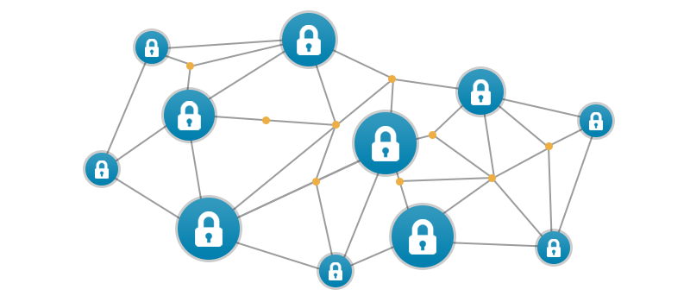
Implementation of Blockchain for Asset management & information security

Slide 2
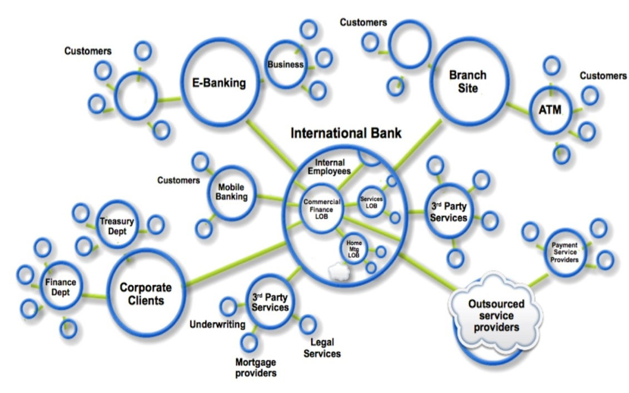
Business Networks, Markets & Wealth
• Business Networks benefit from connectivity
– Connected customers, suppliers, banks, partners
– Cross geography & regulatory boundary
• Wealth is generated by the flow of goods &
services across business network
• Markets are central to this process:
– Public (fruit market, car auction), or
– Private (supply chain financing, bonds)

Slide 3
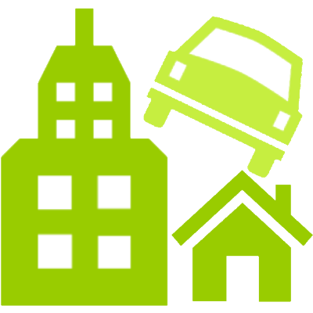
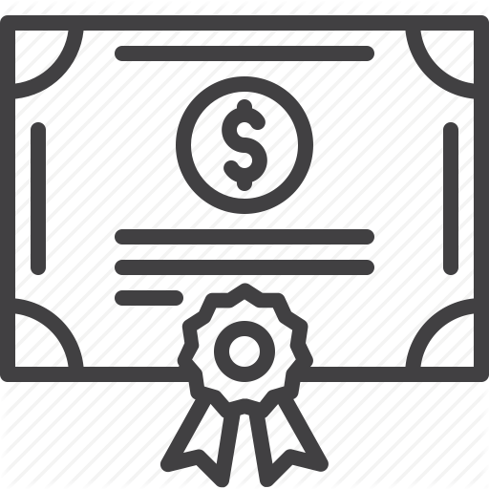

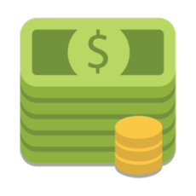
Transferring Assets, building Value
• Anything that is capable of being owned
or controlled to produce value, is an asset
• Two fundamental types of asset
– Tangible, e.g. a house
– Intangible e.g. a mortgage
• Intangible assets subdivide
– Financial, e.g. bond
– Intellectual e.g. patents
– Digital e.g. music
• Cash is also an asset
– Has property of anonymity

Slide 4
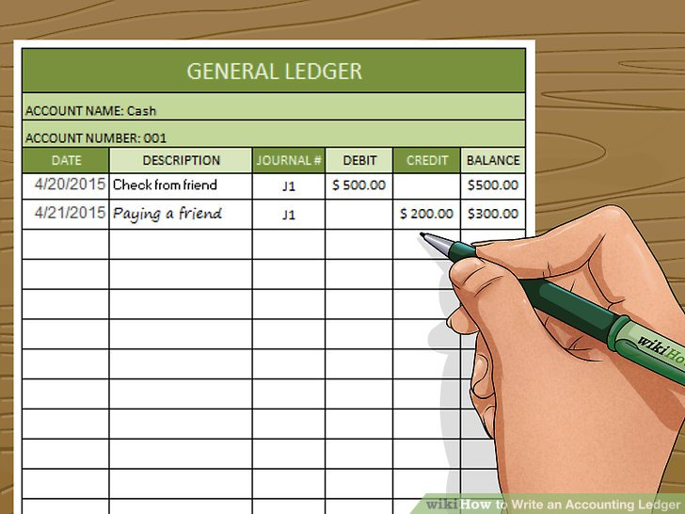
Ledgers are Important
• Ledger is THE system of record for a business
– records asset transfer between participants.
• Business will have multiple ledgers for multiple business networks in which they participate.

Slide 5
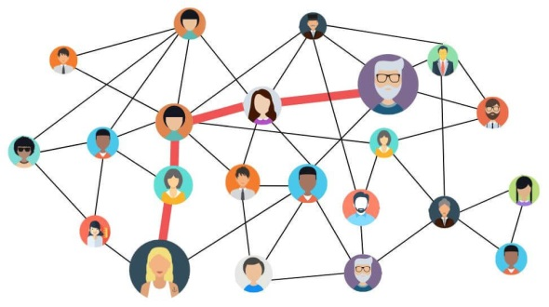
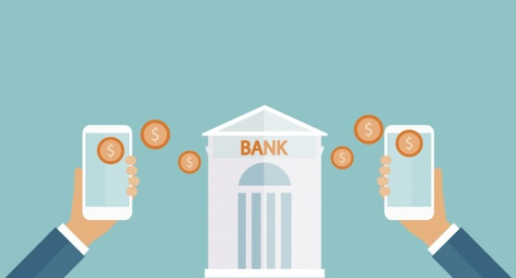

Participants, Transactions & Contracts
• Participants - members of a business network
– Customer, Supplier, Government, Regulator
– Usually resides in an organization
– Has specific identities and roles
• Transaction
an asset transfer
– John gives a car to Anthony (simple)
• Contract - conditions for transaction to occur
– If Anthony pays John money, then car passes from John to Anthony (simple)
– If car won't start, funds do not pass to John (as decided by third party arbitrator) (more complex)

Slide 6
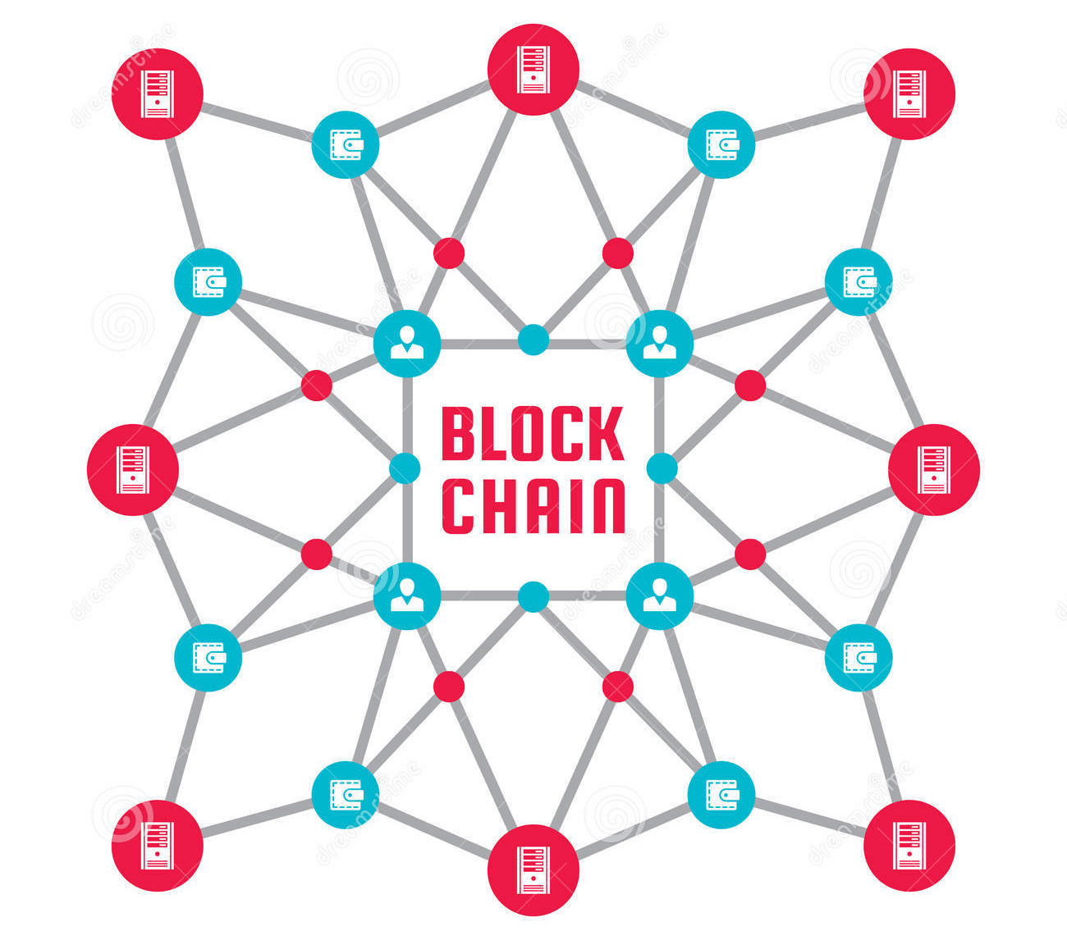
A shared ledger technology allowing any participant in the business network to see THE system of record (ledger)
Introducing Blockchain

Slide 7
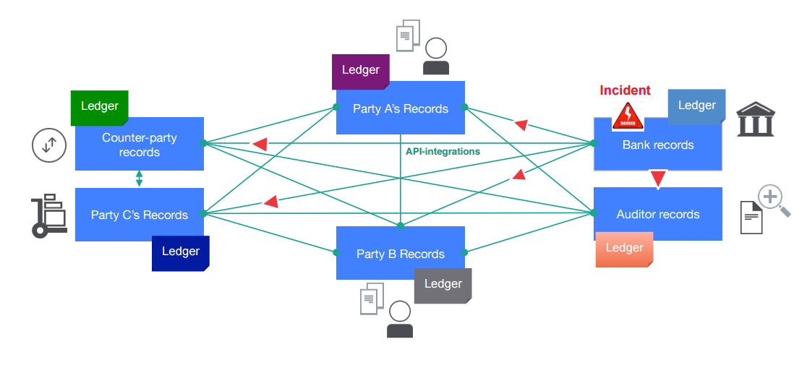
Problem - Difficult to monitor asset ownership and transfers in a trusted business network
Inefficient, expensive, vulnerable

Slide 8
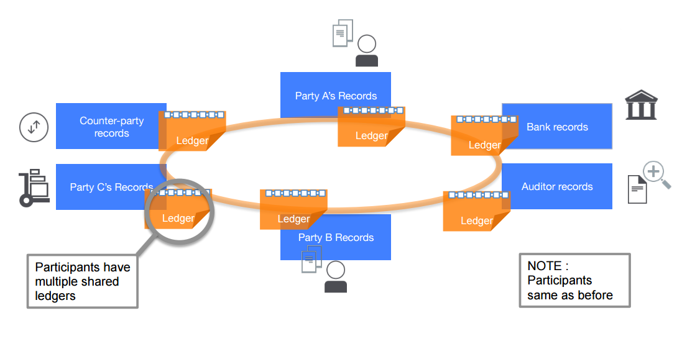
Solution – a permissioned, replicated, shared ledger
Consensus, provenance, immutability, finality

Slide 9
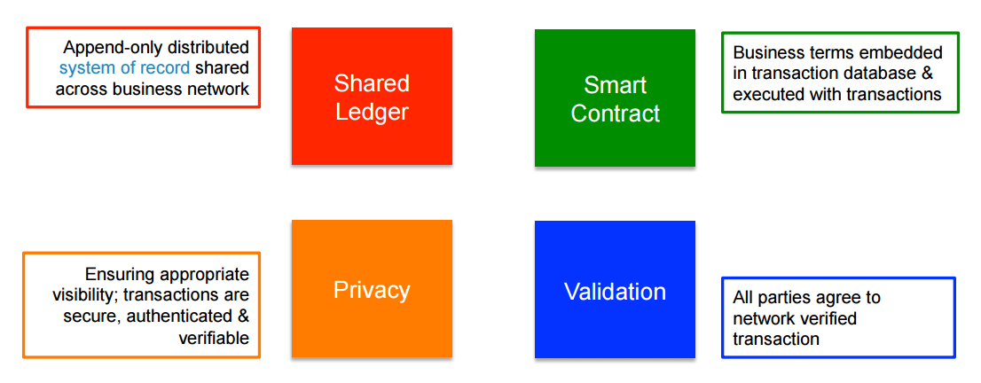
Blockchain for Business
Broader participation, lower cost, increased efficiency

Slide 10
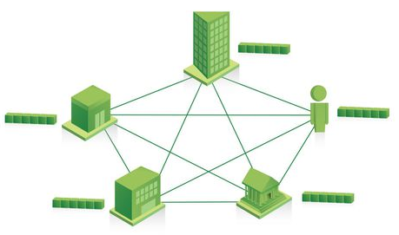
Shared Ledger
• Records all transactions across business network
• Shared between participants
• Participants have own copy through replication
• Permissioned, so participants see only appropriate transactions
• THE shared system of record

Slide 11
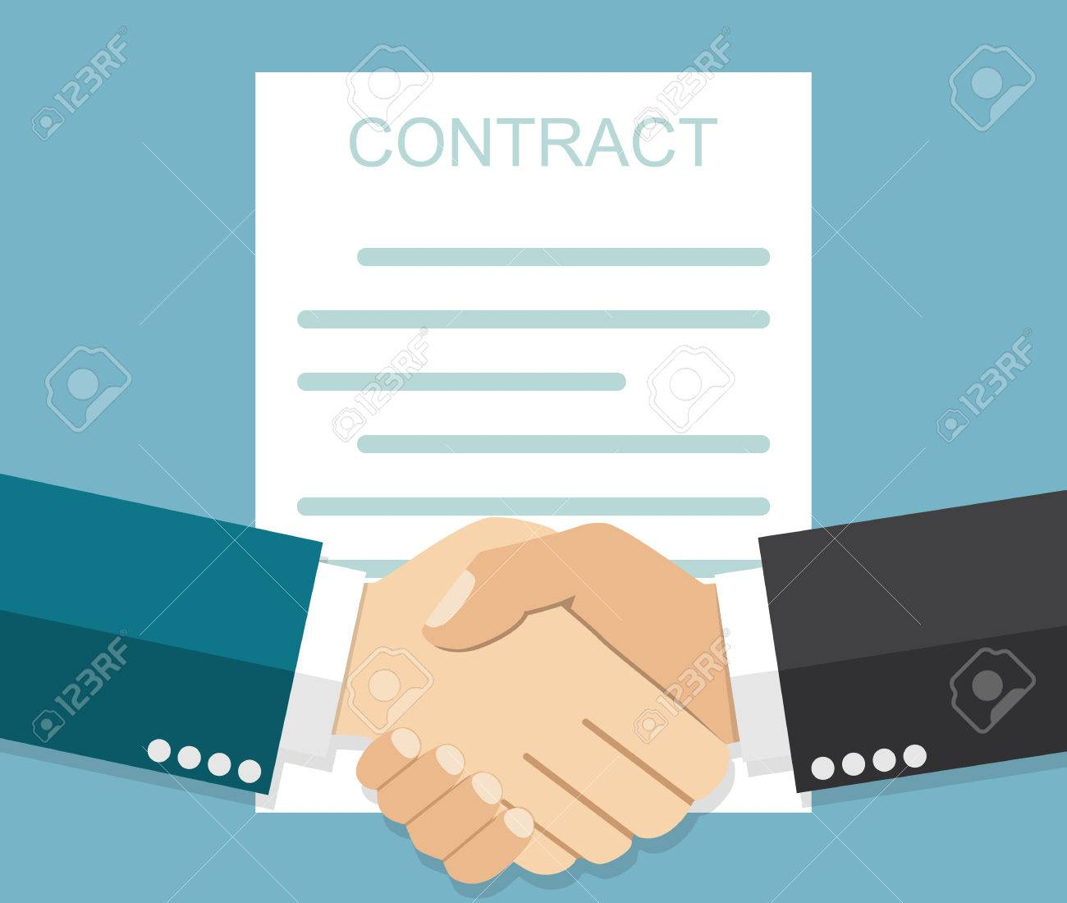
Smart Contract
• Business rules implied by the contract embedded in the Blockchain &
• executed with the transaction
• Verifiable, signed
• Encoded in programming language
• Example:
– Defines contractual conditions under which corporate Bond transfer occurs

Slide 12

Privacy
• Ledger is shared, but participants
require privacy
• Participants need:
– Transactions to be private
– Identity not linked to a transaction
• Transactions need to be authenticated
• Cryptography central to these processes

Slide 13
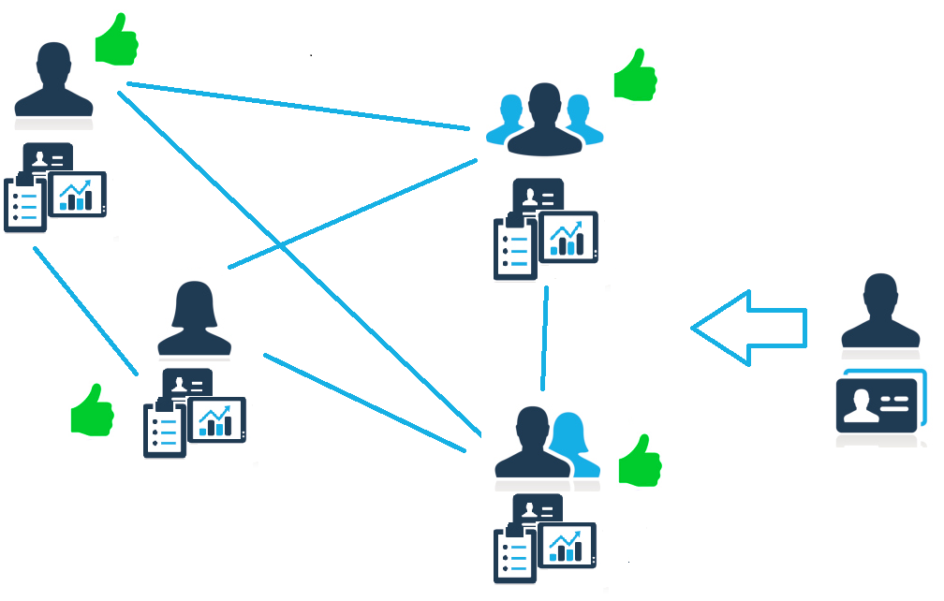
Validation
• Transaction verification & commitment
• When participants are anonymous
– Commitment is expensive
– Bitcoin cryptographic mining provides verification for anonymous participants but at significant compute cost (proof of work)
• When participants are known & trusted
– Commitment possible at low cost
• Multiple alternatives
– proof of stake where fraudulent transactions cost validators (e.g. transaction bond)
– multi-signature (e.g. 3 out of 5 participants agree)
• Industrial Blockchain needs “pluggable” consensus

Slide 14
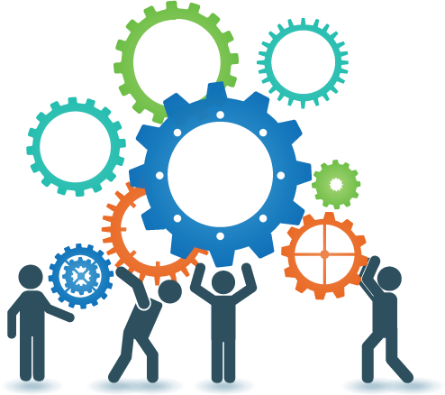


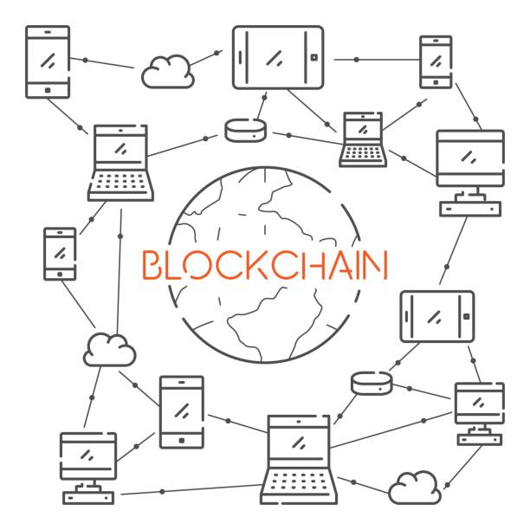
Industrial Blockchain Benefits
Reduce costs
and
complexity
Trusted
recordkeeping
Improve
discoverability
Shared trusted
processes

Slide 15
Motivation
Great West as an organization manages huge number of assets of different entities. We act as middle men in managing funds of different individuals in our client organization.
We also have to deal with a lot of confidential client information hence security of our data is also a huge concern to our organization.
Yearly settlements of individuals is another area where we may be utilizing a lot of our organizational resources.
For this we use traditional relational database approach for this purpose. By maintaining data across our 3 data centers where 1 acts as the main data center and the other two are used for back up incase the main data center were to go offline.
Also the data in our databases is not encrypted so if an external entity were to breach the data layer of our system the security of client data would be at risk. Thus we have thought of this approach keeping in mind the data security and mutability in our current system.

Slide 16
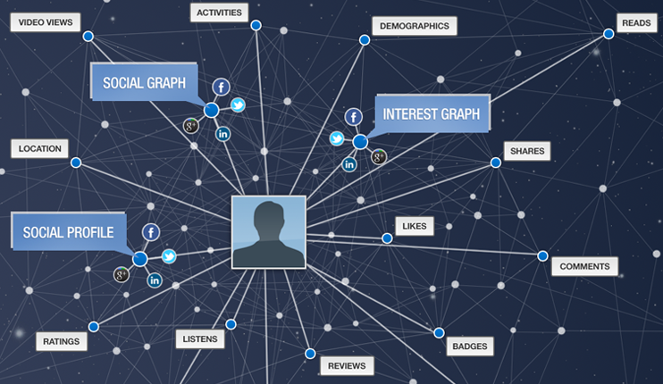
Use Case – Online Identity Management
What?
A participant needs registration which can be done online but financial services like loans, mortgages or insurance require a higher level of security
Compliance with Know Your Customer (KYC) regulations required
It is a time-consuming and costly process
How?
Blockchain ensures data is distributed across a network.
It can be changed only if consensus is gained among network participants that a proposed transaction is correct and valid
Benefits
Empowers consumers to control their own identity and share between trusted entities with their consent.
No single institution can compromise a consumer’s identity
It can eliminate the possibility of a party using a fake mailing address, social security number, insurance policy, or even phone number, which helps protect parties from identity theft

Slide 17

Use Case – Asset Management
Great west manages assets of multiple participants under different sponsors
each participants assets are invested in different funds within a plan for a sponsor
During audit any discrepancy arises it takes a lot of time and effort to resolve it.
It is a time-consuming and costly process
How?
Blockchain ensures data transaction data is stored in immutable ledger.
It can be changed only if consensus is gained among network participants that a proposed transaction is correct and valid.
Transactions are time stamped.
Benefits
If discrepancy arises it can be traced back to the blockchain as and the dispute can be easily resolved.
It can eliminate the possibility of a deleted or modified transaction.
It can act as a trusted system for storing important data which can be used by the auditors during an audit saving time.

