Slide 1
Eulerian Graphs, Hamiltonian Graphs

Slide 2
Definitions
Walk
Trial
Path
Circuit

Slide 3
1. Walk
A walk is an alternating sequence of vertices and connecting edges.
Less formally, a walk is any route through a graph from vertex to vertex along edges.
A walk can end on the same vertex on which it began(Close walk) or on a different vertex(Open walk).
A walk can travel over any edge and any vertex any number of times.

Slide 4
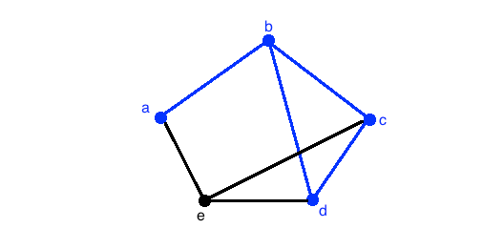
Walk in the given graph is- abcdb

Slide 5
2. Trail
A Trail is defined as a walk with no repeated edges.

Slide 6
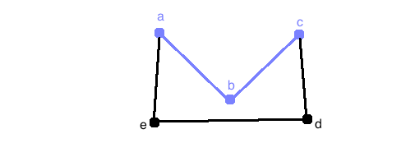

Slide 7
Notice that the walk can be defined as abc. There are no repeated edges so this walk is also a trail.

Slide 8
3. Path
A Path is defined as an open trail with no repeated vertices.

Slide 9
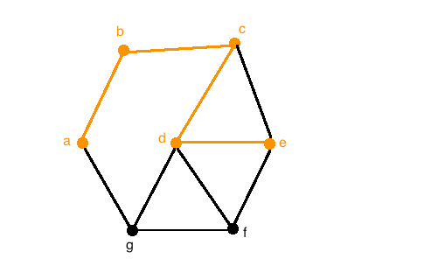
Notice that all paths must therefore be open walks, as a path cannot both start and terminate at the same vertex. For example, the following orange colored walk is a path because the walk abcde does not repeat any edges.

Slide 10
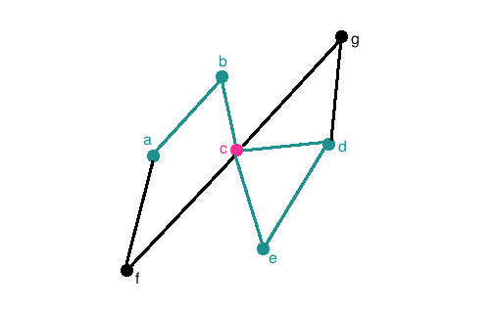
Now let's look at the next graph with the teal walk. This walk is NOT a path since it repeats a vertex, namely the pink vertex c

Slide 11
4. Circuits
Definition: A Circuit is a closed trail. That is, a circuit has no repeated edges but may have repeated vertices.

Slide 12
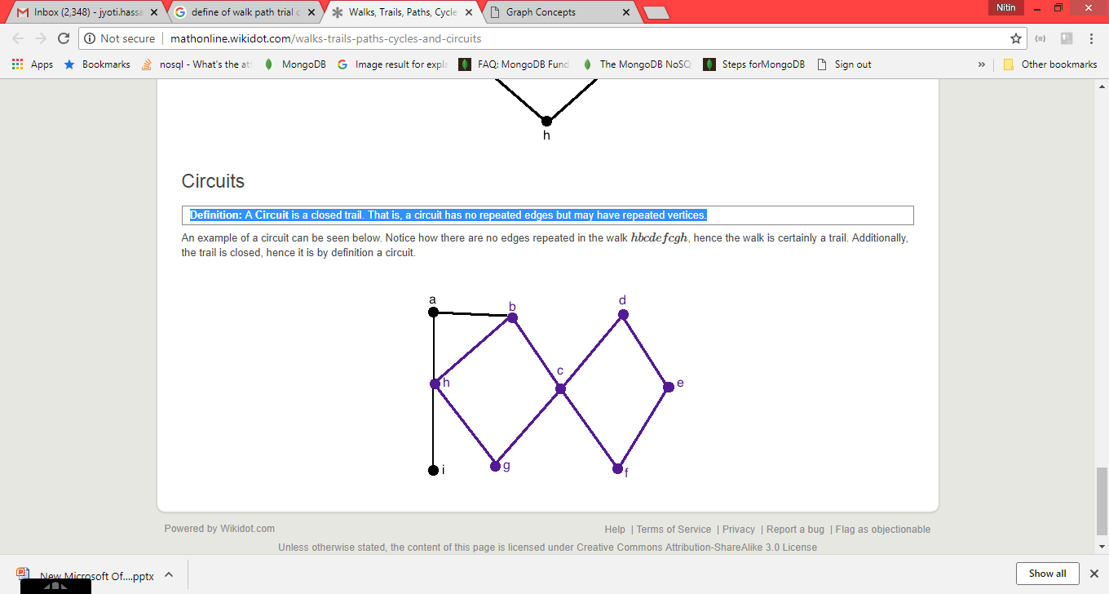
An example of a circuit can be seen below. Notice how there are no edges repeated in the walk hbcdefcgh, hence the walk is certainly a trail. Additionally, the trail is closed, hence it is by definition a circuit.

Slide 13
Eulerian Graphs
The following problem, often referred to as the bridges of K¨onigsberg problem, was first solved by Euler in the eighteenth century.
The problem was rather simple — the town of K¨onigsberg consists of two islands and seven bridges.
Is it possible, by beginning anywhere and ending anywhere, to walk through the town by crossing all seven bridges but not crossing any bridge twice?

Slide 14
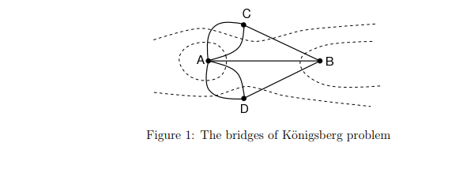

Slide 15
Eulerian trail:
An Eulerian trail is a trail that visits every edge of the graph once and only once. It can end on a vertex different from the one on which it began. A graph of this kind is said to be traversable.

Slide 16
Eulerian Circuit: An Eulerian circuit is an Eulerian trail that is a circuit. That is, it begins and ends on the same vertex.
Eulerian Graph: A graph is called Eulerian when it contains an Eulerian circuit

Slide 17
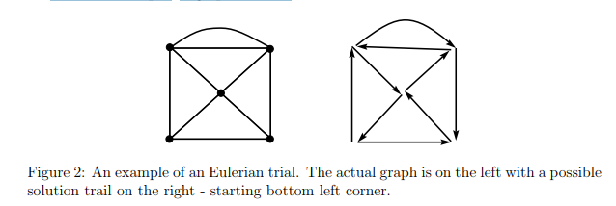

Slide 18
Hamiltonian Graphs
Hamiltonian Circuit: A Hamiltonian circuit in a graph is a closed path that visits every vertex in the graph exactly once.
A Hamiltonian circuit ends up at the vertex from where it started(cycle).
Hamiltonian graphs are named after the nineteenth-century Irish mathematician Sir William Rowan Hamilton(1805-1865).
This type of problem is often referred to as the travelling salesman or postman problem.

Slide 19
Hamiltonian Graph: If a graph has a Hamiltonian circuit, then the graph is called a Hamiltonian graph.
Important: An Eulerian circuit traverses every edge in a graph exactly once, but may repeat vertices, while a Hamiltonian circuit visits each vertex in a graph exactly once but may repeat edges

Slide 20
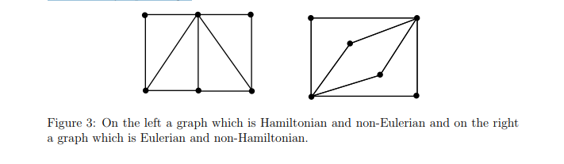
Question: Are the following graphs Hamiltonian or Eulerian or both?

Slide 21
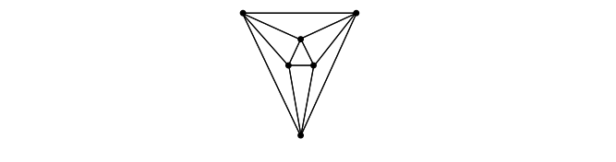
Question: Is the following graph Hamiltonian or Eulerian or both?

Slide 22
Fleury’s Algorithm
Let G be a connected graph. If G is Eulerian then Fleury’s algorithm will produce an Eulerian trail in G. In a connected graph G, a bridge is an edge which, if removed, produces a disconnected graph.

Slide 23
Fleury’s Algorithm
Let G be an Eulerian graph.
STEP 1: Choose any vertex v of G and set current vertex equal to v and current trail equal to the empty sequence of edges.
STEP 2: Select any edge e incident with the current vertex but choosing a bridge only if there is no alternative.
STEP 3: Add e to the current trail and set the current vertex equal to the vertex at the ‘other end’ of e. [If e is a loop, the current vertex will not move.]
STEP 4: Delete e from the graph. Delete any isolated vertices.
Repeat steps 2 – 4 until all edges have been deleted from G. The final current trail is an Eulerian trail in G

Slide 24
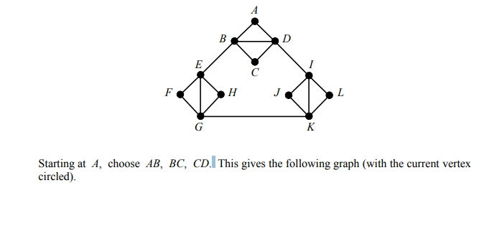
Example Apply Fleury’s algorithm, beginning with vertex A, to find an Eulerian trail in the following graph. In applying the algorithm, at each stage chose the edge (from those available) which visits the vertex which comes first in alphabetical order.

Slide 25
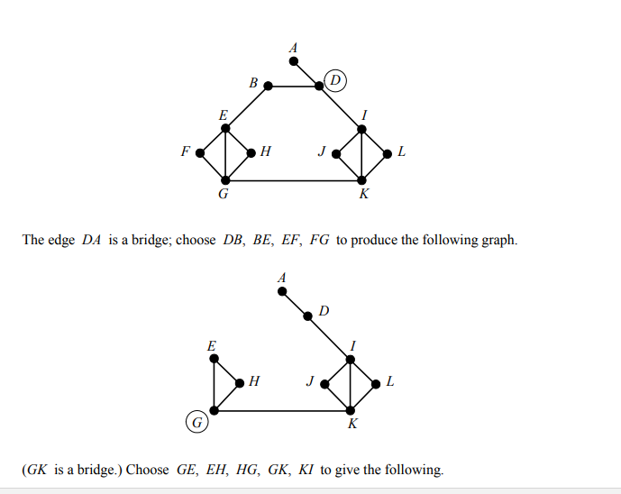
Starting at A, choose AB, BC, CD. This gives the following graph (with the current vertex circled).

Slide 26
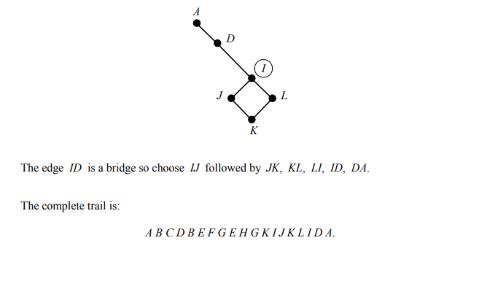

Slide 27
Graph Coloring
Graph coloring is nothing but a simple way of labelling graph components such as vertices, edges, and regions under some constraints. In a graph, no two adjacent vertices, adjacent edges, or adjacent regions are colored with minimum number of colors. This number is called the chromatic number and the graph is called a properly colored graph.
While graph coloring, the constraints that are set on the graph are colors, order of coloring, the way of assigning color, etc. A coloring is given to a vertex or a particular region. Thus, the vertices or regions having same colors form independent sets.

Slide 28
Vertex Coloring
Vertex coloring is an assignment of colors to the vertices of a graph ‘G’ such that no two adjacent vertices have the same color. Simply put, no two vertices of an edge should be of the same color.
Chromatic Number
The minimum number of colors required for vertex coloring of graph ‘G’ is called as the chromatic number of G, denoted by X(G).
χ(G) = 1 if and only if 'G' is a null graph. If 'G' is not a null graph, then χ(G) ≥ 2

Slide 29
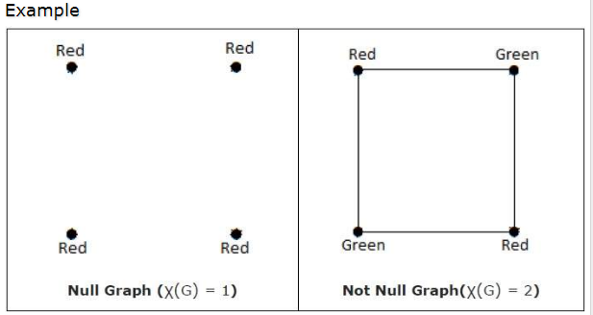

Slide 30
Note − A graph ‘G’ is said to be n-coverable if there is a vertex coloring that uses at most n colors, i.e., X(G) ≤ n.

Slide 31
Region Coloring
Region coloring is an assignment of colors to the regions of a planar graph such that no two adjacent regions have the same color. Two regions are said to be adjacent if they have a common edge.
Example
Take a look at the following graph. The regions ‘aeb’ and ‘befc’ are adjacent, as there is a common edge ‘be’ between those two regions.

Slide 32
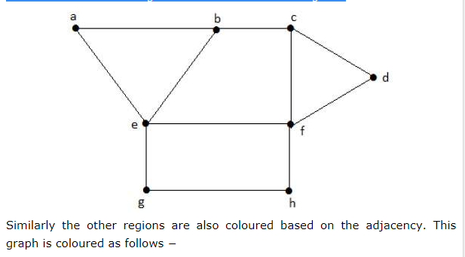

Slide 33
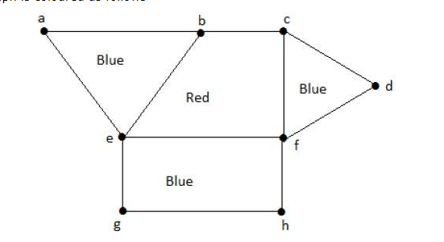

Slide 34
Consider this example with K₄.
In the complete graph, each vertex is adjacent to remaining (n – 1) vertices. Hence, each vertex requires a new color. Hence the chromatic number of K_{n} = n.

Slide 35
