Slide 1
The Poker Room
A website for learning poker and improving your skills.

Slide 2
Who Is This Website For?
New players interested in playing Poker. Those who want to learn the rules of the game.
Novice/Intermediate players interested in improving their poker game.
Advanced/expert players can use the site to promote their own private poker coaching to newer players.

Slide 3
What is the site’s Purpose?
Primary goal: Introduce more people to poker. Increase traffic for all avenues of poker: in casinos, online, or private home games.
Secondary Goal: improve the user’s skill and decision making
Just knowing rules isn’t enough to make a good poker player.
Helping players win more often will keep them interested in poker for the long term.

Slide 4
Why Does it matter?
Poker is an inherently social game. More players = more games = (arguably) more fun.
Poker has a greater skill aspect than other casino games. There is a benefit to learning good strategy in poker.
A larger, more involved player base might help get organizations (and the government) more involved in poker.

Slide 5
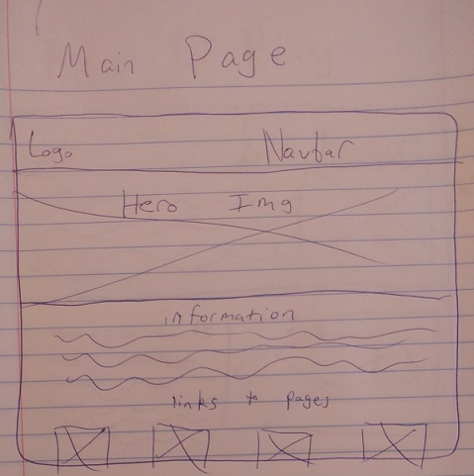
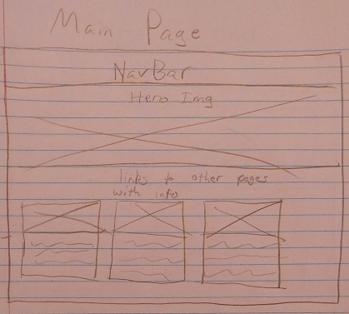
Main Page Wireframes
Draft
Final

Slide 6
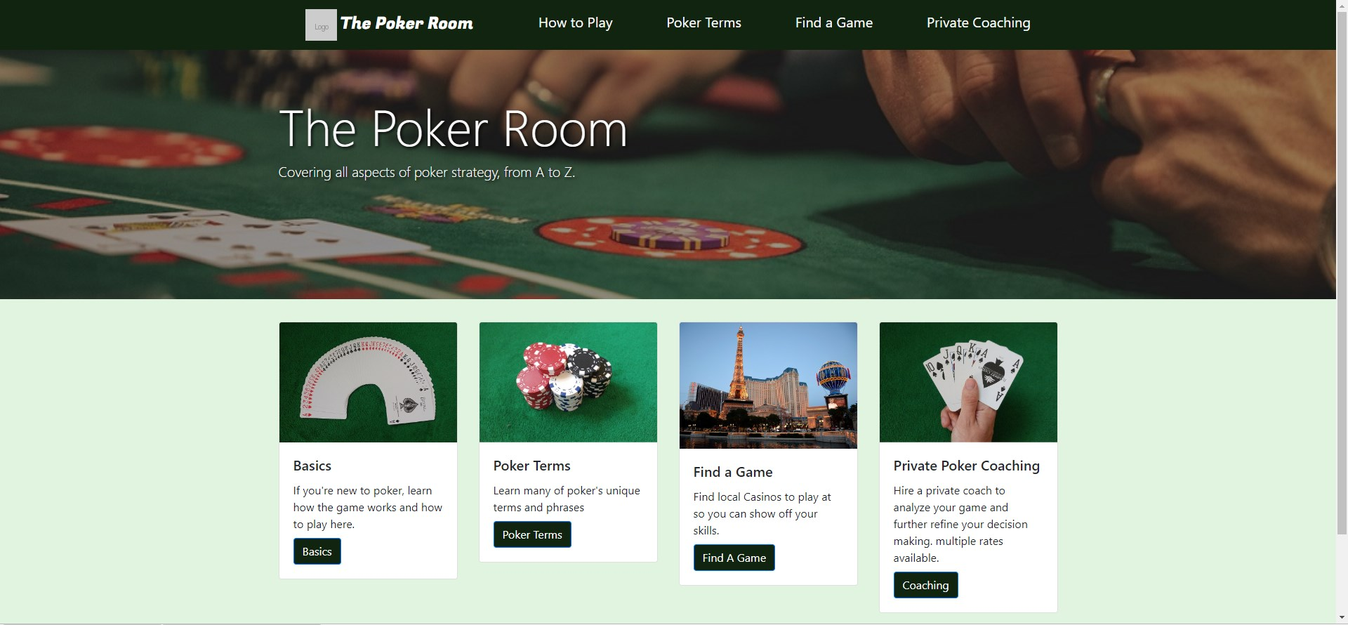

Slide 7
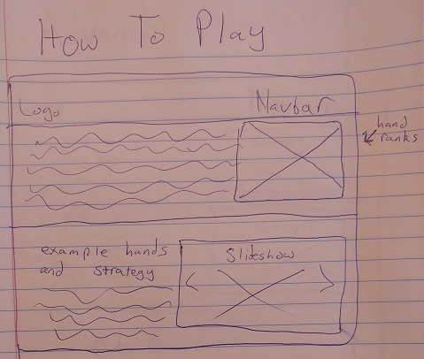
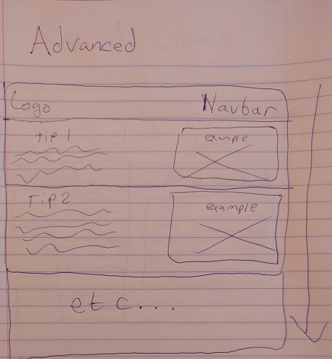
Basics/Advanced Pages (draft)

Slide 8
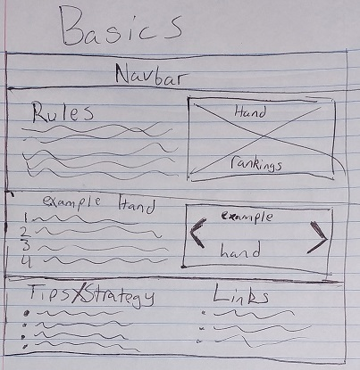
Basics Wireframe (final)
Advanced strategy added to bottom of basics page instead of its own page
Added helpful links for players that want more help and tips

Slide 9
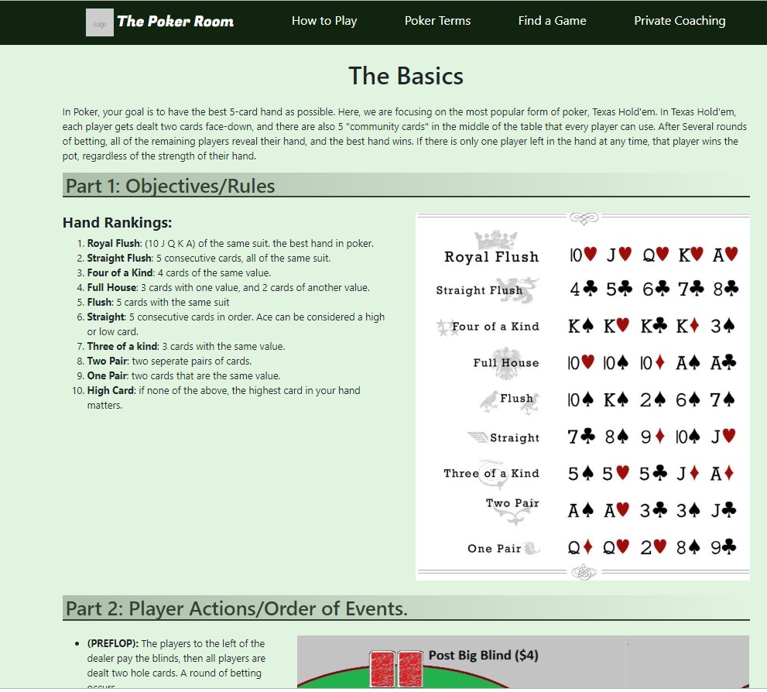
Basics Page (final webpage)

Slide 10
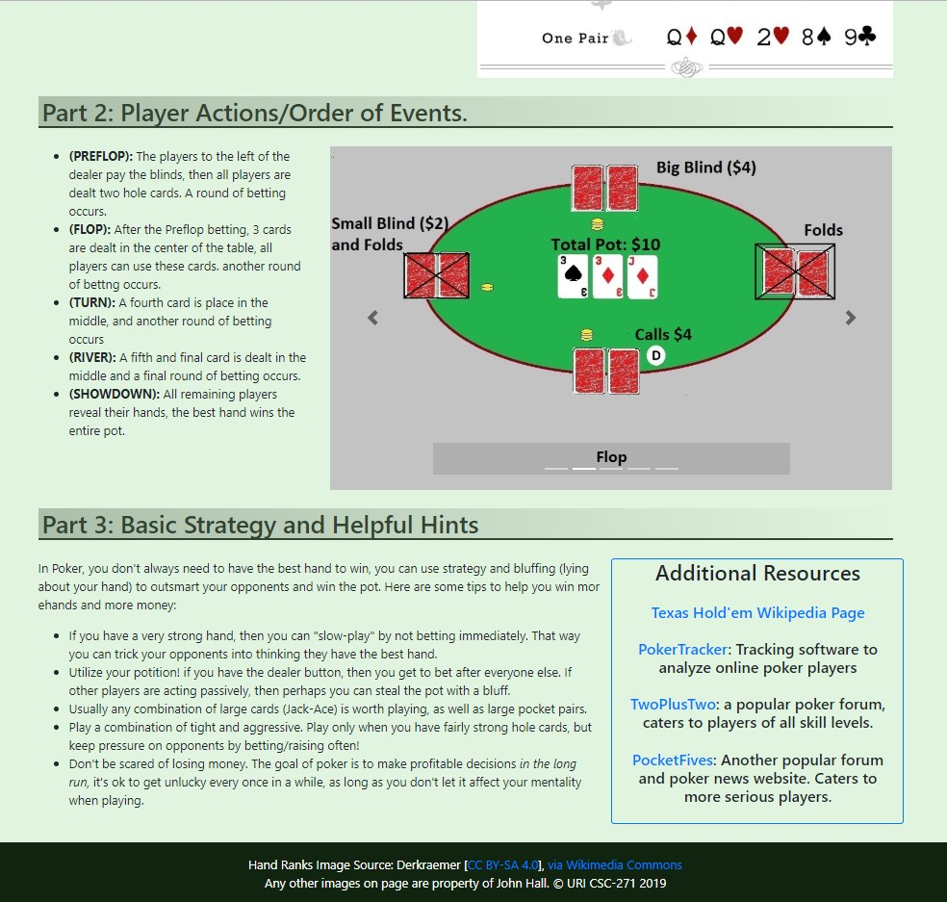
Basics Page (final webpage)

Slide 11
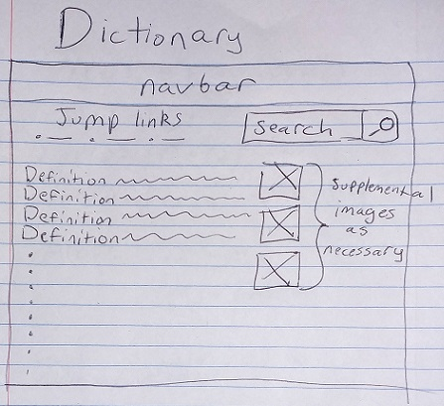
Dictionary Wireframe

Slide 12
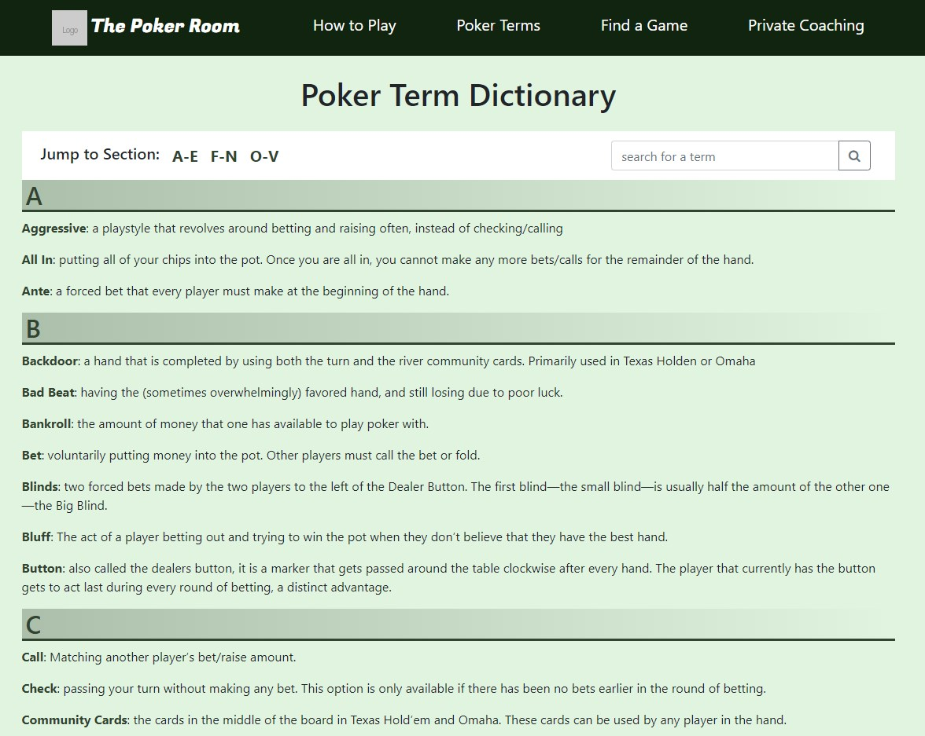
Dictionary

Slide 13
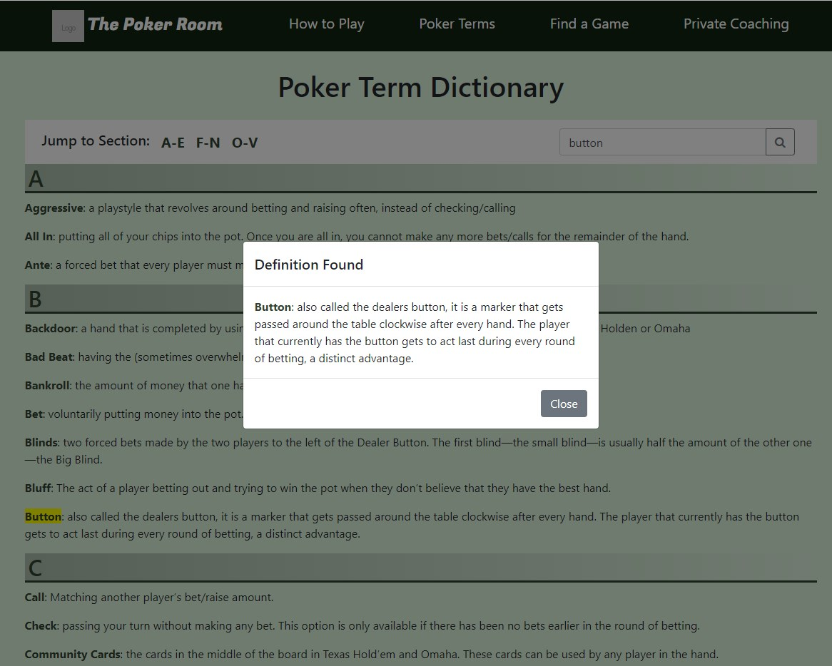
Dictionary (after search)
Opens Modal
Jumps to term on the page
Highlights the term

Slide 14
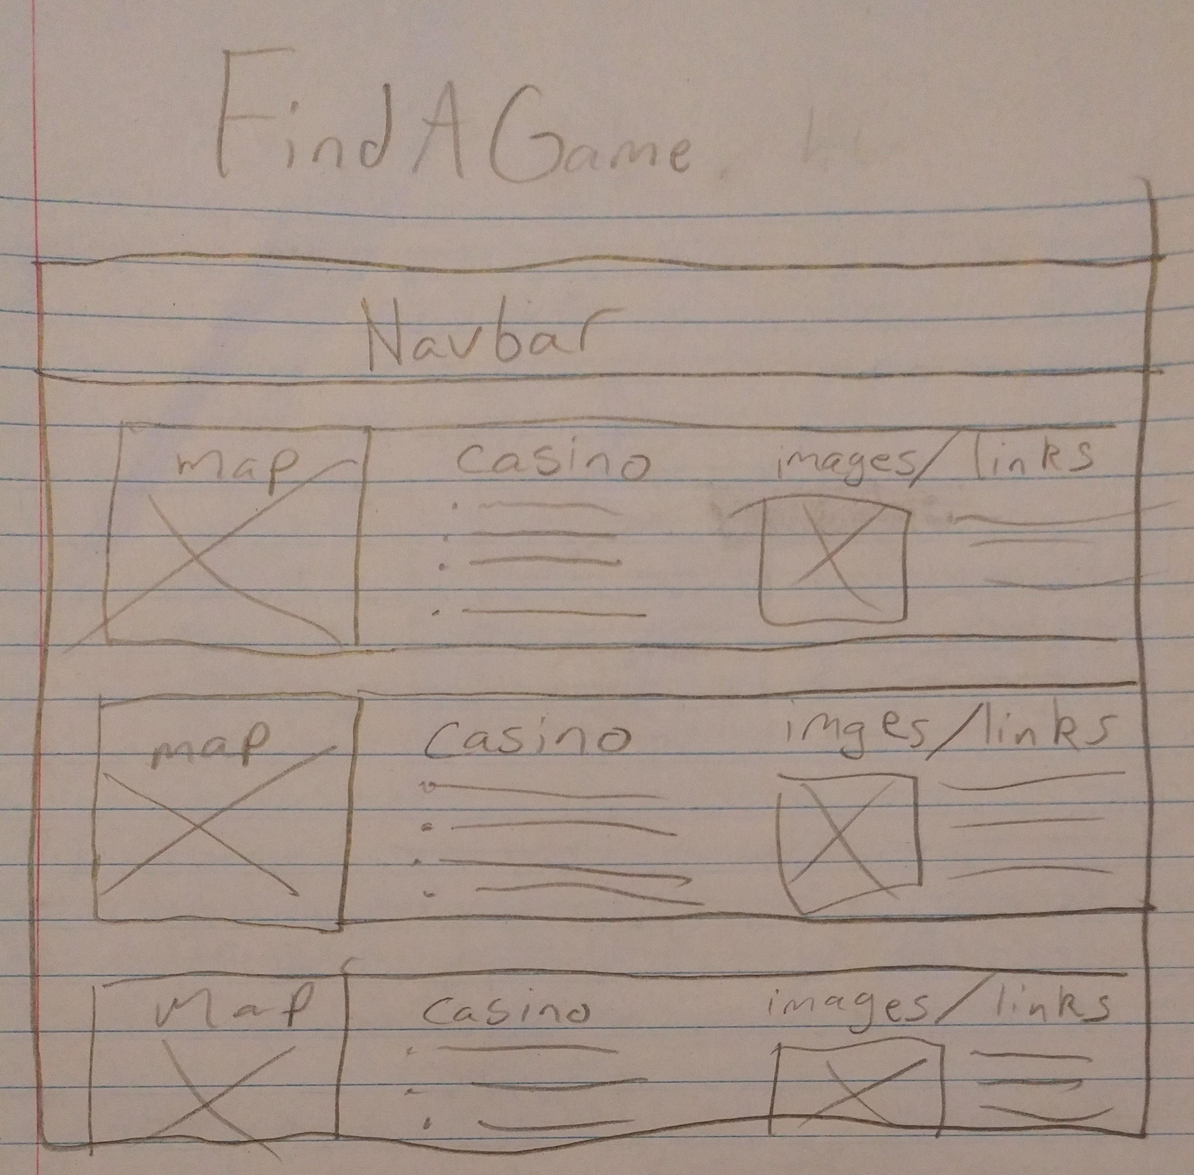
Find a Game (Wireframe)

Slide 15
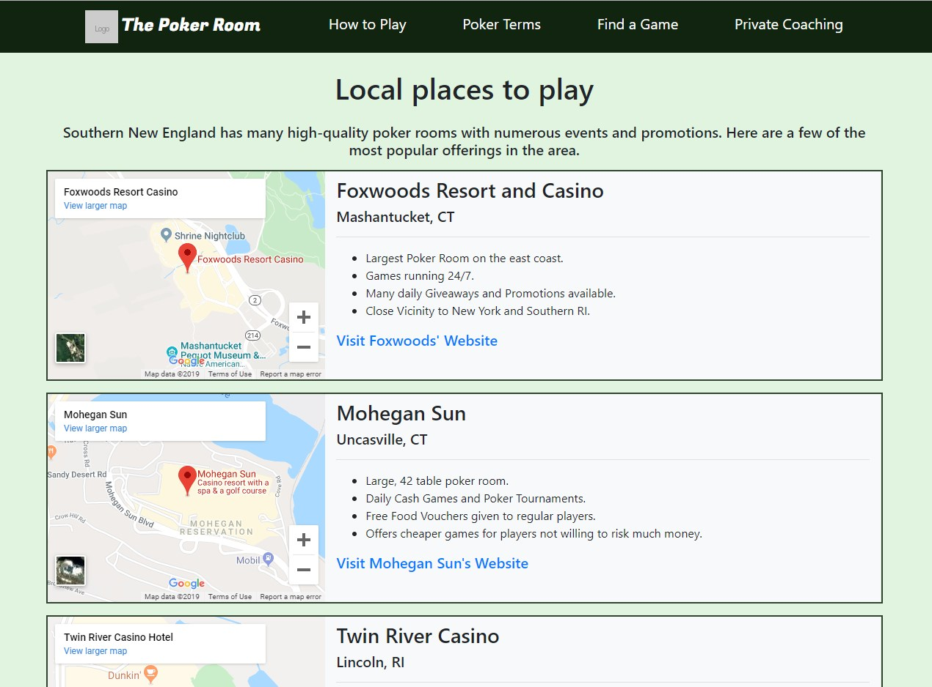
Find a Game (Final Page)
Google Maps embed using iframe

Slide 16
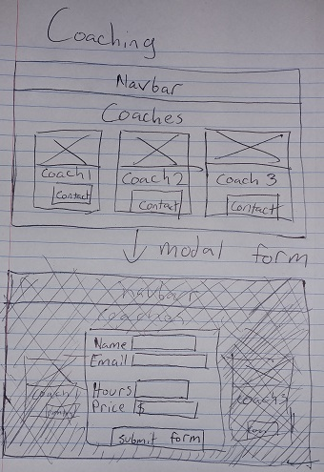
Coaching (wireframe)
(Clicking on a coach’s “contact” button should open a modal form)

Slide 17
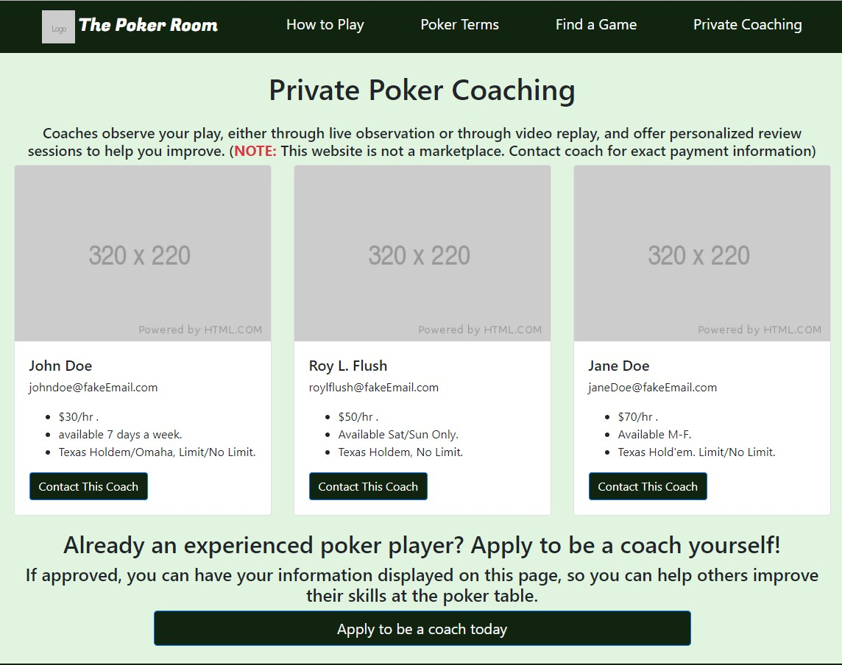
Coaching (Final Page)
Added a form so people can apply to be a coach

Slide 18
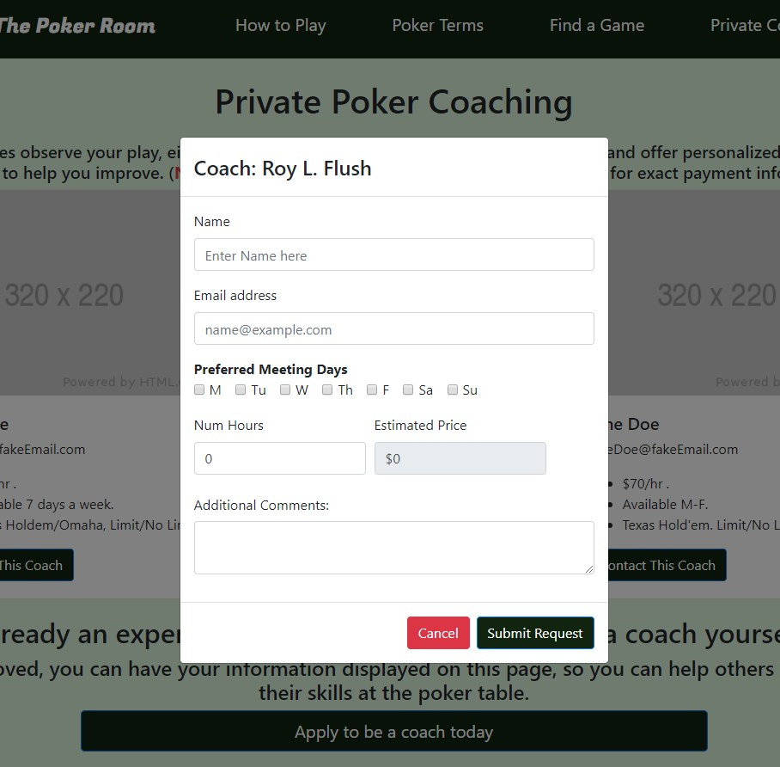
Coaching (Modal Form)
Page uses 1 form, but the fields change based on coach selected.
Form sends email to the selected coach’s email address.
If application, it sends an email to the main website’s email address.

Slide 19
Challenges
The dictionary’s search bar function
Changing the Coaching Form based on selected coach
Getting the Dynamic Bootstrap elements (Modal, Carousel) to be accessible
Carousels aren’t very accessible in the first place!

Slide 20
Potential Changes
Make the style less bland. Maybe change the color scheme.
Add a way for players to search for private poker games near them, and a form so people can invite other players to their own games.
Discuss some of the more interesting/complex strategies in poker.
Calculating Ranges, Pot Odds, Tournament strategy... Each topic could be an entire page on its own.

Slide 21
Fin

