Slide 1

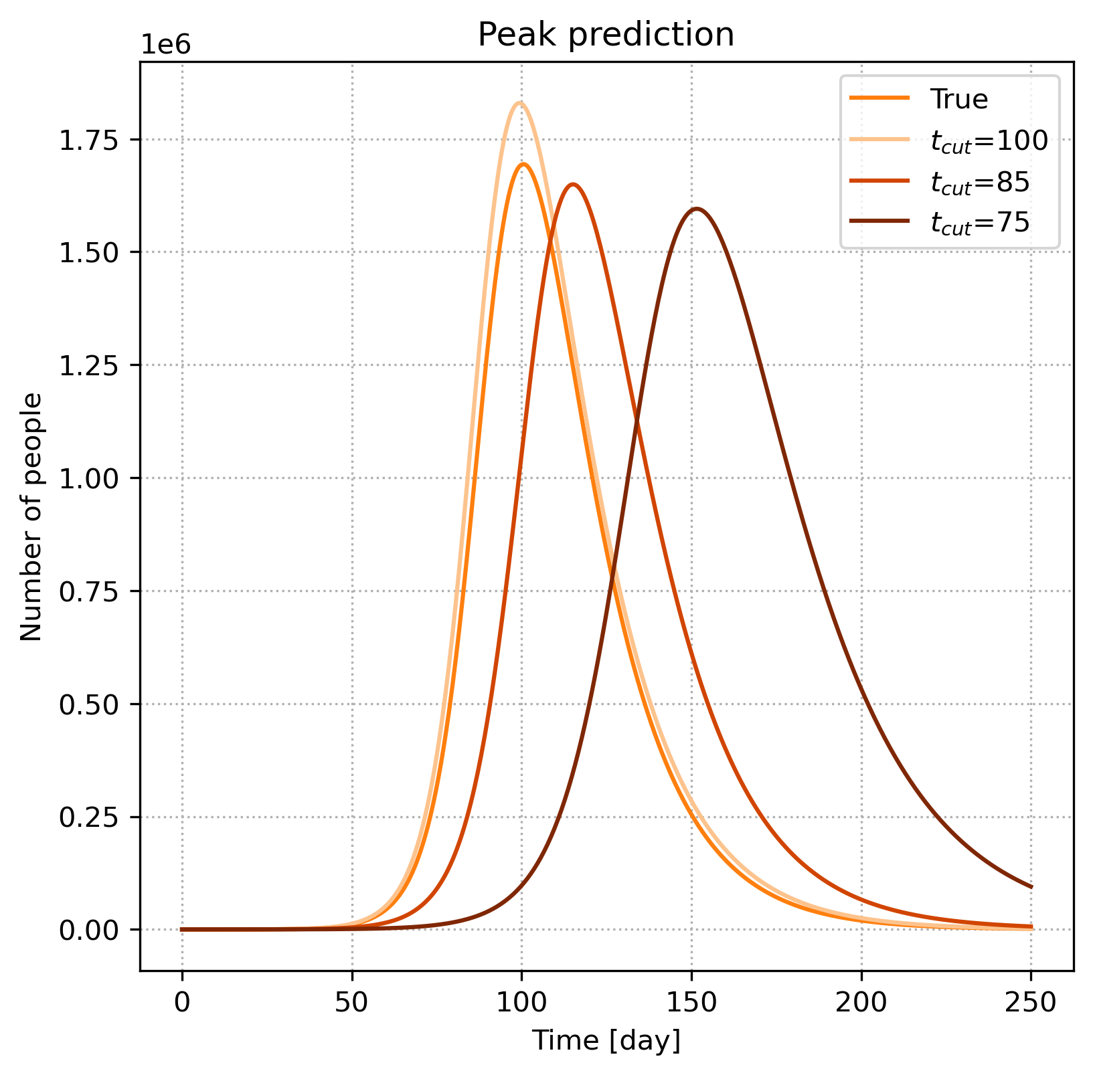
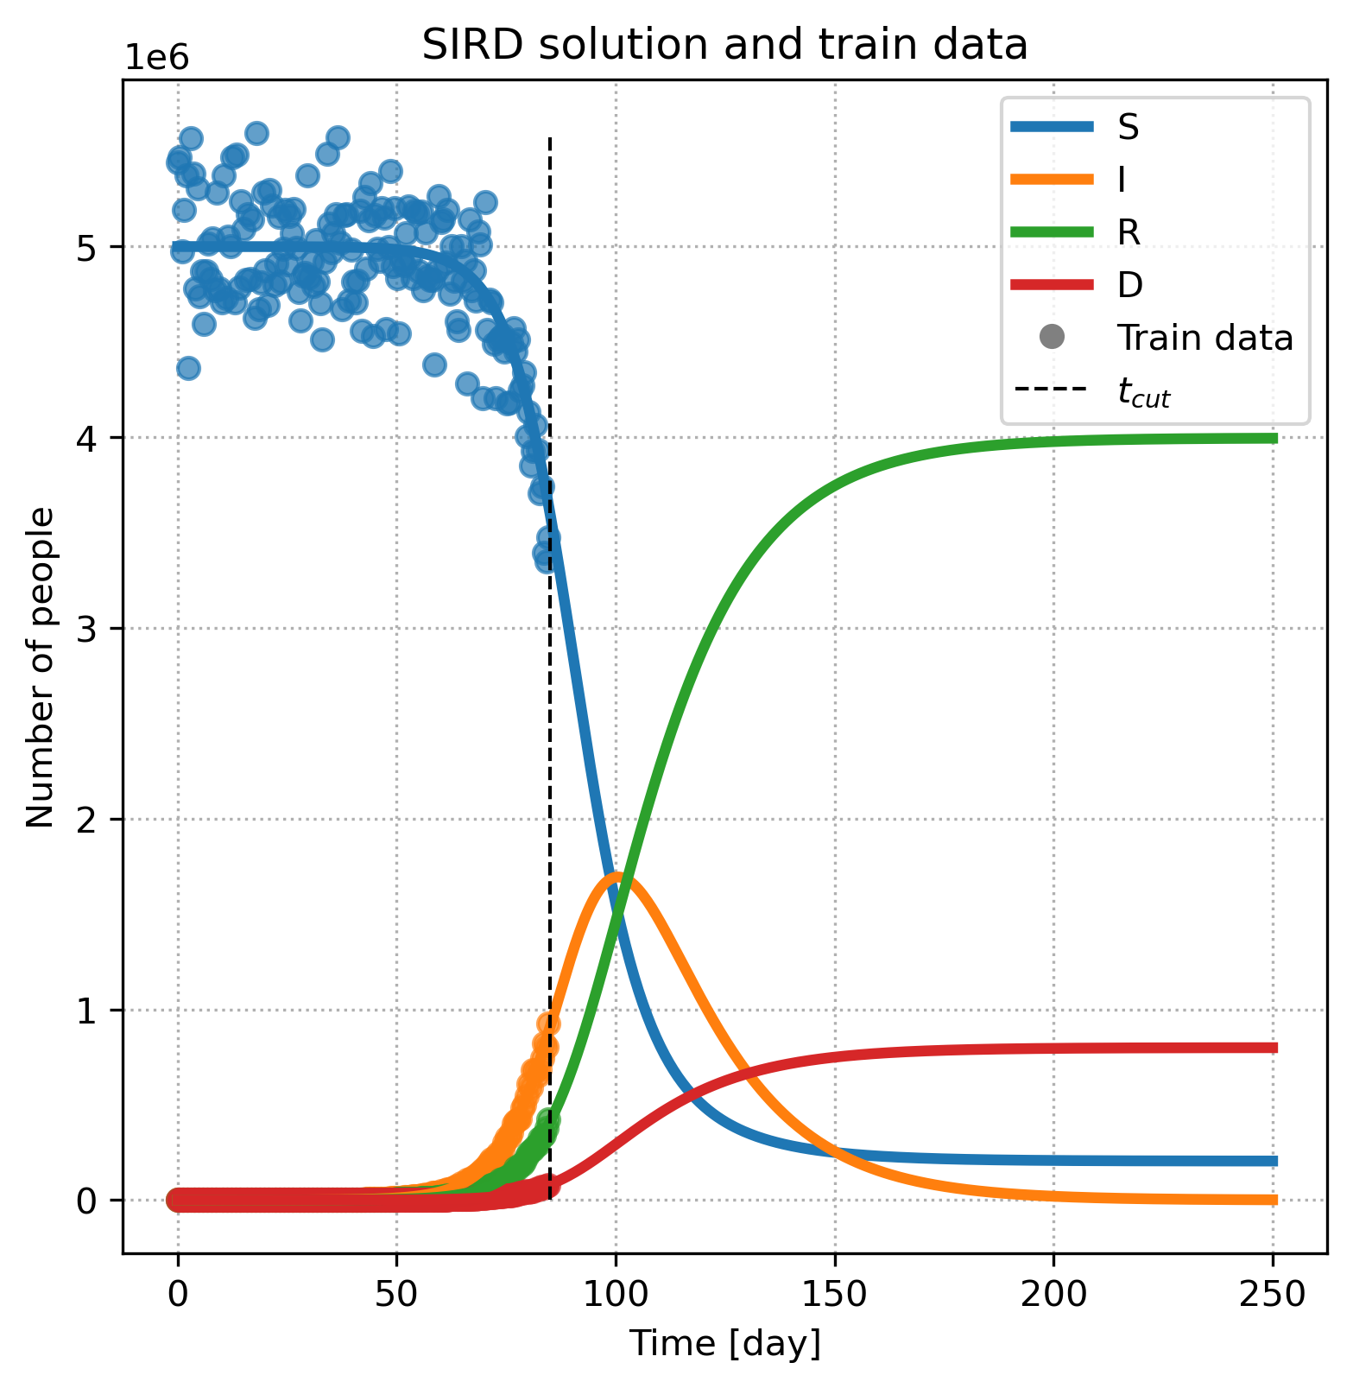
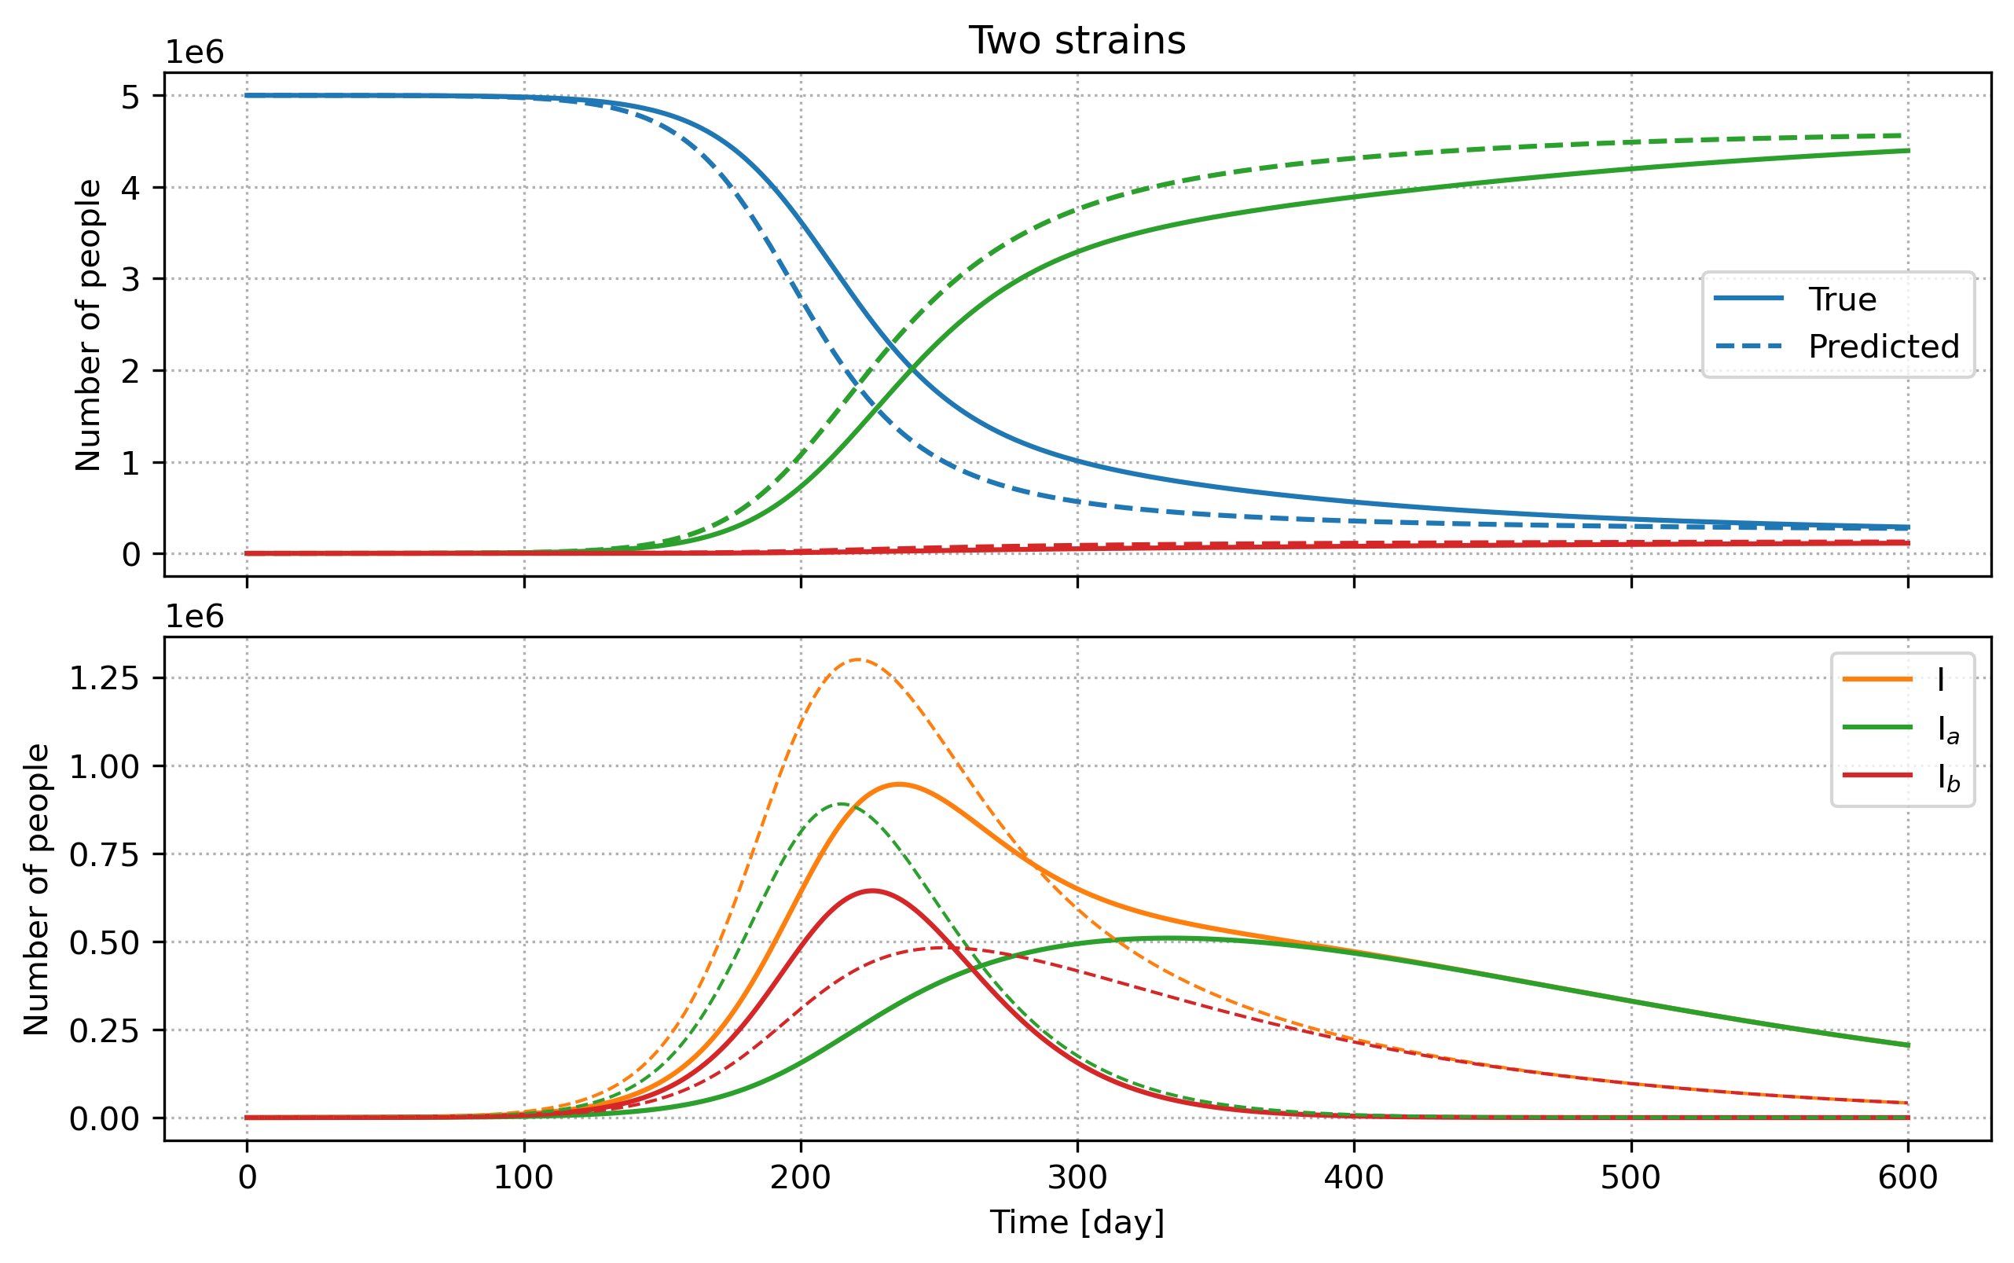
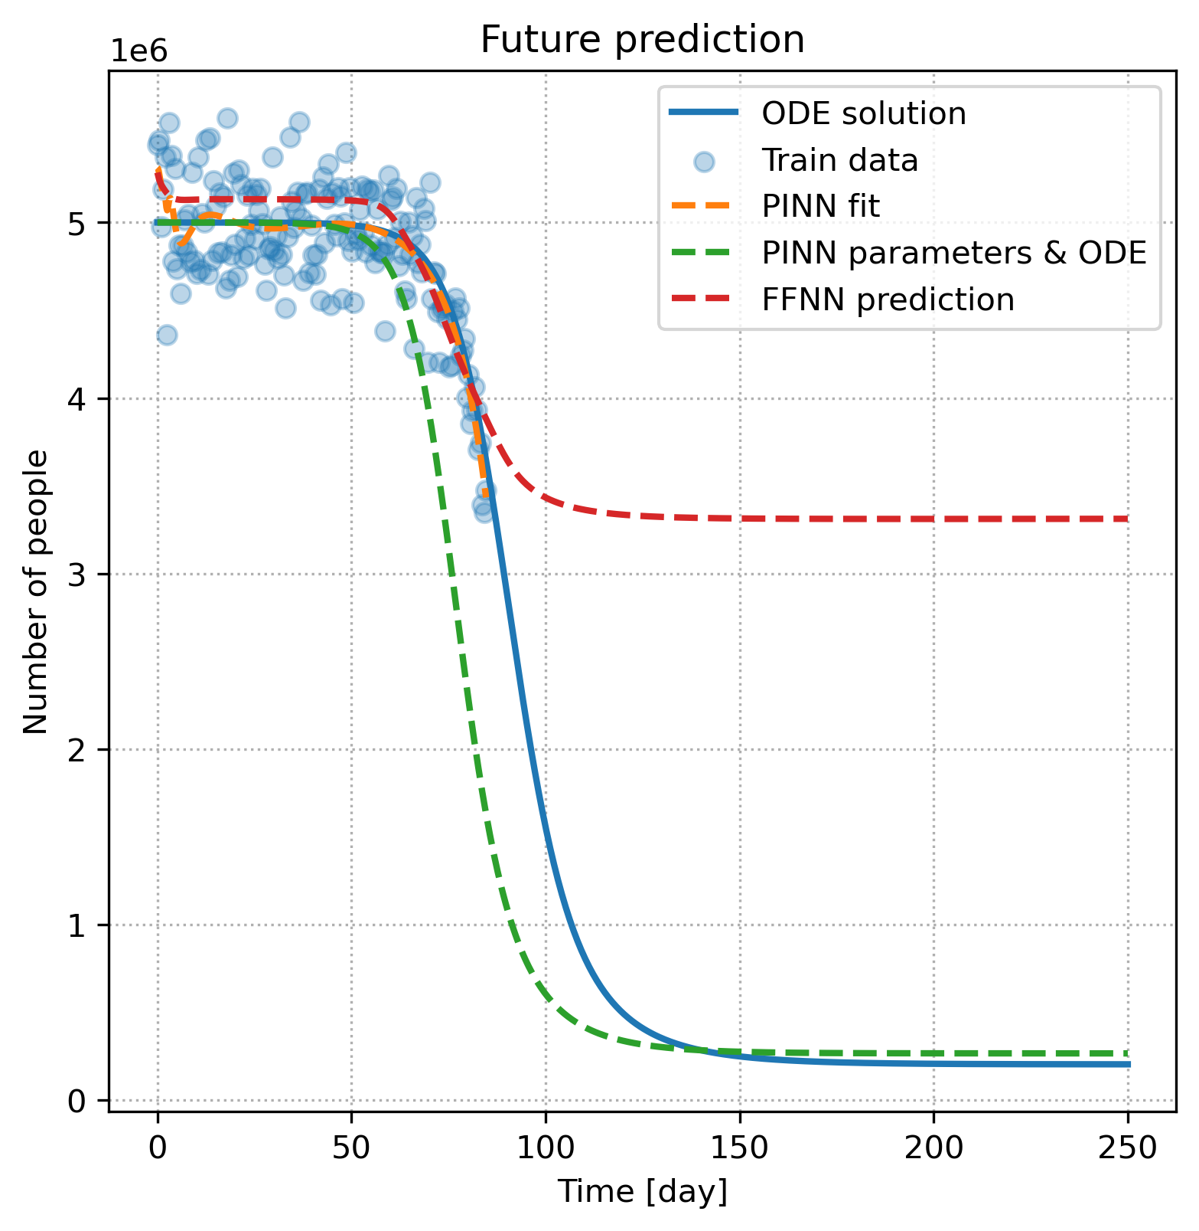
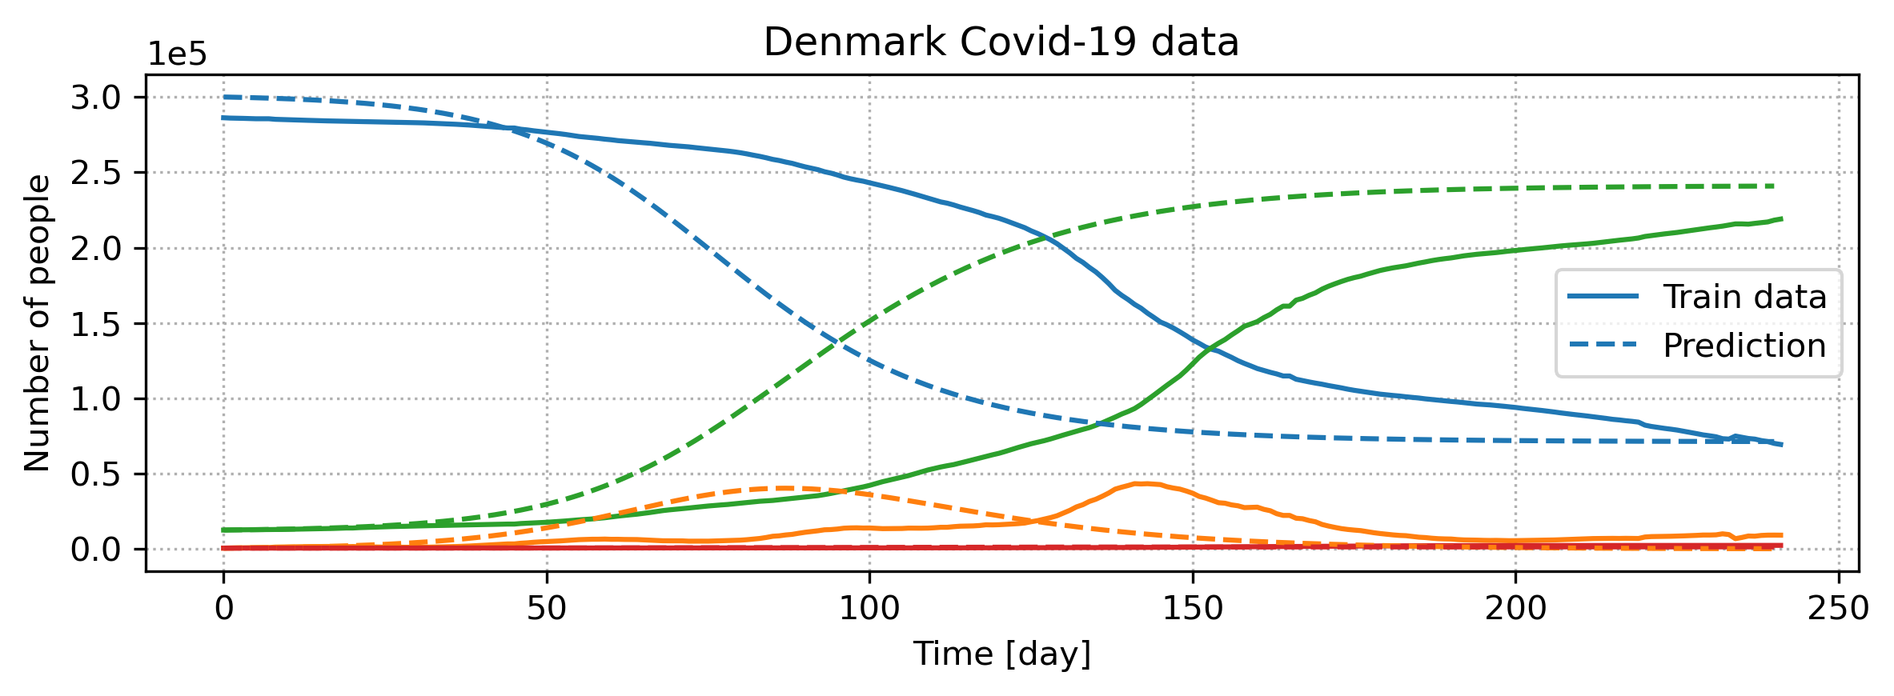
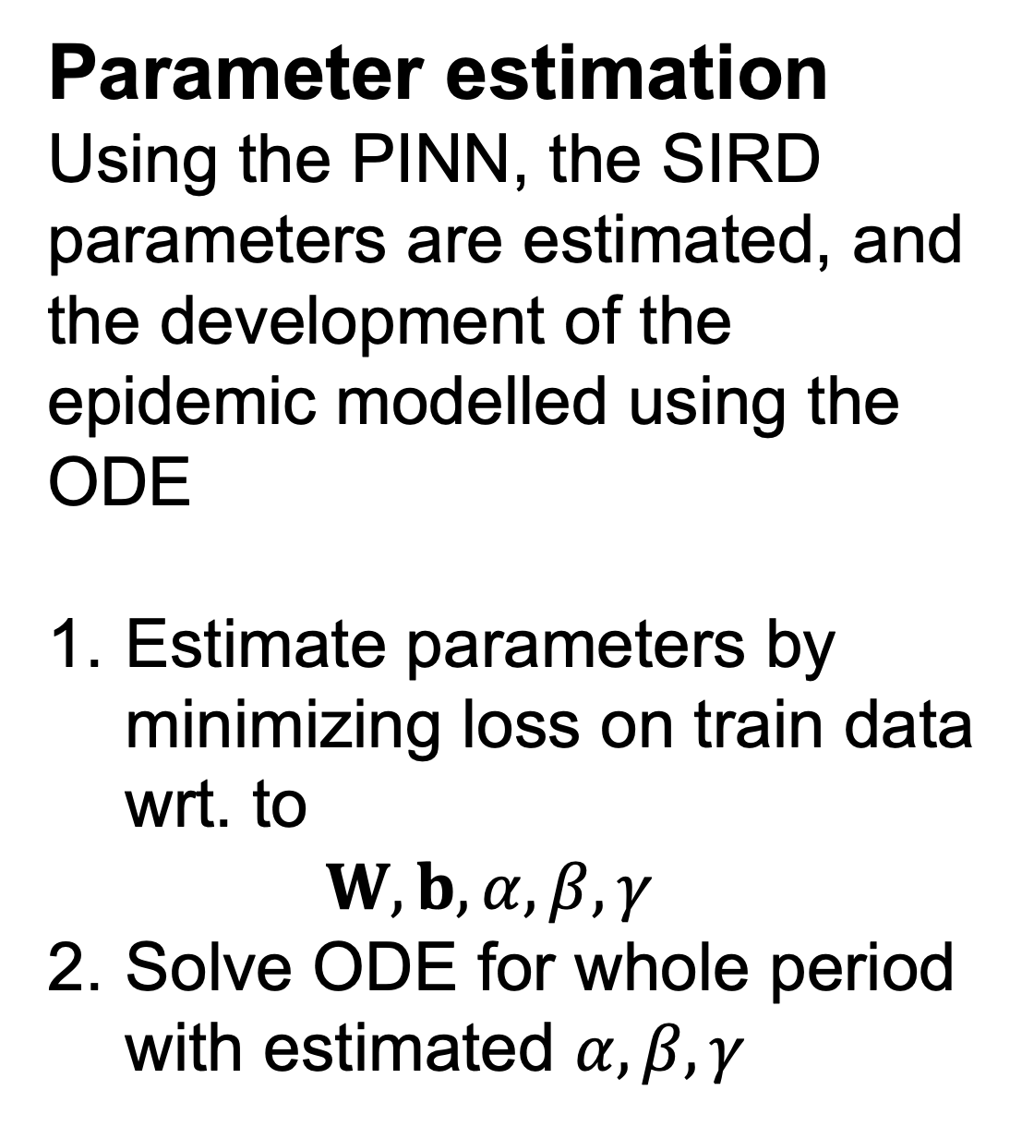
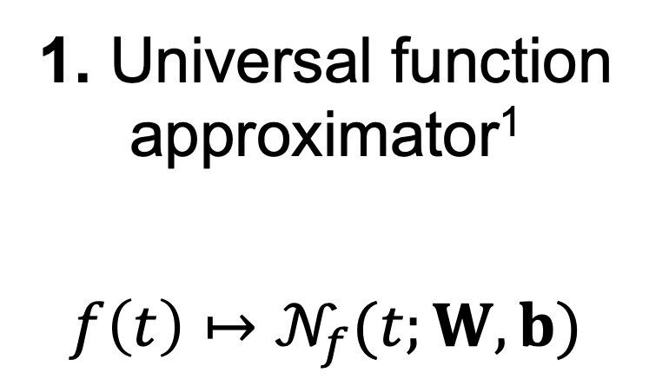


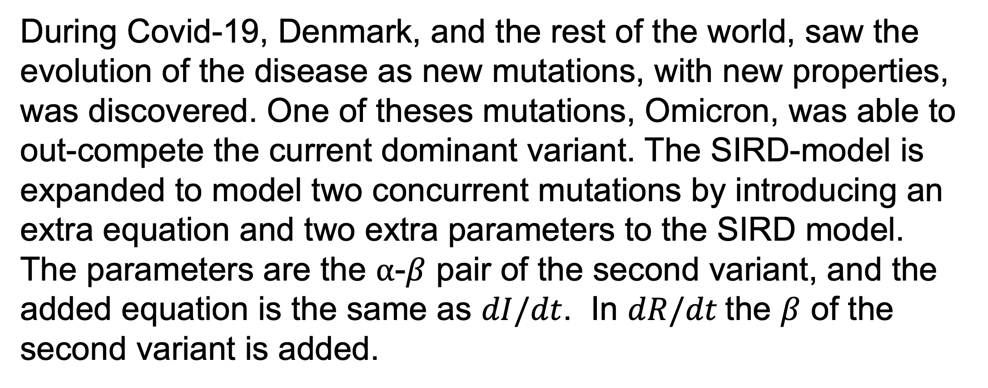
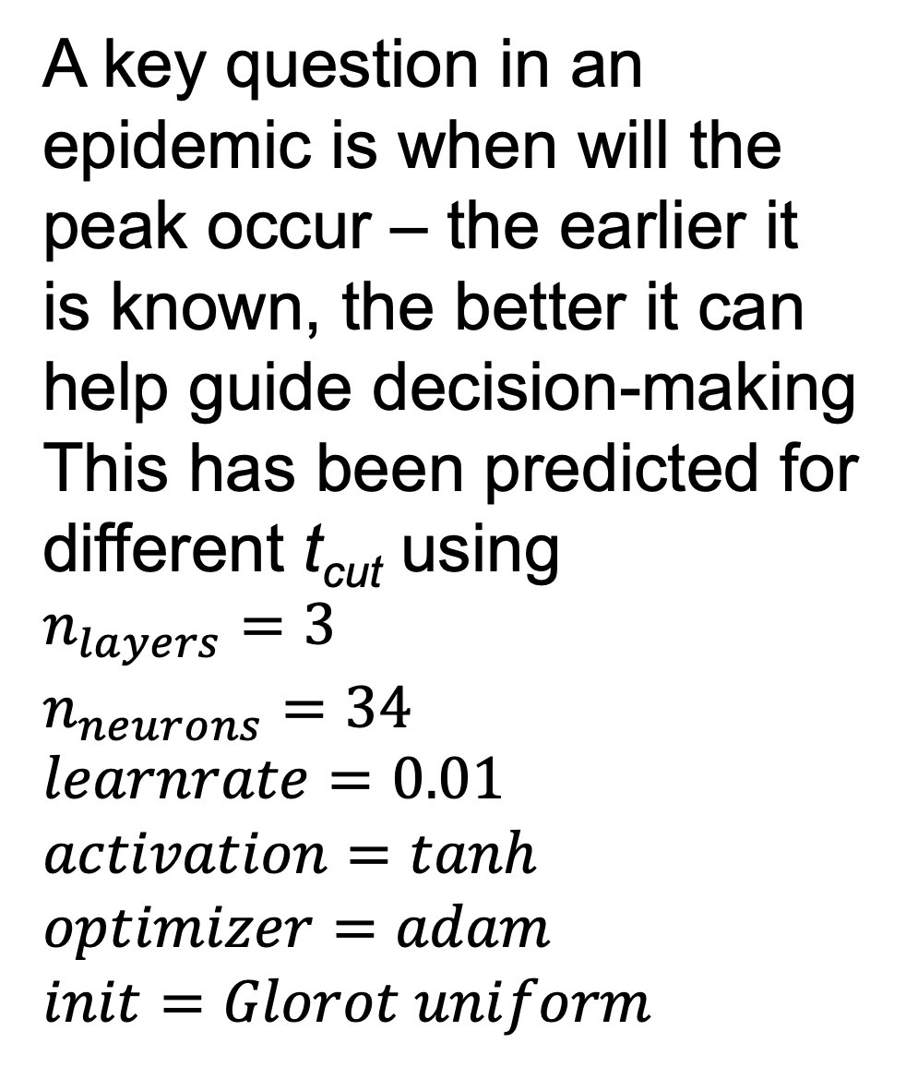
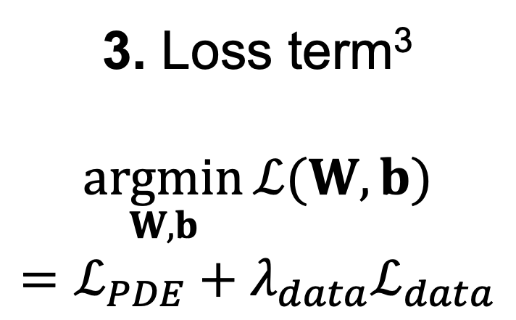
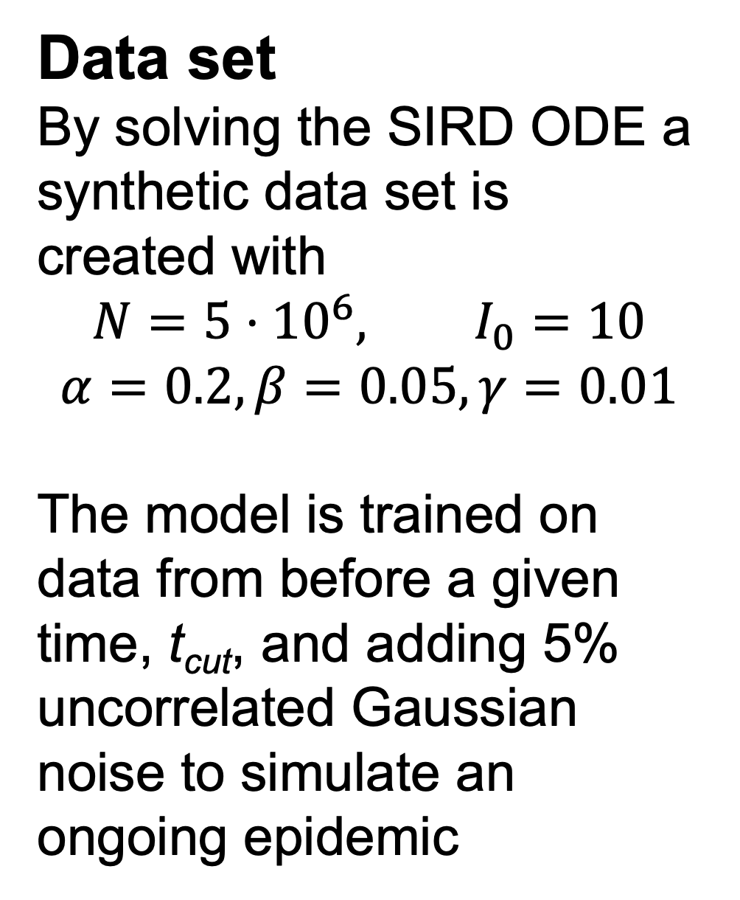
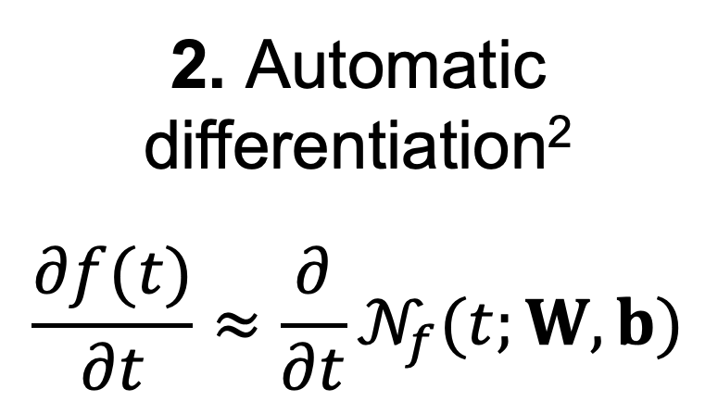
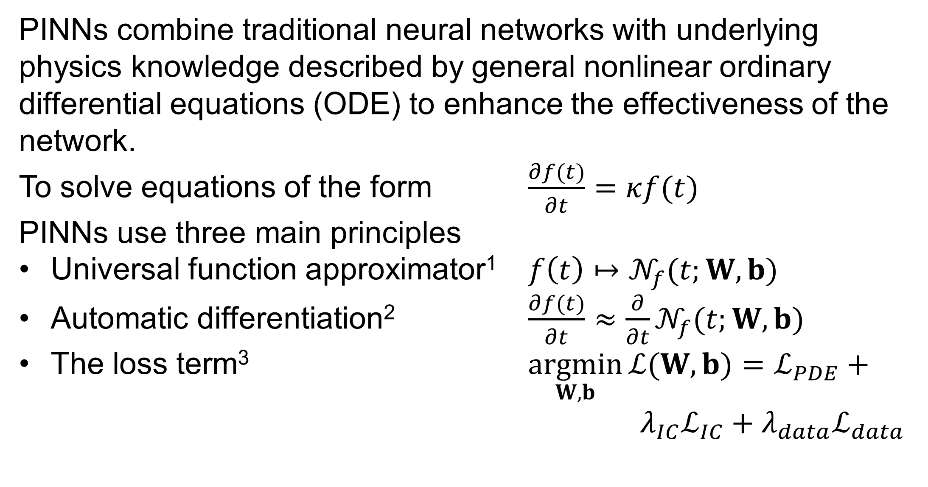
Predicting Epidemic Spread - Using Physics-Informed Neural Networks
02456 Deep Learning
Poster Session 8/12/2022
By: J. Hammer Hedemann (s174044) and William S. Hansen (s163979)
Introduction
Peak prediction
The purpose of this project is to model epidemic spread using physics-informed neural networks (PINN)
A key question in an epidemic is when will the peak occur – the earlier it is known, the better it can help guide decision-making
This has been predicted for different t_{cut} using
$$n_{layers}=3$$
$$n_{neurons}=34$$
$$learnrate=0.01$$
$$activation=tanh$$
$$optimizer=adam$$
$$init=Glorot uniform$$
Theory
PINNs combine feed-forward neural networks with underlying physics knowledge described by general nonlinear ordinary differential equations (ODE) to enhance the effectiveness of the network. Three principles are used to solve equations of the form
$$\frac{∂f(t)}{∂t}=αf(t)$$
1. Universal function approximator¹
$$f\left(t\right)↦𝒩_{f}(t;W,b)$$
2. Automatic differentiation²
$$\frac{∂f(t)}{∂t}≈\frac{∂}{∂t}𝒩_{f}(t;W,b)$$
3. Loss term³
$$\underset{W,b}{argmin}{ℒ(W,b)}=ℒ_{PDE}+λ_{data}ℒ_{data}$$
Two strains
$ℒ_{PDE}=\left\|\frac{∂}{∂t}𝒩_{f}\left(t;W,b\right)−κ𝒩_{f}\left(t;W,b\right)(t) \right\|$
$ℒ_{IC}=\left\|𝒩_{f}\left(0;W,b\right)−f_{0}\right\|$
$ℒ_{data}=\left\|𝒩_{f}\left(t_{data};W,b\right)−f_{data}\right\|$
SIRD model
The SIRD model describes the spread of an infectious disease by dividing the population (N) into the four compartments susceptible (S), infected (I), recovered (R), and dead (D) linked by coupled ODEs
SIRD ODE
$$\frac{dS}{dt} =−\left(\frac{α}{N}\right)SI$$
$$\frac{dI}{dt} =\left(\frac{α}{N}\right)SI−βI−γI$$
$$\frac{dR}{dt} =βI$$
$$\frac{dD}{dt} =γI$$
During Covid-19, Denmark, and the rest of the world, saw the evolution of the disease as new mutations, with new properties, was discovered. One of theses mutations, Omicron, was able to out-compete the current dominant variant. The SIRD-model is expanded to model two concurrent mutations by introducing an extra equation and two extra parameters to the SIRD model. The parameters are the $α$-$β$ pair of the second variant, and the added equation is the same as $dI/dt$. In $dR/dt$the $β$ of the second variant is added.
PINNs combine traditional neural networks with underlying physics knowledge described by general nonlinear ordinary differential equations (ODE) to enhance the effectiveness of the network.
To solve equations of the form $\frac{∂f(t)}{∂t}=κf(t)$
PINNs use three main principles
Universal function approximator¹ $f\left(t\right)↦𝒩_{f}(t;W,b)$
Automatic differentiation² $\frac{∂f(t)}{∂t}≈\frac{∂}{∂t}𝒩_{f}(t;W,b)$
The loss term³ $\underset{W,b}{argmin}{ℒ(W,b)}=ℒ_{PDE}+ λ_{IC}ℒ_{IC}+λ_{data}ℒ_{data}$
Data set
By solving the SIRD ODE a synthetic data set is created with
$$N=5⋅{10}^{6}, I_{0}=10$$
$$α=0.2, β=0.05,γ=0.01$$
The model is trained on data from before a given time, t_{cut}, and adding 5% uncorrelated Gaussian noise to simulate an ongoing epidemic
Danish Covid-19 data
Using real data
Parameter estimation
Using the PINN, the SIRD parameters are estimated, and the development of the epidemic modelled using the ODE
Estimate parameters by minimizing loss on train data wrt. to
$$W, b, α, β, γ$$
Solve ODE for whole period with estimated $α, β,γ$
The given train data of I (in SIRD) is thus the superposition of the two variants. The PINN is somewhat successful in determining the underlying development of each of the two diseases spreading. Though it has, in this case, switched up the parameters which is the cause of the flipped colors. Considering the sensitivity to change in the parameters, the preliminary results are quite satisfactory.
Future improvements
A key component in the capability of the PINN is the loss term.
The loss term contains four terms from the data and four terms from the ODE (one for each of SIRD).
When these terms are weighted evenly, the loss for S will dominate due to the scaling between the terms.
By implementing SoftAdapt we hope to rescale the loss terms during the run to favor all components.
DeVore et al. (2020)
Baydin et al. (2018)
Borrel-Jensen et al. (2021)
Notes:
Tekst og Streger i 100% farve – Baggrund i 90% Transparent.

