Slide 1
Operating System and System Programming (25CS2104E)
Linux File System Explorer Using System Calls
Team 08 | Department of CS&IT, AI&DS
Team Members:
Sindhuja – 2520080045
Jhanasri – 2520090121
Alekhya – 2520090126
Under the Esteemed Guidance of
Raghupathi M
CSE Department

Slide 2
Contents
1
Abstract
7
Modules and Features
2
Introduction
8
Implementation and System Calls
3
Problem Statement
9
Course Outcome Mapping
4
Objectives
10
Testing and Results
5
Hardware and Software Requirements
11
Conclusion
6
System Architecture
12
Future Enhancements

Slide 3




Abstract
Linux File System Explorer is a menu-driven, command-line application written in C. It lets users manage files and directories in a Linux environment through a simple interactive menu.
Users can create, write, read and delete files, create and remove directories, view file information and reposition file offsets with lseek().
Every operation is carried out through Linux system calls and POSIX interfaces, showing how a user-space program requests services from the Linux kernel.
Additional modules cover process management, IPC, memory management and thread synchronization, giving practical OS and system-programming experience.
Menu-driven CLI
Simple interactive interface
File and Directory Operations
Menu options 1 – 11
System Calls
Linux / POSIX interfaces
Practical OS Learning
Six course outcomes covered

Slide 4




Introduction
A file system lets the operating system store and organize files and folders. This project shows how a user-space program works with it through the Linux kernel.
Linux File Systems
User-Space Applications
Kernel Interaction
Organize files and folders for storage and retrieval.
Our explorer runs in user space and cannot access hardware directly.
The Linux kernel performs privileged file operations on behalf of programs.
System Calls
File Handling and Directories
File Descriptors
The interface through which applications request kernel services.
Create, read, write and delete files; manage directories.
Integer handles that identify open files in a process.

Slide 5

Problem Statement and Objectives
Project Objectives
Problem Statement
1
Understand the role of the OS in providing services to applications
Learners often find it hard to connect operating-system theory with real programs.
File and directory handling in Linux needs an understanding of system calls, file descriptors and the kernel.
A simple menu-driven Linux application is needed to perform these operations and show how user programs interact with OS services.
2
Learn how user-space programs interact with the Linux kernel
3
Perform file and directory operations using Linux interfaces
4
Understand file metadata and file positioning
5
Explore process management and process control
6
Demonstrate IPC using pipes, FIFOs and signals
7
Explore memory-management concepts
8
Understand thread synchronization and concurrency
9
Apply C and Linux systems programming in a practical project

Slide 6
Hardware and Software Requirements
Hardware
Software
Component | Requirement
Processor | Intel Core i3 or above
RAM | 4 GB or above
Storage | 10 GB free space
Software | Requirement
Operating System | Linux / Ubuntu
Programming Language | C Programming
Compiler | GCC Compiler
APIs | Linux / POSIX System Calls
Development Tool | VS Code / Linux Terminal
Build Tool | GNU Make
Ubuntu on Windows Subsystem for Linux (WSL) can also be used as a Linux development environment.

Slide 7

System Architecture
USER
User space
System-call interface / kernel
COMMAND LINE INTERFACE
File I/O
open()
read()
write()
close()
lseek()
FILE SYSTEM EXPLORER APPLICATION
Used by: Create, Write, Read File; File Position
FILE AND DIRECTORY OPERATIONS
Directory Operations
LINUX SYSTEM CALLS / POSIX APIs
mkdir()
rmdir()
opendir()
readdir()
Used by: Create / Remove Directory; List Directory
LINUX KERNEL
Metadata and Deletion
FILE SYSTEM / STORAGE
stat()
unlink()
OUTPUT TO USER
Used by: View File Information; Delete File
Typical calls behind each menu operation; see src/filesystem/.

Slide 8



Modules and Features
File and Directory Management
Process Management
Inter-Process Communication
Memory Management
Thread Synchronization
Menu 1 – 11
Menu 12
Menu 13 – 15
Menu 16
Menu 17
List, create, write, read and delete files
Create, remove and change directories
File information and lseek()
Dedicated menu module
Demonstrates process-related OS concepts
Anonymous pipes
Named pipes (FIFOs)
Signal communication
Dedicated menu module
Explores memory-related OS concepts
Dedicated menu module
Thread-related functionality and concurrency
Primary focus: File System Explorer (menu 1 – 11). Menu option 18 exits the application.

Slide 9









File and Directory Management
1
2
3
4
List Directory
Display directory entries
Create File
Create a new file
Write File
Write data to a file
Read File
Read file contents
5
6
7
8
Create Directory
Make a new directory
Remove Directory
Remove an empty directory
View File Information
Show file metadata
Delete File
Remove a file
9
10
11
CO-5 Primary Module
src/filesystem/
file_operations.c, directory_operations.c, file_info.c
Show Current Directory
Display working directory
Change Directory
Navigate to another directory
File Position (lseek)
Move the file offset

Slide 10


Process Management and IPC
Process Management (Menu 12): dedicated module for process-related OS concepts such as process abstraction, lifecycle and control.
Specific calls (fork, exec, wait) are claimed only if present in the source code.
Anonymous Pipe
Menu 13
Named Pipe (FIFO)
Menu 14
Signal Communication
Menu 15
Process A
pipe
Process B
Sender
FIFO
Receiver
Sender
signal
Process
Unidirectional communication channel between processes.
A named channel in the file system, usable by unrelated processes.
Asynchronous notifications delivered to a process.
Source files
Source files
Source files
src/ipc/pipe_operations.c
src/ipc/fifo_operations.c, fifo_sender.c, fifo_receiver.c
src/ipc/signal_operations.c

Slide 11
Memory and Thread Synchronization
Memory Management
Menu option 16
Thread Synchronization
Menu option 17
Dedicated module for exploring memory-related operating-system concepts and how Linux processes use memory.
Dedicated module providing the project's thread-related functionality and demonstrating concurrency in Linux.
Related OS concepts
Related OS concepts
Virtual memory
Address space layout
Threads vs processes
POSIX threads
Page tables
Page faults
Dynamic allocation
Race conditions
Mutexes
Condition variables
Copy-on-write
Semaphores
Source: src/memory/memory_operations.c
Header: src/include/thread_operations.h
Implementation note: the concepts shown are related syllabus topics. Specific mechanisms (e.g. page tables, mutexes, semaphores) are not claimed unless verified in the source code.

Slide 12




Technologies and System Calls
C Programming
Application development
System Call | Purpose | Menu Operation
open() | Open or create a file | Create / Write / Read File
read() | Read data from a file descriptor | Read File
write() | Write data to a file descriptor | Write File
close() | Release a file descriptor | File operations
lseek() | Reposition the file offset | File Position
mkdir() | Create a directory | Create Directory
rmdir() | Remove an empty directory | Remove Directory
opendir() | Open a directory stream | List Directory
readdir() | Read directory entries | List Directory
stat() | Retrieve file metadata | View File Information
unlink() | Remove a file name | Delete File
Linux
Operating system environment
GCC
C compiler
GNU Make
Build automation
POSIX IPC
Pipes, FIFOs, signals
POSIX Threads
Thread functionality
Git and GitHub
Version control and hosting
Mapped from the menu operations; exact calls depend on the implementation in src/filesystem/.

Slide 13
Course Outcome Mapping
OS as a Service Layer
File and directory operations through OS services
PRIMARY COURSE OUTCOME
CO-1
Foundational
CO-5
File Systems, File Abstractions, and File I/O
Processes and Process Control
Process Management (menu 12)
CO-2
Additional module
Inter-Process Communication
Pipes, FIFOs and signals (menu 13 – 15)
File System Explorer, menu options 1 – 11
File I/O, directory operations, metadata and lseek()
Source: src/filesystem/
CO-3
Additional module
Memory Management
Memory Management (menu 16)
CO-4
Additional module
Concurrency and Synchronization
Thread Synchronization (menu 17)
CO-6
Additional module

Slide 14
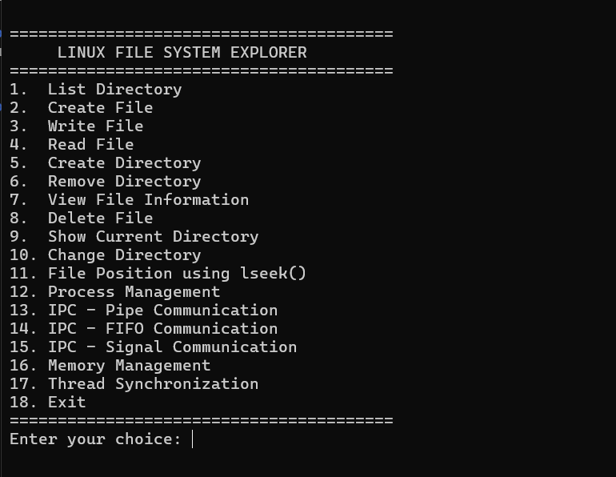
Testing and Results
Test Area | Validation Approach
File creation | Create a file and confirm it exists
File writing and reading | Write content, check the file, read it back
File deletion | Delete a test file and confirm removal
Directory management | Create, navigate and remove directories
File metadata | Display information of an existing file
IPC | Verify pipe, FIFO and signal behavior
Process management | Test implemented process operations
Memory management | Test implemented memory functionality
Thread synchronization | Test implemented thread functionality
Run tests only in a designated test directory; avoid deleting important files.

Slide 15





Conclusion and Future Enhancements
Future Enhancements
Conclusion
Shows how a user-space program uses Linux system calls to reach OS services.
Gives hands-on practice in file and directory management, file metadata and file positioning.
Extends to process management, IPC, memory management and thread synchronization.
Builds practical C, GCC, Make and Git skills for systems programming.
Recursive directory exploration
File searching and filtering
File permission management
Improved metadata display
Process monitoring
Additional IPC demonstrations
Expanded memory management
Improved synchronization
Automated testing
Potential enhancements; not part of the current implementation.

Slide 16
Thank you
Linux File System Explorer Using System Calls
Team 08 | Faculty Guide: Raghupathi M

