Slide 1

Title: NearStitch- Fashion Designing Pickup Delivery platform
Student Name: THOTA JHANA SRI
Student ID: 2520090121)
Cluster:02 Section: 06(FWD)
Under the Guidance of
Supervisor Name: Deepika mam
Assistant Professor Department of CSE
06-03-2026
1

Slide 2
Abstract
NearStitch is a web-based tailoring service platform developed using HTML, CSS, and JavaScript. The main objective of the system is to connect customers with nearby tailoring shops and provide convenient stitching services with pickup and delivery options. In the traditional system, customers often face difficulty in finding reliable tailors, comparing services, and managing orders efficiently.
The proposed system provides a digital solution where users can search for tailors, view service details, check ratings, and place stitching orders online. The system also provides dashboards for customers, tailors, and administrators to manage services, orders, and analytics. This platform improves convenience, saves time, and enhances accessibility to tailoring services through a user-friendly web interface.
Department of CSE

Slide 3
Existing System
• Traditional tailoring services are mostly offline. • Customers must visit tailoring shops physically. • Finding skilled tailors nearby can be difficult. • No centralized platform for tailoring service discovery. • Customers cannot compare prices easily. • Booking process is manual and time-consuming. • Communication between customer and tailor is limited. • Lack of online service management systems.
Department of CSE

Slide 4
Proposed System
• NearStitch provides an online platform for tailoring services. • Users can search for nearby tailors quickly. • Tailor profiles display specialization and ratings. • Pricing details help customers understand service cost. • Online booking form allows service requests easily. • Pickup and delivery options simplify the tailoring process. • Dynamic web interface improves user interaction. • Provides quick confirmation after booking submission.
Department of CSE

Slide 5
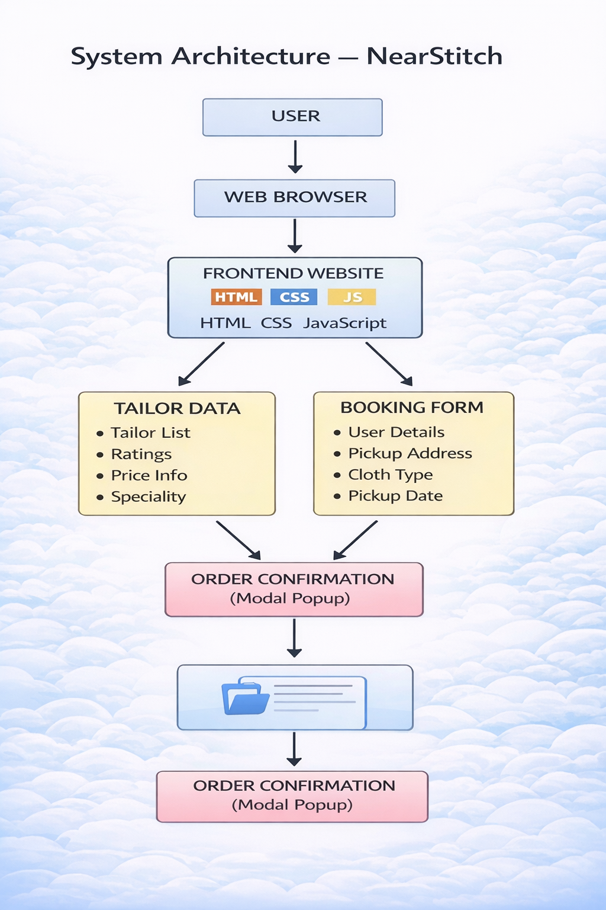
System Architecture
Department of CSE

Slide 6
Project Modules
Home Module
• Displays project introduction and services offered. • Provides navigation to other sections of the website.
Tailor Listing Module
• Displays available tailors and their specialization. • Shows ratings, price information, and location.
Search Module
• Allows users to filter tailors based on specialization. • Improves user experience and quick search.
Pricing Module
• Displays estimated stitching price list. • Helps users understand service costs.
Booking Module
• Allows customers to enter personal details. • Collects pickup address and preferred date.
Department of CSE

Slide 7
Objectives
• To provide a convenient platform for tailoring services. • To connect customers with nearby skilled tailors. • To simplify service booking through an online interface. • To provide clear pricing information for users. • To demonstrate practical frontend web development skills. • To improve accessibility of tailoring services. • To create an interactive and user-friendly website.
Department of CSE

Slide 8
Co’s Attainments - FWD
CO1 - Internet Fundamentals, HTML & Intro CSS
• Developed webpage structure using HTML. • Used semantic HTML tags for better organization. • Applied CSS styling for layout and design. • Implemented responsive design techniques.
CO2 - HTML Forms & CSS Layout
• Created booking forms using HTML form elements. • Styled form components using CSS properties. • Implemented layout using CSS grid and flexbox.
CO3 - JavaScript Programming
• Implemented dynamic tailor data using JavaScript arrays. • Developed search functionality for filtering tailors. • Added interactive webpage behavior.
CO4 - DOM & Events
• Used DOM manipulation techniques to update webpage content. • Implemented event listeners for form submission. • Displayed confirmation popup after booking.
CO5 - Frontend Application Development
• Integrated HTML, CSS, and JavaScript into one project. • Developed a complete frontend web application.
Department of CSE

Slide 9
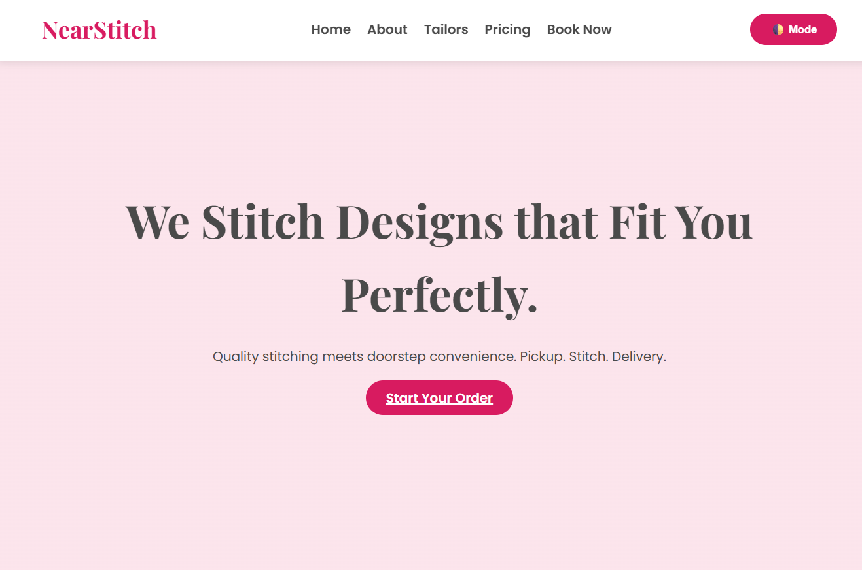
Screenshots for FWD :
Department of CSE

Slide 10
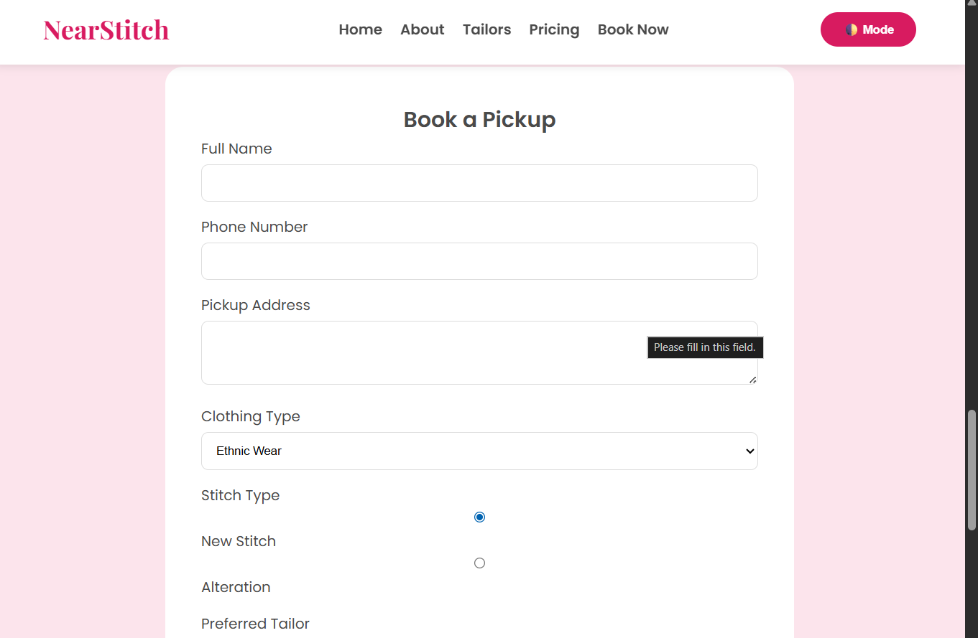

Slide 11
Conclusion
• NearStitch simplifies the process of finding tailoring services. • Provides an easy and convenient online platform. • Customers can search and book services quickly. • Demonstrates effective use of frontend technologies. • Improves accessibility of tailoring services. • Enhances user experience through interactive features. • Shows practical implementation of web development concepts.
Department of CSE

Slide 12
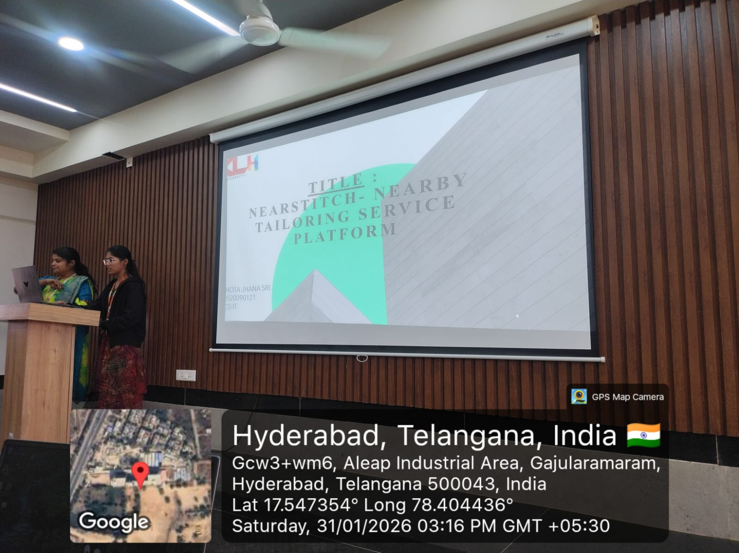
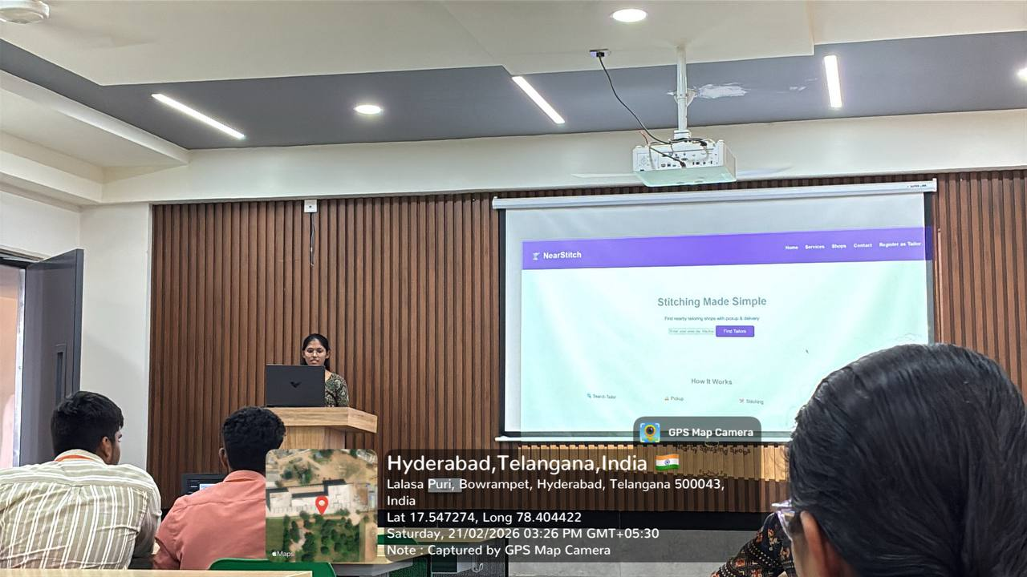
Geo- Tag Photos
Department of CSE

Slide 13
THANK YOU
Department of CSE

