Slide 1

Title: NearStitch- Fashion Designing Pickup Delivery Console Project
Student Name: THOTA JHANA SRI
Student ID: 2520090121)
Cluster:02 Section: 8(DSA)
Under the Guidance of
Supervisor Name:
Balaiah Sir
Assistant Professor Department of CSE
06-03-2026
1

Slide 2
Abstract
NearStitch is a console-based tailoring service application developed using Java and Data Structures. The system helps users easily find nearby tailor shops, select dress stitching services, and book orders through a simple console interface. Users can choose their location, city, and preferred tailor shop, view dress models with stitching costs, and provide customer details for booking.
The application stores tailor information using LinkedList, manages booking requests using Queue, and stores customer data using HashMap. It also generates a unique order ID and provides pickup and delivery details along with the final booking receipt. The project demonstrates practical implementation of Data Structures concepts in a real-world application.
Department of CSE

Slide 3
Existing System
• Customers must visit tailor shops physically • Time-consuming process for searching shops • Difficult to compare different tailoring services • No centralized system for tailoring services • Manual booking and communication with tailors • Lack of organized customer data management • No automated billing or order tracking • Limited access to shop information like rating or contact
Department of CSE

Slide 4
Proposed System
• NearStitch provides a console-based tailoring system • Users can select location and city easily • Displays multiple tailor shops with details • Shows dress models with stitching costs • Allows customers to book tailoring services • Generates unique order ID for every booking • Provides pickup and delivery information • Stores and manages customer records efficiently
Department of CSE

Slide 5
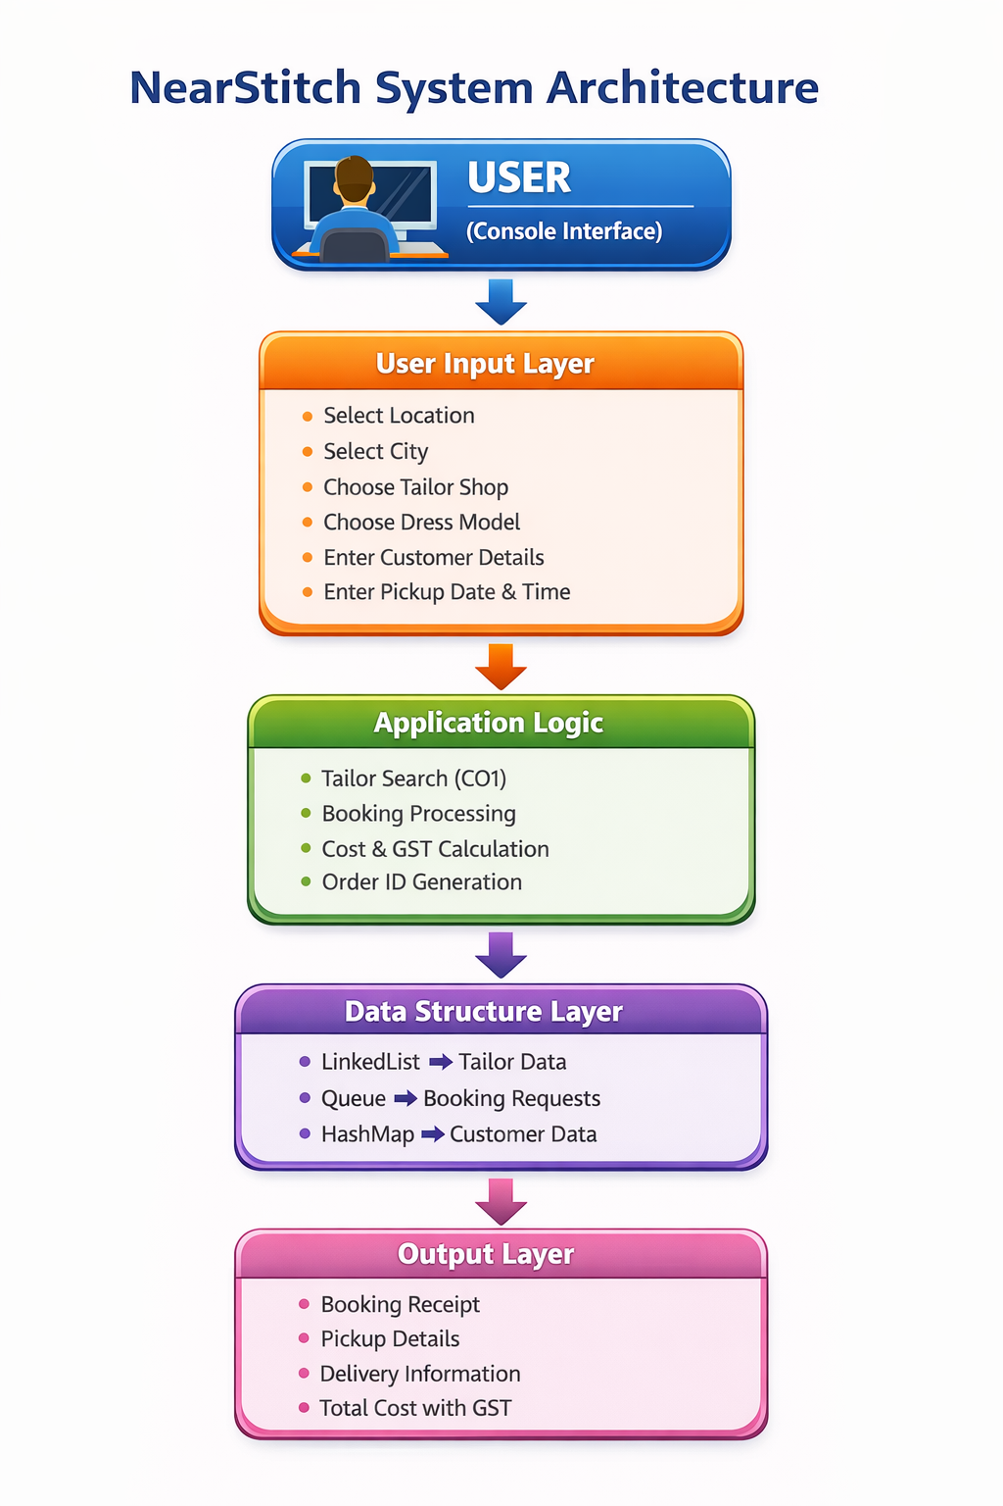
System Architecture
Department of CSE

Slide 6
Project Modules
• Location Selection Module • City Selection Module • Tailor Shop Display Module • Tailor Search Module • Dress Selection Module • Customer Information Module • Booking Management Module • Billing and Receipt Generation Module
Department of CSE

Slide 7
Objectives
• Develop a console-based tailoring service system • Implement Data Structures in real-world applications • Provide easy search for nearby tailor shops • Manage tailor and customer data efficiently • Automate tailoring service booking process • Generate automated order ID and receipts • Demonstrate searching and data management techniques • Improve convenience for tailoring service users
Department of CSE

Slide 8
Co’s Attainments - FWD
• CO1 - Linear Search used to find tailor shops • CO2 - LinkedList used to store tailor shop details • CO3 - Queue used to manage booking requests • CO4 - HashMap used to store customer records • Efficient data storage using data structures • Implementation of searching algorithm • Demonstrates real-time booking management • Practical use of DSA concepts in application
Department of CSE

Slide 9
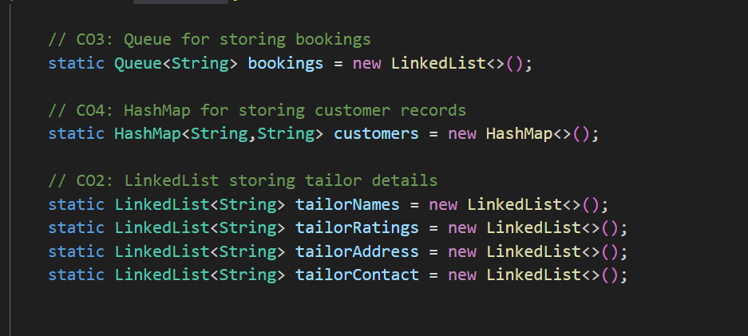
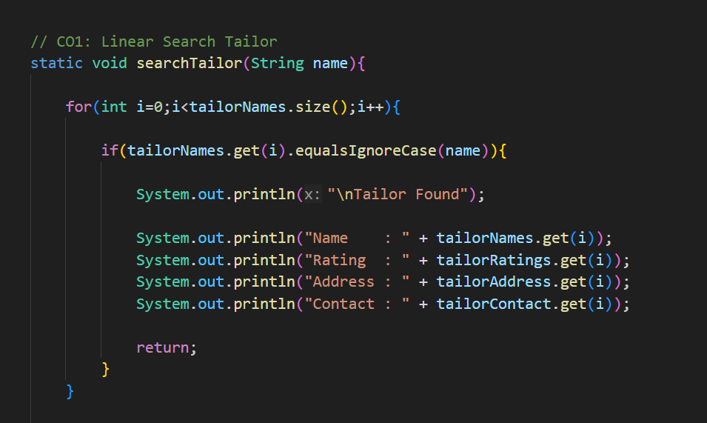
Screenshots for DSA :
Department of CSE

Slide 10
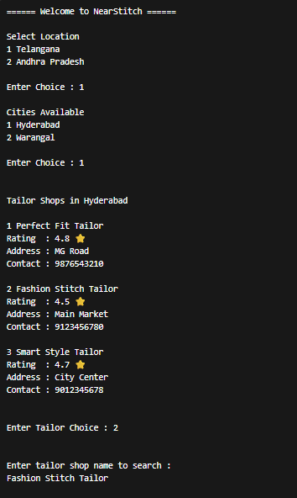
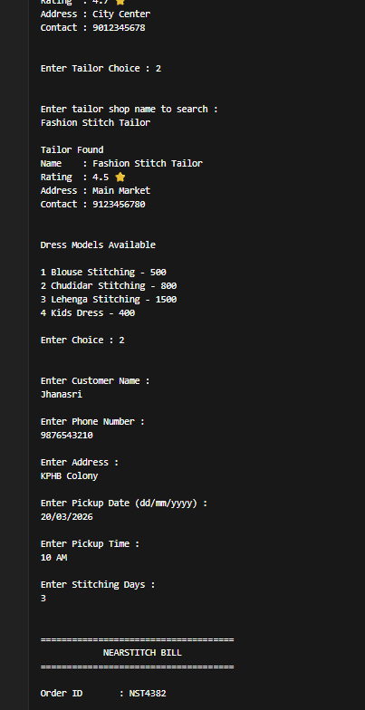
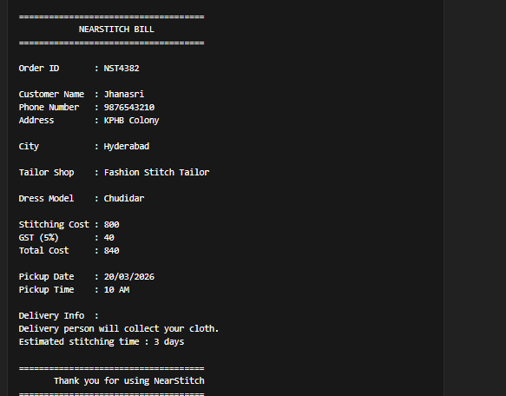
OUTPUT SCREENSHOTS

Slide 11
Conclusion
• NearStitch simplifies tailoring service booking • Demonstrates implementation of Data Structures • Provides easy console-based user interaction • Efficiently manages tailor and customer data • Generates automated booking receipts • Improves service accessibility for customers • Can be extended to web or mobile platforms • Shows practical application of DSA concepts
Department of CSE

Slide 12
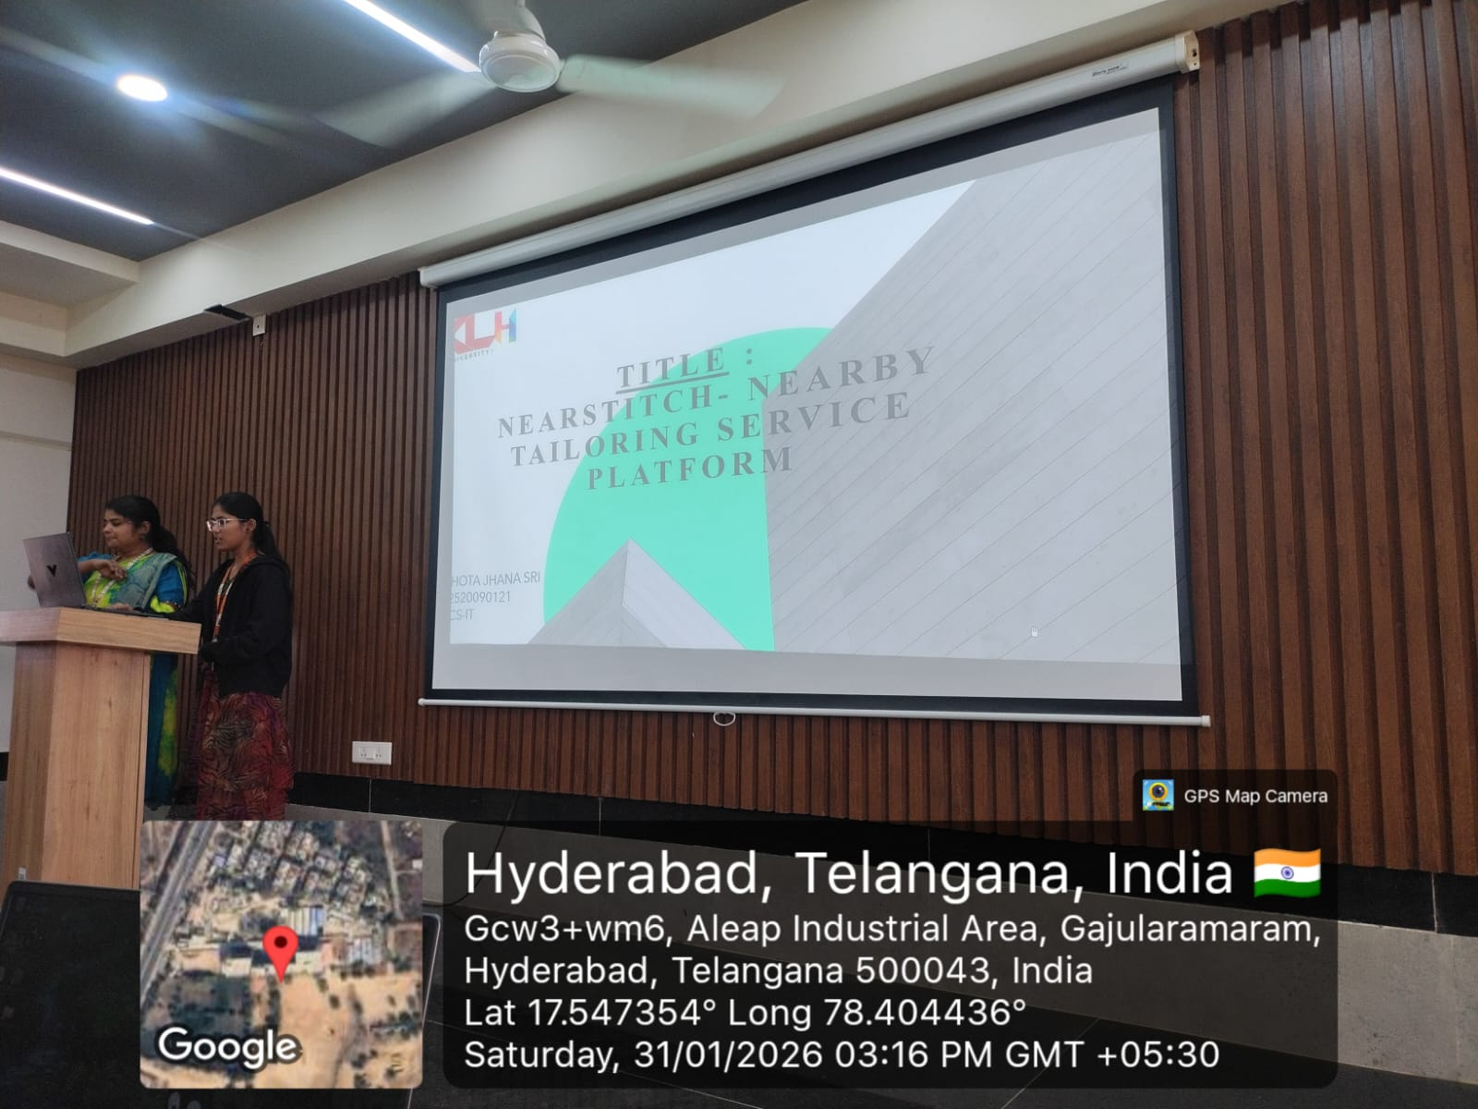
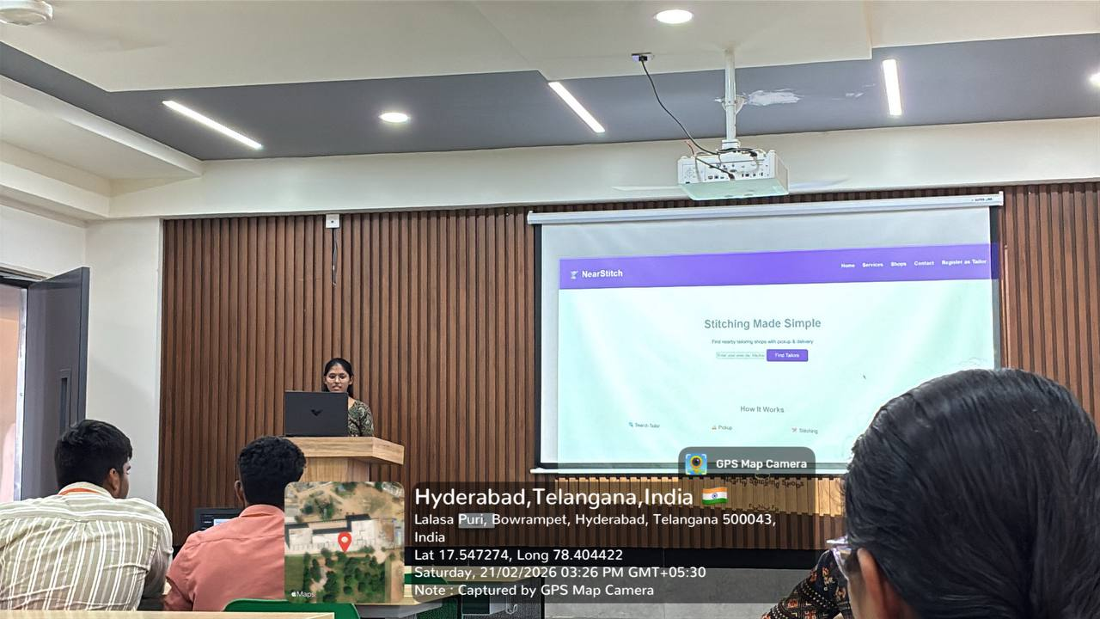
Geo- Tag Photos
Department of CSE

Slide 13
THANK YOU
Department of CSE

