Slide 1

QISKIT FALL FEST 2026 · VNQFF-02
Q-HealthGuard
Privacy-Preserving Federated Quantum Healthcare AI
Collaborative healthcare intelligence without sharing raw patient data.
QISKIT
EPIC ENGINEERS

Slide 2
01
Hospital A, B, C
EXECUTION FLOW
Patient data remains within local hospital premises.
Train locally. Share parameters. Improve globally.
02
Local quantum training
Each client trains a Qiskit circuit model locally.
Multiple hospitals collaboratively train healthcare prediction models without directly sharing raw patient records.
03
Privacy layer
Clip updates and add Differential Privacy noise.
04
Parameter-only exchange
Only encrypted quantum circuit weights are transmitted.
05
Global model
TRIAD SYNTHESIS
Federated Aggregation with Federated Averaging/FedAvg.
Federated Averaging + Qiskit QML Kernels + Differential Privacy.

Slide 3
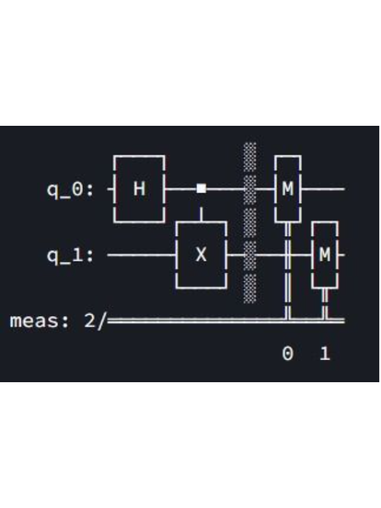
IMPLEMENTATION STACK
Built from open tools and a small circuit
TECHNOLOGY STACK
METHODOLOGY PIPELINE
Frontend — Streamlit
Core language — Python 3.10+
Data & ML — Pandas · Scikit-learn
Quantum SDK — Qiskit 1.x · Qiskit QML
Simulation — Qiskit Aer
Cloud quantum — IBM Quantum Compute
  Patient preprocessing — Feature normalization into [0, π] angles.
  Qiskit QML encoding — State mapping with an entangling ansatz.
  Local client training — Quantum kernel classification optimization.
  Privacy + FedAvg — Gradient clipping and secure parameter fusion.
Qiskit Aer supports fast local exact and noisy runs.

Slide 4
FEASIBILITY AND VIABILITY
Four risks, each with a bounded mitigation
The prototype stays feasible by keeping the circuit shallow, the data local, and the exchanged updates protected.
POTENTIAL CHALLENGE & RISK | STRATEGY TO OVERCOME · STATUS
Small quantum hardware & noise | Qiskit Aer local noise simulation + shallow depth circuits · Mitigated
Privacy leakage in model updates | Update clipping threshold + Differential Privacy noise addition · Protected
Heterogeneous hospital datasets | Standardized local feature scaling into unified quantum angle ranges · Standardized
Computational bottlenecks | Lightweight 4-qubit parameterized classification ansatz · Optimized
TECHNICAL FEASIBILITY
Qiskit Aer provides local noise and state vector simulation without requiring cloud QPU queues during development.
OPERATIONAL FEASIBILITY
Hospitals retain full data custody. Prototype validates on 3 simulated local clients using synthetic clinical data.
ECONOMIC VIABILITY
Built with 100% open-source software stack. IBM Quantum Compute cloud hardware used strictly for verification runs.

Slide 5







IMPACT AND BENEFITS
Privacy boundary, shared value across four audiences
Q-HealthGuard keeps patient data local while making cross-institutional intelligence possible.
POTENTIAL AUDIENCE IMPACT
BENEFITS OF THE SOLUTION
Hospitals & Networks
Collaborative cross-institutional intelligence without GDPR/HIPAA violation liability.
Absolute privacy
Zero central infra
Guarantees patient confidentiality across healthcare boundaries.
Eliminates expensive redundant central databases and pipelines.
Healthcare Professionals
More generalizable clinical risk prediction models supported by diverse demographic cohorts.
Research Institutions
QML advantage
Lightweight compute
Benchmark real-world quantum kernel advantages in privacy-preserving medical diagnostics.
Validates quantum kernel mapping in real-world clinical AI.
Lowers energy footprint compared to massive centralized data transfers.

Slide 6

RESEARCH AND REFERENCES
KEY THEORETICAL FOUNDATIONS
Grounded in IBM Quantum tools and established methods
Federated Learning (FedAvg)
McMahan et al. · Multi-institutional model aggregation
Quantum-enhanced feature spaces
PRIMARY IBM QUANTUM LITERATURE · USE IN Q-HEALTHGUARD
Qiskit Documentation (Qiskit SDK 1.x) — Quantum circuits, parameterized rotation gates, and transpilation
IBM Quantum Kernel Training (QKT) — Feature mapping to high-dimensional Hilbert space for classification
Qiskit Aer Simulation Guides — Exact and realistic device noise modeling with custom noise matrices
IBM Quantum Compute Client (Runtime API) — Cloud primitives for hardware execution and verification
Havlíček et al. · Supervised learning with quantum kernels
Differential Privacy (DP)
Dwork et al. · Rigorous privacy bounds on parameter sharing
RESOURCE PORTAL
quantum.cloud.ibm.com/docs
Qiskit Fall Fest 2026 Submission · Jovial Korivi

