Slide 1
Welcome

Slide 2
Alzheimer’s disease classification
PRESENTED BY
Santoshi Dhannure
Nutan Devachand Hagare
Kushal S
Gayatri VJ
Chinnapareddygari Bhavya Sree
Jhansi mulakalapally
Kannavena Rakesh

Slide 3
INDEX
Project Work Flow Chart
Introduction
Abstract
Problem Statement
Code and Outputs

Slide 4
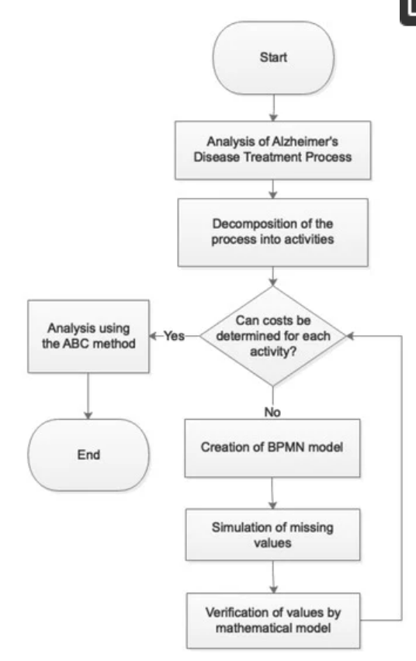

Slide 5
Introduction
A project focused on AI models that can accurately identify and potentially predict the disease using data like brain scans and other relevant information, potentially aiding in early diagnosis and treatment.

Slide 6
Abstract:
The Alzheimer’s classifier is a ML model developed using the Vgg16 architecture.
This classifier is specifically designed to assess and categorize brain imaging data to identify patterns associated with Alzheimer’s disease.
The data is hand collected from various websites with each and every labels verified
Determining the cost of healthcare and social care for patients is a crucial issue for many parties; therefore, both public and private payments play a decisive role in patient care. The article deals with the analysis of the possibilities of the simulation of costs related to Alzheimer’s disease.

Slide 7
Problem Statement :
TO develop an accurate and efficient method for identifying and classifying individuals at risk of or with Alzheimer’s disease, using various data sources like brain imaging and cognitive tests, to aid in early diagnosis and potentially improve patient outcomes.

Slide 8
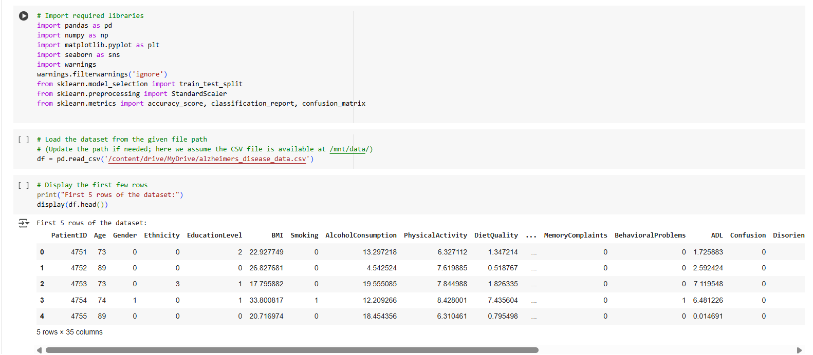
Code EDA

Slide 9
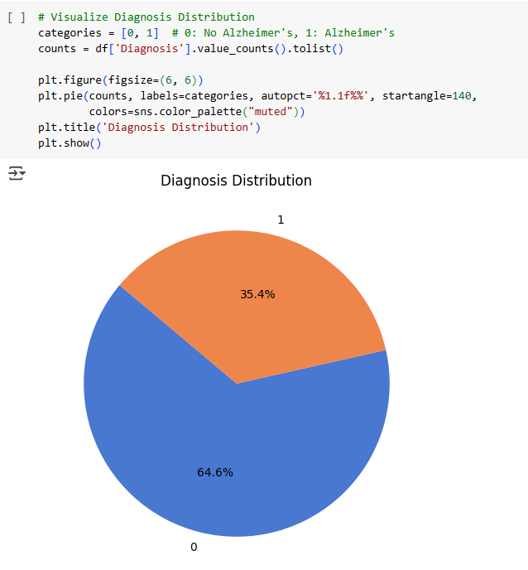
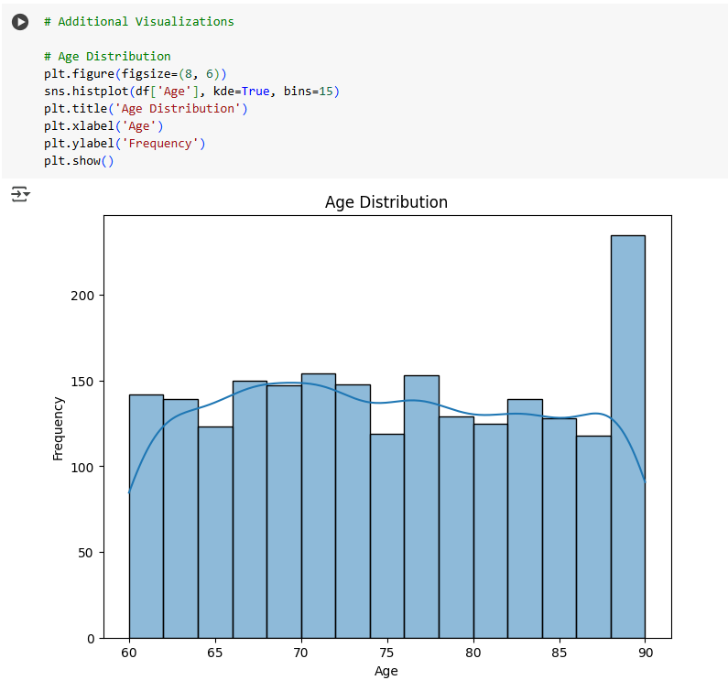

Slide 10
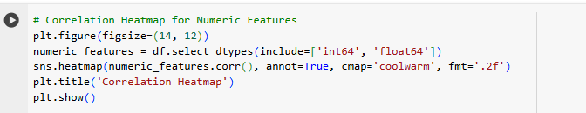
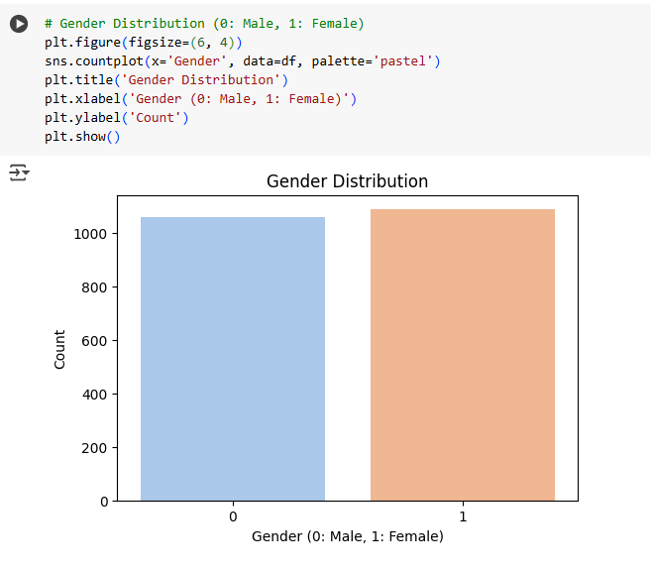
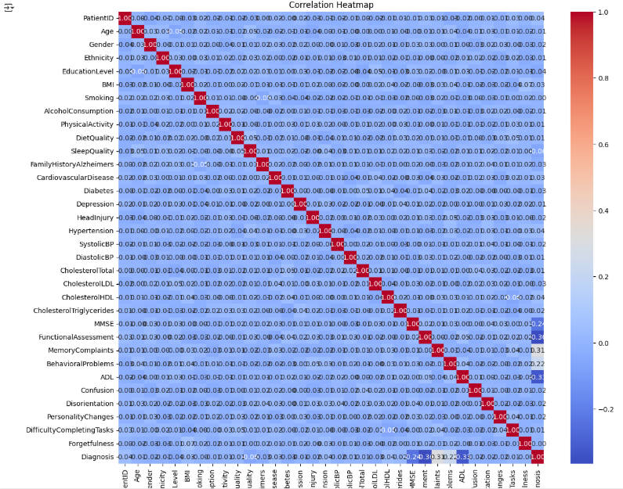

Slide 11
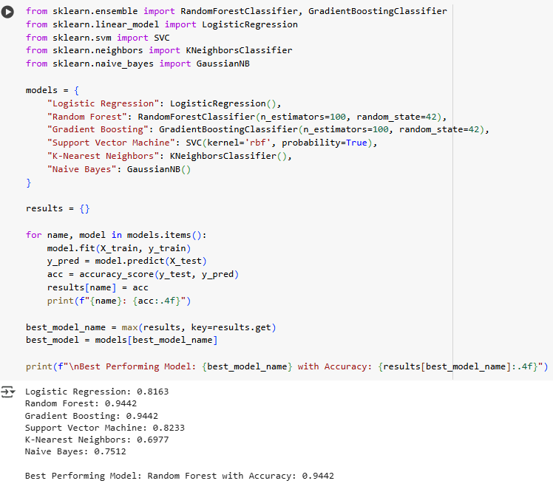
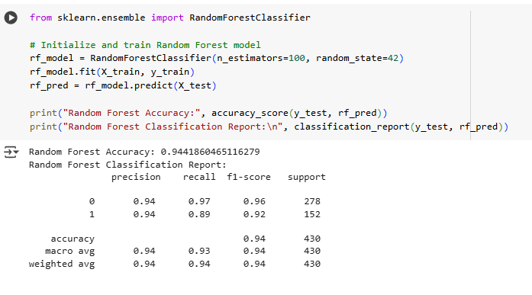

Slide 12
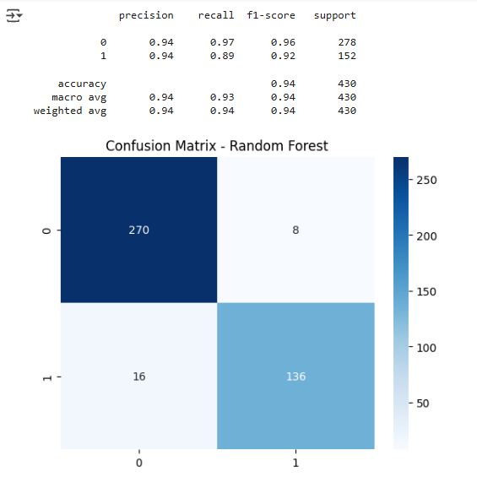
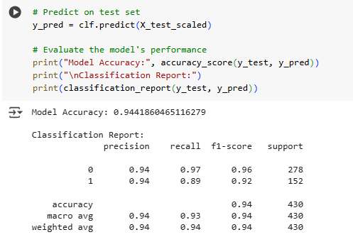

Slide 13


Slide 14
