Slide 1
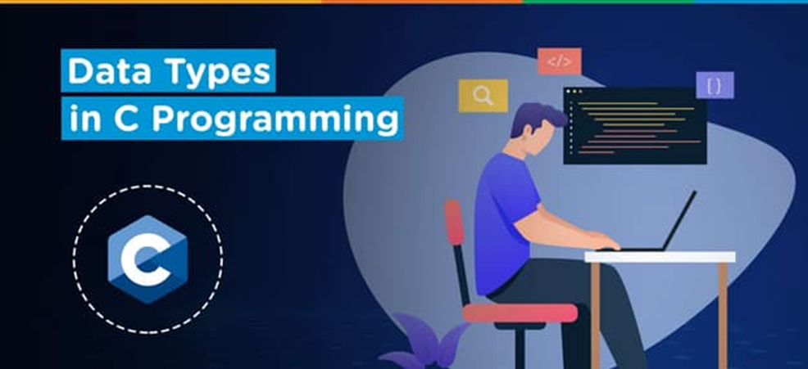
Chapter-3
Getting the Most Out of C

Slide 2
Course Outline
Data-Types
Useful Typdefs and Define
Manipulating Bits in Memory
Accessing Data through Pointers
Structure and Union

Slide 3
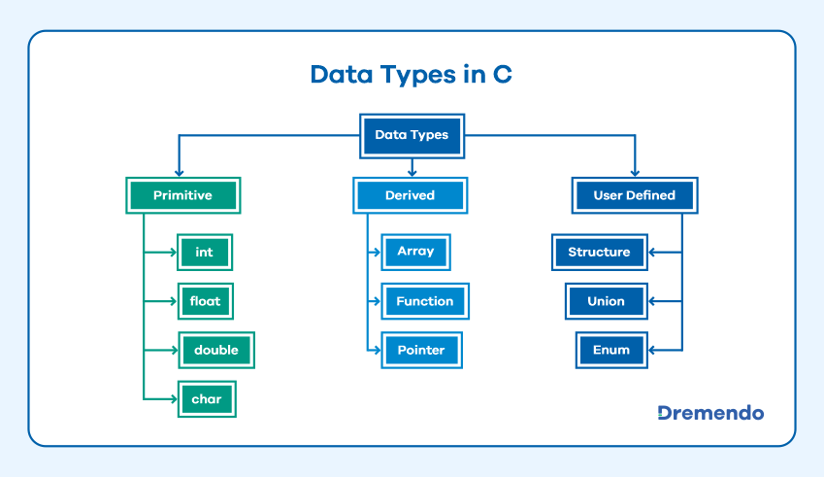
Data Types

Slide 4
Primitive Data types
char Character data type allows its variable to store only a single character. The size of the character is 1 byte. It is the most basic data type in C. It stores a single character and requires a single byte of memory in almost all compilers.
int The integer datatype in C is used to store the integer numbers (any number including positive, negative and zero without decimal part). Octal values, hexadecimal values, and decimal values can be stored in int data type in C
Float In C programming float data type is used to store floating-point values. Float in C is used to store decimal and exponential values. It is used to store decimal numbers (numbers with floating point values) with single precision.
double The double data type is basically a precision sort of data type that is capable of holding 64 bits of decimal numbers or floating points. Since double has more precision as compared to that float then it is much more obvious that it occupies twice the memory occupied by the floating-point type.

Slide 5
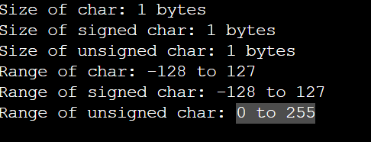
Example of char Datatype Output: #include <stdio.h>
#include <limits.h>
int main() {
// Sizes of char types
printf("Size of char: %zu bytes\n", sizeof(char));
printf("Size of signed char: %zu bytes\n", sizeof(signed char));
printf("Size of unsigned char: %zu bytes\n", sizeof(unsigned char));
// Ranges of char types
printf("Range of char: %d to %d\n", CHAR_MIN, CHAR_MAX);
printf("Range of signed char: %d to %d\n", SCHAR_MIN, SCHAR_MAX);
printf("Range of unsigned char: 0 to %u\n", UCHAR_MAX);
return 0;
}

Slide 6
Example of Integer Datatype
#include <stdio.h>
#include <limits.h>
int main() {
// Sizes of integer types
printf("Size of short int: %zu bytes\n", sizeof(short int));
printf("Size of unsigned short int: %zu bytes\n", sizeof(unsigned short int));
printf("Size of int: %zu bytes\n", sizeof(int));
printf("Size of unsigned int: %zu bytes\n", sizeof(unsigned int));
printf("Size of long int: %zu bytes\n", sizeof(long int));
printf("Size of unsigned long int: %zu bytes\n", sizeof(unsigned long int));
printf("Size of long long int: %zu bytes\n", sizeof(long long int));
printf("Size of unsigned long long int: %zu bytes\n", sizeof(unsigned long long int));
// Ranges of integer types
printf("Range of short int: %d to %d\n", SHRT_MIN, SHRT_MAX);
printf("Range of unsigned short int: 0 to %u\n", USHRT_MAX);
printf("Range of int: %d to %d\n", INT_MIN, INT_MAX);
printf("Range of unsigned int: 0 to %u\n", UINT_MAX);
printf("Range of long int: %ld to %ld\n", LONG_MIN, LONG_MAX);
printf("Range of unsigned long int: 0 to %lu\n", ULONG_MAX);
printf("Range of long long int: %lld to %lld\n", LLONG_MIN, LLONG_MAX);
printf("Range of unsigned long long int: 0 to %llu\n", ULLONG_MAX);
return 0;
}

Slide 7
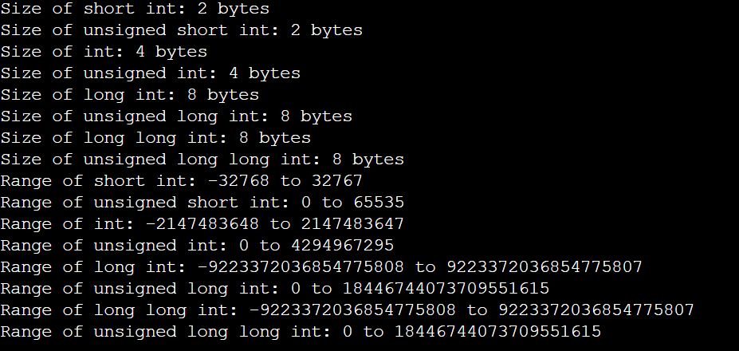
Output:

Slide 8
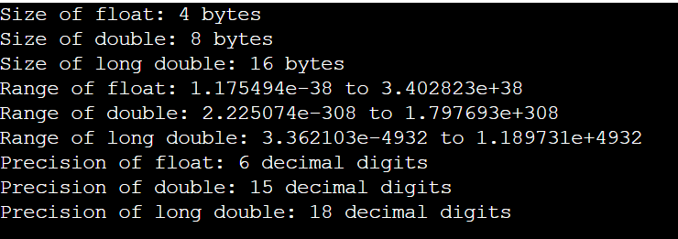
Example of Float Datatype output:
#include <stdio.h>
#include <float.h>
int main() {
// Sizes of floating-point types
printf("Size of float: %zu bytes\n", sizeof(float));
printf("Size of double: %zu bytes\n", sizeof(double));
printf("Size of long double: %zu bytes\n", sizeof(long double));
// Ranges of floating-point types
printf("Range of float: %e to %e\n", FLT_MIN, FLT_MAX);
printf("Range of double: %e to %e\n", DBL_MIN, DBL_MAX);
printf("Range of long double: %Le to %Le\n", LDBL_MIN, LDBL_MAX);
// Precision of floating-point types
printf("Precision of float: %d decimal digits\n", FLT_DIG);
printf("Precision of double: %d decimal digits\n", DBL_DIG);
printf("Precision of long double: %d decimal digits\n", LDBL_DIG);
return 0;
}

Slide 9
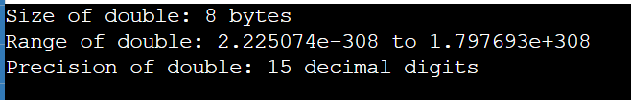
Example of Double Datatype Output:
#include <stdio.h>
#include <float.h>
int main() {
// Size of double
printf("Size of double: %zu bytes\n", sizeof(double));
// Range of double
printf("Range of double: %e to %e\n", DBL_MIN, DBL_MAX);
// Precision of double
printf("Precision of double: %d decimal digits\n", DBL_DIG);
return 0;
}

Slide 10
Derived Data types
Array Array in C is a fixed-size collection of similar data items stored in contiguous memory locations. An array is capable of storing the collection of data of primitive, derived, and user-defined data types.
Pointer A pointer in C language is a data type that stores the address where data is stored. Pointers store memory addresses of variables, functions, and even other pointers.
Function A function is called a C language construct which consists of a function-body associated with a function-name. In every program in C language, execution begins from the main function, which gets terminated after completing some operations which may include invoking other functions.

Slide 11
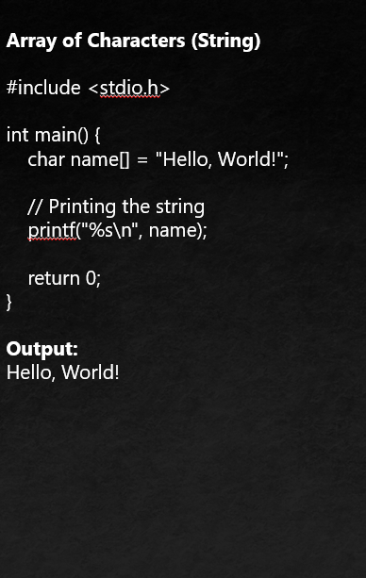
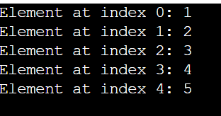
Basic Array Initialization and Access #include <stdio.h>
int main() {
int numbers[5] = {1, 2, 3, 4, 5};
// Accessing array elements
for (int i = 0; i < 5; i++) {
printf("Element at index %d: %d\n", i, numbers[i]);
}
return 0;
} Output :

Slide 12
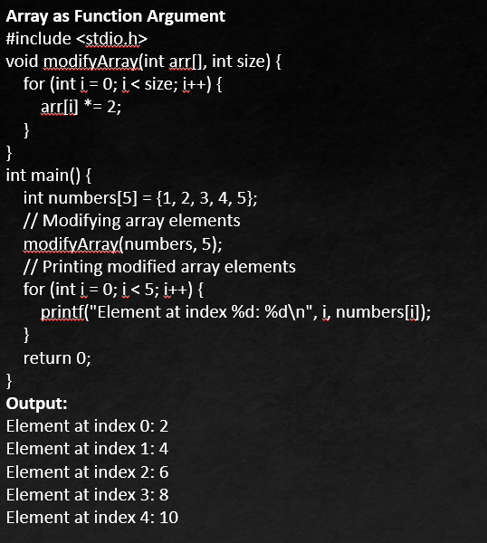
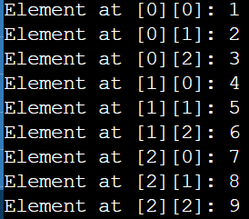
Multi-dimensional Array
#include <stdio.h>
int main() {
int matrix[3][3] = {
{1, 2, 3},
{4, 5, 6},
{7, 8, 9}
};
// Accessing elements of the 2D array
for (int i = 0; i < 3; i++) {
for (int j = 0; j < 3; j++) {
printf("Element at [%d][%d]: %d\n", i, j, matrix[i][j]);
}
}
return 0;
} Output:

Slide 13
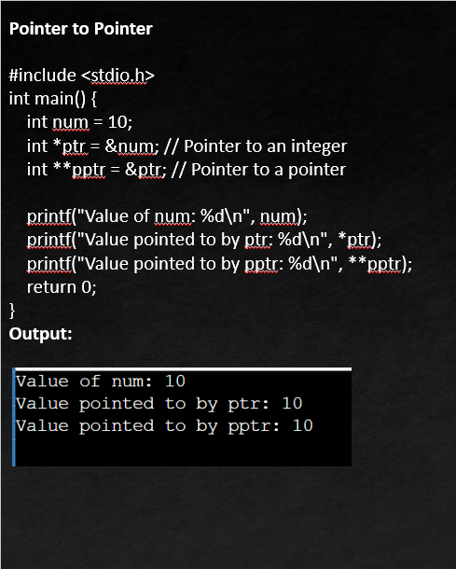
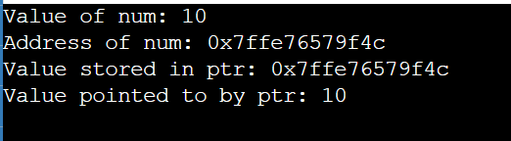
Basic Pointer
#include <stdio.h>
int main() {
int num = 10;
int *ptr = &num; // Pointer to an integer
printf("Value of num: %d\n", num);
printf("Address of num: %p\n", (void*)&num);
printf("Value stored in ptr: %p\n", (void*)ptr);
printf("Value pointed to by ptr: %d\n", *ptr);
return 0;
} Output:

Slide 14
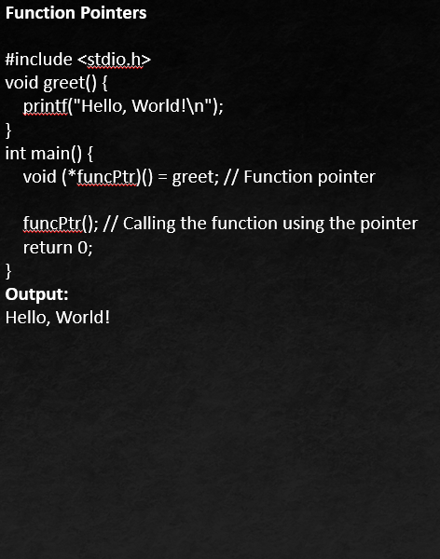
Void Pointer
#include <stdio.h>
int main() {
int num = 10;
float fnum = 5.5;
void *ptr;
ptr = &num; // Void pointer pointing to an integer
printf("Value of num: %d\n", *(int*)ptr);
ptr = &fnum; // Void pointer pointing to a float
printf("Value of fnum: %.2f\n", *(float*)ptr);
return 0;
} Output: Value of num: 10
Value of fnum: 5.50

Slide 15
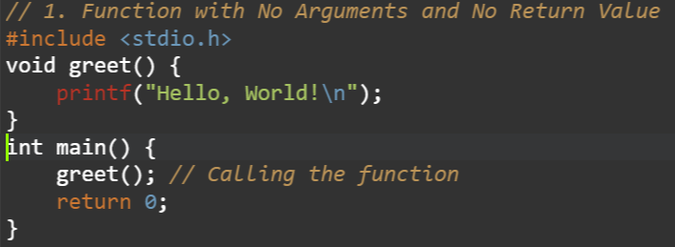
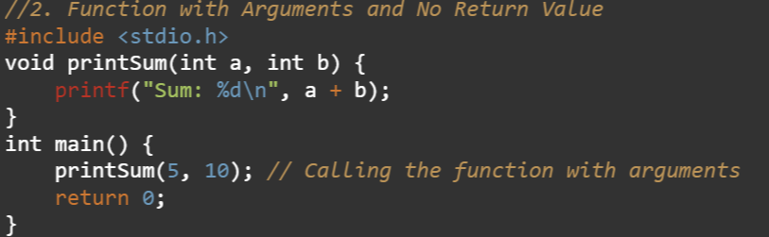
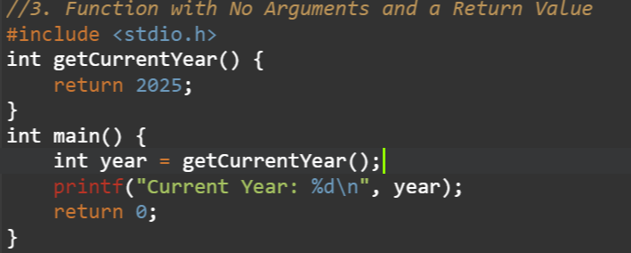
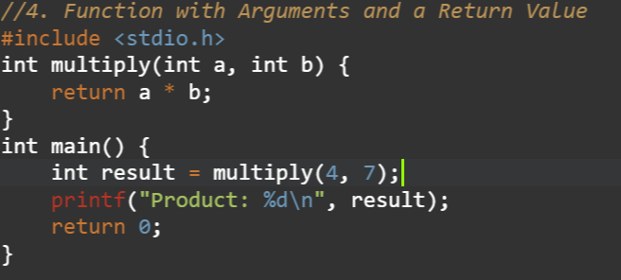

Slide 16
Useful Typdefs and define
typedef in C
The typedef keyword is used to define a new type name for an existing type. It is used primarily to improve code readability by providing a more meaningful or simplified name for complex data types. Basic Typedef for Simplicity Typedef for Structs Typedef for Enums
typedef unsigned char BYTE; typedef struct { typedef enum {
BYTE b1, b2; int x; RED;
int y; GREEN;
}Point; BLUE;
Point p1,p2; }Color;
Color favoriteColor = GREEN;

Slide 17
Useful Typdefs and define
define In C programming, #define is a preprocessor directive that is used to define macros. The macros are the identifiers defined by #define which are replaced by their value before compilation. We can define constants and functions like macros using #define. Defining Constants Macro Functions
#define PI 3.14159 #define SQUARE(x) ((x) * (x))
#define MAX_BUFFER_SIZE 1024 #define MAX(a, b) ((a) > (b) ? (a) : (b))
Hardware Register Access
#define REG_BASE_ADDR 0x40000000
#define REG(offset) (*(volatile unsigned int *)(REG_BASE_ADDR + (offset)))
// Usage
unsigned int value = REG(0x10); // Access register at offset 0x10

Slide 18
Bit Manipulation
Bit manipulation in C involves directly working with the binary representation of data, manipulating individual bits to achieve specific computational results. It's a fundamental technique used in various programming tasks, especially in low-level programming, system programming, and performance-critical applications.
Setting a Bit
#include <stdio.h>
int main() {
int num = 0b00001111; // Initial value: 15 (binary: 00001111)
int pos = 5; // Position to set the bit
num |= (1 << pos); // Set bit at position 5
printf("After setting bit %d: %d (binary: %08b)\n", pos, num, num);
return 0;
}

Slide 19
Clearing a Bit
#include <stdio.h>
int main() {
int num = 0b00001111; // Initial value: 15 (binary: 00001111)
int pos = 3; // Position to clear the bit
num &= ~(1 << pos); // Clear bit at position 3
printf("After clearing bit %d: %d (binary: %08b)\n", pos, num, num);
return 0;
}
Toggling a Bit
#include <stdio.h>
int main() {
int num = 0b00001111; // Initial value: 15 (binary: 00001111)
int pos = 2; // Position to toggle the bit
num ^= (1 << pos); // Toggle bit at position 2
printf("After toggling bit %d: %d (binary: %08b)\n", pos, num, num);
return 0;
}

Slide 20
Accessing data through pointers
Accessing data through pointers involves using a pointer to refer to the memory address of a variable. By dereferencing the pointer, you can read or modify the value stored at that memory address. This technique is fundamental in C programming for dynamic memory allocation, array manipulation, and efficient data handling
Array Access Using Pointers
#include <stdio.h>
int main()
{
int a[10]={1,20,35,46,51,69,78,84,92};
int *p;
p=a;
printf("%d",*(p+8));
return 0;
}

Slide 21
User Defined Data types
Structure Structures are used to group items of different types into a single type. The "struct" keyword is used to define a structure. The size of the structure is equal to or greater than the total size of all of its members.
Union Unions are similar to structures in many ways. What makes a union different is that all the members in the union are stored in the same memory location resulting in only one member containing data at the same time. The size of the union is the size of its largest member. Union is declared using the "union" keyword.
Enum enum is short for "Enumeration". It allows the user to create custom data types with a set of named integer constants. The "enum" keyword is used to declare an enumeration. Enum simplifies and makes the program more readable.

Slide 22
Structures
#include <stdio.h>
// Define a structure
struct Person {
char name[50];
int age;
float height;
};
int main() {
// Declare and initialize a structure variable
struct Person person1 = {"Alice", 30, 5.5};
// Access structure members
printf("Name: %s\n", person1.name);
printf("Age: %d\n", person1.age);
printf("Height: %.2f\n", person1.height);
return 0;
}
Output:
Name: Alice
Age: 30
Height: 5.50

Slide 23
Unions
#include <stdio.h>
union Data {
int i;
float f;
char str[20];
};
int main() {
union Data data;
// Access union members one at a time
data.i = 10;
printf("data.i: %d\n", data.i);
data.f = 220.5;
printf("data.f: %.2f\n", data.f);
// Note: Assigning a new value to one member will overwrite the previous value
snprintf(data.str, sizeof(data.str), "Hello");
printf("data.str: %s\n", data.str);
return 0;
} Output: data.i: 10
data.f: 220.50
data.str: Hello

Slide 24
Enums
#include <stdio.h>
enum Weekday {
SUNDAY,
MONDAY,
TUESDAY,
WEDNESDAY,
THURSDAY,
FRIDAY,
SATURDAY
};
int main() {
// Declare an enum variable
enum Weekday today;
// Assign a value to the enum variable
today = FRIDAY;
// Print the value of the enum variable
printf("Today is day number %d of the week.\n", today);
return 0;
}
Output: Today is day number 5 of the week.

Slide 25
THANK YOU

