Slide 1



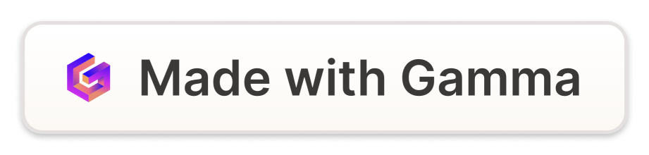
Introduction to Arrays
Arrays are a fundamental data structure in programming, consisting of a collection of items stored at contiguous memory locations. They can store multiple values of the same data type effectively.
by jhansi vaddipalli

Slide 2
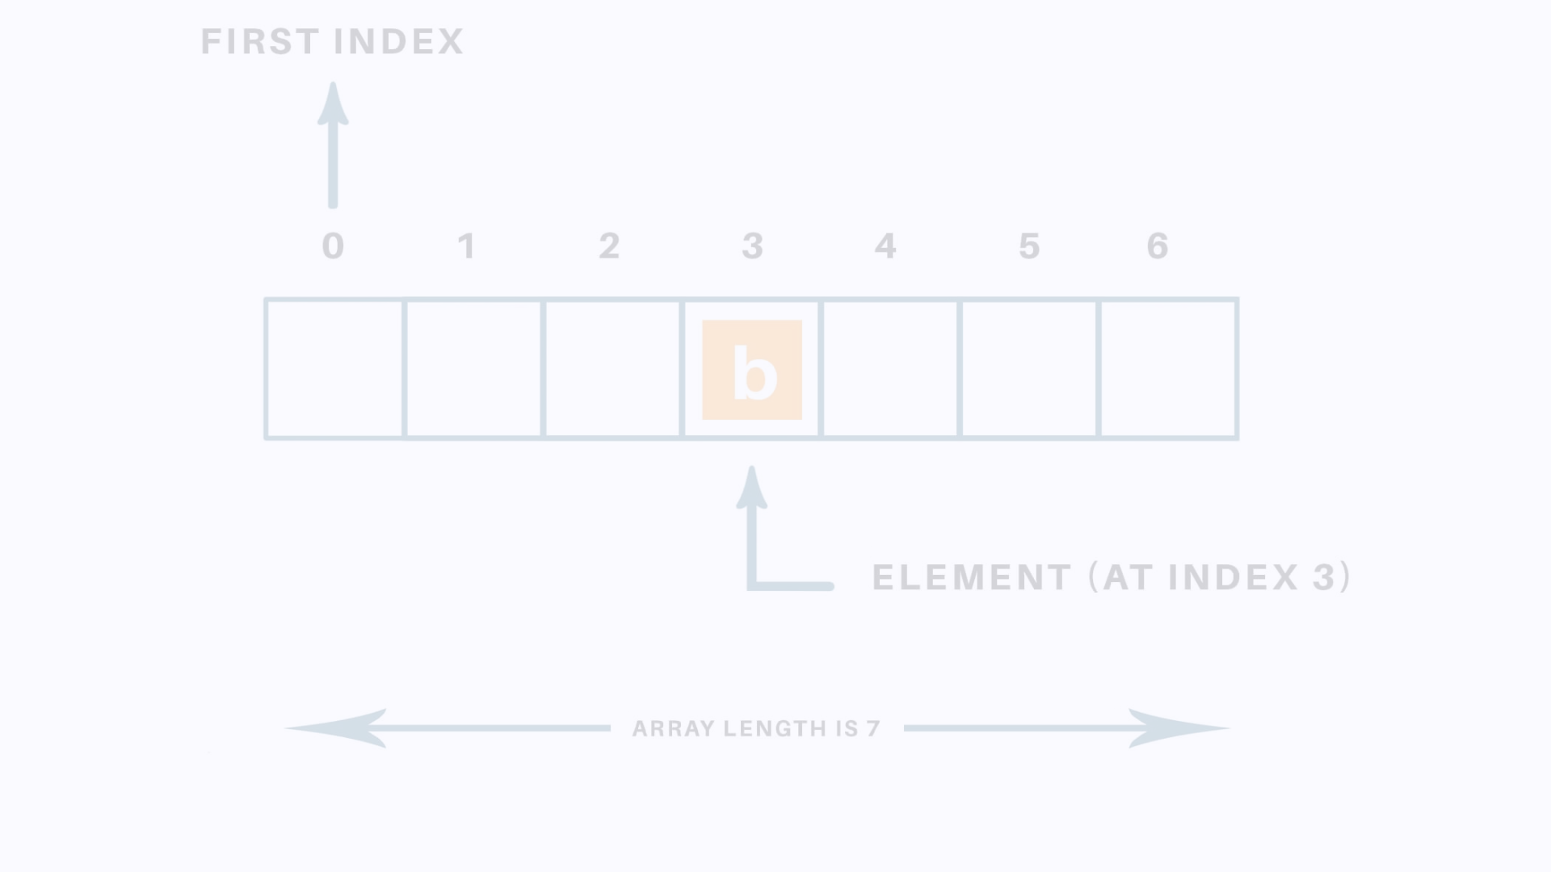
Declaration and Initialization of Arrays
1
Static or Dynamic
2
Initialization
Arrays can be declared with a fixed size or dynamically resized.
Values can be assigned during array creation or individually after creation.

Slide 3
Accessing Elements in an Array
Index-based Access
Traversal
Elements are accessed by their position, starting from index 0.
Looping through the array to access each element systematically.

Slide 4
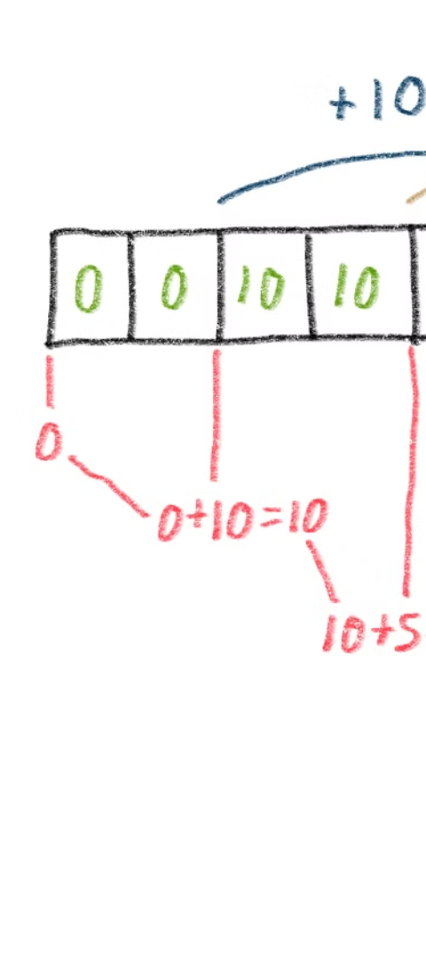
Manipulating Arrays
1
Sorting
Arranging elements in ascending or descending order.
2
Searching
Looking for specific elements within the array.
3
Insertion/Deletion
Adding or removing elements from the array.

Slide 5

Introduction to Pointers
1
Pointer Basics
2
Usage
Pointers are variables that store memory addresses.
Pointers are used for dynamic memory allocation and passing functions by reference.

Slide 6


Declaring and Initializing Pointers
Declaration
Initialization
Defining a pointer with the * symbol and the data type.
Assigning the memory address of a variable to a pointer.

Slide 7
Accessing Values through Pointers
Pointer Syntax
Accessing values using the * operator.

Slide 8
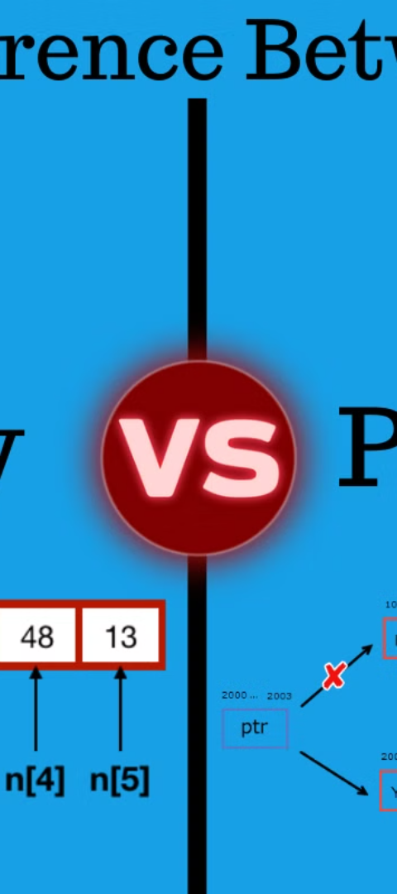
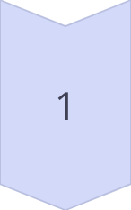
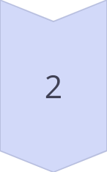
Relationship Between Arrays and Pointers
Array to Pointer
Arrays can decay into pointers pointing to their first element.
Pointer Arithmetic
Performing arithmetic operations on pointers for array traversal.

