Slide 1
POINTERS
Point to here, point to there, point to that, point to this, and point to nothing!
well, they are just memory addresses!!??
www.tenouk.com, ©
1/5<number>

Slide 2
POINTERS
When declaring a variable, the compiler sets aside memory storage with a unique address to store that variable.
The compiler associates that address with the variable’s name.
When the program uses the variable name, it automatically accesses a proper memory location.
No need to concern which address.
But we can manipulate the memory address by using pointers.
Let say we declare a variable named nRate of type integer and assign an initial value as follows,
    int nRate = 10;
www.tenouk.com, ©
2/51

Slide 3
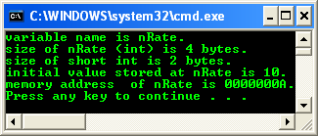
POINTERS
#include <stdio.h>
void main(void)
{
int nRate = 10;
printf("variable name is nRate.\n");
// or sizeof(int)
printf("size of nRate (int) is %d bytes.\n", sizeof(nRate));
printf("size of short int is %d bytes.\n", sizeof(short int));
printf("initial value stored at nRate is %d.\n", nRate);
printf("memory address of nRate is %p.\n", nRate);
}
www.tenouk.com, ©
3/51

Slide 4
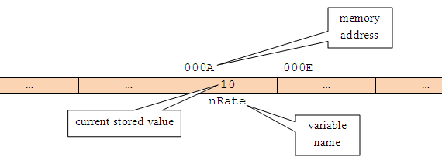
POINTERS
The variable is stored at specific memory address and can be depicted as follows,
www.tenouk.com, ©
4/51

Slide 5
POINTERS
The variable scope is local to the main() function.
The memory allocation is from the main() function's stack.
The nRate memory address (or any other variable) is a number, so can be treated like any other number in C.
Using %p, the address is in hexadecimal format.
Hence, if a variable’s memory address is 'known', we can create a second variable for storing the memory address.
From the previous example, let declare another variable, named pTonRate to hold the address of nRate variable.
5/<number>1
www.tenouk.com, ©

Slide 6
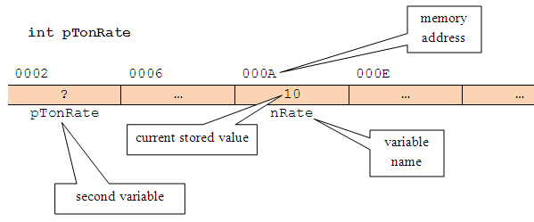
POINTERS
At the beginning, pTonRate is uninitialized.
So, storage has been allocated for pTonRate, but its initial value is undetermined, as shown below,
www.tenouk.com, ©
6/51

Slide 7
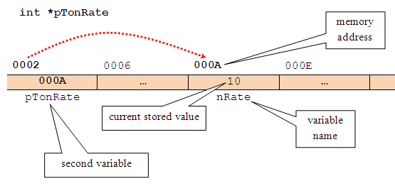
POINTERS
Let store the nRate's memory address, in pTonRate variable.
So, pTonRate now holds the nRate's memory address, where the actual data (10) is stored.
Finally, in C vocabulary, pTonRate is pointing to nRate or is said a pointer to nRate and can be illustrated as follows,
www.tenouk.com, ©
7/51

Slide 8
POINTERS
So, the pointer variable declaration becomes something like this,
    int *pTonRate;
In other word, the pTonRate variable holds the memory address of nRate and is therefore a pointer to nRate.
The asterisk (*) is used to show that is it the pointer variable instead of normal variable.
Definition: A pointer is a variable that holds memory address of another variable, where, the actual data is stored.
www.tenouk.com, ©
8/51

Slide 9
POINTERS
By using pointers, it is an efficient way of accessing and manipulating data.
Very useful for dynamic memory management, as we know memory, registers and cache are scarce resource in computer system.
Every computer system, there are fixed and limited amount of memory for temporary data storage and processing.
There are loading and unloading data into and from, moving data from and to different locations of the memory, including the cache and the processors’ registers for temporary data storage and processing.
The loading and unloading need an efficient memory management.
Some of the memory portion also used for shared data to further optimizes the utilization.
This shared data access (read/write) depends heavily on the pointers manipulation.
Without moving/loading/unloading data to/from different locations in memory, we can use pointers to point to different locations.
www.tenouk.com, ©
9/51

Slide 10
POINTERS
Pointers and Simple Variables
A pointer is a numeric variable and like other variables, must be declared and initialized before it can be used.
The following is a general form for declaring a pointer variable,
  type_of_stored_data * pointer_variable_name;
For example,
  char* chName;
  int * nTypeOfCar;
  float *fValue;
type_of_stored_data is any valid pointer base type such as char, int, float or other valid C derived types such as array and struct.
It indicates the type of the variable’s data to which the pointer is pointed to.
The pointer_variable_name follows the same rules as other C variable naming convention and must be unique.
www.tenouk.com, ©
10/51

Slide 11
POINTERS
From the pointer declaration examples, in the first line, the declaration tells us that chName is a pointer to a variable of type char.
The asterisk (*) is called indirection operator, and it indicates that chName is a pointer to type char and not a normal variable of type char.
Note the position of the *, it is valid for all the three positions.
Pointers can be declared along with non pointer variables as shown below,
// chFirstName and chSecondName both are pointers to
// type char while chInitial is normal char type variable
char *chFirstName, *chSecondName, chInitial;
// fValue is a pointer to type float, and fPercent
// is an ordinary float type variable.
float *fValue, fPercent;
www.tenouk.com, ©
11/51

Slide 12
POINTERS
Initializing Pointers
Once a pointer is declared, we must initialize it.
This makes the pointer pointing to something.
Don’t make it point to nothing; it is dangerous.
Uninitialized pointers will not cause a compiler error, but using an uninitialized pointer could result in unpredictable and potentially disastrous outcomes.
Until pointer holds an address of a variable, it isn’t useful.
C uses two pointer operators,
  Indirection operator (*) – asterisk symbol, has been explained previously.
  Address-of-operator (&) – ampersand symbol, means return the address of…
When & operator is placed before the name of a variable, it will returns the memory address of the variable instead of stored value.
www.tenouk.com, ©
12/51

Slide 13
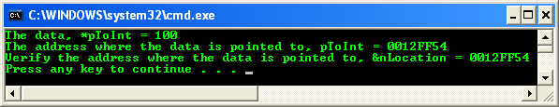
POINTERS
Program example: initializing a pointer
In this example, pointer variable, pToInt receives the address of nLocation or
The memory address of the nLocation variable is assigned to pToInt pointer variable.
www.tenouk.com, ©
13/51

Slide 14
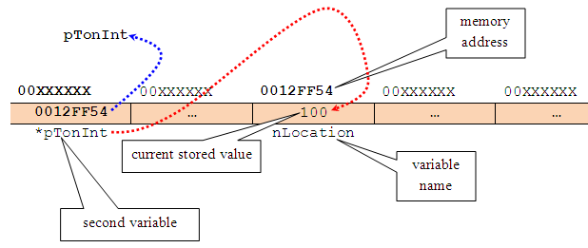
POINTERS
Graphically this situation can be illustrated as shown below.
The * operator is a complement of & operator.
* means returns the current value of the variable pointed to.
www.tenouk.com, ©
14/51

Slide 15
POINTERS
From the previous example, if we declare another variable of type int,
  int anotherVar;
  int * pToInt;
  pToInt = &nLocation;
  nLocation = 100;
Then, statement,
  anotherVar = *pToInt;
will place the actual current data value stored in variable nLocation into variable anotherVar.
Which means anotherVar was assigned the actual current data value stored at the memory address held by pToInt.
The * operator appears before a pointer variable in only two places:
  When declaring a pointer variable.
  When de-referencing a pointer variable (to show the data it‘s pointed to).
www.tenouk.com, ©
15/51

Slide 16
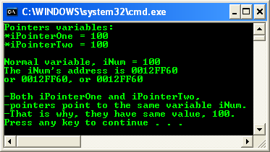
POINTERS
Using Pointers
Only the addition and subtraction operations are permitted in pointer's expression.
As with any variable, a pointer may be used on the right hand side of an assignment statement to assign its value to another pointer as shown in the following example.
Program example: using pointers
www.tenouk.com, ©
16/51

Slide 17
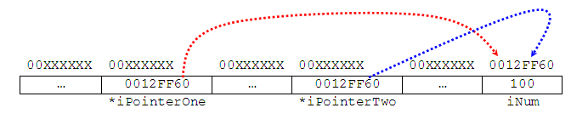
POINTERS
The situation can be illustrated as shown below. The memory address should be different for different run/system.
Take note the difference between memory address and the actual data value, which stored at the memory address.
Do not worry about the address, which are determined and provided by the system.
From the previous example, we can:
  Access the variable's content by using the variable name (iNum) and is called direct access.
  Access the variable's content by using a pointer to the variable (*iPointerOne or *iPointerTwo) and is called indirect access or indirection.
www.tenouk.com, ©
17/51

Slide 18
POINTERS
As a conclusion, if a pointer named pPointerVar of type int has been initialized to point to a variable named iNumVar, the following are true,
  // declare a pointer variable named pPointerVar, where the
  // data stored pointed to by pPointerVar is int type
  int * pPointerVar;
  // assign the iNumVar's address to pPointerVar pointer variable
  pPointerVar = &iNumVar;
* pPointerVar and iNumVar both refer to the contents of iNumVar (that is, whatever data value stored there).
pPointerVar and &iNumVar refer to the address of iNumVar (the pPointerVar only hold the address of variable iNumVar not the actual data value).
So, a pointer name without the indirection operator (*) accesses the pointer value itself, which is of course, the address of the variable pointed to.
www.tenouk.com, ©
18/51

Slide 19
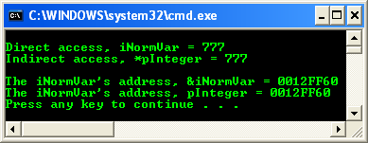
POINTERS
Program example: using pointers operator
The address displayed for variable iNormVar may be different on your system because different computer will have different specification.
www.tenouk.com, ©
19/51

Slide 20
POINTERS
For pointer arithmetic operation, only two arithmetic operations, that is addition and subtraction available. For example,
  int iAge = 35;
Hence, C reserved storage for the variable iAge and store the value 35 in it.
Let say, C has stored this value at the memory address 1000, then we declare a pointer variable named pPointerToAge that point to the iAge variable.
Then, after the following expressions have been executed,
  int * pPointerToAge;
  pPointerToAge = &iAge;
  pPointerToAge++;
The content of the pointer then becomes 1004 instead of 1001 (integer value takes 4 bytes so C add 4 to the pointer).
www.tenouk.com, ©
20/51

Slide 21
POINTERS
Different variable types occupy different amount of memory, implementation dependent, following C standard or implementation extension and whether 16, 32 or 64 bits system.
Each time the pointer is incremented, it points to the next integer and similarly, when a pointer is decremented, it points to the previous integer.
Each individual byte of memory has its own address; so multi-byte variable actually occupies several addresses.
When pointers used to handle the addresses of multi-byte variables, the address of a variable is actually the address of the lowest byte it occupies.
For example,
    int iNum = 12252; // 4 bytes
    char chVar = 90; // 1 byte
    float fVar = 1200.156004; // 4 bytes
www.tenouk.com, ©
21/51

Slide 22
POINTERS
The pointer variables are pointing to the lowest byte of variable memory slots e.g: iNum occupies 4 bytes and chVar occupies 1 byte.
Other pointer arithmetic operation is called differencing, which refers to subtracting two pointers.
For example, two pointers that point to different elements of the same array can be subtracted to find out how far apart they are.
Pointer arithmetic automatically scales the answer, so that it refers to the array elements.
Thus, if pPointer1 and pPointer2 point to elements of an array (of any type), the following expression tells you how far apart the elements are,
    pPointer1 – pPointer2;
www.tenouk.com, ©
22/51

Slide 23
POINTERS
However ptrdiff_t type can be used to return the subtraction operation between two pointers.
It is a base signed integer type of C/C++ language.
The type's size is chosen so that it could store the maximum size of a theoretically possible array of any type.
On a 32-bit system ptrdiff_t will take 32 bits, on a 64-bit one 64 bits.
The ptrdiff_t type enable you to write well-portable code.
ptrdiff_t (together with wchar_t and size_t) defined in stddef.h (cstddef for C++).
www.tenouk.com, ©
23/51

Slide 24
POINTERS
Pointers Comparison
The comparison is valid only between pointers that point to the same array.
The following relational operators work for pointers operation: ==, !=, >, <, >= and <=.
A lower array element that is those having a smaller subscript, always have a lower address than the higher array elements.
Thus if pPointer1 and pPointer2 pointing to the elements of the same array, the following comparison is TRUE,
  pPointer1 < pPointer2
If pPointer1 points to an earlier member of the array than pPointer2 does.
Many arithmetic operations that can be performed with regular variables, such as multiplication and division, do not work with pointers and will generate errors in C.
www.tenouk.com, ©
24/51

Slide 25
POINTERS
The following table summarizes pointer operations.
Operation | Description
1. Assignment (=) | You can assign a value to a pointer. The value should be an address with the address-of-operator (&) or from a pointer constant (array name)
2. Indirection (*) | The indirection operator (*) gives the value stored in the pointed to location.
3. Address of (&) | You can use the address-of operator to find the address of a pointer, so you can use pointers to pointers.
4. Incrementing | You can add an integer to a pointer to point to a different memory location.
5. Differencing | You can subtract an integer from a pointer to point to a different memory location.
6. Comparison | Valid only with two pointers that point to the same array.
www.tenouk.com, ©
25/51

Slide 26
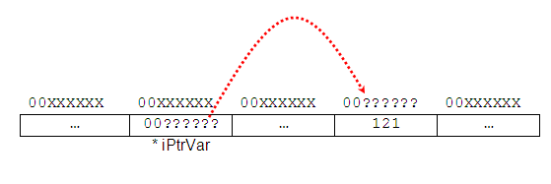
POINTERS
Uninitialized Pointers Issue
Let say we have declared a pointer something like this,
  int *iPtrVar;
This statement declares a pointer to type int but not yet initialized, so it doesn’t point to anything known value (address).
Then, consider the following pointer assignment statement,
  // this is not an address that system allocate!
  *iPtrVar = 121;
www.tenouk.com, ©
26/51

Slide 27
POINTERS
This statement means the value of 121 is assigned to whatever address (00??????) iPtrVar is pointing to.
That address can be anywhere in memory which may contain critical data.
The 121 stored in that location may overwrite some important information, and the result can be anything from program error to a full system crash.
We must initialize a pointer so that it point to something. Do not create a stray pointer.
A better solution, we can assign NULL (\0) value during the initialization before using it, such as,
  int *iPtrVar = NULL; /* null pointer, pointing to something but nothing */
For pointer that point to a string you may just point to an empty string for a dummy such as,
  char *chMyString = " ";
The .NET C/C++ programming uses nullptr instead of NULL. The
NULL/nullptr is a pointer that point to the 0x00000000 (32 bits system) memory address.
www.tenouk.com, ©
27/51

Slide 28
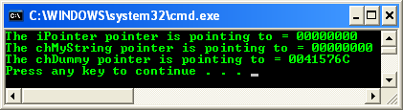
POINTERS
Program example: NULL pointer and empty string
www.tenouk.com, ©
28/51

Slide 29
POINTERS
Arrays and Pointers
A special relationship exists between pointers and arrays.
An array name without brackets is a pointer to the array’s first element.
So, if a program declared an array,
  char chName[10];
chName (array’s name) is the address of the first array element and is equivalent to the expression,
  &chName[0]
Which is a reference to the address of the array’s first element.
chName equivalent to &chName[0].
The array’s name is, therefore a pointer to the array’s first element and therefore to the string if any.
www.tenouk.com, ©
29/51

Slide 30
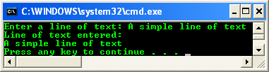
POINTERS
A pointer is a constant, which cannot be changed and remains fixed for the duration of program execution.
Many string operations in C are typically performed by using pointers because strings tend to be accessed in a strictly sequential manner.
Program example: pointers and array
www.tenouk.com, ©
30/51

Slide 31
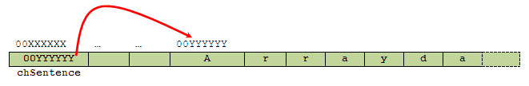
POINTERS
Which can be illustrated as follows,
www.tenouk.com, ©
31/51

Slide 32
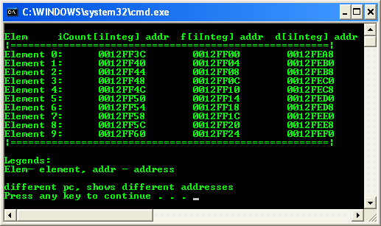
POINTERS
Let take a look at the following example: pointers and array
Notice the difference between the element addresses.
    12FF40 – 12FF3C = 4 bytes for int
    12FF04 – 12FF00 = 4 bytes float
    12FEB0 – 12FEA8 = 8 bytes double
www.tenouk.com, ©
32/51

Slide 33
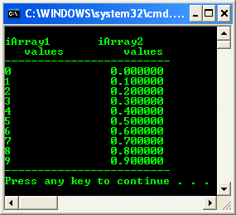
POINTERS
Try another program example: pointers and array access
www.tenouk.com, ©
33/51

Slide 34
POINTERS
Let re-cap, if an array named iListArray[ ] is a declared array, the expression * iListArray is the array’s first element, *( iListArray + 1) is the array’s second element, and so on.
Generally, the relationship is,
  *(iListArray) == iListArray[0] // first element
  *(iListArray + 1) == iListArray[1] // second element
  *(iListArray + 2) == iListArray[2] // third element
  ...
  ...
  *(iListArray + n) == iListArray[n] // the nth element
So, you can see the equivalence of array subscript notation and array pointer notation.
www.tenouk.com, ©
34/51

Slide 35
POINTERS
Arrays of Pointers and Function
Pointers may be arrayed like any other data type.
For example, a pointer array iArrayPtr of sized 20 is declared as,
  int *iArrayPtr[20];
To assign the address of an integer variable called iIntVar to the first element of the array, we could write something like this,
  // assign the address of variable
  // iIntVar to the first iArrayPtr element
  iArrayPtr [0] = &iIntVar;
www.tenouk.com, ©
35/51

Slide 36
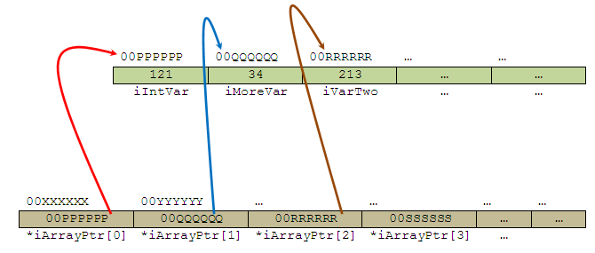
POINTERS
Graphically can be depicted as follows,
www.tenouk.com, ©
36/51

Slide 37
POINTERS
To find the value stored in iIntVar, we could write something like this,
  iArrayPtr[0]
To pass an array of pointers to a function, we simply call the function with the array’s name without any index/subscript, because this is an automatically a pointer to the first element of the array, as explained before.
For example, to pass the array named iArrayPtr to viewArrayFunc() function, we use the following statement,
  viewArrayFunc(iArrayPtr);
www.tenouk.com, ©
37/51

Slide 38
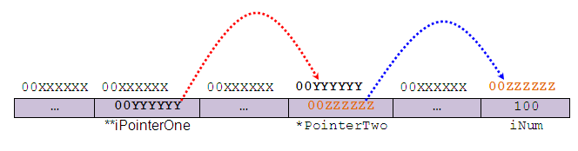
POINTERS
Pointers to Pointers
Graphically, the construct of a pointer to pointer can be illustrated as shown below.
iPointerOne is the first pointer, pointing to the second pointer, iPointerTwo and finally iPointerTwo is pointing to a normal variable iNum that hold integer 100.
www.tenouk.com, ©
38/51

Slide 39
POINTERS
In order to indirectly access the target value pointed to by a pointer to a pointer, the asterisk operator must be applied twice. For example,
  int **iPointerOne;
Tells compiler that iPointerOne is a pointer to a pointer of type integer.
Pointer to pointer is rarely used but you will find it regularly in programs that accept argument(s) from command line.
Consider the following declarations,
  char chVar; /* a normal character variable */
  char *pToChar; /* a pointer to a character */
  char **pToCharPointer; /* a pointer to a pointer to a character */
www.tenouk.com, ©
39/51

Slide 40


POINTERS
If the variables are related as shown below,
We can do some assignment like this,
  chVar = 'A';
  pToChar = &chVar;
  pToCharPointer = pToChar;
Recall that char * (which is *pToChar in this case) refers to a NULL terminated string.
Then, we can declare a pointer to a pointer to a string something like this,
www.tenouk.com, ©
40/51

Slide 41
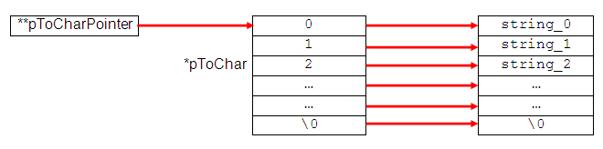
POINTERS
Taking this one stage further we can have several strings being pointed to by the integer pointers (instead of char) as shown below,
www.tenouk.com, ©
41/51

Slide 42
POINTERS
Then, we can refer to the individual string by using pToCharPointer[0], pToCharPointer[1],…. and generally, this is identical to declaring,
  char * pToCharPointer[ ]; /* an array of pointer */
Or from last figure,
  char ** pToCharPointer;
Thus, programs that accept argument(s) through command line, the main() parameter list is declared as follows,
  int main(int argc, char **argv)
Or something like this,
  int main(int argc, char *argv[ ])
Where the argc (argument counter) and argv (argument vector) are equivalent to pToChar and pToCharPointer respectively.
www.tenouk.com, ©
42/51

Slide 43
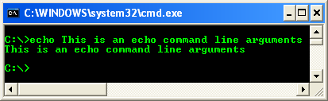
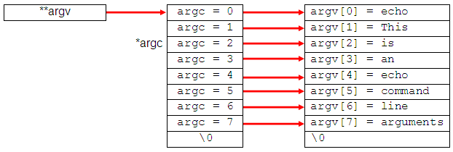
POINTERS
For example, program that accepts command line argument(s) such as echo,
This can be illustrated as,
www.tenouk.com, ©
43/51

Slide 44
POINTERS
So our main() function now has its own arguments.
As a convention, these are the only arguments main() accepts.
Notice that the argv[0] is an application name.
argc (argument counter) is the number of arguments (unsigned integer), which we input including the program name.
argv (argument vector) is an array of strings (argv[0], argv[1], argv[2],...) holding each command line argument including the program name that is the first array element, argv[0].
But some implementation will have another third parameter, envp/env, which is a pointer to an environment variable as shown below.
  int main(int argc, char *argv[ ], *envp[ ])
Environment variable in Operating System is an array of strings.
www.tenouk.com, ©
44/51

Slide 45
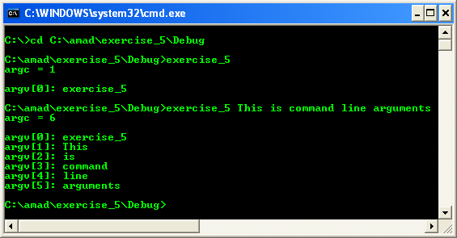
POINTERS
Let try a program example (this program must be run at command prompt)
www.tenouk.com, ©
45/51

Slide 46
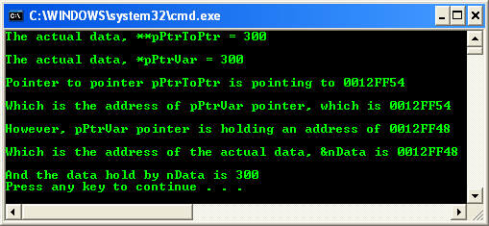
POINTERS
Another pointer-to-pointer example
www.tenouk.com, ©
46/51

Slide 47
POINTERS
NULL Pointer Constant
The null pointer constant is guaranteed not to point to any real object.
You can assign it to any pointer variable since it has type void *.
The preferred way to write a null pointer constant is with NULL.
  char * pNulPointer = NULL; or
  char * pNulPointer = nullptr;
NULL pointer when set, actually pointing to memory address 0x00000000 (32 bits).
The computer systems have reserved this zero address for NULL pointer and that is why it cannot be used for other purposes.
(in C++ .NET programming, nullptr is used as the keyword instead of NULL)
Since C functions can only return one variable, it is common practice for those which return a pointer is set to NULL, can avoid the stray pointer.
Set a pointer to NULL to indicate that it’s no longer in use.
www.tenouk.com, ©
47/51

Slide 48

POINTERS
void Pointers
There are times when you write a function but do not know the data type of the returned value.
When this is the case, you can use a void pointer, a pointer of type void.
Program example: void pointer
www.tenouk.com, ©
48/51

Slide 49
POINTERS
Other pointer declarations that you may find and can make you confused are listed below.
Pointer declaration | Description
int *x | x is a pointer to int data type.
int *x[10] | x is an array[10] of pointer to int data type.
int *(x[10]) | x is an array[10] of pointer to int data type.
int **x | x is a pointer to a pointer to an int data type – double pointers.
int (*x)[10] | x is a pointer to an array[10] of int data type.
int *funct() | funct() is a function returning an integer pointer.
int (*funct)() | funct() is a pointer to a function returning int data type – quite familiar constructs.
int (*(*funct())[10])() | funct() is a function returning pointer to an array[10] of pointers to functions returning int.
int (*(*x[4])())[5] | x is an array[4] of pointers to functions returning pointers to array[5] of int.
www.tenouk.com, ©
49/51

Slide 50
POINTERS
And something to remember!
* | - is a pointer to…
[ ] | - is an array of…
( ) | - is a function returning…
& | - is an address of…
www.tenouk.com, ©
50/51

Slide 51
END-of-C POINTERS
www.tenouk.com, ©
51/<number>

