Slide 1
Greenhouse Monitoring System
BY Apeksha pawar- 3BR21EC020
CH Monisha- 3BR21EC031
K Mounavi- 3BR21EC064
Gurram JhansiLakshmi- 3BR21EC050
Project Guide: Dr. Shiva Kumar K.S
Coordinator: Dr.Prabhakar K,
Mr.Manjunath G,
Dr.Abdul Lateef PS

Slide 2
Introduction
The Greenhouse Monitoring System automates the monitoring and control of environmental conditions within a greenhouse to support plant health.
Monitors temperature, humidity, soil moisture, and light intensity.
Uses ESP8266 microcontroller with DHT11, LDR, and Soil Moisture sensors.
Data is uploaded to Blynk and ThingSpeak for real-time monitoring.

Slide 3
Requirements
Hardware and software components used in the project.
ESP8266 NodeMCU
DHT11 Temperature & Humidity Sensor
Soil Moisture Sensor
LDR Sensor
Relay & Water Pump
Blynk Cloud and ThingSpeak
Arduino IDE

Slide 4
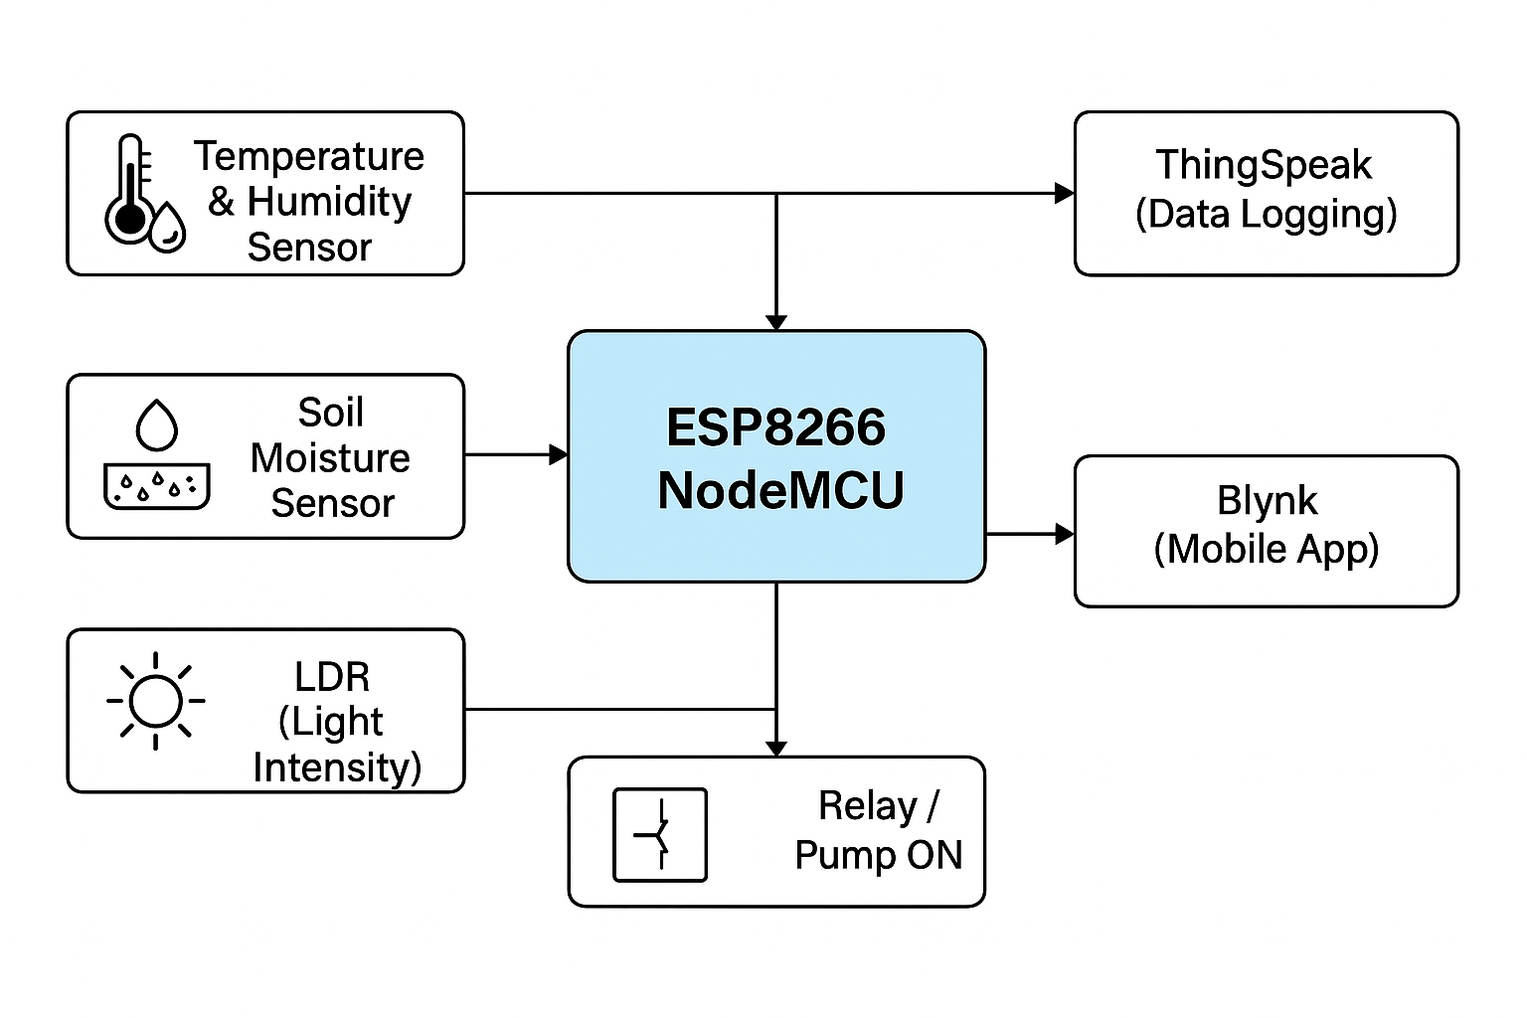
Block Diagram

Slide 5
Methodology
Working flow of the system.
Sensors gather environmental data.
ESP8266 processes data and sends it to Blynk and ThingSpeak.
If soil moisture < threshold, pump is activated.
Users monitor conditions via Blynk dashboard or ThingSpeak graphs.

Slide 6
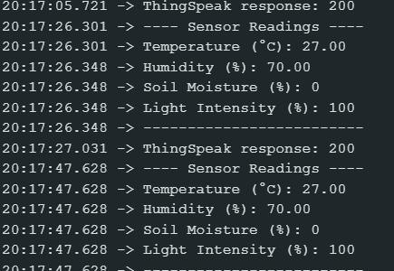
Sensor Readings - Serial Monitor

Slide 7
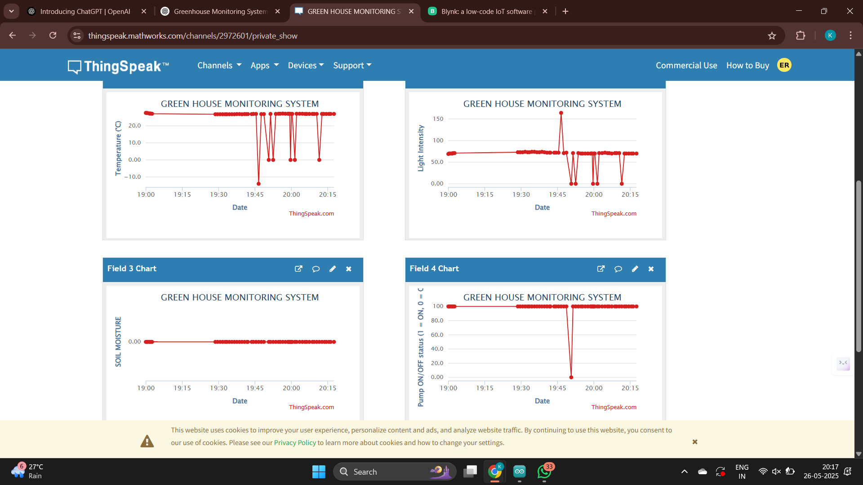
ThingSpeak Dashboards

Slide 8
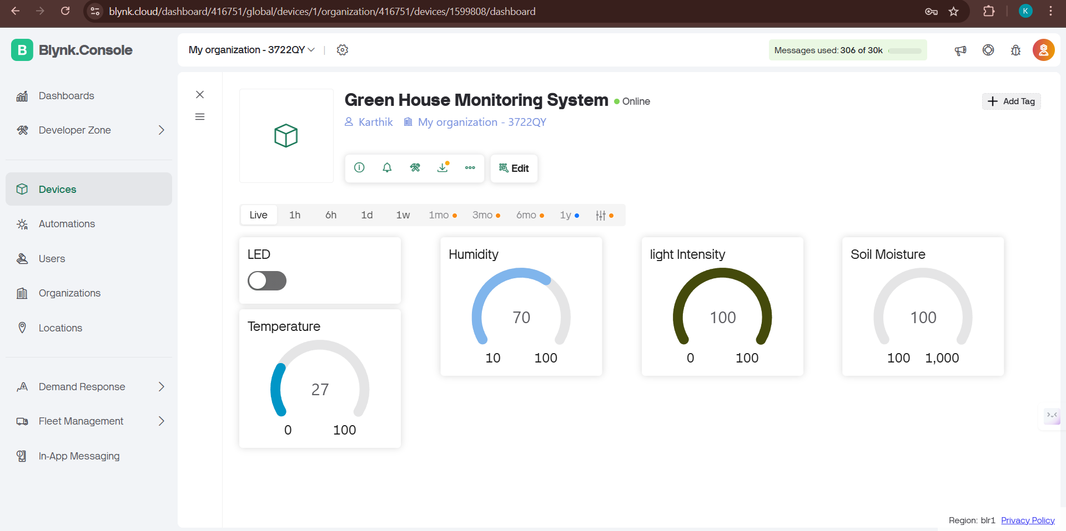
BLYNK IOT APPLICATION

Slide 9
Idea / Theme
Utilizing IoT for Smart Agriculture:
Automate environmental condition monitoring.
Remote control and live data visualization.
Reduce manual efforts and water wastage.

Slide 10
Literature Survey
References and prior research studies:
Various projects demonstrate ESP8266’s use in data logging.
Real-time cloud dashboards like Blynk and ThingSpeak enhance accessibility.
IoT is proven effective in greenhouse and precision farming.

Slide 11
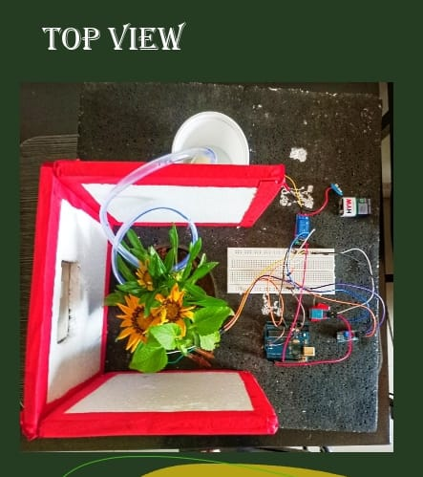
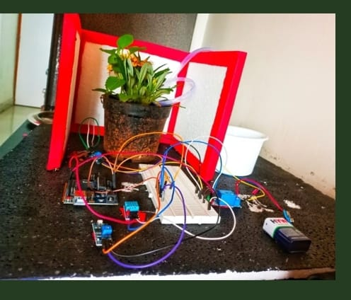
Prototype

Slide 12
Advantages
Key benefits of the system:
Automated control reduces manual labor.
Water-saving through precise irrigation.
24/7 Monitoring with cloud support.
Cost-effective and scalable.

Slide 13
Applications
Use cases where this system is useful:
Greenhouses and indoor farming.
Botanical gardens.
Agricultural research centers.
Home gardening automation.

Slide 14
Conclusion
The Greenhouse Monitoring System demonstrates a scalable and efficient method to automate plant care using IoT. It enhances productivity, reduces resource usage, and supports sustainable agriculture.

Slide 15
References
ThingSpeak Documentation
Blynk IoT Platform
ESP8266 Datasheets
Arduino Libraries for DHT and HTTP

Slide 16
Thank You!
.

