Slide 1


Slide 2

Authentication and Authorization
PROFESSOR :NITAL SHAH
GROUP - 5
JHANVI BRAHMBHATT
SUKHMAN KAUR
HEENA KASHYAP

Slide 3
Project summary
This Project is about creating a 3-level Authentication and Authorization to access and manipulate data in an ASP.Net web app in Visual Studio 2022 with .Net 6.0,​
The 3 Level of security groups are:​
Registered Users : can view all the approved data and can edit/delete their own data.​
Managers : can approve or reject contact data. Only approved contacts are visible to users.​
Administrators : can approve/reject and edit/delete any data.​

Slide 4
What is Authentication?​
Determines whether users are who they claim to be
​Asks the user to verify their credentials (for example, through passwords, answers to security questions, or facial recognition).​
Usually done before authorization.​
Transfers data often using an ID Token.
​Generally controlled via the OIDC protocol (OpenID Connect).​Example: Before accessing their workplace email, employees must authenticate over the network.

Slide 5
What is Authorization?​
Identifies what users are permitted and not to access.
​Checks to see if access is permitted by policies and regulations.​
After successful authentication, this is often done.​
Transfers data often using an Access Token
​Example: The system decides what data the employees are permitted access to after an employee successfully authenticates.

Slide 6
MEET the Team
Jhanvi Brahmbhatt
-Admin creation
-Admin related documentation
Sukhman Kaur
-Manager Creation
-Manager Related documentation
Heena Kashyap
-User Creation
-User Related documentation

Slide 7
Part 1
User Data Protected by Authorization
Screen Shots

Slide 8
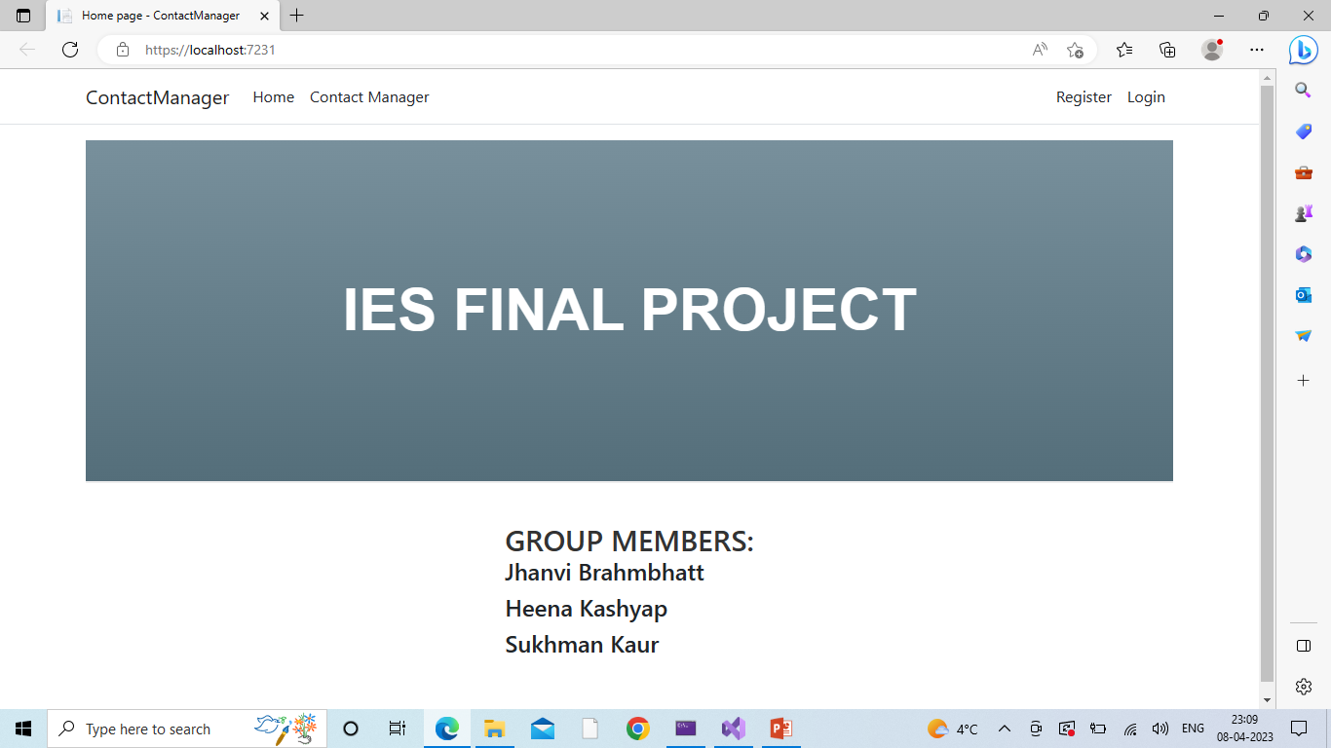
Home Page

Slide 9
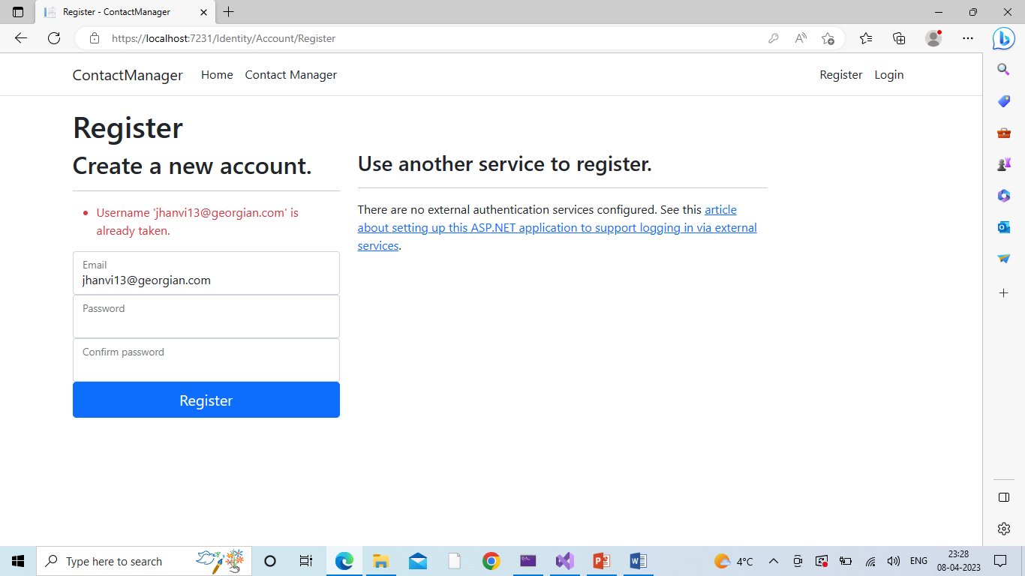
Username Validation

Slide 10
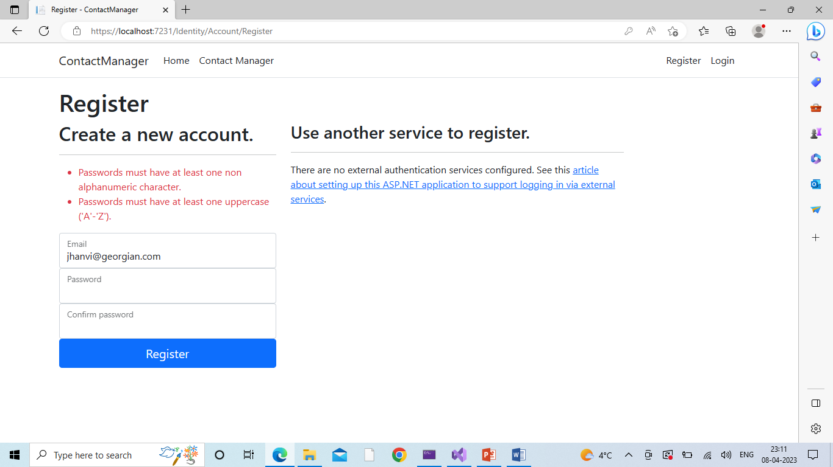
Password Validation

Slide 11
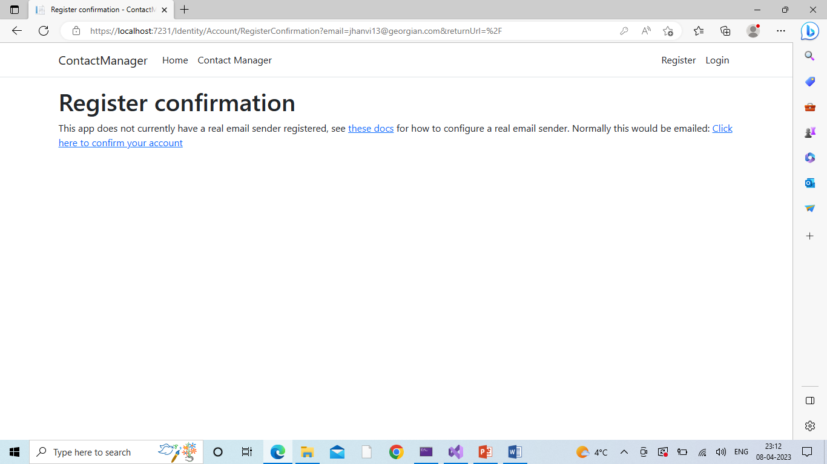
Registration Confirmation

Slide 12
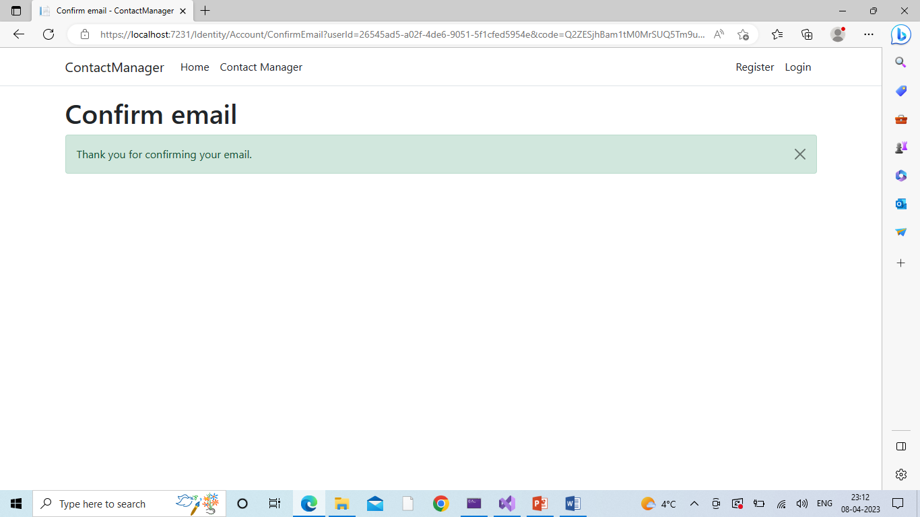
Registration Confirmed

Slide 13
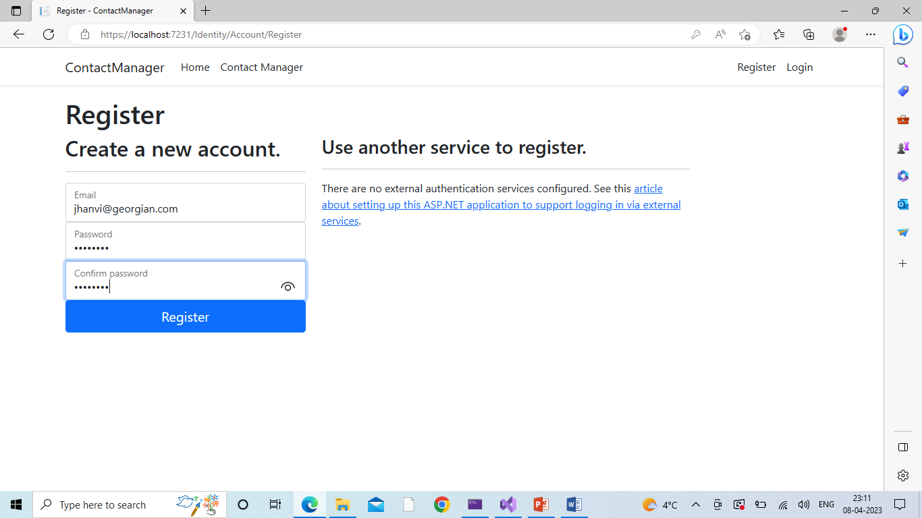
ADMIN LOGIN

Slide 14
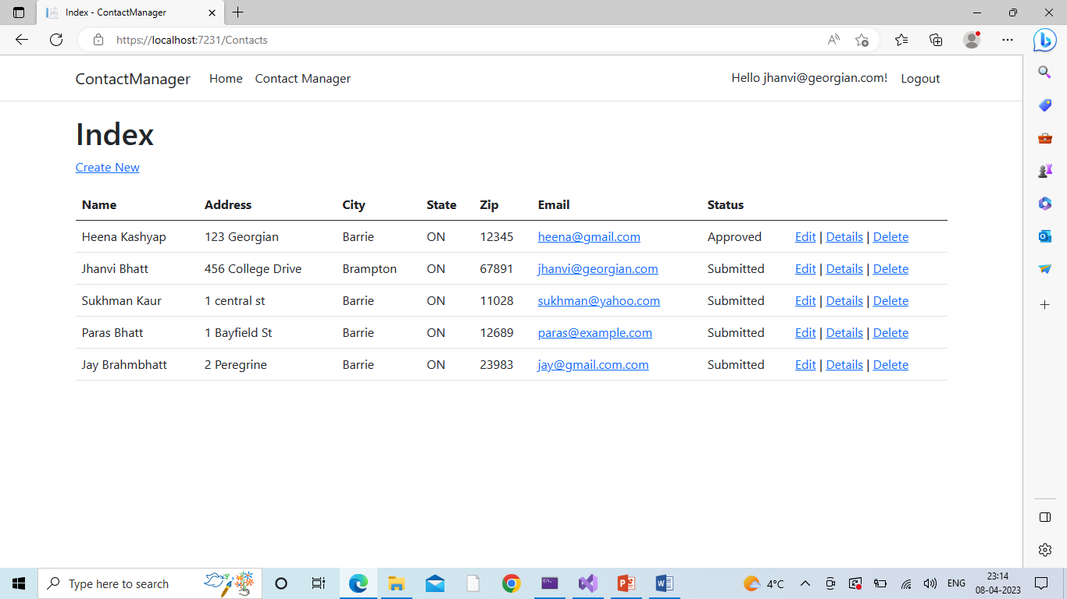
Admin Index Page

Slide 15
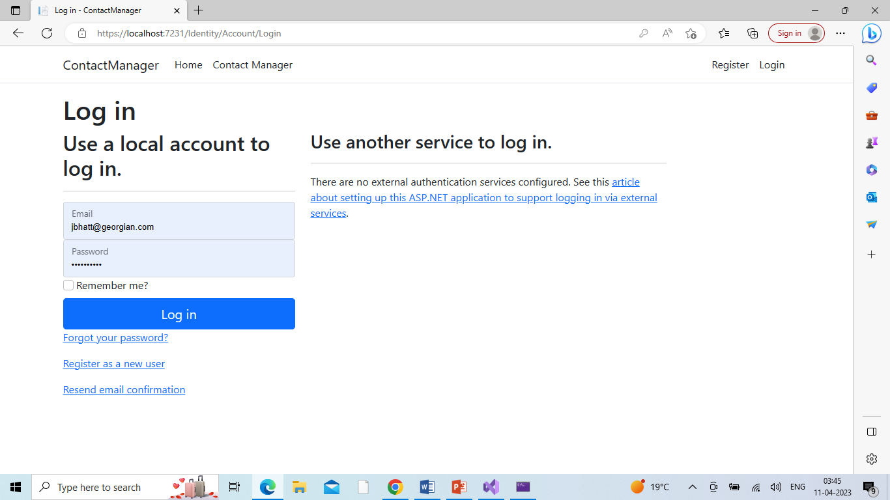
Manager Login

Slide 16
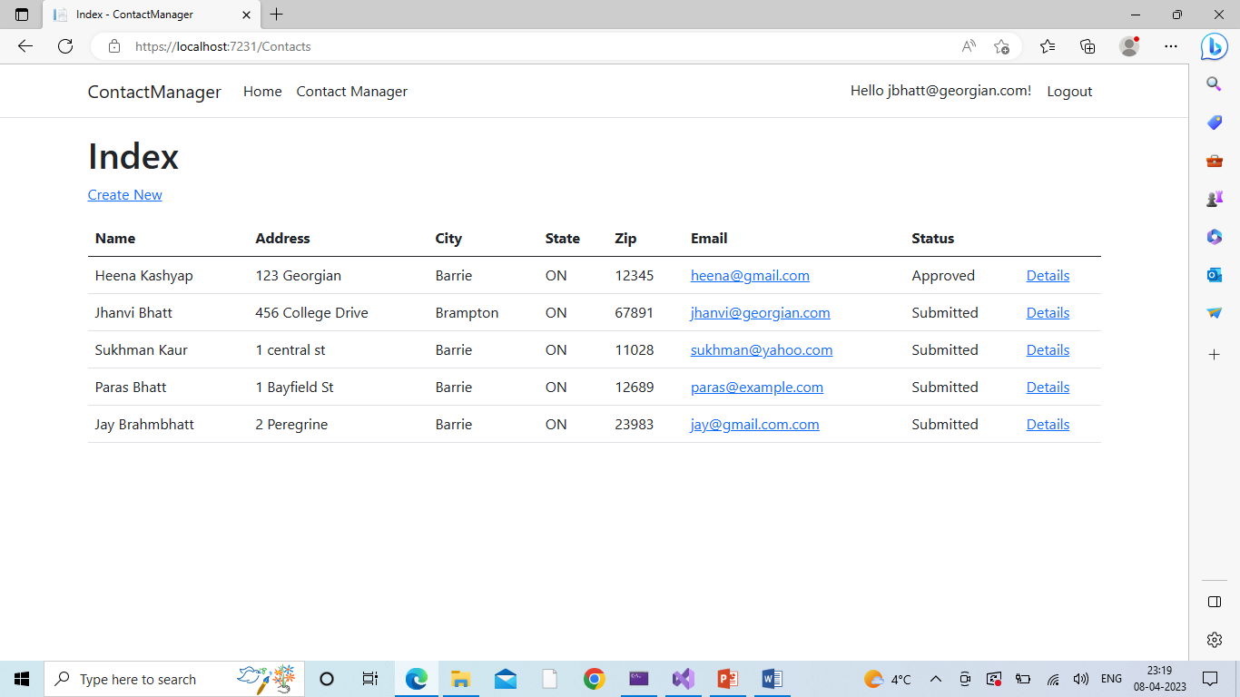
Manager Index Page
before using delete in Admin

Slide 17
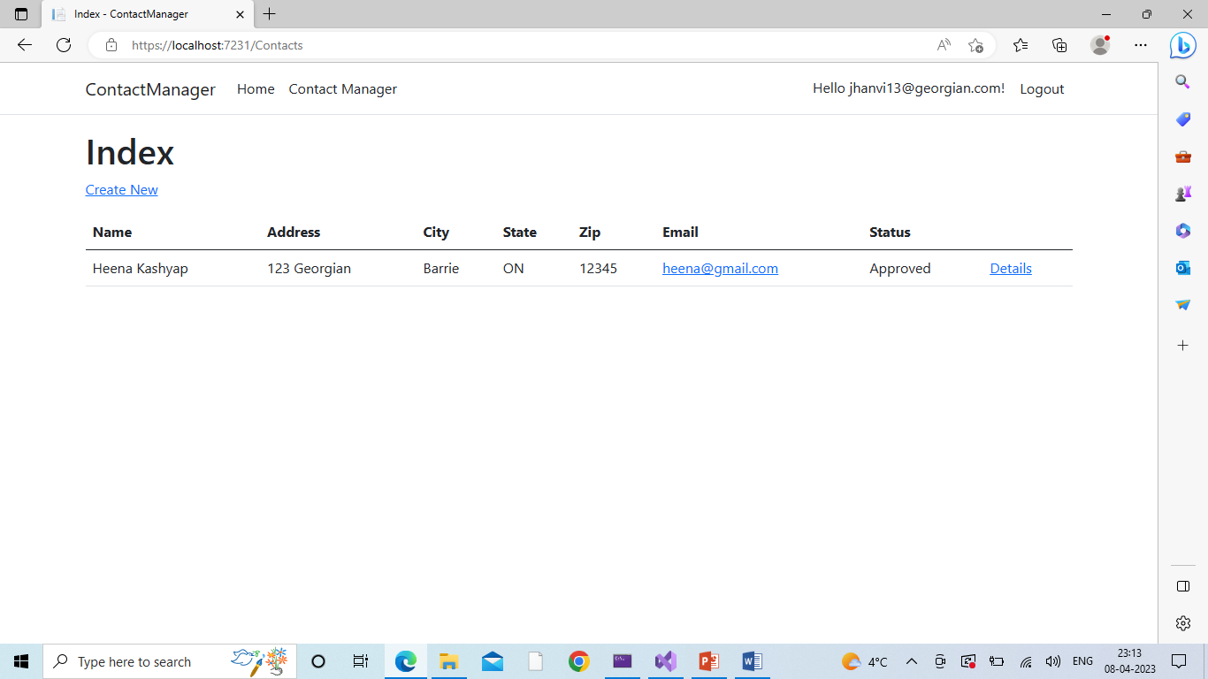
Manager Index
Page after deletion

Slide 18
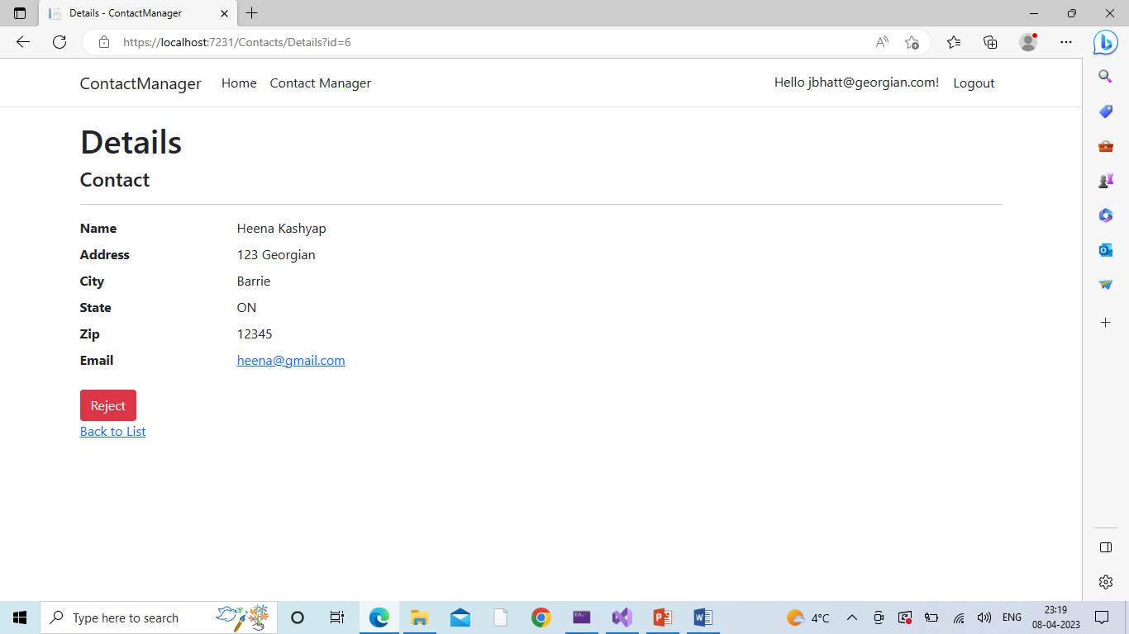
Manager View Of
Approved Contact

Slide 19
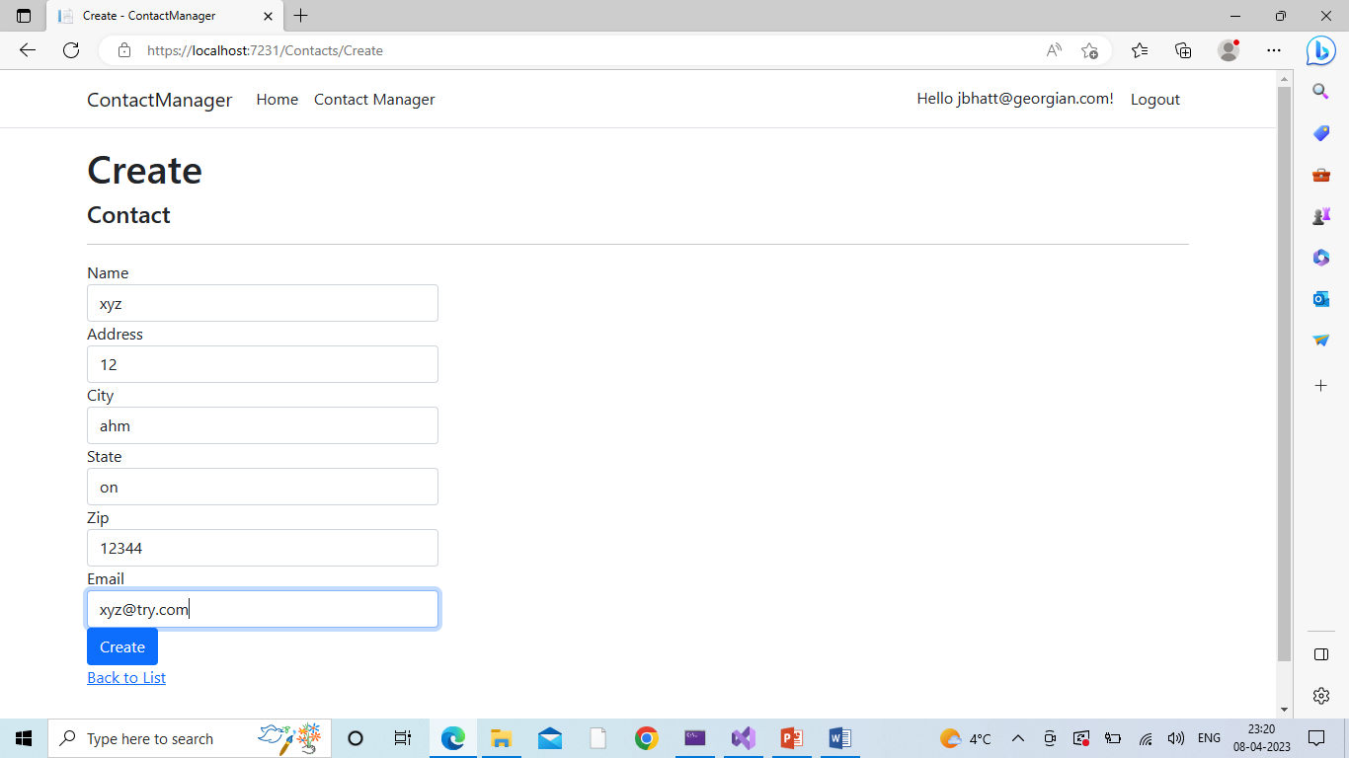
Manager Creating New Contact

Slide 20
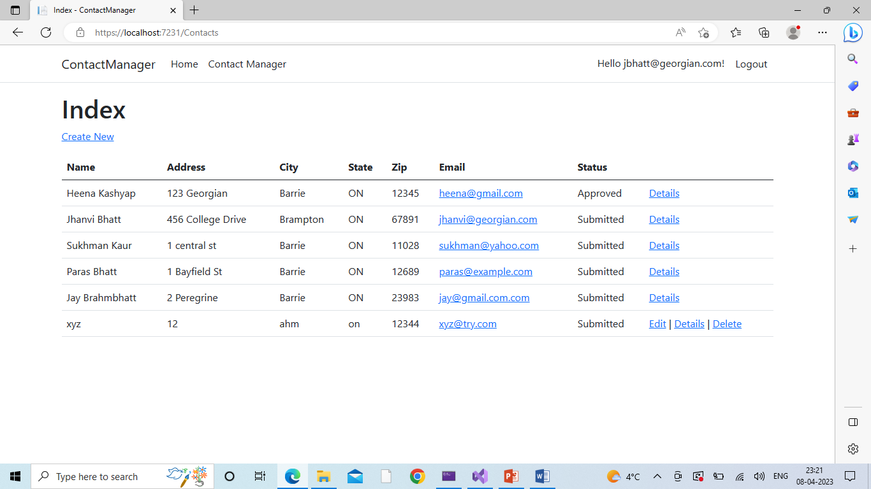
After Adding Contact

Slide 21
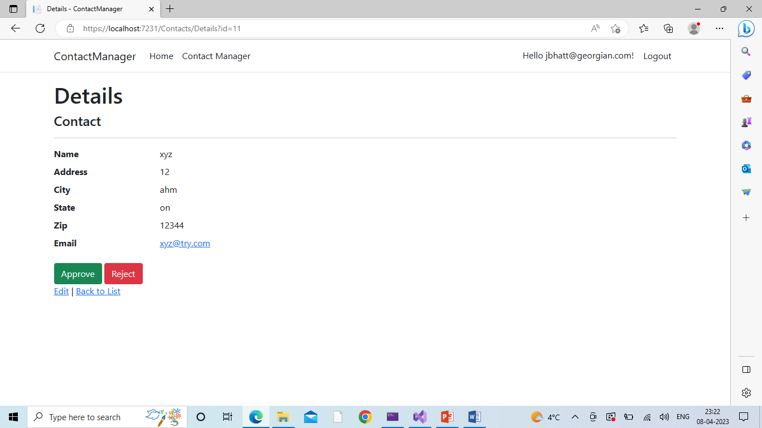
Managers Approve/Reject Page

Slide 22
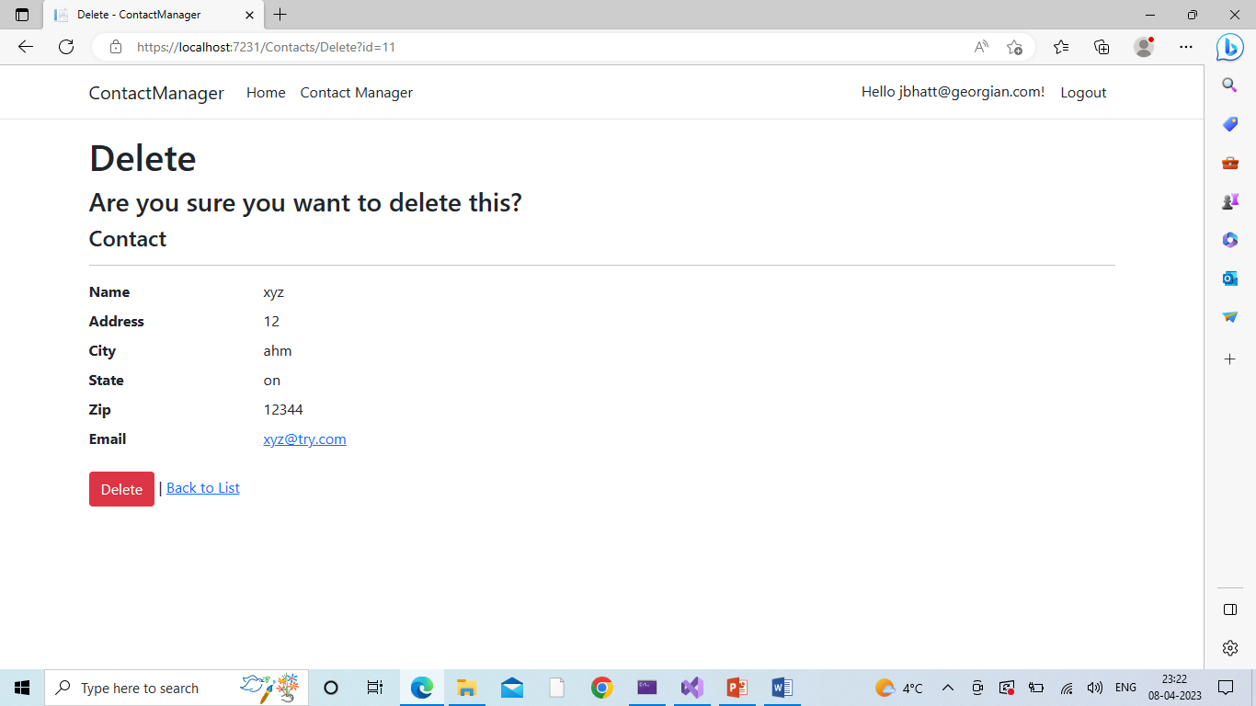
Manager Delete Contact Page

Slide 23

User Login

Slide 24
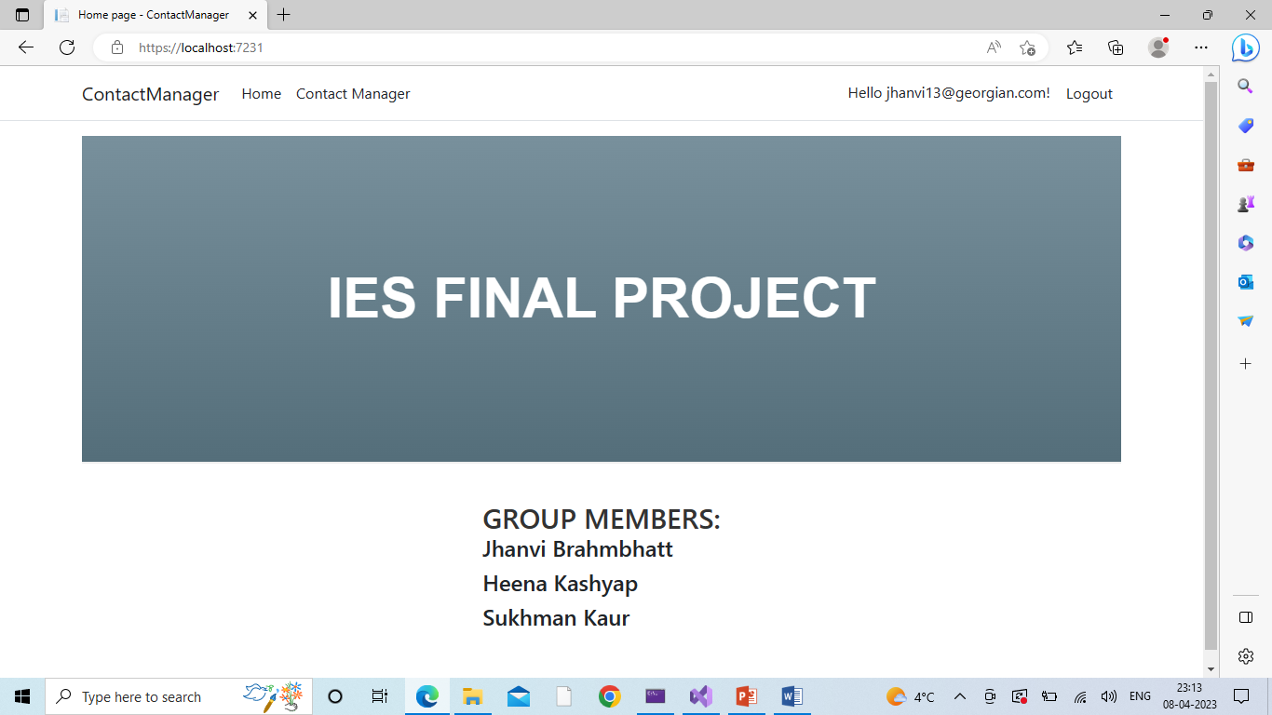
User Home Page

Slide 25

User’s Contact Page

Slide 26
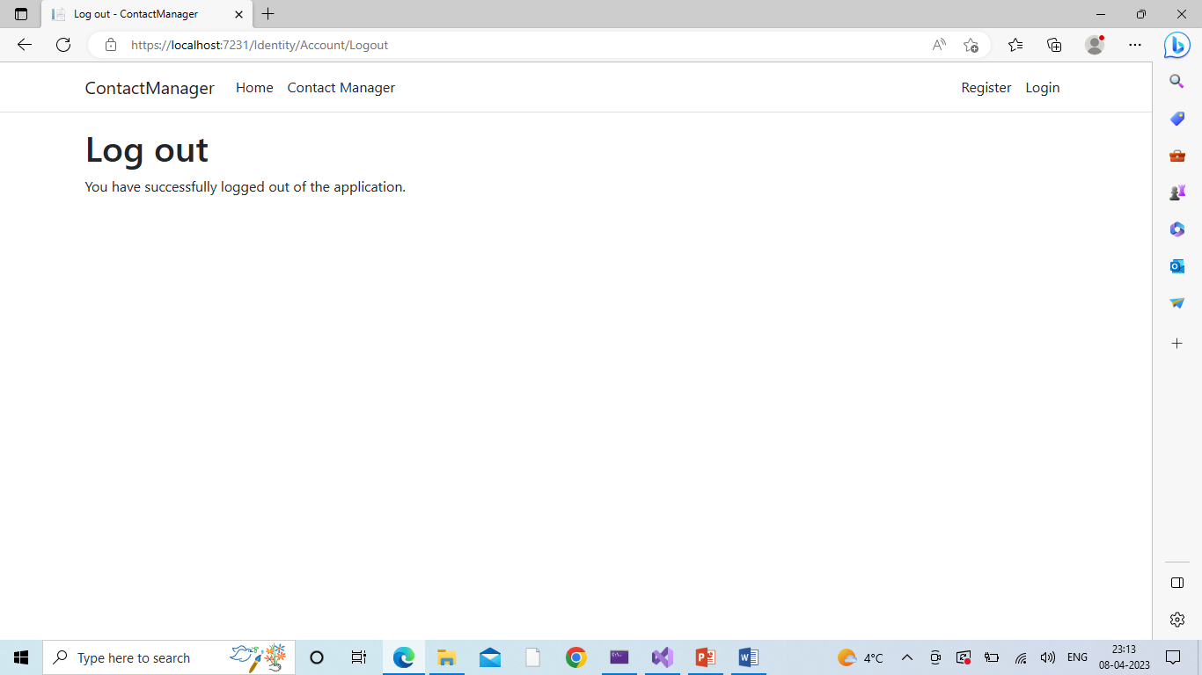
Logout Screen

Slide 27
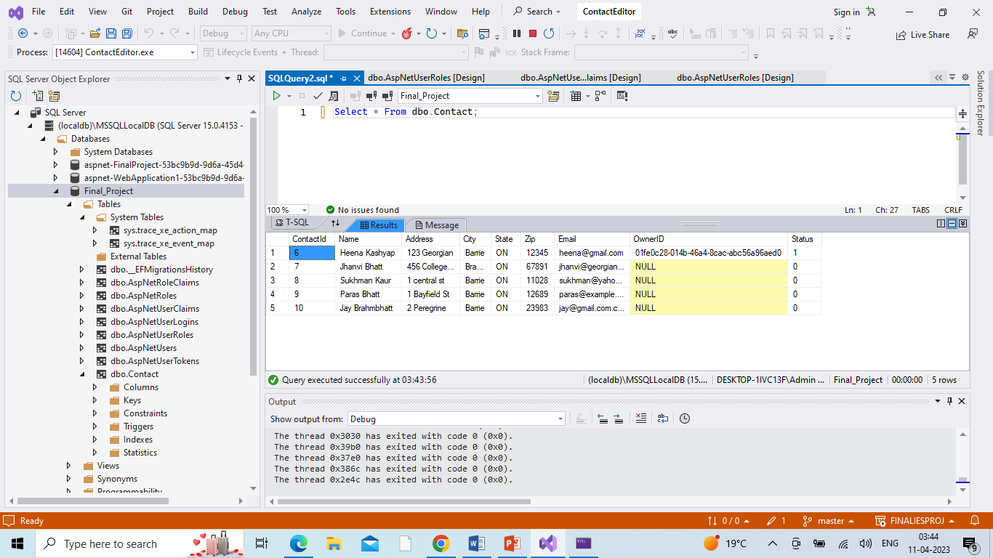
Database Snapshot

Slide 28
Part 2
Security Technologies Recommendation
Q and A Section

Slide 29
1) How can we transfer personal data securely within their network?​
Use encryption: The usage of a private key is the most secure method of data transport. This is a technique that encrypts and decrypts messages using a special algorithm that only you and the recipient are aware of. ​
Implement strong authentication: To confirm the identity of users accessing the network, employ strong authentication techniques such as two-factor authentication (2FA) or multi-factor authentication (MFA). Hence, unauthorized access to private information is reduced.
There are a few ways to transport personal data within their network, but employing encryption and the protocol is the safest option.

Slide 30
2) What security protocol is best for transferring personal files?​
FTP was once the protocol of choice for moving data over networks, however a few new protocols have gained popularity for sharing personal files due to their increased security. ​
Top secure file transfer protocols include SFTP, FTPS, and AS2. Each of these offers stronger encryption than standard FTP, as well as additional safeguards, including keys, passwords, and certificates to authenticate users or connections.
The Internet Engineering Task Force (IETF) created the SFTP protocol, which is currently the most popular file transfer protocol. Secure Shell encryption is used by SFTP to encrypt sent data.

Slide 31
3) Can we encode and encrypt images?​
Similar to how software encrypts words, an image can also be encrypted. By running a sequence of mathematical operations, called an algorithm, on the binary data that comprises an image, encryption software changes the values of the numbers in a predictable way. ​
Images are typically encoded using Base64 formats. Base64 encoding transforms binary data into text format so that it can be properly handled by a user across a communication channel. ​

Slide 32
4) OUR DATABASE CANNOT BE MOVED FROM THE SITE AND WE NEED TO BE ABLE TO ACCESS IT EXTERNALLY USING A SECURE​
​
Using JSON Web Tokens (JWTs) in authenticating and authorizing API clients​
In addition, a secure API architecture should also include monitoring and logging mechanisms to detect and respond to potential security threats.
Finally, regular security audits and updates should be conducted to ensure that the API remains secure and up-to-date with the latest security best practices.

Slide 33
5) Can you recommend a secure framework for coding an API?​
API architecture refers to the technical framework of developing a software interface that exposes backend data and application functionality for use in external applications. An API architecture consists of components for external interfacing, traffic control, runtime execution of business logic, and data access.​
​FastAPI is another safe programming environment for creating Python APIs. With built-in security features including support for OAuth2, JWT tokens, and SSL/TLS encryption, FastAPI is a cutting-edge, high-performance framework.
NancyFX is a quick-to-use and safe framework for C# API development. Support for SSL/TLS encryption is included with Nancy's built-in security capabilities, which also include authentication and permission.

Slide 34
6) What data interchange format should we use while transferring data between locations?​
Depending on the licensor, "Data Exchange Format" refers to a machine-readable data format designed or appropriate for data sharing or redistribution amongst software applications.
The most popular data exchange format for web apps and more is JSON. Data representation uses a format called JSON, or JavaScript Object Notation. ​
For transferring data that contains complex relational structures, the GraphQL format can be a good choice. It allows clients to request only the data they need, reducing the amount of data transferred and improving performance.

Slide 35
7) How should we store our data in our many locations?​
To protect important data from loss or inappropriate disclosure, follow thing should be considered.​
Store encrypted data on all devices​
Store into more than one copy (Depends on data size and budget of an organization. Cloud is the best option)​
Keep the data backup in encrypted form

Slide 36
8) What are the ethical concerns related to the transmission of personal data?​
Freedom from unauthorized access to private data. ​
Inappropriate use of data. ​
Accuracy and completeness when collecting data about a person or persons (corporations included) by technology.​
Availability of data content, and the data subject's legal right to access; ownership.​
Some other concerns:​
  Transparency​
  Accountability​
  Equality​

Slide 37
GitHub Link
https://github.com/Jhanvi13/Group5IES-.git

Slide 38
THANK YOU!

