Slide 1

Green Pace
Security Policy Presentation
Developer: Jonathan Haro

Slide 2

OVERVIEW: DEFENSE IN DEPTH
Defense in Depth (DiD) is an approach to cybersecurity in which a series of defensive mechanisms are layered in order to protect valuable data and information.

Slide 3
THREATS MATRIX
Likely Threats that very likely to happen | Priority Standard with high relevancy
Low priority Standard with low relevancy. | Unlikely Threats that not likely to happen
Secure coding standards come with certain levels of vulnerability to measure the impact of that certain standard.

Slide 4
10 PRINCIPLES
Validate Input Data
Heed Compiler Warnings
Architect & Design for Security Policies
Keep it Simple
Default Deny
Adhere to the Principle of Least Privilege
Sanitize Data Sent to Other Systems
Practice Defense in Depth
Use Effective Quality Assurance Techniques
Adopt a Secure Coding Standard

Slide 5
CODING STANDARDS
Do NOT cast to an out-of-range enumeration value
Use valid references, pointers, and iterator to reference elements of a container
Do NOT attempt to create a string from a null pointer
Do NOT store an already-owned pointer value in an unrelated smart pointer
Properly deallocate dynamically allocated resources
Use a static assertion to test the value of a constant expression
Handle all exceptions thrown before main is executed
Do NOT alternately input and output from a file stream without an intervening position call
Do NOT invoke virtual functions from constructors or destructors
Value returning functions must return a value from all exit paths

Slide 6
ENCRYPTION POLICIES
Encryption in Rest | Keeping customers data safe is of utmost importance. There are a couple ways to accomplish this, such data encryption at rest. Encryption at rest is designed to prevent the attacker from accessing the unencrypted data by ensuring the data is encrypted when on disk. If an attacker obtains a hard drive with encrypted data but not the encryption keys, the attacker must defeat the encryption to read the data.
Encryption at Flight | In addition to the encryption at rest, data often needs to be accessed over the network. When the data sits on the disk the data remains encrypted, however, once it is in transmission it becomes vulnerable. To mitigate this vulnerability the data can also be encrypted in transit which protects your data if communications are intercepted while data moves between your site and the cloud provider or between two services. This protection is achieved by encrypting the data before transmission; authenticating the endpoints; and decrypting and verifying the data on arrival.
Encryption in Use | As mentioned, protecting customer data is of utmost importance. While encrypting data at rest and in transit does help it does not fully protect the data. This is because to interact with the data it first must decrypted which again leaves data vulnerable. However, through the use of Homomorphic Encryption that data can be used without having being decrypted.

Slide 7
TRIPLE-A POLICIES
Authentication | Authentication is the process where the user’s identity is confirmed. It essentially confirms the question, are you who you say you are? This is done through methods such login and password authentication and multi factor authentication.
Authorization | Authorization refers to the level of access a user has once the user has been authenticated. When speaking in terms of database, authorization would determine if the user has read, edit, create, and delete access. Once recommended approach to authorization is to implement role-based authorization. This allows us to grant access via a role instead of individual assignments which are often hard to maintain.
Accounting | Accounting refers to the audit of the system. System security should be reviewed and monitored at a regular cadence. Doing so help will help uncover suspicious and malicious activity.

Slide 8
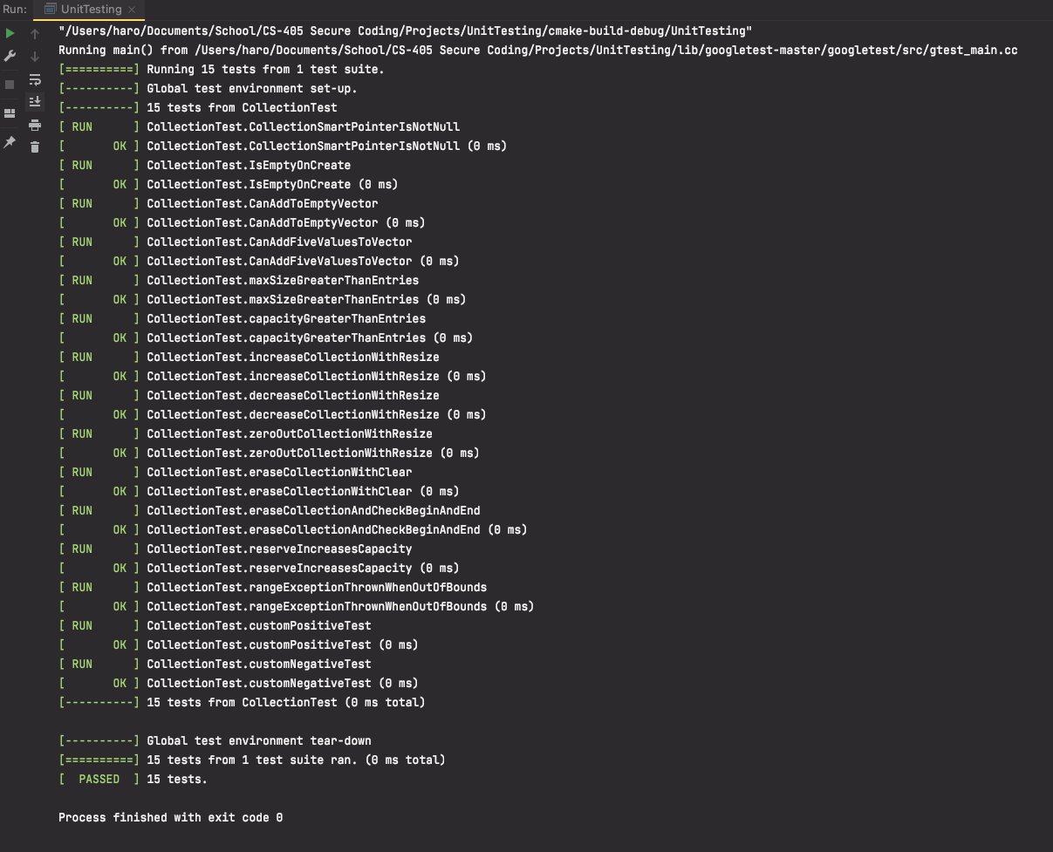
Unit Testing

Slide 9

AUTOMATION SUMMARY

Slide 10
TOOLS
DevSecOps - is development security operations. Its mantra is to make everyone accountable for security with the objective of implementing security decisions and actions at the same scale and speed as development and operations decisions and actions.
The DevSecOps pipeline is an automated iterative process through out the lifecycle of an application. It entails leveraging automation tools at different points of the development lifecycle.
Here at Green Pace, we leverage a multitude of tools with each one serving a specific purpose. For writing code, we use linters such as PMD, this tool helps detects vulnerabilities as the code. For the build process we use tools such as SonarQube, this tool will scan the code and scan dependencies in our application. For the release we use tools such as terraform and ansible, this allows us to convert our configuration to reusable templates. Lasty, for motoring we use tools such as firewalls, and log collectors such as Sentry and DataDog.

Slide 11
RISKS AND BENEFITS
When implementing security there are always some trade offs, it is more than likely that vulnerabilities will be introduced, nothing can be 100% secure.
It is better to assume that there will be vulnerabilities in the system and that there will be individuals looking to exploit them. Therefore, having the correct infrastructure and security process is crucial to detecting and resolving these vulnerabilities.

Slide 12
RECOMMENDATIONS
Security is a constant iterative process, hackers are constantly finding new vulnerabilities and exploiting them. It is important to keep up with new security threats and trends.
More automation, security can be hard to implement and maintain, leveraging automated tools can help facilitate the process.

Slide 13
CONCLUSIONS
Security is not fool proof it requires constant monitoring and maintenance. Following best practices and current security trends can helpful with combating new and existing vulnerabilities.
Use automation when ever possible they can help with repetitive task that are time consuming and error prone.
Leverage security tools when possible. Linters, deploy managers, penetration tools and system logs are few types of tools that can help uncover vulnerabilities.
Layered approach. There are trades off when implementing security, however, by implementing a layered approach you increase the level of effort a hackers needs to apply and if one layer fails there are multiple backups in its place.

Slide 14
REFERENCES
What is DevSecOps?. Forcepoint. (2021). Retrieved from https://www.forcepoint.com/cyber-edu/devsecops.
SEI CERT C Coding Standard - SEI CERT C Coding Standard - Confluence. (2021). Retrieved August 2021, from https://wiki.sei.cmu.edu/confluence/display/c/SEI+CERT+C+Coding+Standard
What is Defense in Depth?. (2021). Retrieved August 2021, from https://www.forcepoint.com/cyber-edu/defense-depth

