Slide 1

Bakeoff 1
Processing App

Slide 2
Initial Ideas
Test scaffold code to establish a comparison for changes to the original code.
Add flashing block for easier recognition of the target block.
Reduce cursor size in addition to the flashing target blocks.
Add a mouseover function to change block color when on target in addition to the flashing target blocks.
Add an auto return to cursor to focus cursor back to center on each click.

Slide 3
Scaffold Code Baseline
Scaffold Code Test Run |  | Hits | Misses | Accuracy | Total Time Taken | Average Time for Each Button | Avg Time + Penalty
1 |  | 16 | 0 | 100.00% | 14.300 | 0.894 | 0.894
2 |  | 13 | 3 | 81.25% | 13.225 | 0.827 | 3.577
3 |  | 14 | 2 | 87.50% | 12.185 | 0.762 | 2.262
4 |  | 16 | 0 | 100.00% | 13.050 | 0.816 | 0.816
5 |  | 14 | 2 | 87.50% | 12.834 | 0.802 | 2.302
6 |  | 15 | 1 | 93.75% | 12.652 | 0.791 | 1.041
7 |  | 16 | 0 | 100.00% | 14.966 | 0.935 | 0.935
8 |  | 12 | 4 | 75.00% | 11.564 | 0.723 | 4.723
9 |  | 14 | 2 | 87.50% | 12.334 | 0.771 | 2.271
10 |  | 16 | 0 | 100.00% | 12.623 | 0.789 | 0.789
Average Test Run |  | 14.6 | 1.4 | 91.25% | 12.973 | 0.811 | 1.961

Slide 4
1st Prototypes
This code was added to make the target block flash.
if (trials.get(trialNum) == i) // see if current button is the target {
fill(millis() % 255); // if so, fill with flashing light -- changes based on milliseconds passed

Slide 5
1st Testing Testing involved multiple runs of code the averaging the results
Flash Code Test Run |  | Hits | Misses | Accuracy | Total Time Taken | Average Time for Each Button | Avg Time + Penalty
1 |  | 16 | 0 | 100.00% | 12.550 | 0.784 | 0.784
2 |  | 12 | 4 | 75.00% | 13.415 | 0.838 | 4.838
3 |  | 14 | 2 | 87.50% | 11.502 | 0.719 | 2.219
4 |  | 15 | 1 | 93.75% | 12.786 | 0.799 | 1.049
5 |  | 15 | 1 | 93.75% | 11.401 | 0.713 | 0.963
6 |  | 15 | 1 | 93.75% | 11.953 | 0.747 | 0.997
7 |  | 12 | 4 | 75.00% | 10.500 | 0.656 | 4.656
8 |  | 13 | 3 | 81.25% | 10.377 | 0.649 | 3.399
9 |  | 15 | 1 | 93.75% | 11.502 | 0.719 | 0.969
10 |  | 14 | 2 | 87.50% | 11.051 | 0.691 | 2.191
Average Test Run |  | 14.1 | 1.9 | 88.13% | 11.704 | 0.732 | 2.207

Slide 6
1st Refinement
The flashing worked as anticipated and made it easier to notice the new target. We refined by changing the flashing color to be more pronounced. We decided this would be our new baseline.

Slide 7
2nd Prototypes
While running each test it appeared the cursor size effected the hit to miss ratio. If the cursor was not fully on target a miss registered. We reduced the size of the cursor by half to 20px.
ellipse(mouseX, mouseY, 20, 20); //draw user cursor as a circle with a diameter of 20

Slide 8
2nd Testing Testing involved multiple runs of code the averaging the results
Cursor Code Test Run |  | Hits | Misses | Accuracy | Total Time Taken | Average Time for Each Button | Avg Time + Penalty
1 |  | 12 | 4 | 75.00% | 13.152 | 0.822 | 4.822
2 |  | 14 | 2 | 87.50% | 15.918 | 0.995 | 2.495
3 |  | 16 | 0 | 100.00% | 13.633 | 0.852 | 0.852
4 |  | 15 | 1 | 93.75% | 13.150 | 0.822 | 1.072
5 |  | 13 | 3 | 81.25% | 12.251 | 0.766 | 3.516
6 |  | 15 | 1 | 93.75% | 14.821 | 0.962 | 1.176
7 |  | 15 | 1 | 93.75% | 13.402 | 0.838 | 1.088
8 |  | 15 | 1 | 93.75% | 13.985 | 0.874 | 1.124
9 |  | 15 | 1 | 93.75% | 14.235 | 0.890 | 1.140
10 |  | 11 | 5 | 68.75% | 15.716 | 0.982 | 0.982
Average Test Run |  | 14.1 | 1.9 | 88.13% | 14.026 | 0.880 | 1.827

Slide 9
Refinement & Final Prototype
In the final prototype we kept the flashing target. The small cursor size was kept even though the results of testing showed only moderate improvement. In addition, a mouseOver function was created to highlight the target with a solid color change when the cursor was fully over the target.
if(mouseOver(bounds)==true) // if cursor is in range of target turn rectangle green
{
fill(0,255,0);
}
boolean mouseOver(Rectangle bounds)//check to see if cursor is in bounds then change color to green
{
return ((mouseX > bounds.x && mouseX < bounds.x + bounds.width) && (mouseY > bounds.y && mouseY < bounds.y + bounds.height)); // test to see if hit was within bounds
}

Slide 10
Final Prototype Test
MouseOver Code Test Run |  | Hits | Misses | Accuracy | Total Time Taken | Average Time for Each Button | Avg Time + Penalty
1 |  | 15 | 1 | 93.75% | 12.350 | 0.772 | 1.022
2 |  | 16 | 0 | 100.00% | 12.768 | 0.789 | 0.789
3 |  | 16 | 0 | 100.00% | 12.166 | 0.760 | 0.760
4 |  | 13 | 3 | 81.25% | 12.423 | 0.776 | 3.526
5 |  | 15 | 1 | 93.75% | 13.616 | 0.851 | 1.101
6 |  | 14 | 2 | 87.50% | 13.135 | 0.821 | 2.321
7 |  | 16 | 0 | 100.00% | 13.034 | 0.815 | 0.815
8 |  | 15 | 1 | 93.75% | 13.017 | 0.814 | 1.064
9 |  | 15 | 1 | 93.75% | 13.098 | 0.819 | 1.069
10 |  | 15 | 1 | 93.75% | 12.362 | 0.773 | 1.023
Average Test Run |  | 15 | 1 | 93.75% | 12.797 | 0.799 | 1.349

Slide 11
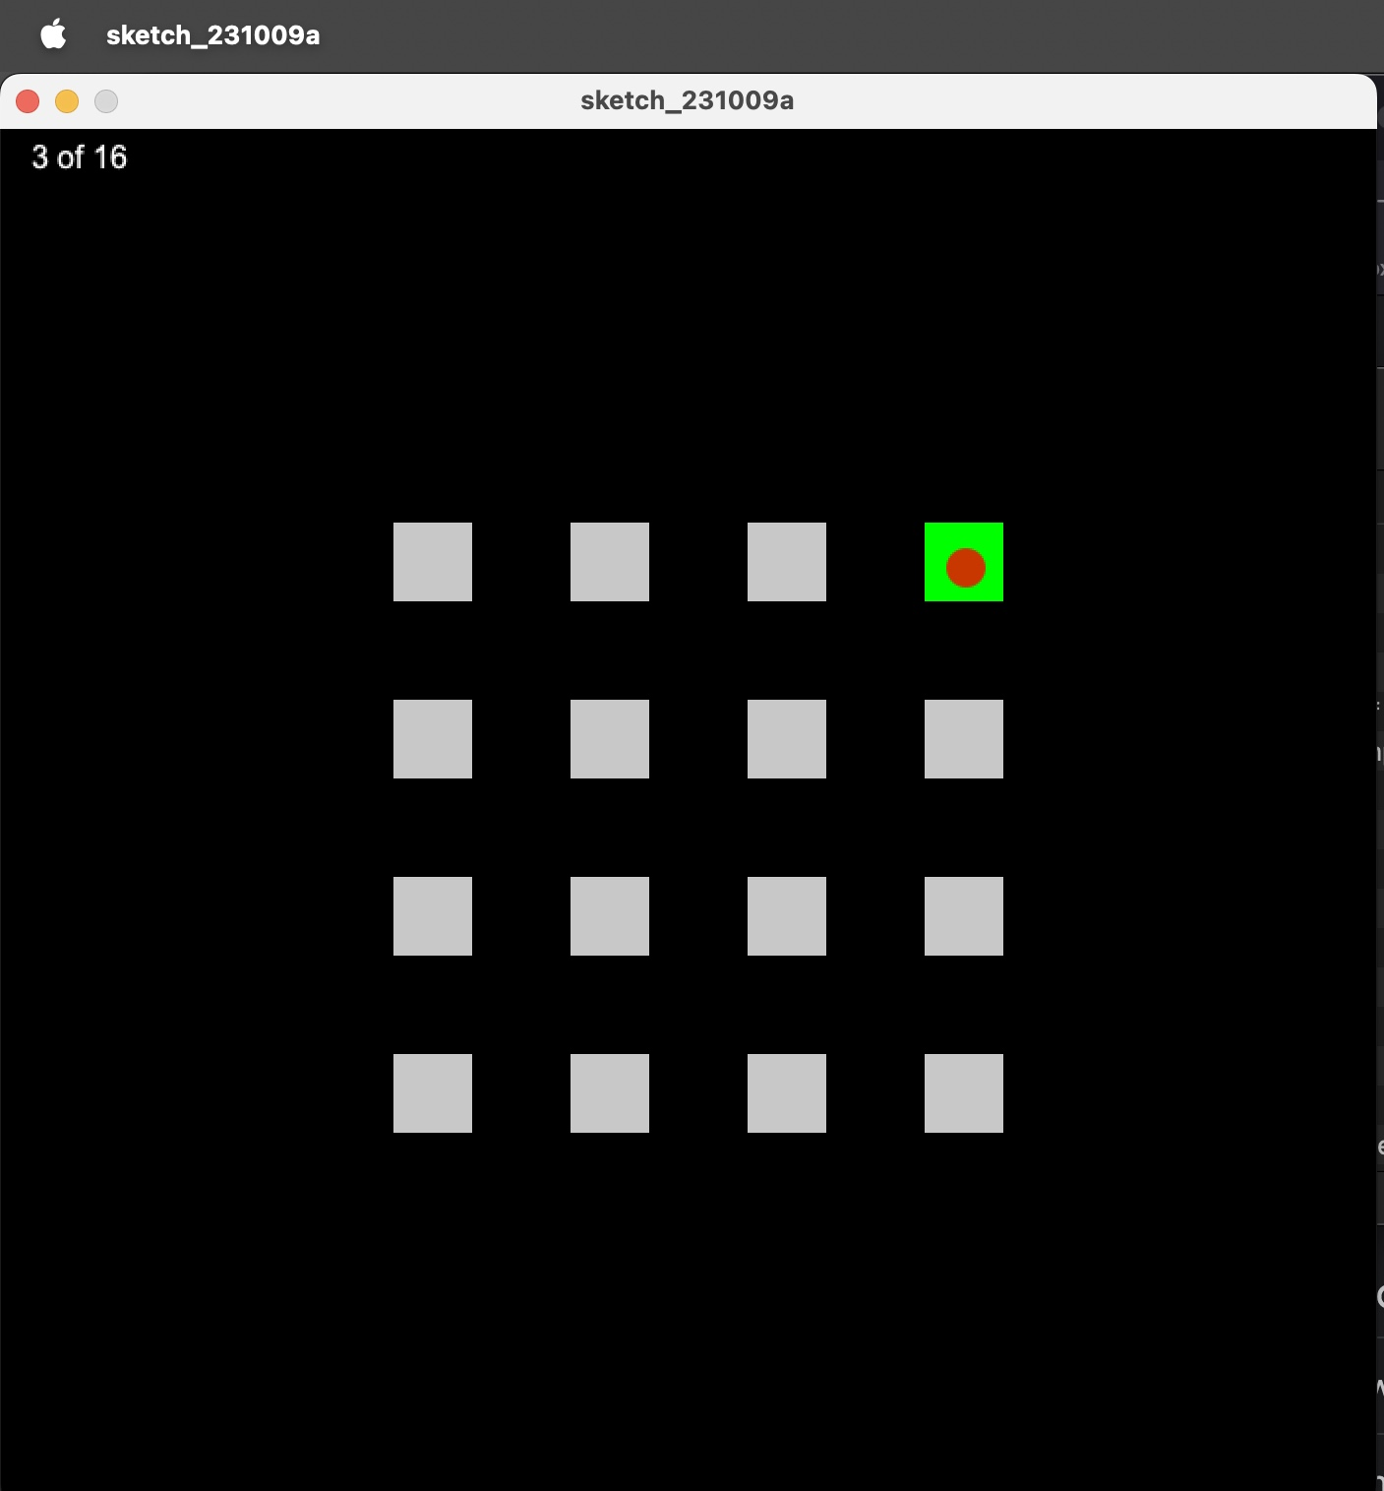
Final Result
The combination of all three changes did show the best improvement during testing. The changes to the final code included a flashing target to increase recognition, a smaller cursor to refine the hit likelihood, and a mouseOver f(x) that turned the target to green if the target is fully engaged.
Improvements in accuracy, total hits, and total time(penalty).

