Slide 1
GUI Programming in
Python

Slide 2
Introduction:
A graphical user interface is an application that has buttons, windows, and lots of other widgets that the user can use to interact with your application.
A good example would be a web browser. It has buttons, tabs,
and a main window where all the content loads.
In GUI programming, a top-level root windowing object contains all of the little windowing objects that will be part of your complete GUI application.
These windowing objects can be text labels, buttons, list boxes, etc.These individual little GUI components are known as
widgets.

Slide 3
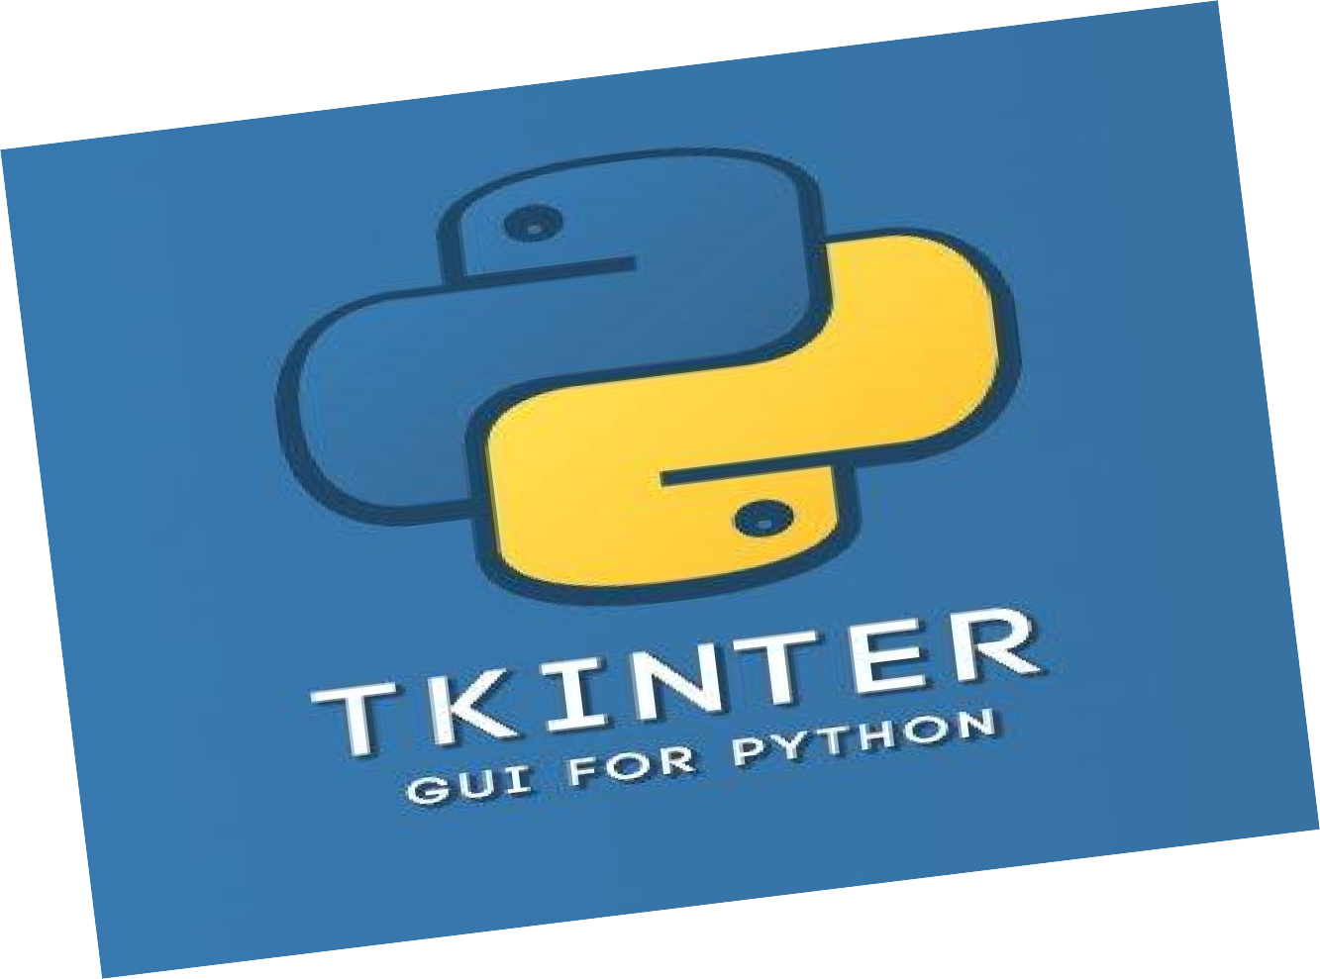
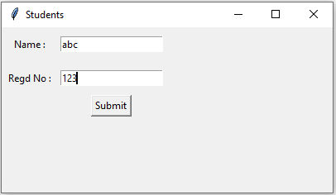
Python offers multiple options for developing GUI (Graphical User Interface). The most commonly used GUI method is tkinter.
Tkinter is the easiest among all to get started with. It is Python's standard GUI (Graphical User Interface) package. It is the most commonly used toolkit for GUI Programming in Python
since Tkinter is the Python interface to Tk (Tea Kay), it can be
pronounced as Tea-Kay-inter. i.e tkinter = t k inter.

Slide 4
tkinter - GUI for Python:
Python provides the standard library tkinter for creating the
graphical user interface for desktop based applications.
Developing desktop based applications with tkinter is not a complex task.
A Tkinter window application can be created by using the following steps.
Import the tkinter module.
Create the main application window.
Add the widgets like labels, buttons, frames, etc. to the window.
Call the main event loop so that the actions can take place on the
user's computer screen.

Slide 5
Importing tkinter is same as importing any other module in the python code. Note that the name of the module in Python 2.x is ‘Tkinter’ and in Python 3.x is ‘tkinter’.
import tkinter (or) from tkinter import *
After importing tkinter module we need to create a main window, tkinter offers a method ‘Tk()’ to create main window. The basic code used to create the main window of the application is:
top = tkinter.Tk() (or) top=Tk()
After creating main window, we need to add components or
widgets like labels, buttons, frames, etc.
After adding widgets to main window, we need to run the application, tkinter offers a method ‘mainloop()’ to run application. The basic code used to run the application is:
top.mainloop ()

Slide 6
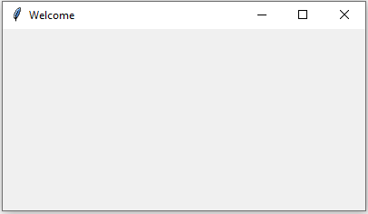
Example:
tkndemo.py
import tkinter
top = tkinter.Tk() top.title("Welcome")
#creating the application main window. #title of main window
top.geometry("400x300") top.mainloop()
Output:
>>> python tkndemo.py
#size of main window #calling the event main loop
Title of window
Main Window (400x300)

Slide 7
tkinter also offers access to the geometric configuration of the widgets which can organize the widgets in the parent windows.
Tkinter provides the following geometry methods 1. pack () method:
The pack() method is used to organize components or widgets in
main window.
Syntax:
widget.pack (options)
The possible options are
side: it represents the side to which the widget is to be placed on the window. Side may be LEFT or RIGHT or TOP(default) or BOTTOM.

Slide 8
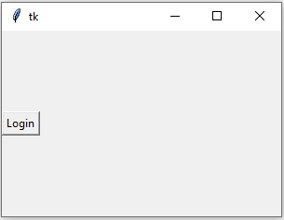
Example: tknpack.py
from tkinter import *
top = Tk() top.geometry("300x200")
btn1 = Button(top, text = "Login") btn1.pack( side = LEFT)
top.mainloop()
Output:
>>> python tknpack.py

Slide 9
2. grid() method:
The grid() method organizes the widgets in the tabular form. We can specify the rows and columns as the options in the method call.
This is a more organized way to place the widgets to the python application.
Syntax:
widget.grid (options)
The possible options are
Column
The column number in which the widget is to be placed. The
leftmost column is represented by 0.
padx, pady
It represents the number of pixels to pad the widget outside the widget's border.
row
The row number in which the widget is to be placed. The topmost row is represented by 0.

Slide 10
Example: tkngrid.py from tkinter import * parent = Tk() parent.title("Students")
parent.geometry("300x200")
name = Label(parent,text = "Name : ") name.grid(row = 0, column = 0,pady=10,padx=5) e1 = Entry(parent)
e1.grid(row = 0, column = 1)
regno = Label(parent,text = "Regd No : ") regno.grid(row = 1, column = 0,pady=10,padx=5) e2 = Entry(parent)
e2.grid(row = 1, column = 1)
btn = Button(parent, text = "Submit") btn.grid(row = 3, column = 1) parent.mainloop()
Output:
>>>python tkngrid.py

Slide 11
3. place() method:
The place() method organizes the widgets to the specific x and
y coordinates.
Syntax:
widget.place(x,y)
x, y: It refers to the horizontal and vertical offset in the pixels.

Slide 12
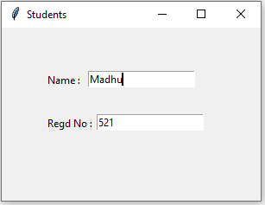
Example: tknplace.py from tkinter import * parent = Tk() parent.title("Students")
parent.geometry("300x200")
name = Label(parent,text = "Name : ")
name.place(x=50,y=50) e1 = Entry(parent) e1.place(x=100,y=50)
regno = Label(parent,text = "Regd No : ")
regno.place(x=50,y=100) e2 = Entry(parent) e2.place(x=110,y=100) parent.mainloop() Output:
>>>python tknplace.py

Slide 13
Tkinter widgets or components:
Tkinter supports various widgets or components to build GUI
application in python.
Widget | Description
Button | Creates various buttons in Python Application.
Checkbutton | Select one or more options from multiple options.(Checkbox)
Entry | Allows the user to enter single line of text(Textbox)
Frame | Acts like a container which can be used to hold the other widgets
Label | Used to display non editable text on window
Listbox | Display the list items, The user can choose one or more items.
Radiobutton | Select one option from multiple options.
Text | Allows the user to enter single or multiple line of text(Textarea)
Scale | Creates the graphical slider, the user can slide through the range of values
Toplevel | Used to create and display the top-level windows(Open a new window)

Slide 14
Button Widget in Tkinter:
The Button is used to add various kinds of buttons to the python application. We can also associate a method or function with a button which is called when the button is pressed.
Syntax: name = Button(parent, options)
The options are
activebackground:It represents the background of the button when it is
active.
activeforeground:It represents the font color of the button when it is active..
bd: It represents the border width in pixels.
bg: It represents the background color of the button.
command:It is set to the function call which is scheduled when the function is called.
text: It is set to the text displayed on the button.
fg: Foreground color of the button.
height:The height of the button.
padx:Additional padding to the button in the horizontal direction.
pady:Additional padding to the button in the vertical direction.
width:The width of the button.

Slide 15
Example: btndemo1.py
from tkinter import *
from tkinter import messagebox top = Tk() top.geometry("300x200")
def fun():
messagebox.showinfo("Hello", "Blue Button clicked")
btn1 = Button(top, text = "Red",bg="red",fg="white",width=10)
btn1.pack( side = LEFT)
btn2 = Button(top, text = "Green",bg="green",fg="white",width=10,height=5, activebackground="yellow")
btn2.pack( side = TOP)
btn3 = Button(top, text ="Blue",bg="blue",fg="white",padx=10,pady=10, command=fun)
btn3.pack( side = BOTTOM) top.mainloop()

Slide 16
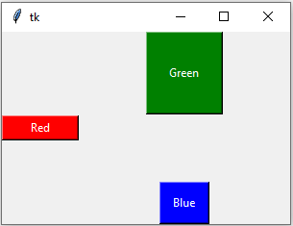
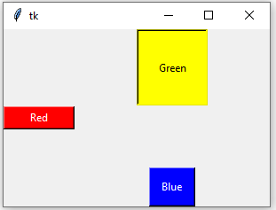
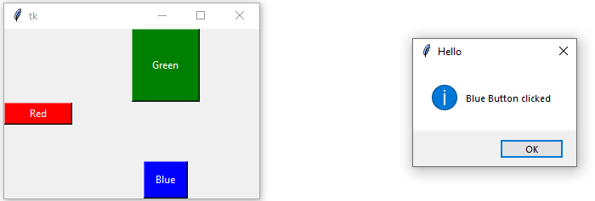
Output:
>>>python btndemo1.py

Slide 17
Checkbutton Widget in Tkinter:
The Checkbutton is used to display the CheckButton on the window. The Checkbutton is mostly used to provide many choices to the user among which, the user needs to choose the one. It generally implements many of many selections.
Syntax: name = Checkbutton(parent, options)
The options are
activebackground:It represents the background of the Checkbutton when it is active.
activeforeground:It represents the font color of the Checkbutton when when it is active.
bd: It represents the border width in pixels.
bg: It represents the background color of the Checkbutton.
command: It is set to the function call which is scheduled when the function is
called.
text: It is set to the text displayed on the Checkbutton.
fg: Foreground color of the Checkbutton.
height: The height of the Checkbutton.
padx: Additional padding to the Checkbutton in the horizontal direction.
pady: Additional padding to the Checkbutton in the vertical direction.
width: The width of the Checkbutton.

Slide 18
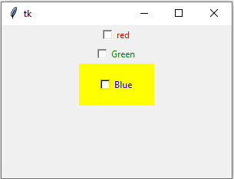
Example: chbtndemo.py
from tkinter import * top = Tk()
top.geometry("300x200")
cbtn1 = Checkbutton(top, text="red",fg="red") cbtn1.pack()
cbtn2 = Checkbutton(top, text="Green",fg="green",activebackground="orange") cbtn2.pack()
cbtn3 = Checkbutton(top, text="Blue",fg="blue",bg="yellow",width=10,height=3) cbtn3.pack()
top.mainloop()
Output:
>>>python chbtndemo.py

Slide 19
Entry Widget in Tkinter:
The Entry widget is used to provide the single line text-box to the user to accept a value from the user. We can use the Entry widget to accept the text strings from the user.
Syntax: name = Entry(parent, options)
The options are
bd: It represents the border width in pixels.
bg: It represents the background color of the Entry.
show: It is used to show the entry text of some other type instead of the
string. For example, the password is typed using stars (*).
fg: Foreground color of the Entry.
width: The width of the Entry.

Slide 20
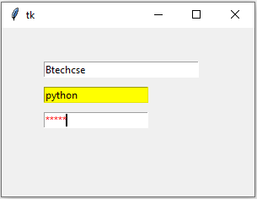
Example: entrydemo.py
from tkinter import * top = Tk()
top.geometry("300x200") enty0 = Entry(top,width="30") enty0.place(x=50,y=40)
enty1 = Entry(top,bg="yellow") enty1.place(x=50,y=70)
enty2 = Entry(top,fg="red",show="*") enty2.place(x=50,y=100) top.mainloop()
Output:
>>>python entrydemo.py

Slide 21
Frame Widget in Tkinter:
Frame widget is used to organize the group of widgets. It acts like a container which can be used to hold the other widgets. The rectangular areas of the screen are used to organize the widgets to the python application.
Syntax: name = Frame(parent, options)
The options are
bd: It represents the border width in pixels.
bg: It represents the background color of the frame.
width: The width of the frame.
height: The height of the frame.

Slide 22
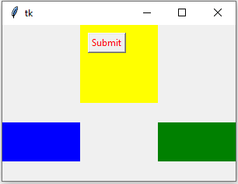
Example: framedemo.py
from tkinter import * top = Tk()
top.geometry("300x200")
tframe = Frame(top,width="100",height="100",bg="yellow") tframe.pack()
lframe = Frame(top,width="100",height="50",bg="blue")
lframe.pack(side = LEFT)
rframe = Frame(top,width="100",height="50",bg="green") rframe.pack(side = RIGHT)
btn1 = Button(tframe, text="Submit", fg="red")
btn1.place(x=10,y=10) top.mainloop() Output:
>>>python framedemo.py

Slide 23
Label Widget in Tkinter:
The Label is used to specify the container box where we can place
the text or images.
Syntax: name = Label(parent, options)
The options are
bd: It represents the border width in pixels.
bg: It represents the background color of the label.
text: It is set to the text displayed on the label.
fg: Foreground color of the label.
height:
image:
padx:
pady:
width:
The height of the label.
It is set to the image displayed on the label.
Additional padding to the label in the horizontal direction.
Additional padding to the label in the vertical direction.
The width of the label.

Slide 24
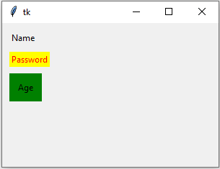
Example: labeldemo.py
from tkinter import * top = Tk()
top.geometry("300x200")
lbl1 = Label(top, text="Name") lbl1.place(x=10,y=10)
lbl2 = Label(top, text="Password", fg="red",bg="yellow") lbl2.place(x=10,y=40)
lbl3 = Label(top, text="Age", padx=10,pady=10,bg="green") lbl3.place(x=10,y=70)
top.mainloop()
Output:
>>>python labeldemo.py

Slide 25
Listbox Widget in Tkinter:
The Listbox widget is used to display the list items to the user. We can place only text items in the Listbox. The user can choose one or more items from the list.
Syntax: name = Listbox(parent, options)
The options are
bd: It represents the border width in pixels.
bg: It represents the background color of the listbox.
fg: Foreground color of the listbox.
width: The width of the listbox.
height: The height of the listbox.
The following method is associated with the Listbox to insert list item to listbox at
specified index.i.e, insert ().
Syntax:
Listbox.insert (index, item)

Slide 26
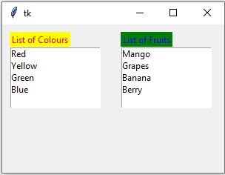
Example: listboxdemo.py
from tkinter import *
top = Tk()
top.geometry("300x200")
lbl1 = Label(top, text="List of Colours",fg="red",bg="yellow") lbl1.place(x=10,y=10)
lb = Listbox(top,height=5)
lb.insert(1,"Red") lb.insert(2, "Yellow") lb.insert(3, "Green") lb.insert(4, "Blue") lb.place(x=10,y=30)
lbl2 = Label(top, text="List of Fruits",fg="blue",bg="green")
lbl2.place(x=160,y=10)
lb1 = Listbox(top,height=5) lb1.insert(1,"Mango") lb1.insert(2, "Grapes") lb1.insert(3, "Banana") lb1.insert(4, "Berry") lb1.place(x=160,y=30) top.mainloop()
Output:
>>>python listboxdemo.py

Slide 27
Radiobutton Widget in Tkinter:
The Radiobutton widget is used to select one option among multiple options. The Radiobutton is different from a checkbutton. Here, the user is provided with various options and the user can select only one option among them.
Syntax: name = Radiobutton(parent, options)
The options are
activebackground:It represents the background of the Radiobutton when it is active.
activeforeground:It represents the font color of the Radiobutton when when it is active.
bd: It represents the border width in pixels.
bg: It represents the background color of the Radiobutton.
command:It is set to the function call which is scheduled when the function is called.
text: It is set to the text displayed on the Radiobutton.
fg: Foreground color of the Radiobutton.
height:The height of the Radiobutton.
padx: Additional padding to the Radiobutton in the horizontal direction.
pady: Additional padding to the Radiobutton in the vertical direction.
width:The width of the Radiobutton.
Variable: It is used to keep track of the user's choices. It is shared among all the radiobuttons.

Slide 28
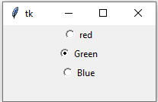
Example: rbtndemo.py from tkinter import * top = Tk()
top.geometry("200x100") radio = IntVar()
rbtn1 = Radiobutton(top, text="red",variable=radio,value="1") rbtn1.pack()
rbtn2 = Radiobutton(top, text="Green",variable=radio,value="2")
rbtn2.pack()
rbtn3 = Radiobutton(top, text="Blue",variable=radio,value="3") rbtn3.pack()
top.mainloop()
Output:
>>>python rbtndemo.py

Slide 29
Text Widget in Tkinter:
The Text widget allows the user to enter multiple lines of text.It is different from Entry because it provides a multi-line text field to the user so that the user can write the text and edit the text inside it.
Syntax: name = Text(parent, options)
The options are
bd: It represents the border width in pixels.
bg: It represents the background color of the Text.
show: It is used to show the entry text of some other type instead of the
string. For example, the password is typed using stars (*).
fg: Foreground color of the Text.
width: The width of the Text.
height: The vertical dimension of the widget in lines.

Slide 30
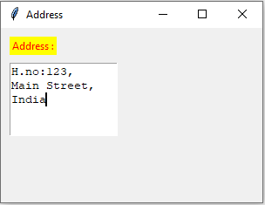
Example: textdemo.py from tkinter import * top = Tk() top.title("Address")
top.geometry("300x200") lbl=Label(top,text="Address :",fg="red",bg="yellow") lbl.place(x=10,y=10) txt=Text(top,width=15,height=5) txt.place(x=10,y=40)
top.mainloop()
Output:
>>>python textdemo.py

Slide 31
Scale Widget in Tkinter:
The Scale widget provides a graphical slider object that allows you to select values from a specific scale.
Syntax: name = Scale(parent, options)
The options are
activebackground:It represents the background of the Scale when it is active.
bd: It represents the border width in pixels.
bg: It represents the background color of the Scale.
command: It is set to the function call which is scheduled when the function is called.
fg: Foreground color of the Scale.
from_: It is used to represent one end of the widget range.
to: It represents a float or integer value that specifies the other end of the range represented by the scale.
orient: It can be set to horizontal or vertical depending upon the type of the scale.

Slide 32
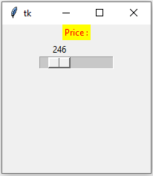
Example: scaledemo.py from tkinter import * top = Tk()
top.geometry("200x200") lbl=Label(top,text="Price :",bg="yellow",fg="red") lbl.pack()
scale = Scale( top, from_ = 100, to = 1000, orient = HORIZONTAL)
scale.pack(anchor=CENTER)
top.mainloop()
Output:
>>>python scaledemo.py

Slide 33
Toplevel Widget in Tkinter:
The Toplevel widget is used to create and display the toplevel windows which are directly managed by the window manager.
Syntax: name = Toplevel(options)
The options are
bd: It represents the border width in pixels.
bg: It represents the background color of the Toplevel.
fg: Foreground color of the Toplevel.
width: The width of the Toplevel.
height: The vertical dimension of the widget in lines.

Slide 34
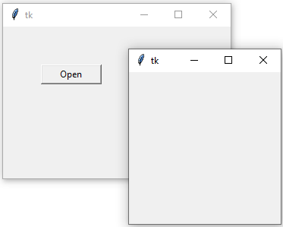
from tkinter import *
top = Tk() top.geometry("300x200") def fun():
Example: topleveldemo.py
chld = Toplevel(top) chld.mainloop()
btn1 = Button(top, text = "Open",width=10,command=fun)
btn1.place(x=50,y=50) top.mainloop() Output:
>>>python topleveldemo.py

Slide 35
import tkinter as tk
Example: simplecalc.py
from functools import partial
def call_result(label_result, n1, n2): num1 = (n1.get())
num2 = (n2.get())
result = int(num1)+int(num2) label_result.config(text="Result is %d" % result) return
root = tk.Tk() root.geometry('400x200+100+200') root.title('Simple Calculator') number1 = tk.StringVar()
number2 = tk.StringVar()

Slide 36
labelTitle = tk.Label(root, text="Simple Calculator").grid(row=0, column=2) labelNum1 = tk.Label(root, text="Enter a number").grid(row=1, column=0) labelNum2 = tk.Label(root, text="Enter another number").grid(row=2,
column=0)
labelResult = tk.Label(root) labelResult.grid(row=7, column=2)
entryNum1 = tk.Entry(root, textvariable=number1).grid(row=1, column=2) entryNum2 = tk.Entry(root, textvariable=number2).grid(row=2, column=2) call_result = partial(call_result, labelResult, number1, number2)
buttonCal = tk.Button(root, text="Calculate", command=call_result).grid(row=3, column=0)
root.mainloop()

Slide 37
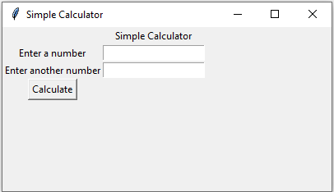
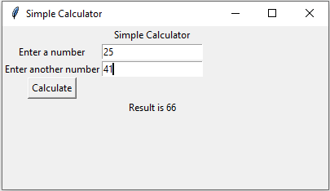

Slide 38
Brief Tour of Other GUIs:
Python offers multiple options for developing GUI (Graphical User Interface). The most commonly used GUI methods are
1. Tix (Tk Interface eXtensions):
Tix, which stands for Tk Interface Extension, is an extension library for Tcl/Tk. Tix adds many new widgets, image types and other commands that allows you to create compelling Tcl/Tk-based GUI applications.
Tix includes the standard, widgets those are tixGrid,tixHList,tixInputOnly, tixTlist and
etc.
2. Pmw (Python MegaWidgets Tkinter extension):
Pmw is a toolkit for building high-level compound widgets in Python using the Tkinter module.
It consists of a set of base classes and a library of flexible and extensible megawidgets built on this foundation. These megawidgets include notebooks, comboboxes, selection widgets, paned widgets, scrolled widgets and dialog windows.
3. wxPython (Python binding to wxWidgets):
wxPython is a blending of the wxWidgets GUI classes and the Python programming
language.
wxPython is a Python package that can be imported at runtime that includes a collection of Python modules and an extension module (native code). It provides a series of Python classes that mirror (or shadow) many of the wxWidgets GUI classes.

