Slide 1
Efficacy of 3D Game Development in the Godot Game Engine
DATASPIRE GAME PROJECT
BY KENNETH W. AND VANCE B.

Slide 2
Our Objectives
To gain a basic understanding of…
How Godot works.
3D development in Godot.
To provide an overview of…
Our experience with Godot.
Implementation in Godot vs. Unity or Unreal Engine.
DATASPIRE GAME PROJECT
KENNETH W. // VANCE B.

Slide 3
Our Goals
To help new game developers…
Understand the basics of Godot.
Know if Godot is right for them.
To create a 3D game in Godot.
The DATASPIRE Game Project.

Slide 4

1. The Godot Engine
A game development engine.
Supports 2D and 3D games.
Supports multiple languages.
Native language is GDScript.
Supports C#, C++, and more.
Utilizes Nodes and Scenes.

Slide 5
1. The Godot Engine
Nodes are basic building blocks.
Collision shapes, Cameras, Animators, etc.
Scenes are collections of Nodes.
Scripts can be added to Nodes to extend their functionality.
Scenes can be nested in other Scenes.

Slide 6
2. Our Experience
Easy to learn, hard to master.
User friendly.
Good in-engine documentation.
Lack of online tutorials.
Lots of community-made assets available.

Slide 7
2. Implementation Comparison
Godot vs. Unity: Player Stair-stepping
Stair-stepping allows players to walk up stair steps without needing to jump over them.
Unity - Built-in; define a maximum step height with stepOffset.
Godot – “Custom” implementation needed.

Slide 8
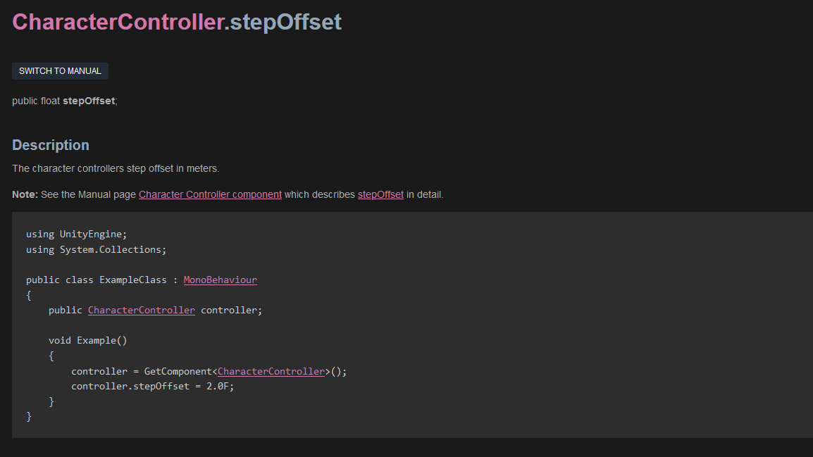
UNITY STAIR-STEPPING IMPLEMENTATION

Slide 9
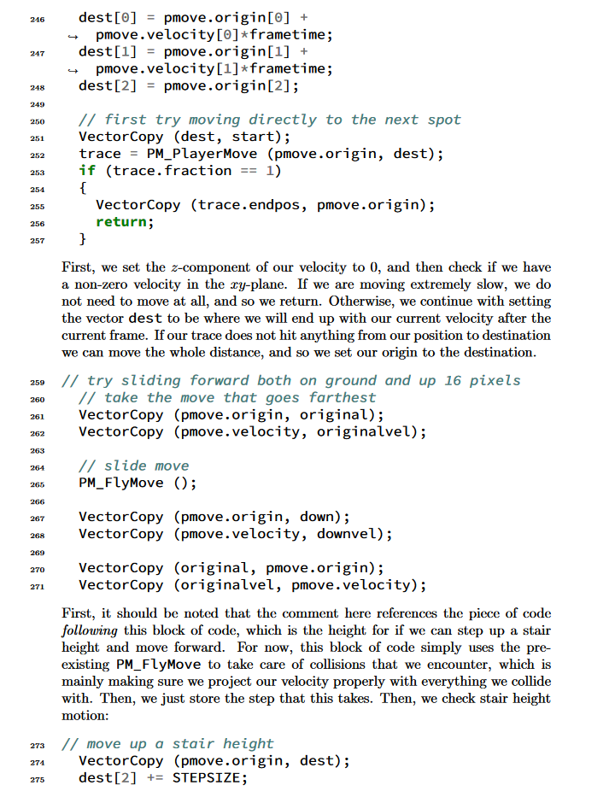
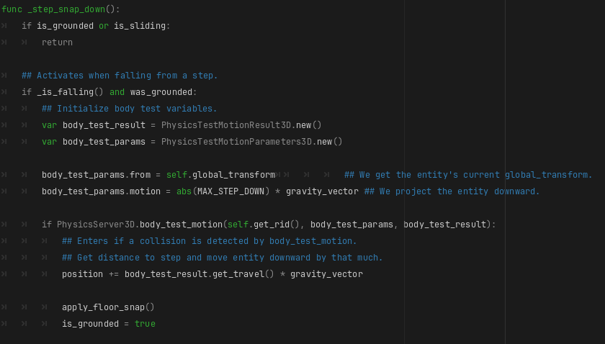
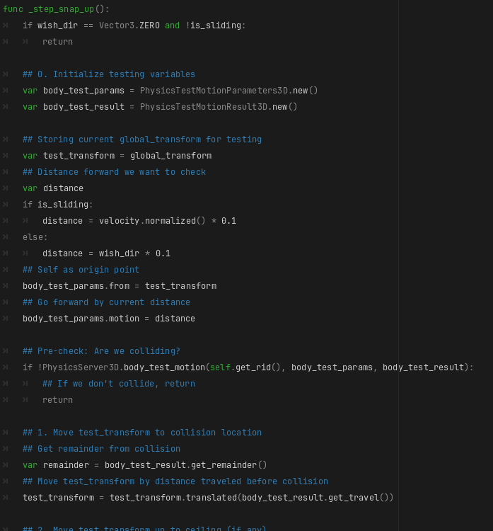
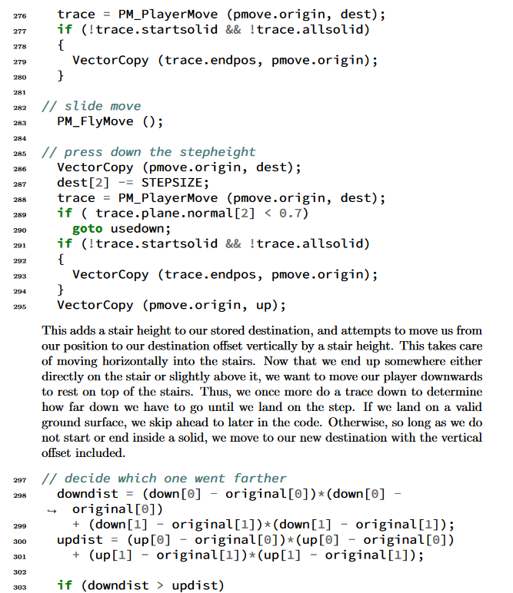
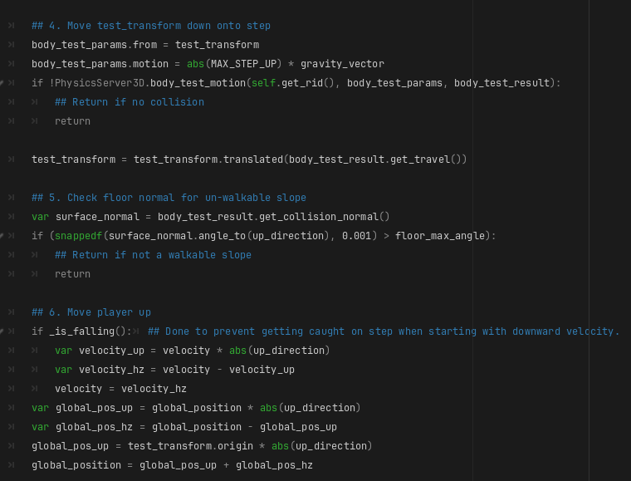
GODOT STAIR-STEPPING IMPLEMENTATION

Slide 10
2. Implementation Comparison
Godot vs. Unreal Engine: Level Loading
Game levels must be loaded before entering.
Godot – Technically custom, but easy to do
Just instantiate some scenes!
Unreal Engine – Different architecture than Godot, but similarly easy!
Just load the level!

Slide 11
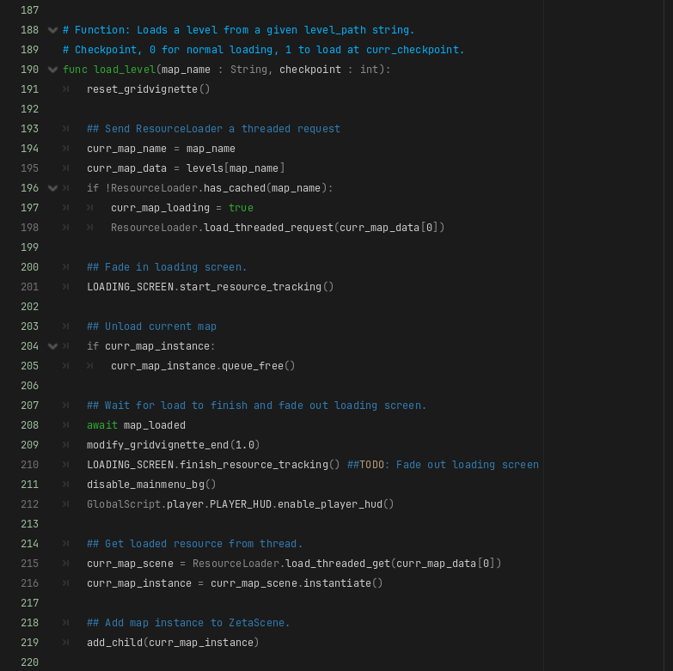
GODOT LEVEL-LOADING IMPLEMENTATION
1
Load new scene / map
Destroy current map (if it exists)
Instantiate the loaded scene and add it as a child to the scene tree
2
3

Slide 12
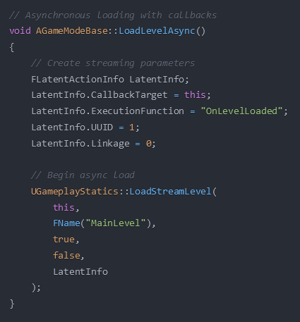
UNREAL LEVEL-LOADING IMPLEMENTATION
Set up on-load functionality
The actual load call…
World Context
Level to load
Make level visible?
Block while loading?
Callback info
Don’t have to care about unloading!
1
2

Slide 13
3. Should You Use Godot
Supports 2D and 3D games.
GDScript, similar to Python, is easy to learn.
Can use C++ and C# as well.
Community-driven, completely free.
Growing popularity means more online tutorials.

Slide 14
4. DATASPIRE Game Project
A 3D action-platformer.
Melee combat system utilizing elements.
Earth, wind, and fire, not hydrogen, helium, and lithium.
Millions of humans are trapped within Cyberspace Online, a Virtual Reality platform.
The Player must fight their way to the top of the DATASPIRE, which is the center of the simulation.

Slide 15
4. What We Accomplished
NPCs and Enemy AI:
Enemy attack behavior
Enemy pathfinding
Game Mechanics:
Player movement
Elemental combat
Knockback and collision
Game Levels:
Level creation
Level loading
User Interface:
Main menu
Pause menu
Player HUD

Slide 16
Notes:
Switch to this slide when showcasing DATASPIRE.

Slide 17
Q&A

