Slide 1
Efficacy of 3D Game Development in the Godot Game Engine
DATASPIRE GAME PROJECT
BY KENNETH W. AND VANCE B.

Slide 2
Who We Are
KENNETH W.
Lead Developer
Focus:
Enemies, AI
User Interface
Player Physics
Player Movement
VANCE B.
Developer
Focus:
Combat
Level Loading
Combo System
Elemental Reactions
DATASPIRE GAME PROJECT
KENNETH W. // VANCE B.

Slide 3
Our Objectives
To gain a basic understanding of…
How Godot works.
3D development in Godot.
To provide an overview of…
Our experience with Godot.
Implementation in Godot vs. Unity or Unreal Engine.

Slide 4
Our Goals
To help new game developers…
Understand the basics of Godot.
Know if Godot is right for them.
To create a 3D game in Godot.
The DATASPIRE Game Project.

Slide 5

1. The Godot Engine
A game development engine.
Supports 2D and 3D games.
Supports multiple languages.
Native language is GDScript.
Supports C#, C++, and more.
Utilizes Nodes and Scenes.

Slide 6
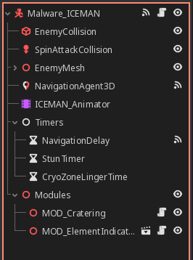
1. The Godot Engine
Nodes are basic building blocks.
Collision shapes, Meshes, NavigationAgents, etc.
Scenes are collections of Nodes.
Scripts can be added to Nodes to extend their functionality.
Scenes can be nested in other Scenes.

Slide 7
2. Our Experience: Pros
Easy to learn, hard to master.
User friendly interface.
Good documentation.
Lots of community-made assets available.

Slide 8
2. Our Experience: Cons
Lack of online tutorials.
Missing features that are standard in other engines.

Slide 9
2. First Comparison
Godot vs. Unity: Player Stair-stepping
Stair-stepping allows players to walk up stair steps without needing to jump over them.
Unity - Built-in; define a maximum step height with stepOffset.
Godot – “Custom” implementation needed.

Slide 10
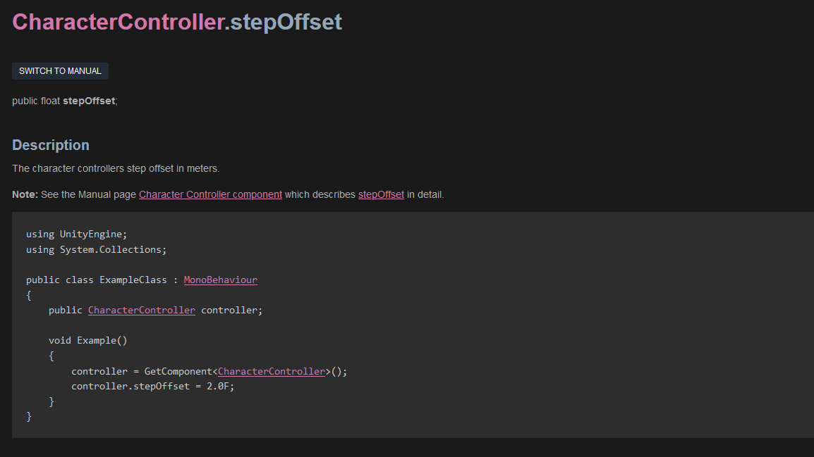
UNITY STAIR-STEPPING IMPLEMENTATION

Slide 11
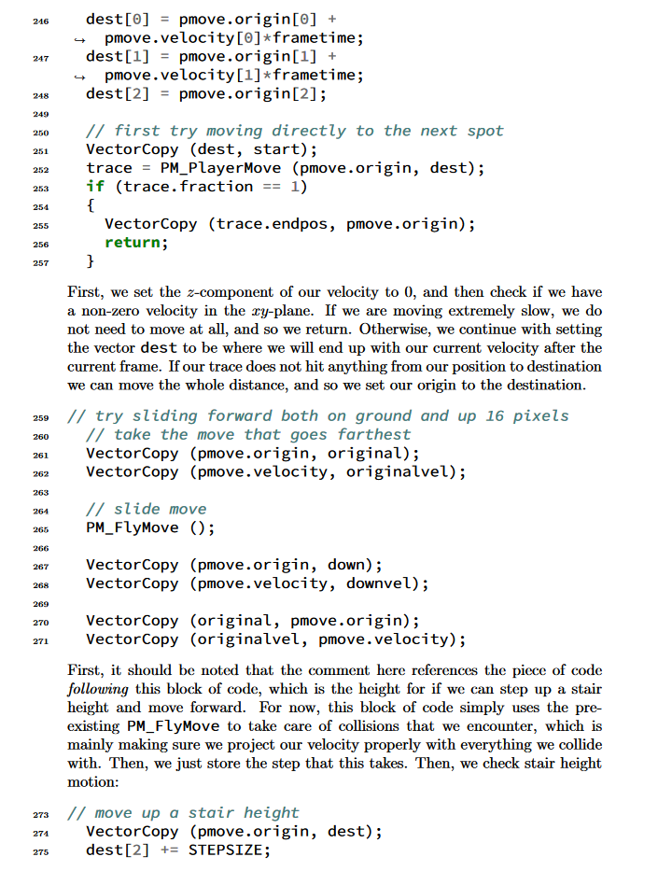
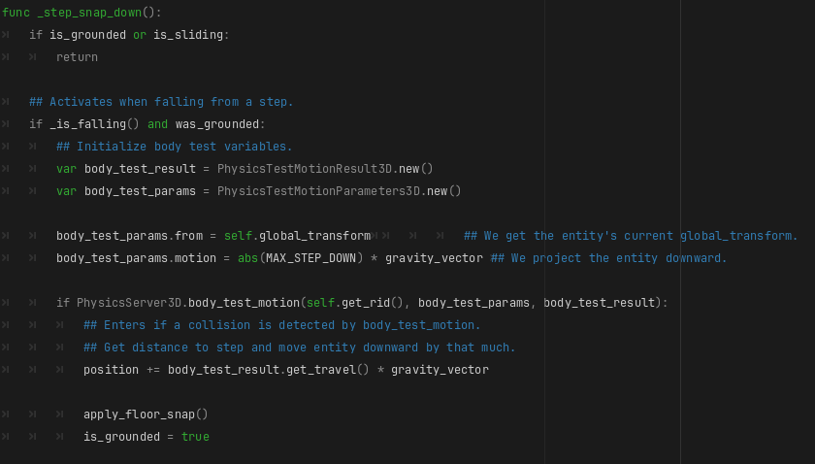
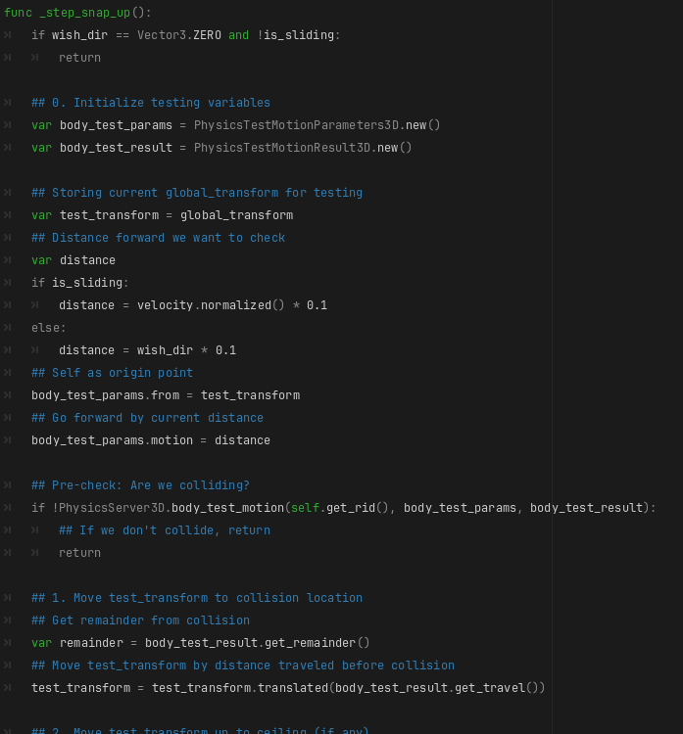
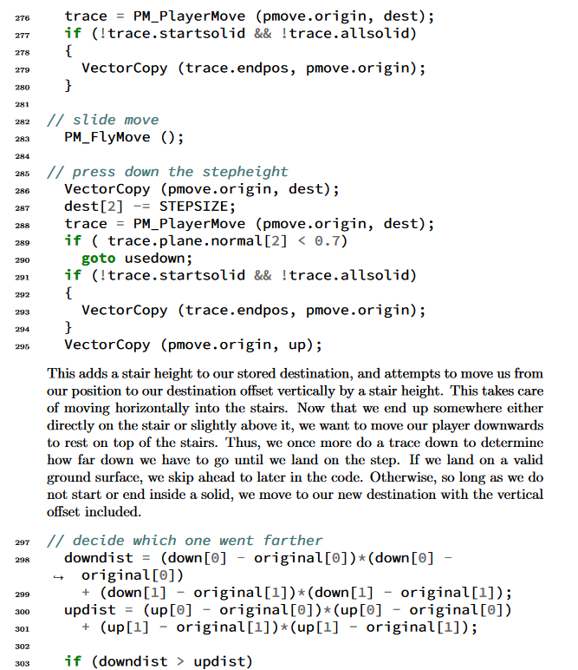
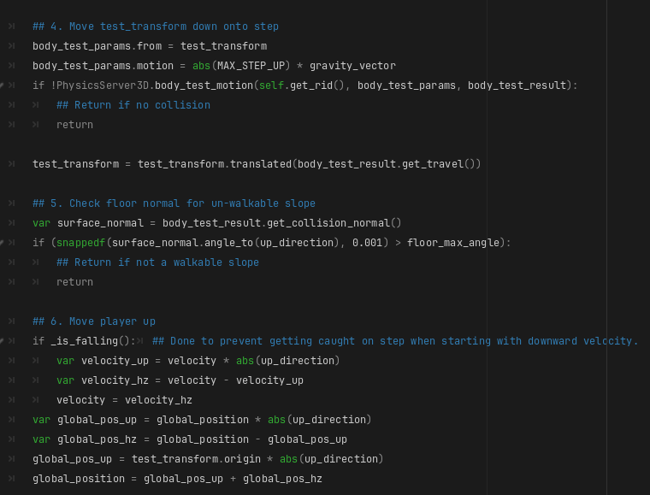
GODOT STAIR-STEPPING IMPLEMENTATION

Slide 12
2. Second Comparison
Godot vs. Unreal Engine: Level Loading
Game levels must be loaded before entering.
Godot – Technically custom, but easy to do
Just instantiate some scenes!
Unreal Engine – Different architecture than Godot, but similarly easy!
Just load the level!

Slide 13
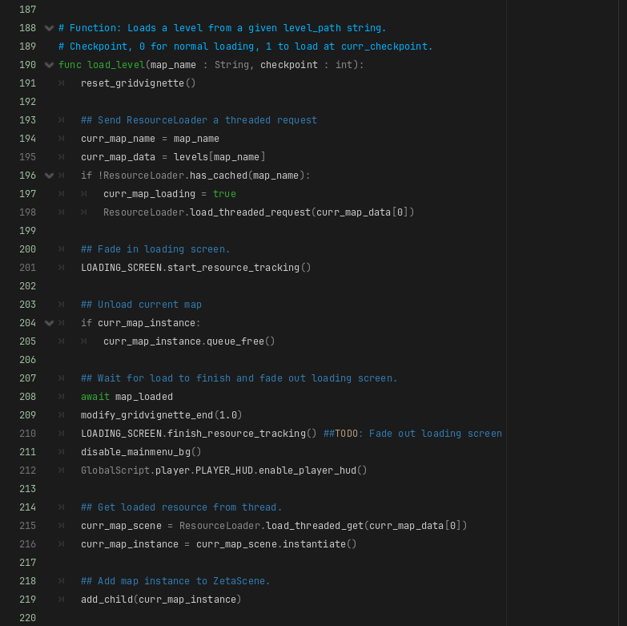
GODOT LEVEL-LOADING IMPLEMENTATION
1
Load new scene (map)
Destroy current map
(if it exists)
Instantiate the loaded scene and add it to the scene tree.
2
3

Slide 14
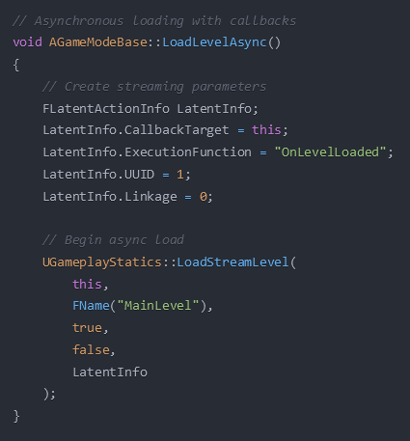
UNREAL LEVEL-LOADING IMPLEMENTATION
Set up on-load functionality
The actual load call:
World Context
Level to load
Make level visible
Block while loading
Callback info
Don’t have to care about unloading!
1
2

Slide 15
3. Should You Use Godot?
GODOT
GDScript, similar to Python, is easy to learn.
Can use C++ and C# as well.
Community-driven, completely free.
Growing popularity means more online tutorials.
UNITY / UNREAL ENGINE
Already well established.
More tutorials available.
Subscriptions allow access to official support lines.

Slide 16
4. DATASPIRE Game Project
A 3D action-platformer.
Melee combat system utilizing elements.
Earth, wind, and fire, not hydrogen, helium, and lithium.
Millions of humans are trapped within Cyberspace Online, a Virtual Reality platform.
The Player must fight their way to the top of the DATASPIRE, which is the center of the simulation.

Slide 17
4. Game Structure
Three Singletons:
PlayerSettings
Loads and Saves settings. (Controls, Graphics, etc.)
GlobalScript
Global variables and functions for modifying game state.
ZetaScene
Holds UI elements and handles level loading.

Slide 18
4. First Demo: User Interface
Showcasing:
Intro Animation
Main Menu
Loading Screen
Player HUD
Pause Menu

Slide 19
4. Second Demo: Game Map
Showcasing:
Ladders
Ziplines
Water
Portals

Slide 20
4. Third Demo: Game Mechanics
Showcasing:
Player Movement
Walk, Jump, Crouch, Dash, Slide, Wall jump
Combat System
Elemental Reactions
Knockback and Collision

Slide 21
4. Last Demo: Entity Behavior
Showcasing:
Target Pathfinding
Attack Behavior
Entity Factions and Targeting

Slide 22
Final Thoughts
We recommend it to any new developers looking to get into game development.
Godot is very powerful, though slightly limited in comparison to other engines.
This simplicity, however, makes it easier to learn and understand.

Slide 23
Q&A

