Slide 1
Efficacy of 3D Game Development in the Godot Game Engine
DATASPIRE GAME PROJECT
BY KENNETH W. AND VANCE B.

Slide 2
Who Are We?
Kenneth W.
Lead Developer
Focus:
Enemies, AI
User Interface
Player Physics
Player Movement
Vance B.
Developer
Focus:
Combat
Level Loading
Combo System
Elemental Reactions
DATASPIRE GAME PROJECT
KENNETH W. // VANCE B.

Slide 3
What Are Our Objectives?
To gain a basic understanding of…
How Godot works.
3D development in Godot.
To provide an overview of…
Our experience with Godot.
Implementation in Godot vs. Unity or Unreal Engine.

Slide 4
What Are Our Goals?
To help new game developers…
Understand the basics of Godot.
Know if Godot is right for them.
To create a 3D game in Godot.
The DATASPIRE Game Project.

Slide 5

The Godot Engine
A game development engine.
Supports 2D and 3D games.
Supports multiple languages.
Primary language is GDScript.
Also supports C# and C++.
Utilizes Nodes and Scenes.

Slide 6
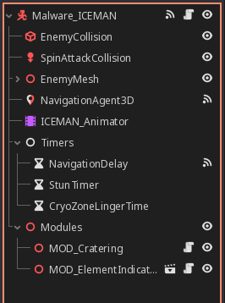
The Godot Engine
Nodes are basic building blocks.
Collision shapes, Meshes, NavigationAgents, etc.
Scenes are collections of Nodes.
Scripts can be added to Nodes to extend their functionality.
Scenes can be nested in other Scenes.

Slide 7
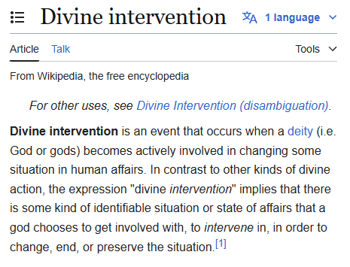
Our Experience: Why Godot?
Originally planned to use Unity.
Unity announced a revised licensing agreement, including a Runtime fee for all games.
Developers would be charged monthly, calculated per-installation once the game reached a specific revenue threshold.

Slide 8
Our Experience: Pros
Godot…
Is easy to learn, hard to master.
Has a user friendly interface.
Has good documentation.
Has lots of community-made assets available.

Slide 9
Our Experience: Cons
Godot…
Has a fewer online tutorials than other game engines.
Low popularity prior to 4.0 release.
Is missing features that are standard in other engines.
Such as…

Slide 10
First Comparison
Godot vs. Unity: Player Stair-stepping
Stair-stepping allows players to walk up stair steps without needing to jump over them.
Unity - Built-in; define a maximum step height with stepOffset.
Godot – “Custom” implementation needed.

Slide 11
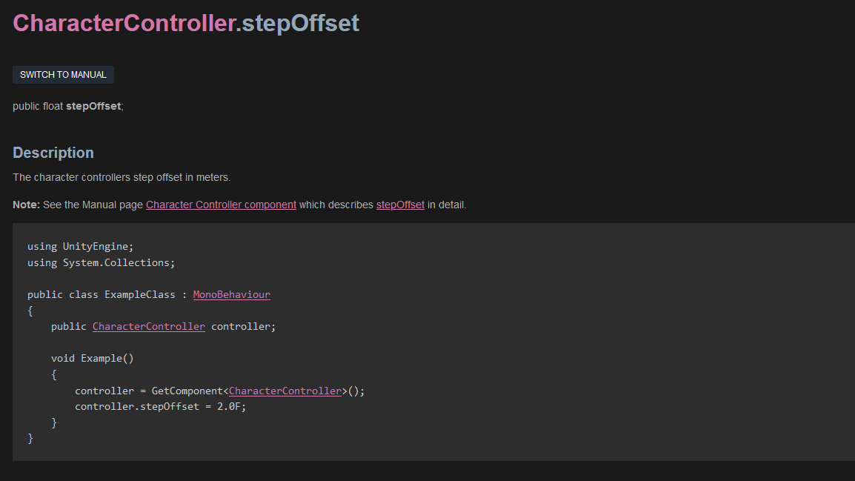
UNITY STAIR-STEPPING IMPLEMENTATION

Slide 12
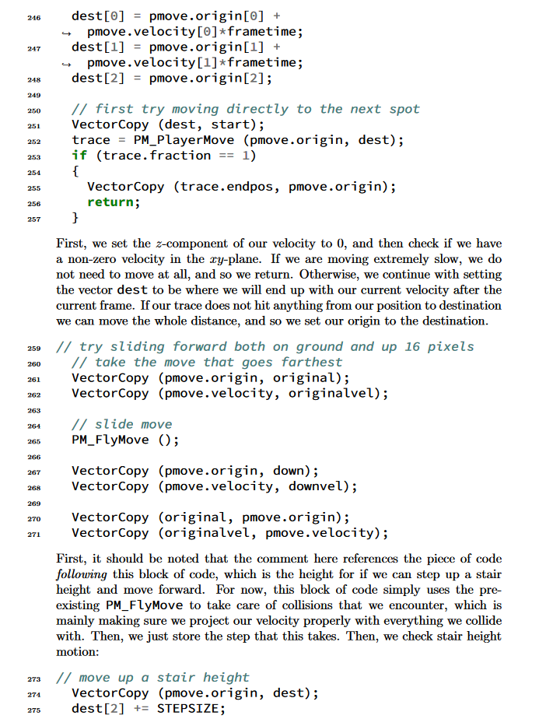
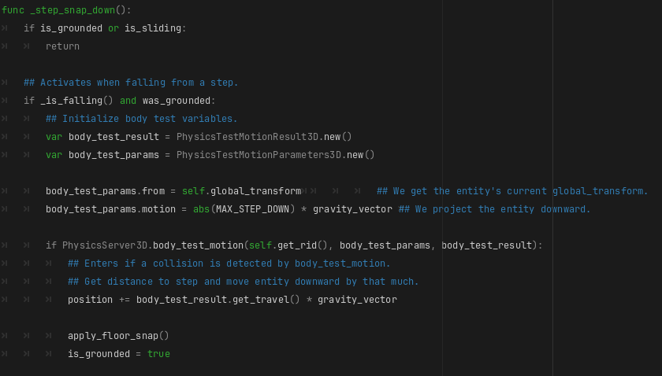
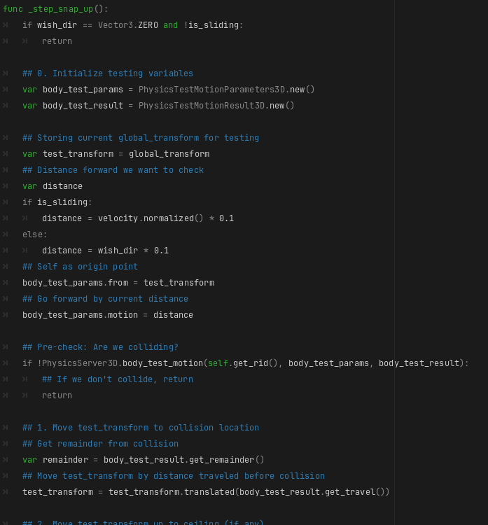
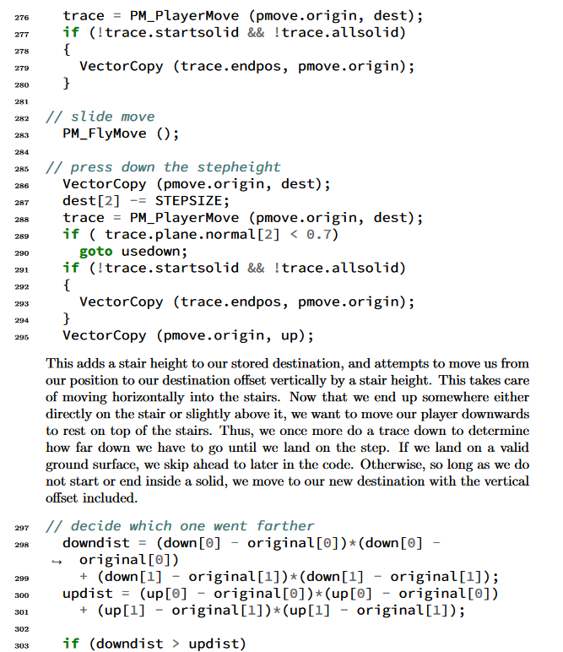
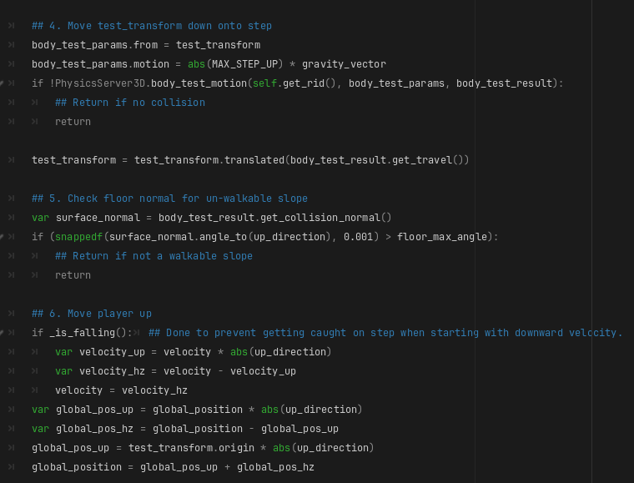
GODOT STAIR-STEPPING IMPLEMENTATION

Slide 13
Second Comparison
Godot vs. Unreal Engine: Level Loading
Game levels must be loaded before entering.
Godot – Technically custom, but easy to do
Just instantiate some scenes!
Unreal Engine – Different architecture than Godot, but similarly easy!
Just load the level!

Slide 14
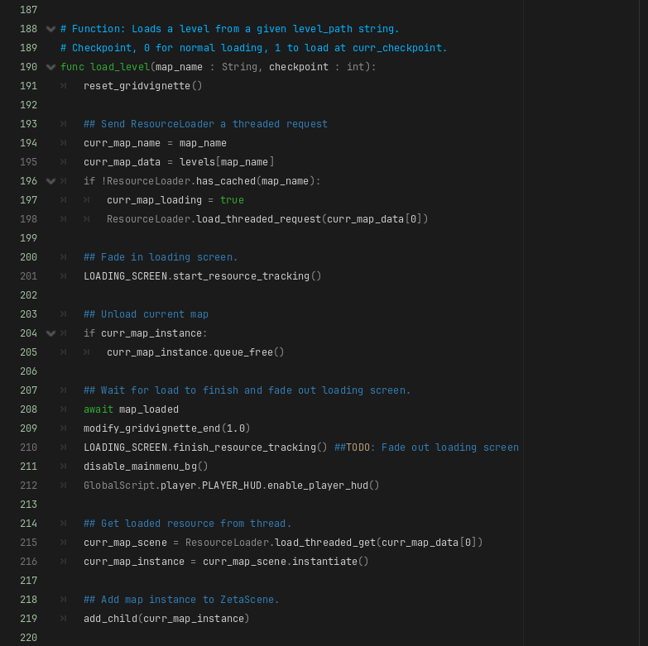
GODOT LEVEL-LOADING IMPLEMENTATION
1
Load new scene (map)
Destroy current map
(if it exists)
Instantiate the loaded scene and add it to the scene tree.
2
3

Slide 15
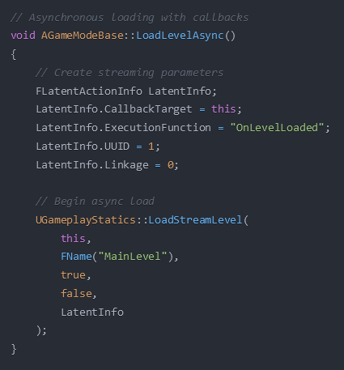
UNREAL LEVEL-LOADING IMPLEMENTATION
Set up on-load functionality
The actual load call:
World Context
Level to load
Make level visible
Block while loading
Callback info
Don’t have to care about unloading!
1
2

Slide 16
General Comparison
GODOT | UNITY | UNREAL ENGINE
GDScript, C#, C++ | C# | C++
Godot 3: 2018 Godot 4: 2023 | Unity 5: 2015 Unity 6: 2024 | UE4: 2014 UE5: 2022
Open Source | Requires License | Requires License
Free: The engine is completely free, allowing anyone to download or contribute. | Free and Paid: Free for personal projects. Paid for commercial games. | Royalty-based: You owe a percentage of your game’s sales to Epic Games, the creators of Unreal Engine.
Notes:
Native languages
Major version releases
Source-code accessibility
Free/paid

Slide 17
Should You Use Godot?
Scripting (GDScript) is easy to learn.
Completely free.
Growing popularity will lead to more tutorials.
Lightweight compared to other engines.
Godot 4: ~190MB
Unity 5: ~9.5GB
Unreal Engine 5: ~10-15GB

Slide 18
DATASPIRE Game Project
A 3D action-platformer.
First-person melee combat system with combos and elemental reactions.
Millions of humans are trapped within Cyberspace Online, a Virtual Reality platform.
The Player must fight their way to the top of the DATASPIRE, which is the center of the simulation.

Slide 19
Rough Project Timeline
09-16-2023: Project Started
12-27-2023: Player Movement Started
01-06-2024: Test Map Created
05-10-2024: AI and Pathfinding Started
05-17-2024: Combat System Started
11-10-2024: Presentation Demo Finished
2023
2024

Slide 20
Game Structure
Three Singletons:
PlayerSettings
Loads and Saves settings. (Controls, Graphics, etc.)
GlobalScript
Global variables and functions for modifying game state.
ZetaScene
Holds UI elements and handles level loading.

Slide 21
First Demo: User Interface
Showcasing:
Intro Animation
Main Menu
Loading Screen
Player HUD
Pause Menu

Slide 22
Second Demo: Game Map
Showcasing:
Ladders
Ziplines
Water
Portals

Slide 23
Third Demo: Game Mechanics
Showcasing:
Player Movement
Combat System
Elemental Reactions
Combo Systems
Knockback and Collision

Slide 24
Last Demo: Entity Behavior
Showcasing:
Target Pathfinding
Attack Behavior
Entity Factions and Targeting

Slide 25
Final Thoughts
We recommend it to any developers looking to get into game development.
Godot is powerful, but lacks the massive complexity of other game engines.
This simplicity makes Godot simpler and easier to learn.

Slide 26
The End
Q&A Time
Contact Information:
Kenneth W.
jhekwall@ut.utm.edu
linkedin.com/in/jhems-wallace/
Vance B.
vanabren@ut.utm.edu
linkedin.com/in/vance-brender-a-brandis-17501a32a/

