Slide 1
UPDATE ONE
DATASPIRE PROJECT
KENNETH W.
VANCE B.

Slide 2
Before the start of the semester…
Movement implemented
Test Map(s) created
~3 prototype enemies
Element switching and charge stacking
Player HUD elements (Health, speed, dash charges, etc.)
Debug console

Slide 3
Kenneth Progress
TLDR: Gravity Switching Bugfixes
Defined and limited 3D development comparison to four points:
NPC AI (Behavior, navigation, etc.)
Game Levels (Creating and using them)
Game Physics (Player movement, collisions, etc.)
Documentation/Tutorial Accessibility
Fixed a bug with the camera smoothing that prevented it from crossing into negative vertical units.
Player collision box now rotates when gravity direction is switched.

Slide 4
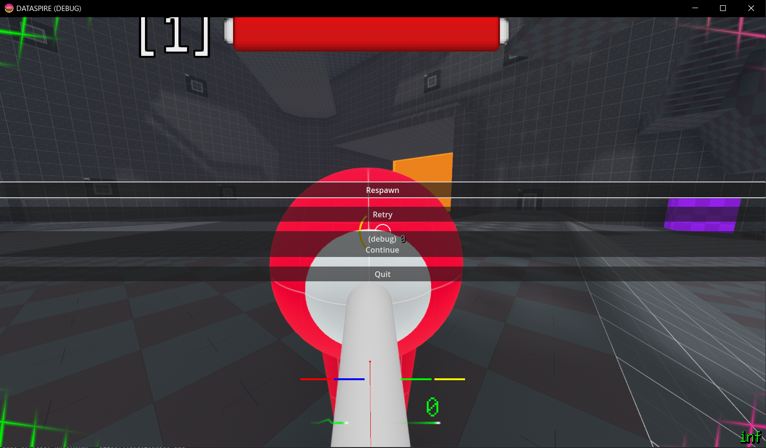
Vance Progress
TLDR: Combat System Progress
Enemies die when they are killed (deleted on death).
Death UI:
Respawn (Use an extra life to keep fighting).
Retry (Resets level).
Continue (Debug option to instantly revive).
Quit (Exits to menu).
Planning for level loading system.

Slide 5
Next Update Goals
Kenneth:
Add an in-game ability to change gravity (currently using debug console).
Add attack animation (Blender -> Godot).
Vance:
Level loading system.
Making Death UI buttons clickable.

